Slide 1

Our changing
information
landscape
12 questions I’d be
asking if I was a
librarian or media
specialist
Dr. Scott McLeod
CASTLE

Slide 2
dangerouslyirrelevant.org/
ILA.html
Say hi to your neighbor!

Slide 3

Notes:
Not meant to scare you
Sincere questions that I believe you should be thinking about

Slide 4
Do I really
understand the global economic climate?
1

Slide 5
Percentile change in
importance of task type
in U.S. economy
Abstract
Routine
Manual
Autor, D., Levy, F., & Murnane, R. J. (2003). The skill content of recent technological change:
An empirical exploration. Quarterly Journal of Economics 188, 4. [updated, D. Autor, 2008]

Slide 6
Growth of the creative class
Florida, R. (2002). The rise of the creative class (p. 332). New York, NY: Basic Books.
Notes:
Since 1950…
agriculture = less than 2%
working = primarily high school diploma, some have a little bit of college - factory workers, construction workers, food service workers, custodians, truck drivers – low levels of education, highly manual labor
service = beauticians, secretaries, paralegals, workers in retail stores, tourism and hotel workers, personal health care assistants
creative = scientists, engineers, technology workers, architects, lawyers, doctors, nurses, K-12 educators, university professors, poets, musicians, and entertainers - from 5% in 1900 to 14% in 1945 to 33% in 2008
2005 – Bill Gates - Today, only one-third of our students graduate from high school ready for college, work, and citizenship. . . . The first group goes on to college and careers; the second group will struggle to make a living wage. Let's be clear. Thanks to dedicated teachers and principals around the country, the best-educated kids in the United States are the best-educated kids in the world. We should be proud of that. But only a fraction of our kids are getting the best education.

Slide 7
Growth of the creative class
Notes:
Since 1950…
agriculture = less than 2%
working = primarily high school diploma, some have a little bit of college - factory workers, construction workers, food service workers, custodians, truck drivers – low levels of education, highly manual labor
service = beauticians, secretaries, paralegals, workers in retail stores, tourism and hotel workers, personal health care assistants
creative = scientists, engineers, technology workers, architects, lawyers, doctors, nurses, K-12 educators, university professors, poets, musicians, and entertainers - from 5% in 1900 to 14% in 1945 to 33% in 2008
2005 – Bill Gates - Today, only one-third of our students graduate from high school ready for college, work, and citizenship. . . . The first group goes on to college and careers; the second group will struggle to make a living wage. Let's be clear. Thanks to dedicated teachers and principals around the country, the best-educated kids in the United States are the best-educated kids in the world. We should be proud of that. But only a fraction of our kids are getting the best education.

Slide 8

Notes:
New Commission on the Skills of the American Workforce
Today Indian engineers make $7,500 a year against $45,000 for a similarly-qualified American engineer. Why would the world’s employers pay our engineers more? They would be willing to do that only if we could offer something the Indian engineers cannot.
Producing the most important new products and services depends on a deep vein of creativity that is constantly renewing itself, and on a myriad of people who can imagine how people can use things that have never been available before
Creativity and innovation, facility with the use of ideas and abstractions, the self-discipline and organization needed to manage one’s work and drive it through to a successful conclusion, the ability to function well as a member of a team, the ability to use digital technologies to do everything just mentioned…

Slide 9
120 119 118 117 116 115 114 113 112 111
110 109 108 107 106 105 104 103 102 101
100 99 98 97 96 95 94 93 92 91
90 89 88 87 86 85 84 83 82 81
80 79 78 77 76 75 74 73 72 71
70 69 68 67 66 65 64 63 62 61
60

Slide 10
60 59 58 57 56 55 54 53 52 51
50 49 48 47 46 45 44 43 42 41
40 39 38 37 36 35 34 33 32 31
30 29 28 27 26 25 24 23 22 21
20 19 18 17 16 15 14 13 12 11
10 9 8 7 6 5 4 3 2 1

Slide 11
How do I best
support student
acquisition of
“21st century
skills?”
2

Slide 12
The fundamental dilemma
but now are
expected to
do this
Schools were
designed
for this …
Notes:
Since 1950…
agriculture = less than 2%
working = primarily high school diploma, some have a little bit of college - factory workers, construction workers, food service workers, custodians, truck drivers – low levels of education, highly manual labor
service = beauticians, secretaries, paralegals, workers in retail stores, tourism and hotel workers, personal health care assistants
creative = scientists, engineers, technology workers, architects, lawyers, doctors, nurses, K-12 educators, university professors, poets, musicians, and entertainers - from 5% in 1900 to 14% in 1945 to 33% in 2008
2005 – Bill Gates - Today, only one-third of our students graduate from high school ready for college, work, and citizenship. . . . The first group goes on to college and careers; the second group will struggle to make a living wage. Let's be clear. Thanks to dedicated teachers and principals around the country, the best-educated kids in the United States are the best-educated kids in the world. We should be proud of that. But only a fraction of our kids are getting the best education.

Slide 13

Notes:
13
- not entirely educators’ fault – the system is the issue – governed by an essential 19th century paradigm – one that was appropriate for our grandparents but not our children and grandchildren

Slide 14

Notes:
14

Slide 15


Slide 16
global awareness
effective speaking
critical thinking
problem solving
adaptability
information literacy
collaboration
creativity
media fluency
analytical skills
entrepeneurialism
innovation
effective writing
synthesis
curiosity
Notes:
Wagner: Convergence of college, career, citizenship
1. critical thinking and problem solving in networks of cross-functional teams
world is complex and answers are not in the books
world is moving too fast for inflexible, hierarchical organizations
2. collaboration across networks and leadership by influence rather than positional authority
command and control increasingly less valued in organizations
schools are very much command and control institutions
3. agility and adaptability
intensifying rate of change, overwhelming amount of data, increasing complexity of problems
4. initiative and entrepeneurialism
people who can seek out new opportunities, ideas, and strategies
don’t want students or workers who are apathetic about their experiences
achievement orientation, drive for results, self-starters
5. effective written and oral communication
presentation skills, being clear and concise; creating focus, energy, and passion around the points they want to make
6. accessing and analyzing information
people who can access, evaluate, conceptualize, and synthesize multiple and large streams of incoming information to make meaningful decisions
7. curiosity and imagination
inquisitiveness, analytical skills that are more ‘out of the box’ than in the past, asking great questions is more important than knowing the ‘right answer’

Slide 17
120 119 118 117 116 115 114 113 112 111
110 109 108 107 106 105 104 103 102 101
100 99 98 97 96 95 94 93 92 91
90 89 88 87 86 85 84 83 82 81
80 79 78 77 76 75 74 73 72 71
70 69 68 67 66 65 64 63 62 61
60

Slide 18
60 59 58 57 56 55 54 53 52 51
50 49 48 47 46 45 44 43 42 41
40 39 38 37 36 35 34 33 32 31
30 29 28 27 26 25 24 23 22 21
20 19 18 17 16 15 14 13 12 11
10 9 8 7 6 5 4 3 2 1

Slide 19
Do I really
understand
how students
are using
social media?
3

Slide 20

Notes:
We no longer live in an information pushout world

Slide 21


Slide 22


Slide 23

Notes:
How are you keeping informed?
Born Digital
Grown Up Digital
New Media Literacies Project at MIT
Macarthur Foundation
Pew Internet and American Life Project

Slide 24
120 119 118 117 116 115 114 113 112 111
110 109 108 107 106 105 104 103 102 101
100 99 98 97 96 95 94 93 92 91
90 89 88 87 86 85 84 83 82 81
80 79 78 77 76 75 74 73 72 71
70 69 68 67 66 65 64 63 62 61
60

Slide 25
60 59 58 57 56 55 54 53 52 51
50 49 48 47 46 45 44 43 42 41
40 39 38 37 36 35 34 33 32 31
30 29 28 27 26 25 24 23 22 21
20 19 18 17 16 15 14 13 12 11
10 9 8 7 6 5 4 3 2 1

Slide 26
What more
should I
be doing
to support
open access
initiatives?
4

Slide 27
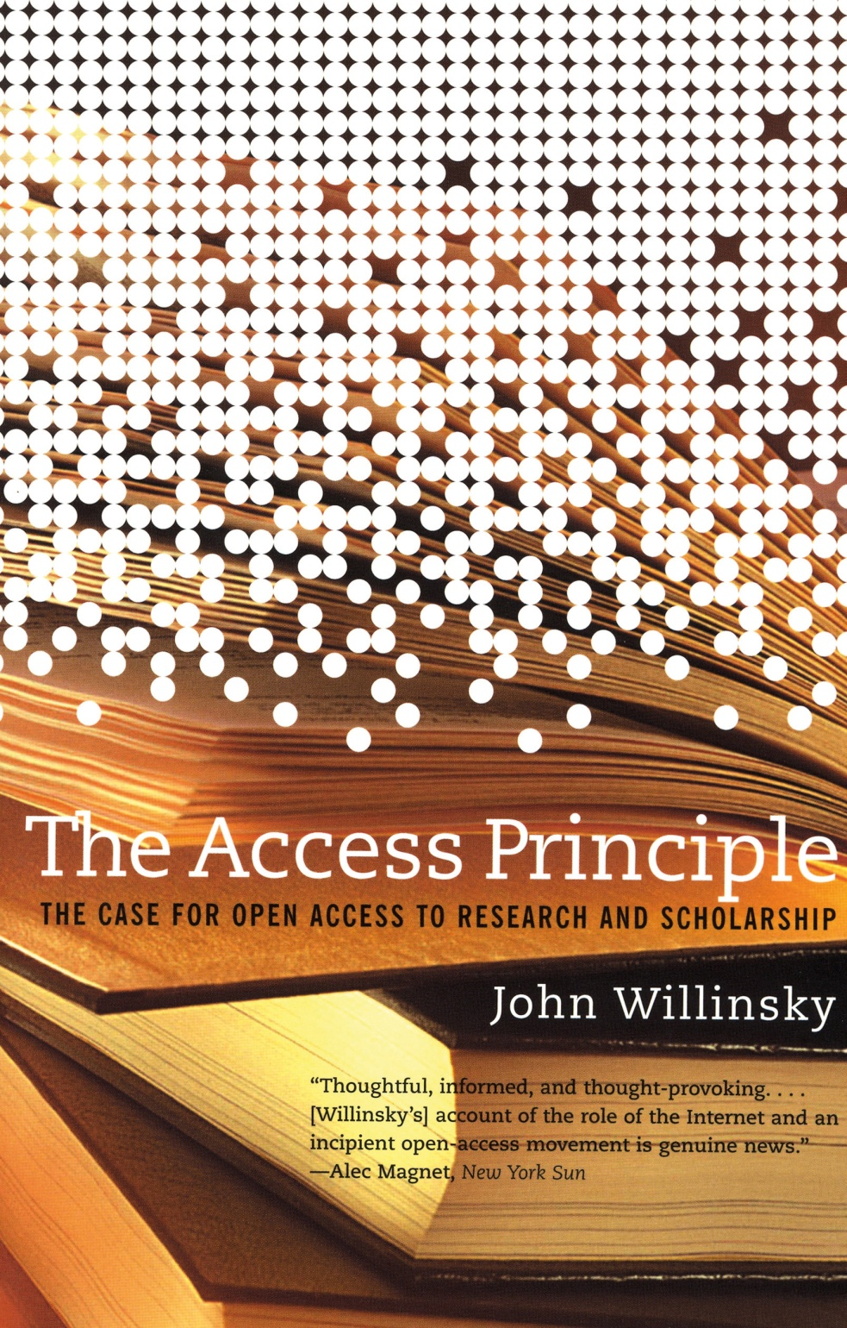
Notes:
Research journals
Federal bills to make funded research public

Slide 28
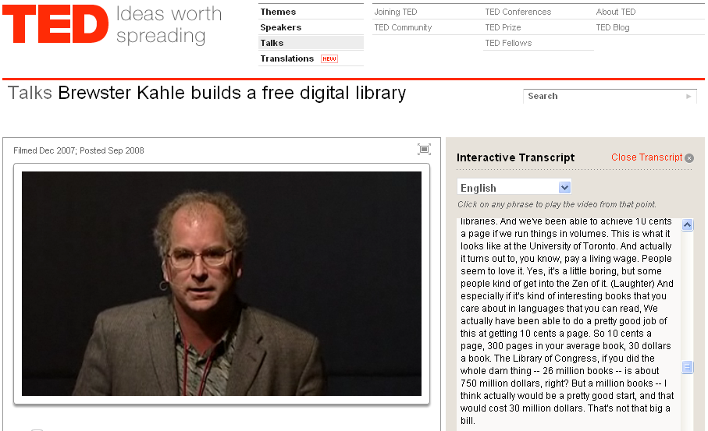
Notes:
$550 billion total expenditures K-12 education USA alone
Book scanning
Song archives
Movie archives

Slide 29
120 119 118 117 116 115 114 113 112 111
110 109 108 107 106 105 104 103 102 101
100 99 98 97 96 95 94 93 92 91
90 89 88 87 86 85 84 83 82 81
80 79 78 77 76 75 74 73 72 71
70 69 68 67 66 65 64 63 62 61
60

Slide 30
60 59 58 57 56 55 54 53 52 51
50 49 48 47 46 45 44 43 42 41
40 39 38 37 36 35 34 33 32 31
30 29 28 27 26 25 24 23 22 21
20 19 18 17 16 15 14 13 12 11
10 9 8 7 6 5 4 3 2 1

Slide 31
What does it mean
to be a “book”
these days?
5

Slide 32
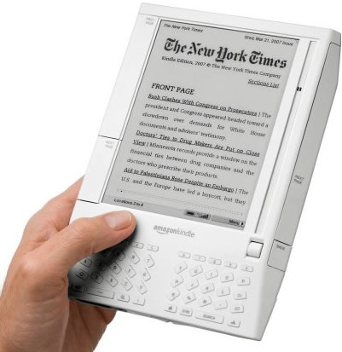
Notes:
Electronic
Hyperlinks
Searchable
Networked / interconnected
Embedded multimedia (audio, video, interactive diagrams)
Accessible to users with visual disabilities
User highlights / comments

Slide 33
120 119 118 117 116 115 114 113 112 111
110 109 108 107 106 105 104 103 102 101
100 99 98 97 96 95 94 93 92 91
90 89 88 87 86 85 84 83 82 81
80 79 78 77 76 75 74 73 72 71
70 69 68 67 66 65 64 63 62 61
60

Slide 34
60 59 58 57 56 55 54 53 52 51
50 49 48 47 46 45 44 43 42 41
40 39 38 37 36 35 34 33 32 31
30 29 28 27 26 25 24 23 22 21
20 19 18 17 16 15 14 13 12 11
10 9 8 7 6 5 4 3 2 1

Slide 35
What does it mean
to be a “library”
these days?
6
Notes:
Books, magazines, newspapers are going electronic
Reference materials going electronic
Eisenberg = “caution tape”
Archival function for old printed text
Books will disappear – affordances are too great
Kindle / Sony eReader / Plasma Logic / Apple tablet / Phillips digital ink
iPhone / smartphones
Curators of digital resources – same as can be accessed at home?
Couches, chairs, tables, and computers?
Library v. community center v. coffee shop v. Internet café
Need to talk now about defining future of libraries or become obsolete

Slide 36
120 119 118 117 116 115 114 113 112 111
110 109 108 107 106 105 104 103 102 101
100 99 98 97 96 95 94 93 92 91
90 89 88 87 86 85 84 83 82 81
80 79 78 77 76 75 74 73 72 71
70 69 68 67 66 65 64 63 62 61
60

Slide 37
60 59 58 57 56 55 54 53 52 51
50 49 48 47 46 45 44 43 42 41
40 39 38 37 36 35 34 33 32 31
30 29 28 27 26 25 24 23 22 21
20 19 18 17 16 15 14 13 12 11
10 9 8 7 6 5 4 3 2 1

Slide 38
Am I modeling
for students and staff these
new literacies?
7
Notes:
Blogging
Wikis
Podcasting
Online video
Social networking
RSS readers
Active consumption AND PRODUCTION of digital content?
Student projects that are doing this stuff?
Web is now social – are you living the INTERACTIVE Web (why not?)

Slide 39
120 119 118 117 116 115 114 113 112 111
110 109 108 107 106 105 104 103 102 101
100 99 98 97 96 95 94 93 92 91
90 89 88 87 86 85 84 83 82 81
80 79 78 77 76 75 74 73 72 71
70 69 68 67 66 65 64 63 62 61
60

Slide 40
60 59 58 57 56 55 54 53 52 51
50 49 48 47 46 45 44 43 42 41
40 39 38 37 36 35 34 33 32 31
30 29 28 27 26 25 24 23 22 21
20 19 18 17 16 15 14 13 12 11
10 9 8 7 6 5 4 3 2 1

Slide 41
Am I teaching
appropriate use
or
empowered use?
8

Slide 42

Notes:
No digital citizenship course
Ideas that spread win
This new information landscape has changed what it means to spread ideas and gets noticed
Product / service / Non-profit doing good / individual ideas
Ocean of information
How to navigate / manage / how to conquer/succeed/thrive

Slide 43
120 119 118 117 116 115 114 113 112 111
110 109 108 107 106 105 104 103 102 101
100 99 98 97 96 95 94 93 92 91
90 89 88 87 86 85 84 83 82 81
80 79 78 77 76 75 74 73 72 71
70 69 68 67 66 65 64 63 62 61
60

Slide 44
60 59 58 57 56 55 54 53 52 51
50 49 48 47 46 45 44 43 42 41
40 39 38 37 36 35 34 33 32 31
30 29 28 27 26 25 24 23 22 21
20 19 18 17 16 15 14 13 12 11
10 9 8 7 6 5 4 3 2 1

Slide 45
What have I
done this week
to help my
leaders?
9

Slide 46

Notes:
Visionary and anticipatory v. reactionary

Slide 47

Notes:
Future oriented v. compliance oriented

Slide 48
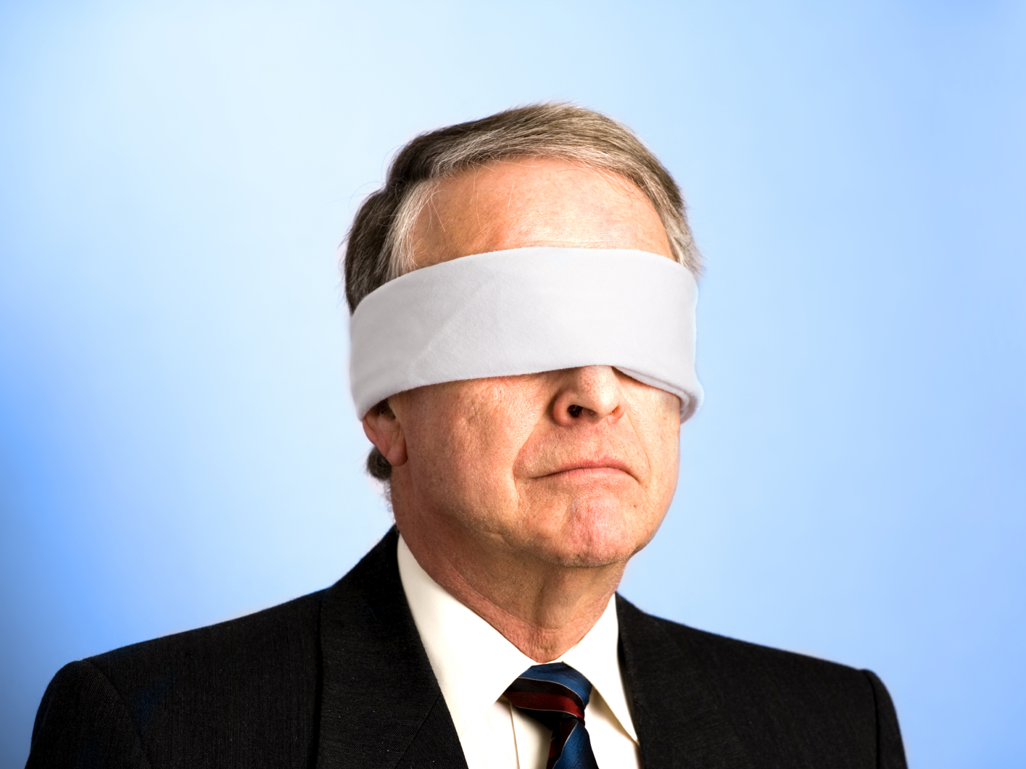
The people in charge
of leading school
organizations into the
21st century …
often are the
least knowledgeable
about the 21st century.
dangerouslyirrelevant.org

Slide 49

If the leaders
don’t get it,
it’s not going
to happen.
dangerouslyirrelevant.org

Slide 50
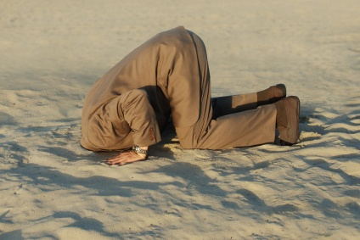
Notes:
50

Slide 51
120 119 118 117 116 115 114 113 112 111
110 109 108 107 106 105 104 103 102 101
100 99 98 97 96 95 94 93 92 91
90 89 88 87 86 85 84 83 82 81
80 79 78 77 76 75 74 73 72 71
70 69 68 67 66 65 64 63 62 61
60

Slide 52
60 59 58 57 56 55 54 53 52 51
50 49 48 47 46 45 44 43 42 41
40 39 38 37 36 35 34 33 32 31
30 29 28 27 26 25 24 23 22 21
20 19 18 17 16 15 14 13 12 11
10 9 8 7 6 5 4 3 2 1

Slide 53
Do I truly
“get it?”
10

Slide 54
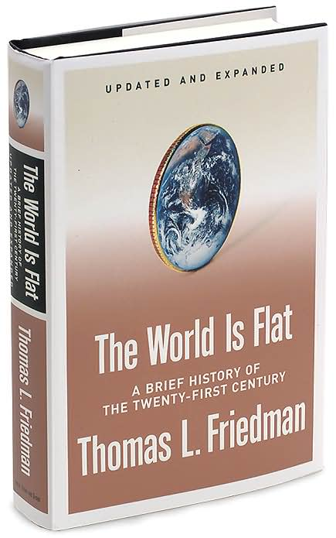
Notes:
54

Slide 55
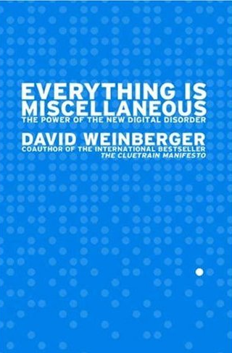
Notes:
55

Slide 56
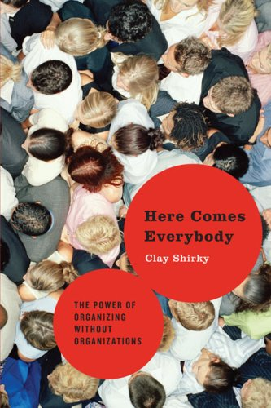
Notes:
Just say NO to Wikipedia
Card catalog / Dewey Decimal / microfiche
Continue to buy printed reference materials rather than electronic

Slide 57



Notes:
Every day you get to make decisions that reinforce status quo or move your library organization forward
If you don’t get it, should you get to keep your job?
Even if you do get it, what’s your duty to police your profession?

Slide 58
120 119 118 117 116 115 114 113 112 111
110 109 108 107 106 105 104 103 102 101
100 99 98 97 96 95 94 93 92 91
90 89 88 87 86 85 84 83 82 81
80 79 78 77 76 75 74 73 72 71
70 69 68 67 66 65 64 63 62 61
60

Slide 59
60 59 58 57 56 55 54 53 52 51
50 49 48 47 46 45 44 43 42 41
40 39 38 37 36 35 34 33 32 31
30 29 28 27 26 25 24 23 22 21
20 19 18 17 16 15 14 13 12 11
10 9 8 7 6 5 4 3 2 1

Slide 60
What percentage
of my job
requires me?
11
Notes:
Appreciate literature – user groups / communities?
Recommend books – Amazon?
Teach how to do stuff – blogs / online articles?
Think critically – video tutorials / electronic simulations?
Lots of people are learning to their dismay that their work can be done by people in India, can be replaced by software
Online forms
Mortgate application evaluation
Tax preparation
Legal document preparation / research
Airline / hotel kiosks
Travel agency bookings
Interpreting MRIs or X-rays
60% of your job replaceable? Only need 2 out of 5 of you

Slide 61
120 119 118 117 116 115 114 113 112 111
110 109 108 107 106 105 104 103 102 101
100 99 98 97 96 95 94 93 92 91
90 89 88 87 86 85 84 83 82 81
80 79 78 77 76 75 74 73 72 71
70 69 68 67 66 65 64 63 62 61
60

Slide 62
60 59 58 57 56 55 54 53 52 51
50 49 48 47 46 45 44 43 42 41
40 39 38 37 36 35 34 33 32 31
30 29 28 27 26 25 24 23 22 21
20 19 18 17 16 15 14 13 12 11
10 9 8 7 6 5 4 3 2 1

Slide 63
Why am
I here?
12

Slide 64


Slide 65


Slide 66


Slide 67


Slide 68


Slide 69

Notes:
Some percentage of you are…
Just collecting paycheck
Counting years until retirement
Hanging on hoping no one will push you too hard to do something different
You have a chance to truly make a difference – a meaningful, substantive impact
You have a chance to redefine your entire profession and how others think about you

Slide 70

Notes:
If you don’t, whether school library or public library, risk irrelevance
If you don’t want to do this, at least get out of the way of those that do
70

Slide 71
Thank you!
Scott McLeod, J.D., Ph.D.
Director, CASTLE
dangerouslyirrelevant.org/ILA.html
Notes:
71

Slide 72
Photo credits
http://www.flickr.com/photos/stolensnapshot/3352221864/in/set-72157615125530681/
http://www.flickr.com/photos/45635774@N00/3440080595/

