Slide 1
Scottmcleod.net/indianhill

Slide 2
A NEW YEAR…

Slide 3
January 1

Slide 4
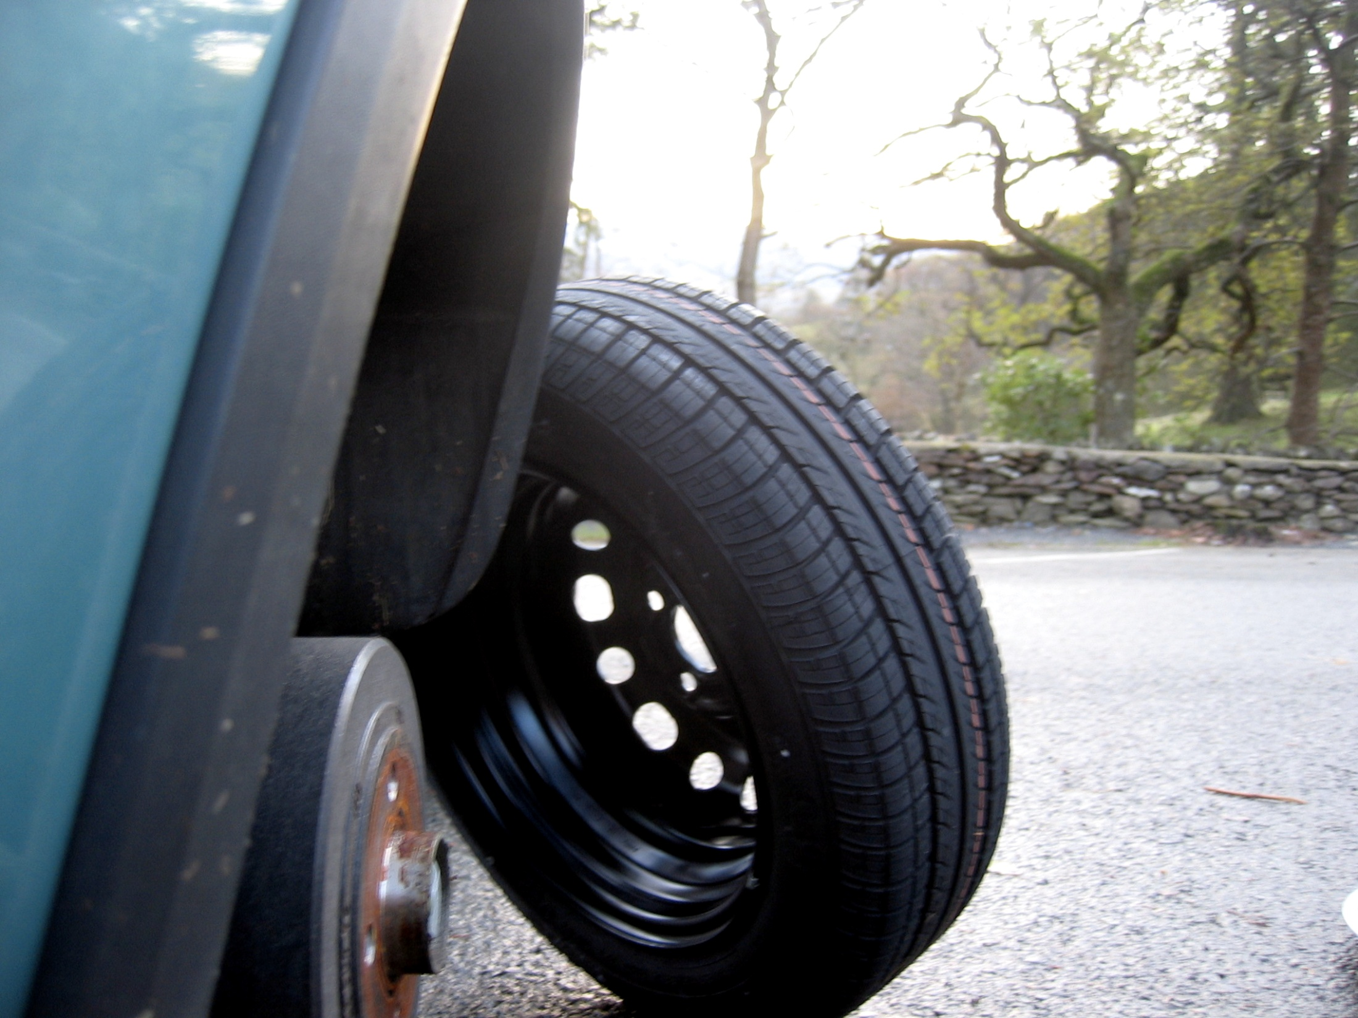

Slide 5

Notes:
http://www.flickr.com/photos/felixmolter/403696513/sizes/l/

Slide 6
January 1

Slide 7


Slide 8
January 1

Slide 9


Slide 10
Baseline data
Instructional goals

Slide 11

9 essential elements of data-driven schools
Frequent progress
monitoring
Professional learning
communities rooted
in student information
Good
baseline data
Measurable
instructional goals
Making instructional
changes
Data safety
Data transparency
Technology
Alignment for results
Notes:
A quick overview of the framework up front – more detailed, and more elements, than you may have seen before
Have used this with educators from Chicago, Philadelphia, Pittsburgh, Minneapolis, St. Paul, and a number of other MN districts
Folks have found a lot of value in it – helps them wrap their head around what they’re striving to achieve
The intent is to try and give you a big picture of what this is all about – an interconnected framework into which you can place your various data-related activities such as balanced assessment, assessment for learning, your work with Stiggins, DuFour, and PLCs, etc.
As we go over this framework, I’m going to pull in a lot of examples from other schools / districts
Note: we’re going to use Woodland Elementary, and its principal, Linda Perdaems, as an example several times in this presentation
WD is not the end-all / be-all of DDDM – it’s the first to admit that it’s on a learning curve with all of this data stuff too
Nor is our use of WD intended to slight the efforts /activities of other schools – you all are doing great things also
That said, I’ve had the chance to work with WD the most and there are a few key activities there that I want to highlight because they’re good examples of this framework in practice
Any questions?

Slide 12
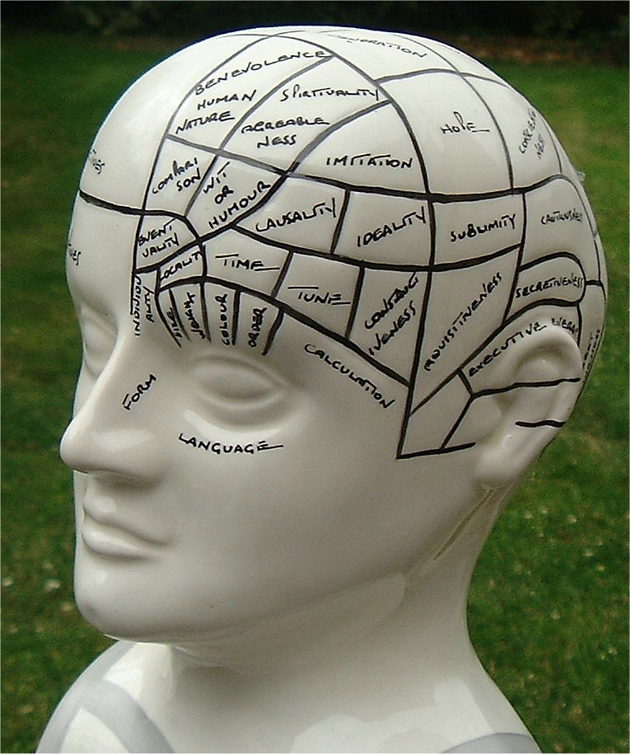

Slide 13
DDDM
NCLB

Slide 14
9 essential elements of data-driven schools
Frequent progress
monitoring
Professional learning
communities rooted
in student information
Good
baseline data
Measurable
instructional goals
Making instructional
changes
Data safety
Data transparency
Technology
Alignment for results
Notes:
A quick overview of the framework up front – more detailed, and more elements, than you may have seen before
Have used this with educators from Chicago, Philadelphia, Pittsburgh, Minneapolis, St. Paul, and a number of other MN districts
Folks have found a lot of value in it – helps them wrap their head around what they’re striving to achieve
The intent is to try and give you a big picture of what this is all about – an interconnected framework into which you can place your various data-related activities such as balanced assessment, assessment for learning, your work with Stiggins, DuFour, and PLCs, etc.
As we go over this framework, I’m going to pull in a lot of examples from other schools / districts
Note: we’re going to use Woodland Elementary, and its principal, Linda Perdaems, as an example several times in this presentation
WD is not the end-all / be-all of DDDM – it’s the first to admit that it’s on a learning curve with all of this data stuff too
Nor is our use of WD intended to slight the efforts /activities of other schools – you all are doing great things also
That said, I’ve had the chance to work with WD the most and there are a few key activities there that I want to highlight because they’re good examples of this framework in practice
Any questions?

Slide 15
problem 1: no data
Notes:
art?
industrial tech?
phys ed?
MN writing test?
some subjects in some grades

Slide 16
WHAT ABOUT LAST YEAR?

Slide 17
how do you know when students are learning?

Slide 18

Notes:
http://www.flickr.com/photos/beija-flor/229632970/sizes/o/

Slide 19
pre-testing

Slide 20
multiple measures

Slide 21
Elementary school
High school
Notes:
Student learning curiosity / engagement with content

Slide 22
9 essential elements of data-driven schools
Frequent progress
monitoring
Professional learning
communities rooted
in student information
Good
baseline data
Measurable
instructional goals
Making instructional
changes
Data safety
Data transparency
Technology
Alignment for results
Notes:
A quick overview of the framework up front – more detailed, and more elements, than you may have seen before
Have used this with educators from Chicago, Philadelphia, Pittsburgh, Minneapolis, St. Paul, and a number of other MN districts
Folks have found a lot of value in it – helps them wrap their head around what they’re striving to achieve
The intent is to try and give you a big picture of what this is all about – an interconnected framework into which you can place your various data-related activities such as balanced assessment, assessment for learning, your work with Stiggins, DuFour, and PLCs, etc.
As we go over this framework, I’m going to pull in a lot of examples from other schools / districts
Note: we’re going to use Woodland Elementary, and its principal, Linda Perdaems, as an example several times in this presentation
WD is not the end-all / be-all of DDDM – it’s the first to admit that it’s on a learning curve with all of this data stuff too
Nor is our use of WD intended to slight the efforts /activities of other schools – you all are doing great things also
That said, I’ve had the chance to work with WD the most and there are a few key activities there that I want to highlight because they’re good examples of this framework in practice
Any questions?

Slide 23
problem 2: no GOALS
Notes:
art?
industrial tech?
phys ed?
MN writing test?
some subjects in some grades

Slide 24


Slide 25
checking in during the school year
Notes:
What kind of data do you currently have?

Slide 26
Focus, focus, focus
Notes:
not just what you know, what can you do with it?
know a bad prof?
Faribault Middle Soc St teachers

Slide 27
Endurance, leverage, and readiness?
Notes:
p. 47, Learning by Doing Handbook (DuFour)
what kind of data do you have like this?
Endurance-Will this standard or indicator provide students with knowledge and skills that will be of value beyond a single test date?
Leverage-Will this provide knowledge and skills that will be of value in multiple disciplines?
Readiness for the next level of learning-Will this provide students with essential knowledge and skills that are necessary for success in the next grade level of instruction?

Slide 28
Endurance. Will this standard or indicator provide students with knowledge and skills that will be of value beyond a single test date?
Leverage. Will this provide knowledge and skills that will be of value in multiple disciplines?
Readiness for the next level of learning. Will this provide students with essential knowledge and skills that are necessary for success in the next grade level of instruction?

Slide 29
nctm focal points

Slide 30
it’s special to be common
Notes:
Mounds View high school foreign language
advantages of common assessments?
disadvantages?

Slide 31
9 essential elements of data-driven schools
Frequent progress
monitoring
Professional learning
communities rooted
in student information
Good
baseline data
Measurable
instructional goals
Making instructional
changes
Data safety
Data transparency
Technology
Alignment for results
Notes:
A quick overview of the framework up front – more detailed, and more elements, than you may have seen before
Have used this with educators from Chicago, Philadelphia, Pittsburgh, Minneapolis, St. Paul, and a number of other MN districts
Folks have found a lot of value in it – helps them wrap their head around what they’re striving to achieve
The intent is to try and give you a big picture of what this is all about – an interconnected framework into which you can place your various data-related activities such as balanced assessment, assessment for learning, your work with Stiggins, DuFour, and PLCs, etc.
As we go over this framework, I’m going to pull in a lot of examples from other schools / districts
Note: we’re going to use Woodland Elementary, and its principal, Linda Perdaems, as an example several times in this presentation
WD is not the end-all / be-all of DDDM – it’s the first to admit that it’s on a learning curve with all of this data stuff too
Nor is our use of WD intended to slight the efforts /activities of other schools – you all are doing great things also
That said, I’ve had the chance to work with WD the most and there are a few key activities there that I want to highlight because they’re good examples of this framework in practice
Any questions?

Slide 32
Problem 3: ISOLATION
Notes:
art?
industrial tech?
phys ed?
MN writing test?
some subjects in some grades

Slide 33

Notes:
isolation is the enemy of improvement
disadvantages of being isolated?
advantages?

Slide 34

Notes:
feeling unsafe
hurt feelings
exposure of weaknesses (what are you going to do with this data?)
not sure HOW to collaborate effectively
how do you know where you are if no data?

Slide 35
variability of student learning experiences
Notes:
learning from each other
Japanese lesson study

Slide 36
role-alike
Notes:
no “other” PLCs
Faribault Middle “other” PLC

Slide 37
rooted in data

Slide 38
use a protocol

Slide 39
respectful of teachers
Notes:
skit?
isolated v. others in group
nassp, naesp, aft, and nea

Slide 40
9 essential elements of data-driven schools
Frequent progress
monitoring
Professional learning
communities rooted
in student information
Good
baseline data
Measurable
instructional goals
Making instructional
changes
Data safety
Data transparency
Technology
Alignment for results
Notes:
A quick overview of the framework up front – more detailed, and more elements, than you may have seen before
Have used this with educators from Chicago, Philadelphia, Pittsburgh, Minneapolis, St. Paul, and a number of other MN districts
Folks have found a lot of value in it – helps them wrap their head around what they’re striving to achieve
The intent is to try and give you a big picture of what this is all about – an interconnected framework into which you can place your various data-related activities such as balanced assessment, assessment for learning, your work with Stiggins, DuFour, and PLCs, etc.
As we go over this framework, I’m going to pull in a lot of examples from other schools / districts
Note: we’re going to use Woodland Elementary, and its principal, Linda Perdaems, as an example several times in this presentation
WD is not the end-all / be-all of DDDM – it’s the first to admit that it’s on a learning curve with all of this data stuff too
Nor is our use of WD intended to slight the efforts /activities of other schools – you all are doing great things also
That said, I’ve had the chance to work with WD the most and there are a few key activities there that I want to highlight because they’re good examples of this framework in practice
Any questions?

Slide 41
because of US? or despite us?

Slide 42
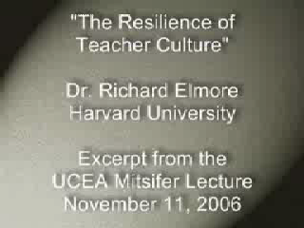
Notes:
And:
Classrooms in which there was evidence of higher-order thinking: 3 percent. Classrooms in which high-yield [instructional] strategies were being used: 0.2 percent. Classrooms in which fewer than one-half of students were paying attention: 85 percent.
– Mike Schmoker, Results Now (2006, p. 18) [citing a study of 1,500+ classroom observations]
And:
The data from our observations in more than 1,000 classrooms support the popular image of a teacher standing or sitting in front of a class imparting knowledge to a group of students. Explaining and lecturing constituted the most frequent teaching activities … And the frequency of these activities increased steadily from the primary to the senior high school years. Teachers also spent a substantial amount of time observing students at work or monitoring their seat-work … Our data show not only an increase in these activities but also a decline in teachers interacting with groups of students within their classes from the primary to the secondary years. . . . Three categories of student activity marked by passivity - written work, listening, and preparing for assignments - dominate … The chances are better than 50–50 that if you were to walk into any of the classrooms of our sample, you would see one of these three activities under way … All three activities are almost exclusively set and monitored by teachers. We saw a contrastingly low incidence of activities invoking active modes of learning.
– John Goodlad, A Place Called School (1984)
And:
The average fifth grader received five times as much instruction in basic skills as instruction focused on problem solving or reasoning; this ratio was 10:1 in first and third grades.
– Robert C. Pianta, et al., Opportunities to Learn in America’s Elementary Classrooms (2007) [study of 2500+ classrooms in more than 1,000 elementary schools and 400 school districts]
And:
When you code classroom practice for level of cognitive demand . . . 80% of the work is at the factual and procedural level. . . . [Teachers] will do low-level work and call it high-level work.
– Richard Elmore, excerpt from Education Leadership as the Practice of Improvement (2006)
And:
What students do in the classroom is what they learn (as Dewey would say) . . . Now, what is it that students do in the classroom? Well, mostly, they sit and listen to the teacher. . . . Mostly, they are required to remember. . . . It is practically unheard of for students to play any role in determining what problems are worth studying or what procedures of inquiry ought to be used. . . . Here is the point: Once you have learned how to ask questions – relevant and appropriate and substantial questions – you have learned how to learn and no one can keep you from learning whatever you want or need to know . . . [However,] what students are restricted to (solely and even vengefully) is the process of memorizing . . . somebody else’s answers to somebody else’s questions. It is staggering to consider the implications of this fact. The most important intellectual ability man has yet developed – the art and science of asking questions – is not taught in school! Moreover, it is not “taught” in the most devastating way possible: by arranging the environment so that significant question asking is not valued. It is doubtful if you can think of many schools that include question-asking, or methods of inquiry, as part of their curriculum.
– Neil Postman & Charles Weingartner, Teaching as a Subversive Activity (1969)

Slide 43
skills, not content
Notes:
not just what you know, what can you do with it?
know a bad prof?
Faribault Middle Soc St teachers

Slide 44
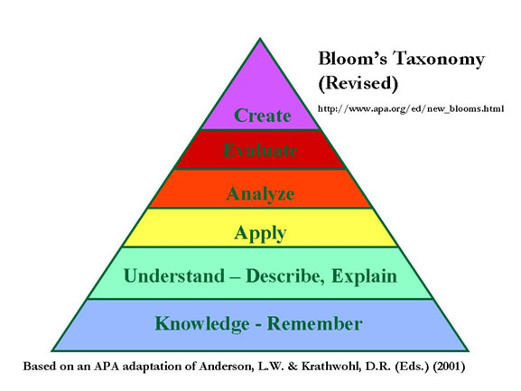
Notes:
Remembering: can the student recall or remember the information? define, duplicate, list, memorize, recall, repeat, reproduce state Understanding: can the student explain ideas or concepts? classify, describe, discuss, explain, identify, locate, recognize, report, select, translate, paraphrase Applying: can the student use the information in a new way? choose, demonstrate, dramatize, employ, illustrate, interpret, operate, schedule, sketch, solve, use, write. Analysing: can the student distinguish between the different parts? appraise, compare, contrast, criticize, differentiate, discriminate, distinguish, examine, experiment, question, test. Evaluating: can the student justify a stand or decision? appraise, argue, defend, judge, select, support, value, evaluate Creating: can the student create new product or point of view? assemble, construct, create, design, develop, formulate, write.
Skills data?

Slide 45
GROWTH, NOT STATUS
Notes:
not just what you know, what can you do with it?
know a bad prof?
Faribault Middle Soc St teachers

Slide 46
9 essential elements of data-driven schools
Frequent progress
monitoring
Professional learning
communities rooted
in student information
Good
baseline data
Measurable
instructional goals
Making instructional
changes
Data safety
Data transparency
Technology
Alignment for results
Notes:
A quick overview of the framework up front – more detailed, and more elements, than you may have seen before
Have used this with educators from Chicago, Philadelphia, Pittsburgh, Minneapolis, St. Paul, and a number of other MN districts
Folks have found a lot of value in it – helps them wrap their head around what they’re striving to achieve
The intent is to try and give you a big picture of what this is all about – an interconnected framework into which you can place your various data-related activities such as balanced assessment, assessment for learning, your work with Stiggins, DuFour, and PLCs, etc.
As we go over this framework, I’m going to pull in a lot of examples from other schools / districts
Note: we’re going to use Woodland Elementary, and its principal, Linda Perdaems, as an example several times in this presentation
WD is not the end-all / be-all of DDDM – it’s the first to admit that it’s on a learning curve with all of this data stuff too
Nor is our use of WD intended to slight the efforts /activities of other schools – you all are doing great things also
That said, I’ve had the chance to work with WD the most and there are a few key activities there that I want to highlight because they’re good examples of this framework in practice
Any questions?

Slide 47
Thank you!
Scott McLeod, J.D., Ph.D.
Director, CASTLE
scottmcleod.net/indianhill
Notes:
47
URL

