Slide 1
The last
5,000
days
Dr. Scott McLeod
CASTLE
Notes:
Good morning. My name is Dr. Scott McLeod. I’m coordinator of the educational administration at Iowa State University. I used to be at the University of Minnesota. I’m also the Director of CASTLE, the only university center in the country dedicated to the technology leadership needs of school administrators.
Today I’m going to talk to you about schools.

Slide 2
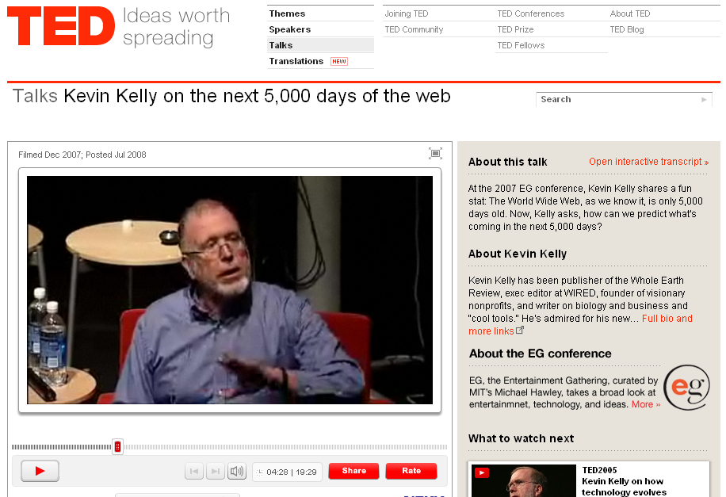

Slide 3
dangerouslyirrelevant.org/ nebraska.html
Say hi to your neighbor!

Slide 4


Slide 5
ACT 1
Our tools
have
changed

Slide 6


Slide 7
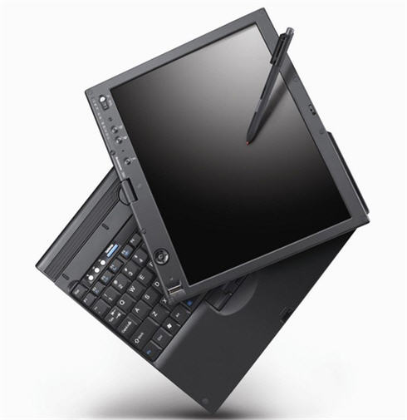

Slide 8

Notes:
Talking went digital.
On the personal level, we now carry around portable little computers (also known as cell phones) that not only let us talk to anyone in the world but also can send text messages, photographs, and videos. They also can hold our calendar, contacts, and music that we like to listen to. All in our pocket.
Hands up – how many of you own a cell phone?
http://www.flickr.com/photos/davyrocket/82339986/
How many of you have heard of a service called Jott that lets you can send yourself an e-mail reminder simply by calling and talking into the phone?

Slide 9
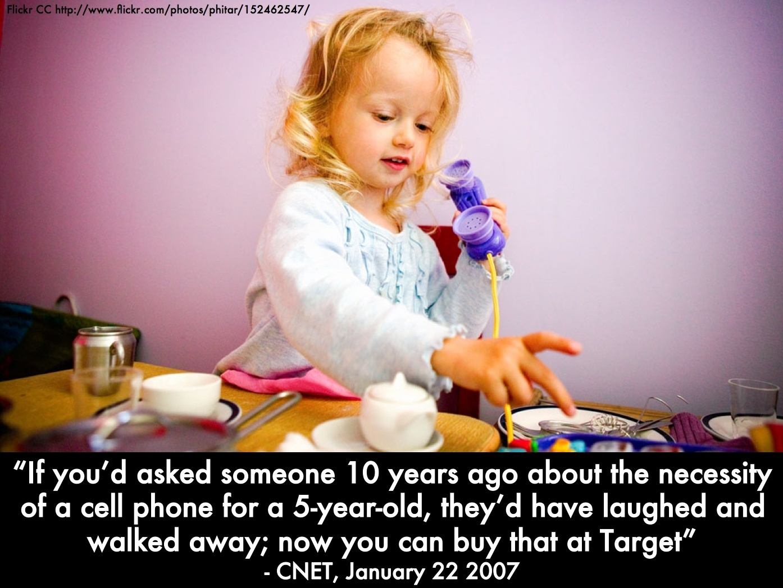

Slide 10
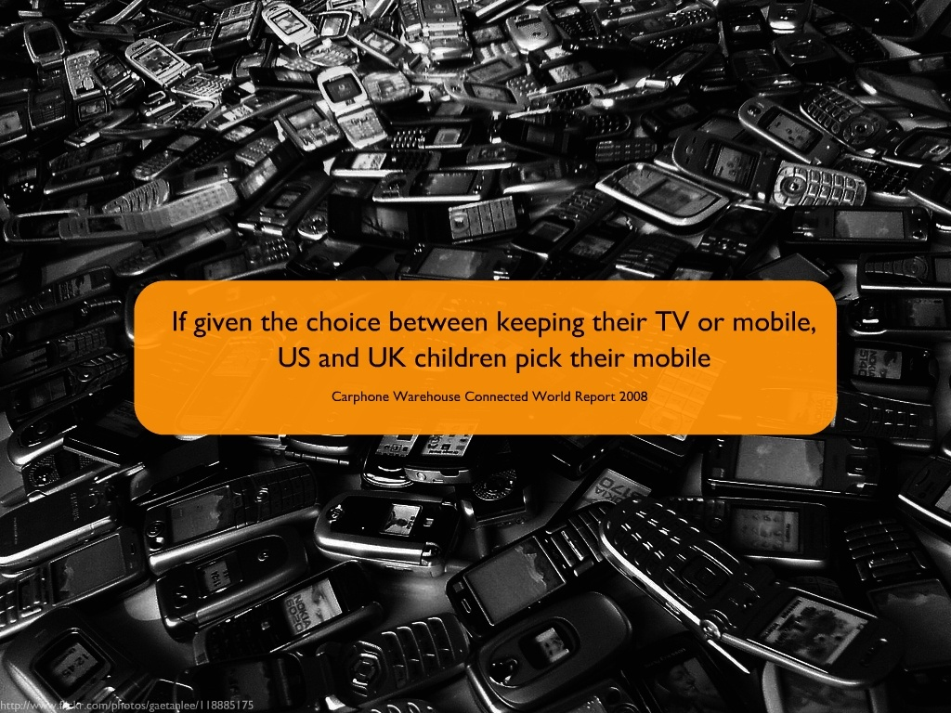

Slide 11

Notes:
Music went digital.
Many of us have iPods or other portable music devices that let us carry around a lifetime’s worth of music. And, again, they fit in our pocket or purse.
And, in addition to being both wonderfully useful and kinda cool, these little devices also are making us completely rethink a number of issues related to intellectual property and copyright.
Hands up – how many of you own an iPod or other kind of portable music player?
http://www.flickr.com/photos/zengame/42914294/sizes/l/

Slide 12

Notes:
Maps went digital.
For a few hundred dollars, we can buy a portable GPS unit and never have to get lost again.
Hands up – how many of you own a GPS unit?
http://www.flickr.com/photos/soumit/450204342/in/photostream/
http://www.flickr.com/photos/mdumlao98/976279763/

Slide 13

Notes:
Photos went digital.
The world of photography has been completely upended in the past couple of decades, as digital cameras infiltrate both the personal and professional realms.
Hands up – how many of you own a digital camera? Those of you who do know the affordances they lend us over regular film photography.
http://www.flickr.com/photos/parl/89822733/
http://www.flickr.com/photos/dhammza/140868495/
http://www.flickr.com/photos/purprin/2070805989/

Slide 14

Notes:
Movies went digital.
Like the digital camera, the digital camcorder also is replacing earlier, often bulky versions, allowing individuals to capture video wherever they might be.
http://www.flickr.com/photos/oldonliner/1571194587/
http://www.flickr.com/photos/checiap/164147687/

Slide 15
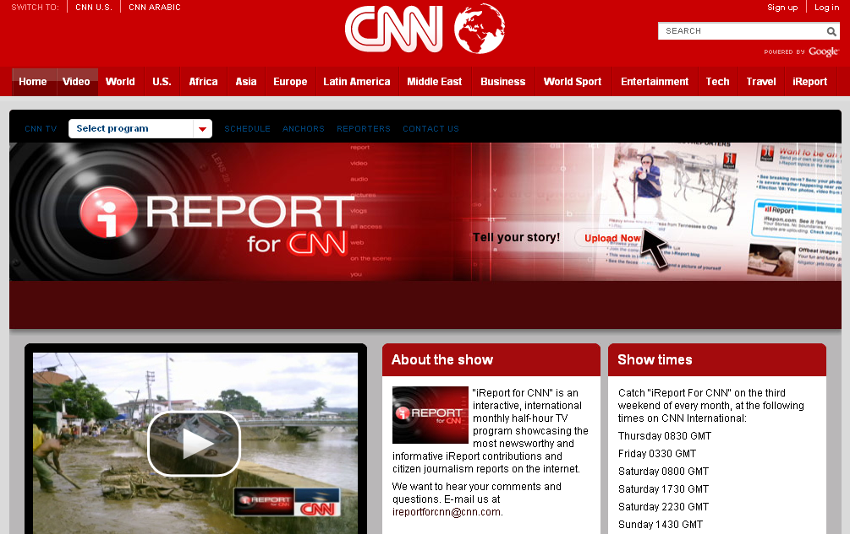

Slide 16
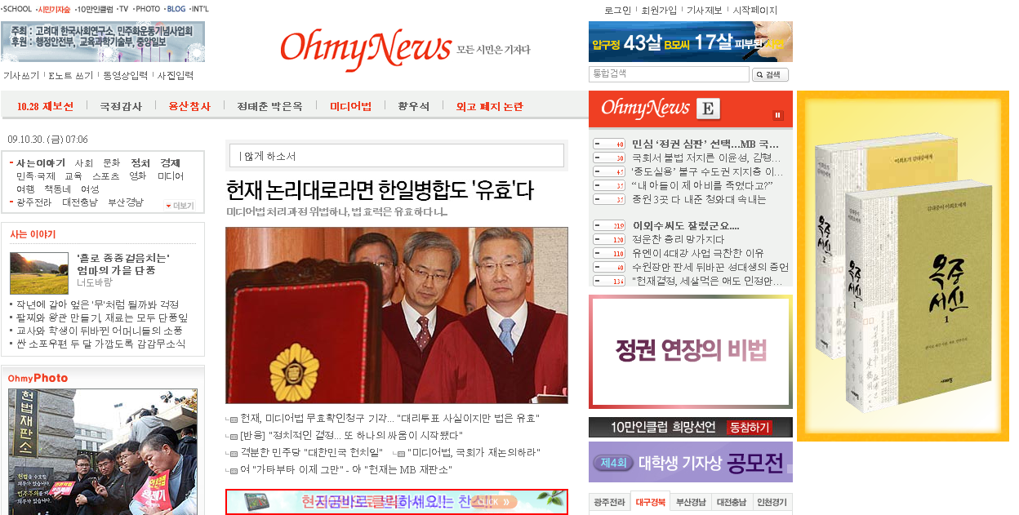

Slide 17
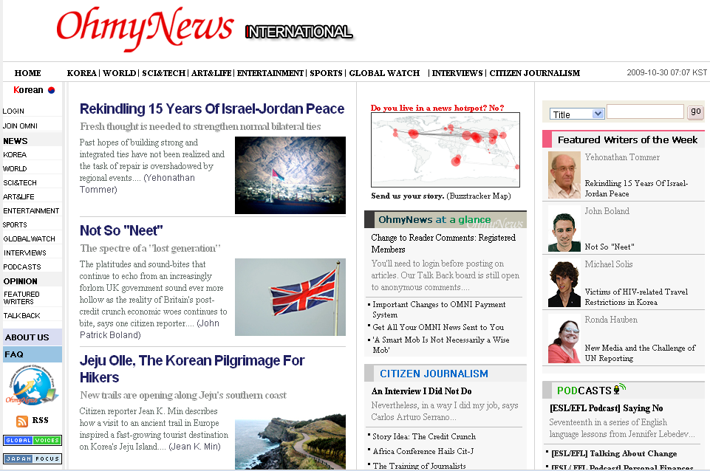

Slide 18
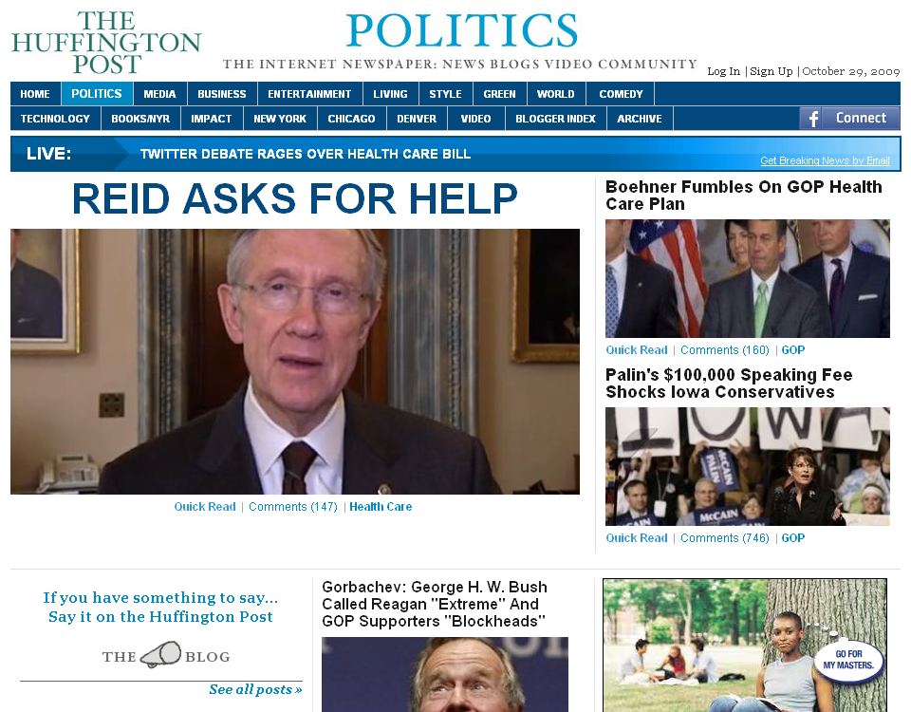

Slide 19
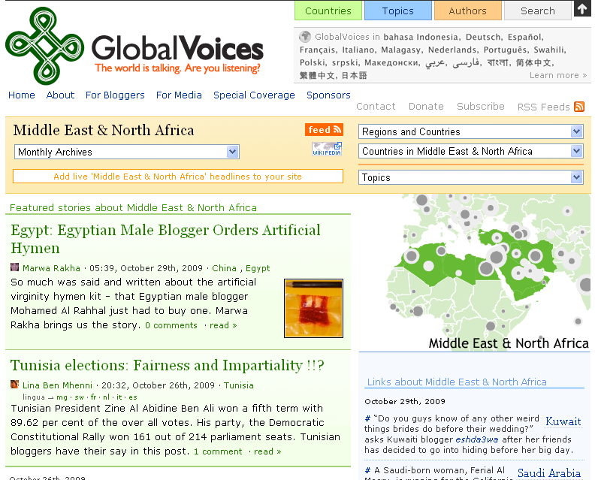

Slide 20
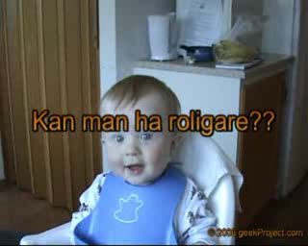
Notes:
And there’s YouTube, now the #3 place on the Web. About 1 in 6 Internet users has visited YouTube in the past 24 hours.
Just ask Judson Laipply, a previously obscure comedian from Cleveland, what it’s done to his career to have his Evolution of Dance routine viewed by over 80 million people. Most major television and film production channels, faced with declining viewership, are trying to establish a YouTube presence.
Hands up – how many of you have watched a video on YouTube? uploaded a video to YouTube?
We now live in a world where a comedian from Cleveland can be viewed by over 50 million people…
hahaha 17 million people
hey 15 million people
ever watched?
ever uploaded?
YouTube is now the #2 most-visited site on the Internet – ahead of Google
Not bad for a company that barely existed 2 years ago
As the Alexa trend graph shows, the percentage of global Internet users who visited YouTube yesterday is nearly 15%. This means that about 1 in 7 Internet users across the globe visited YouTube in the past 24 hours.
The only sites more popular than YouTube are Yahoo, MSN.com, and Google.

Slide 21


Notes:
And then there’s Facebook and MySpace, which are the #5 and #7 places on the Web, respectively. Why? Because they do one thing extremely well – they allow us to connect with each other in ways that we find meaningful and engaging.
Hands up – how many of you belong to MySpace, Facebook, or some other social networking site?
http://www.alexa.com/site/ds/top_sites?ts_mode=global&lang=none

Slide 22
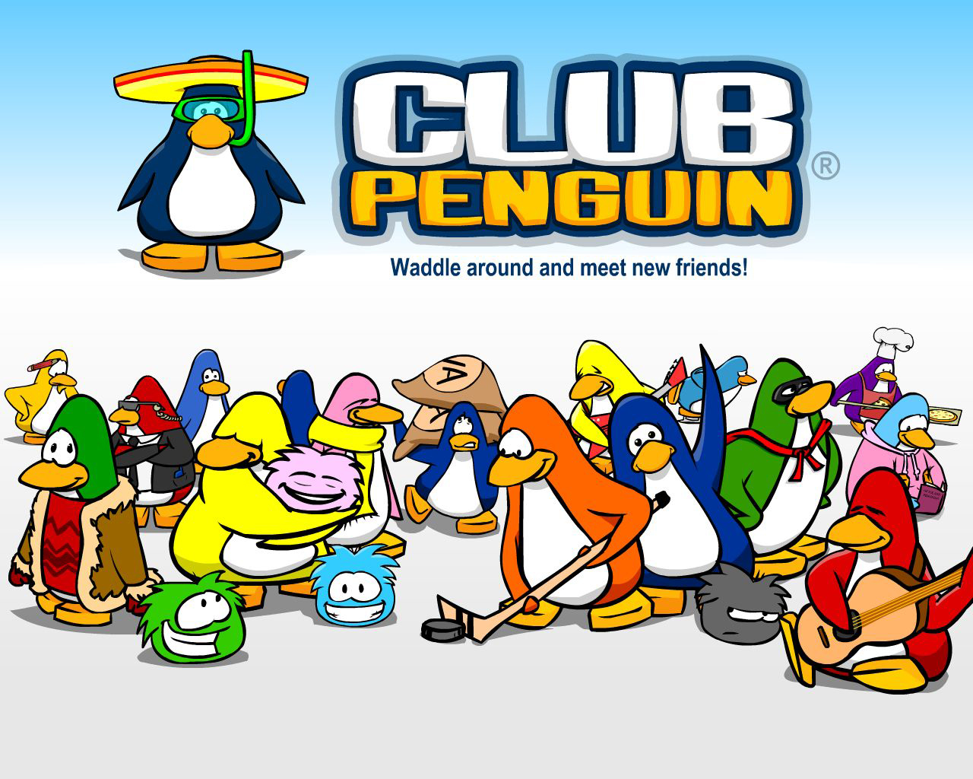

Slide 23
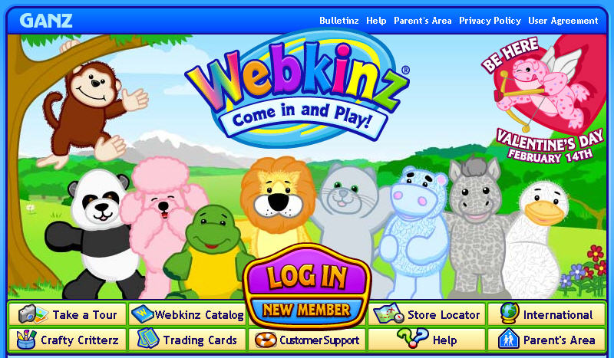

Slide 24

Notes:
But ultimately it is about empowerment. The reason these technologies are going like wildfire is because they allow people to be more efficient, to be more effective, to do things they want to do, and to do things they never could before.
Collaboration
Creativity
Disintermediation
Reach
Putting the power in the
hands of the users
Technology allows us to communicate and collaborate with folks halfway across the globe just about as easily as we can the folks across town
Just like the printing press ushered in a new era where the general population could afford to be literate, to read, we are seeing similar transformations today
No longer need to be a publishing company to publish a book
Record studio to create a hit song or album
Movie studio to create a hit movie or music video
- Digital cameras, camcorders, software – a few hundred dollars, an Internet connection, and an idea and you’re all set
Disintermediation – tools are there that allow us to bypass the “middle man” – used to have to rely on publishers, record companies, movie studios, etc. to reach our audience – now we can reach them directly and they can find us through search engines, video hosting sites, tags, etc.
Not only can we reach them by bypassing traditional entities – we can reach them in the thousands, hundreds of thousands, millions

Slide 25
120 119 118 117 116 115 114 113 112 111
110 109 108 107 106 105 104 103 102 101
100 99 98 97 96 95 94 93 92 91
90 89 88 87 86 85 84 83 82 81
80 79 78 77 76 75 74 73 72 71
70 69 68 67 66 65 64 63 62 61
60

Slide 26
60 59 58 57 56 55 54 53 52 51
50 49 48 47 46 45 44 43 42 41
40 39 38 37 36 35 34 33 32 31
30 29 28 27 26 25 24 23 22 21
20 19 18 17 16 15 14 13 12 11
10 9 8 7 6 5 4 3 2 1

Slide 27
ACT 2
Information
has
changed

Slide 28


Slide 29

Notes:
29

Slide 30


Slide 31


Slide 32


Slide 33


Slide 34


Slide 35
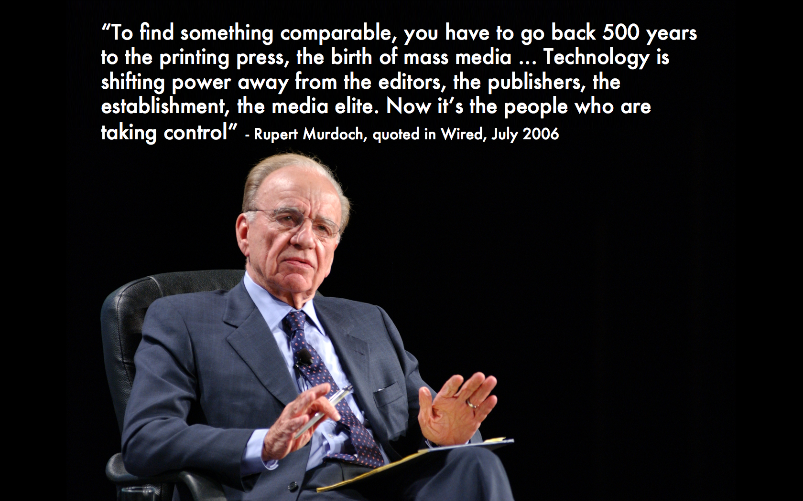

Slide 36
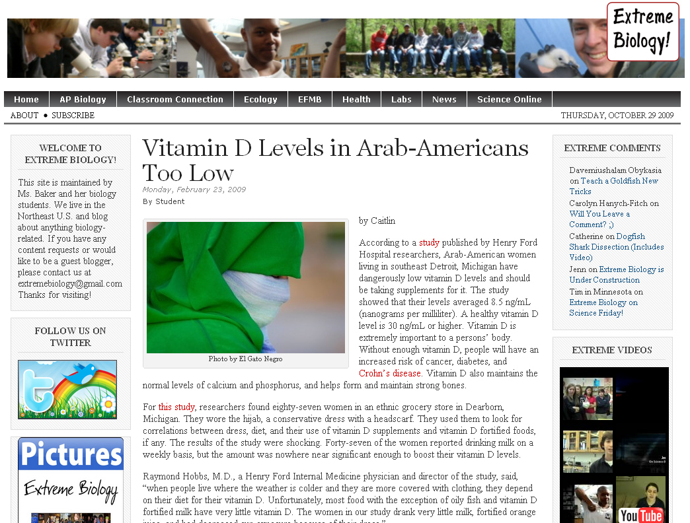

Slide 37
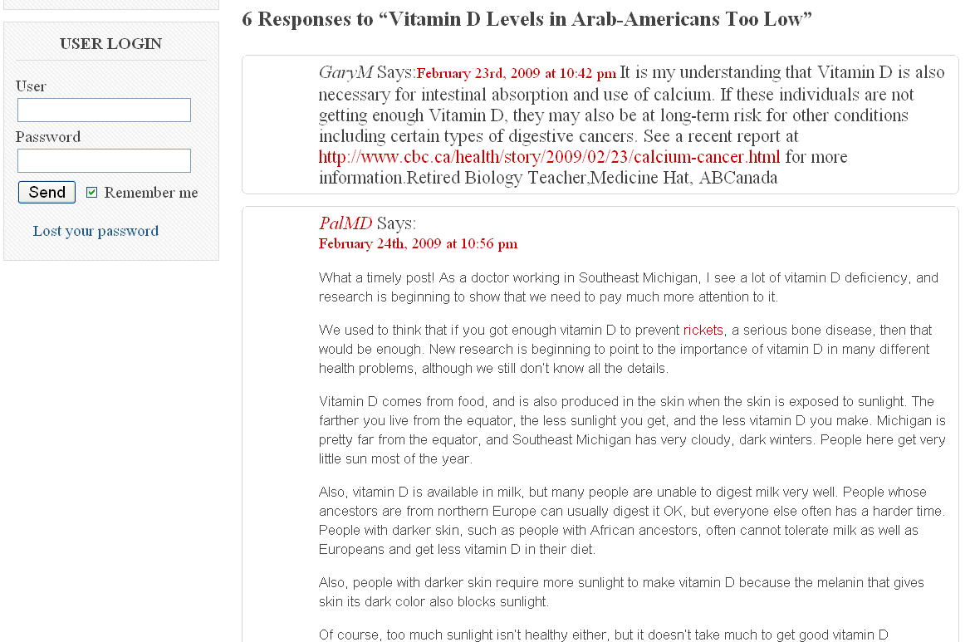

Slide 38
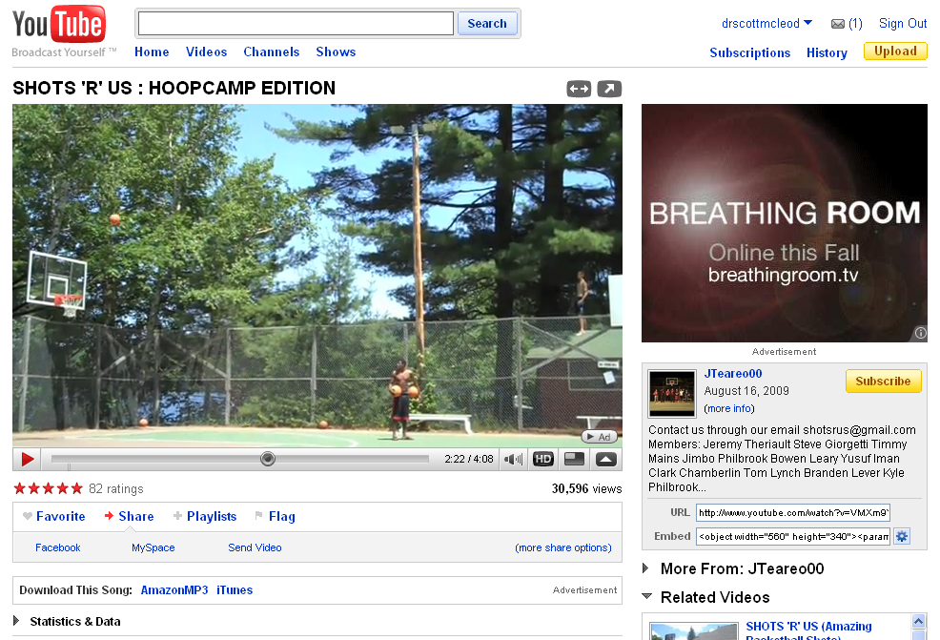

Slide 39
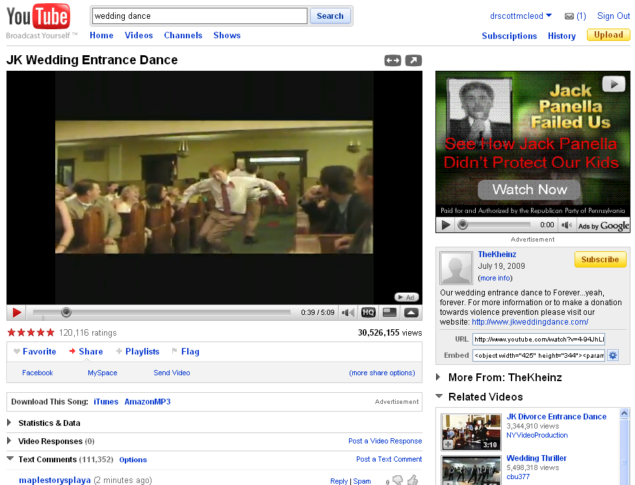

Slide 40
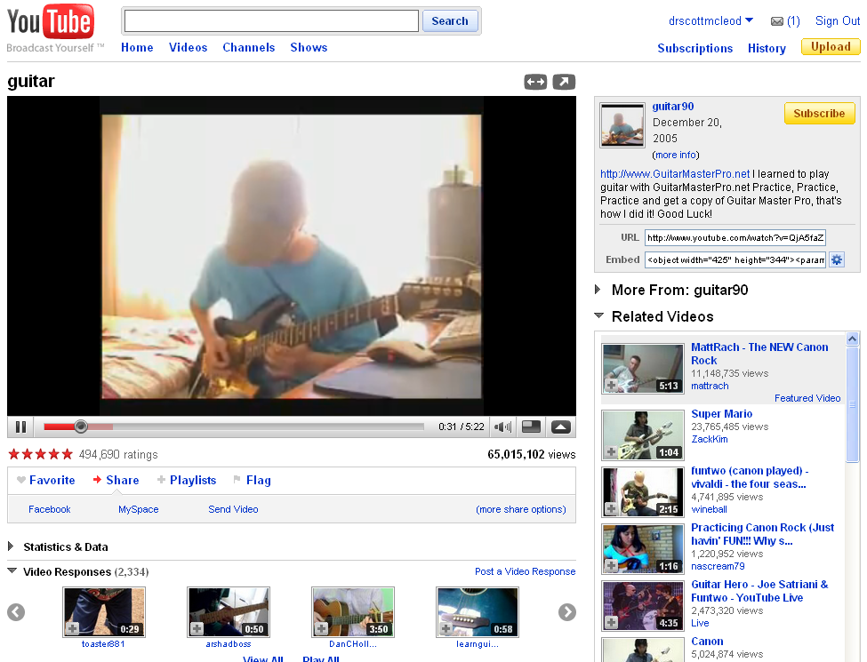

Slide 41
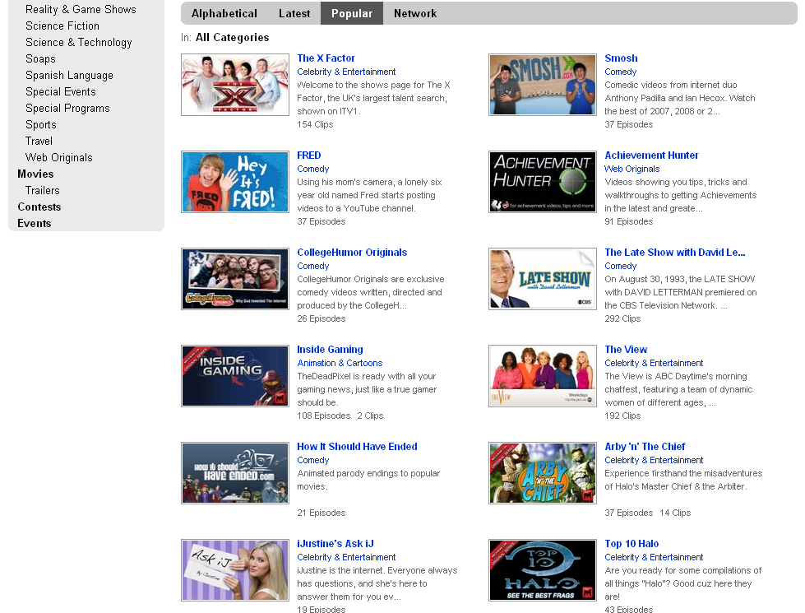

Slide 42
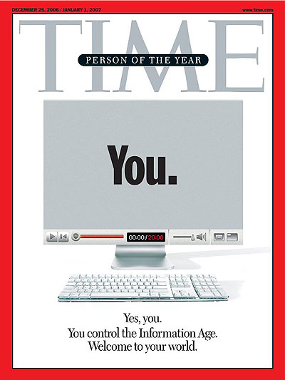
Notes:
The new Web is a very different thing. It’s a tool for bringing together the small contributions of millions of people and making them matter. [As these tools get put in the hands of ordinary people, we are seeing] an explosion of productivity and innovation. It’s just getting started, as millions of minds that would otherwise have drowned in obscurity get backhauled into the global intellectual economy.
A story about community and collaboration on a scale never seen before. It’s about the many wresting the power from the few and helping one another for nothing and how that will not only change the world, but also change the way the world changes.

Slide 43


Slide 44
120 119 118 117 116 115 114 113 112 111
110 109 108 107 106 105 104 103 102 101
100 99 98 97 96 95 94 93 92 91
90 89 88 87 86 85 84 83 82 81
80 79 78 77 76 75 74 73 72 71
70 69 68 67 66 65 64 63 62 61
60

Slide 45
60 59 58 57 56 55 54 53 52 51
50 49 48 47 46 45 44 43 42 41
40 39 38 37 36 35 34 33 32 31
30 29 28 27 26 25 24 23 22 21
20 19 18 17 16 15 14 13 12 11
10 9 8 7 6 5 4 3 2 1

Slide 46
ACT 3
Jobs
have
changed

Slide 47


Notes:
47
If you haven’t noticed, our world has flattened around us. Geography, and time, are disappearing as barriers. Technology lets us communicate and work with people halfway around the world about as easily as we can with people on the other side of town. After we go to bed, businesses in other countries are working away during their daylight hours, ready to interact with us when we wake up again in the morning. The global economy never sleeps.

Slide 48


Slide 49
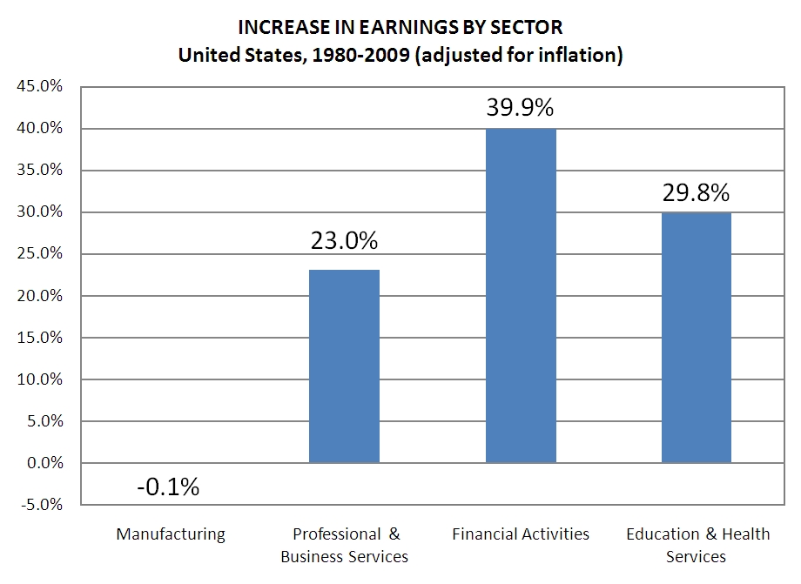

Slide 50


Slide 51
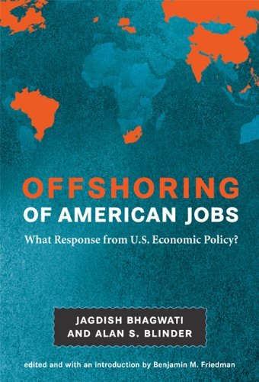

Slide 52
Percentile change in
importance of task type
in U.S. economy
Abstract
Routine
Manual
Autor, D., Levy, F., & Murnane, R. J. (2003). The skill content of recent technological change:
An empirical exploration. Quarterly Journal of Economics 188, 4. [updated, D. Autor, 2008]

Slide 53
global awareness
effective speaking
critical thinking
problem solving
adaptability
information literacy
collaboration
creativity
media fluency
analytical skills
entrepeneurialism
innovation
effective writing
synthesis
curiosity
Notes:
1. critical thinking and problem solving in networks of cross-functional teams
world is complex and answers are not in the books
world is moving too fast for inflexible, hierarchical organizations
2. collaboration across networks and leadership by influence rather than positional authority
command and control increasingly less valued in organizations
schools are very much command and control institutions
3. agility and adaptability
intensifying rate of change, overwhelming amount of data, increasing complexity of problems
4. initiative and entrepeneurialism
people who can seek out new opportunities, ideas, and strategies
don’t want students or workers who are apathetic about their experiences
achievement orientation, drive for results, self-starters
5. effective written and oral communication
presentation skills, being clear and concise; creating focus, energy, and passion around the points they want to make
6. accessing and analyzing information
people who can access, evaluate, conceptualize, and synthesize multiple and large streams of incoming information to make meaningful decisions
7. curiosity and imagination
inquisitiveness, analytical skills that are more ‘out of the box’ than in the past, asking great questions is more important than knowing the ‘right answer’

Slide 54
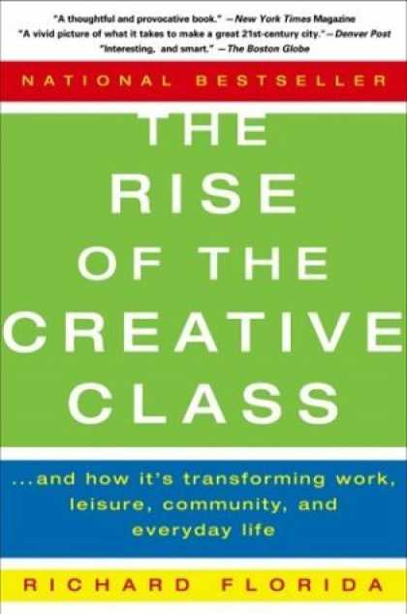

Slide 55
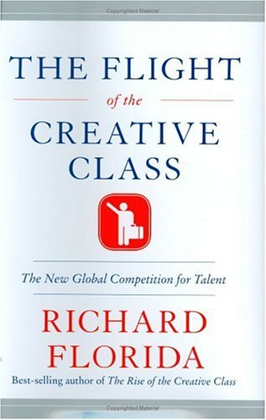

Slide 56
Growth of the creative class
Florida, R. (2002). The rise of the creative class (p. 332). New York, NY: Basic Books.
Notes:
Since 1950…
agriculture = less than 2%
working = primarily high school diploma, some have a little bit of college - factory workers, construction workers, food service workers, custodians, truck drivers – low levels of education, highly manual labor
service = beauticians, secretaries, paralegals, workers in retail stores, tourism and hotel workers, personal health care assistants
creative = scientists, engineers, technology workers, architects, lawyers, doctors, nurses, K-12 educators, university professors, poets, musicians, and entertainers - from 5% in 1900 to 14% in 1945 to 33% in 2008
2005 – Bill Gates - Today, only one-third of our students graduate from high school ready for college, work, and citizenship. . . . The first group goes on to college and careers; the second group will struggle to make a living wage. Let's be clear. Thanks to dedicated teachers and principals around the country, the best-educated kids in the United States are the best-educated kids in the world. We should be proud of that. But only a fraction of our kids are getting the best education.

Slide 57
Growth of the creative class
Florida, R. (2002). The rise of the creative class (p. 332). New York, NY: Basic Books.
Notes:
Since 1950…
agriculture = less than 2%
working = primarily high school diploma, some have a little bit of college - factory workers, construction workers, food service workers, custodians, truck drivers – low levels of education, highly manual labor
service = beauticians, secretaries, paralegals, workers in retail stores, tourism and hotel workers, personal health care assistants
creative = scientists, engineers, technology workers, architects, lawyers, doctors, nurses, K-12 educators, university professors, poets, musicians, and entertainers - from 5% in 1900 to 14% in 1945 to 33% in 2008
2005 – Bill Gates - Today, only one-third of our students graduate from high school ready for college, work, and citizenship. . . . The first group goes on to college and careers; the second group will struggle to make a living wage. Let's be clear. Thanks to dedicated teachers and principals around the country, the best-educated kids in the United States are the best-educated kids in the world. We should be proud of that. But only a fraction of our kids are getting the best education.

Slide 58
MANUFACTURING IN IOWA
% of all Iowa jobs
in May ‘08
% of overall job losses
by Sep ‘09

Slide 59
  Can someone overseas
  do it cheaper?
  Can a computer
  do it faster?
  Is what I’m offering in demand
  in an age of abundance?
Notes:
New Commission on the Skills of the American Workforce
It is becoming progressively less expensive to automate functions that used to be performed by people. As the cost of labor rises and the cost of automating jobs continues to fall, it becomes both possible and necessary for firms simply to eliminate job after job now being done by humans. Earlier, almost all the jobs subject to automation were low-skill jobs. That is no longer true. Now it is more accurate to say that the jobs that are most vulnerable are the jobs involving routine work. If someone can figure out the algorithm for a routine job, chances are that it is economical to automate it. Many good, well-paying, middle-class jobs involve routine work of this kind and are rapidly being automated. [Think tax preparers, lawyers… being replaced by software]
Daniel Pink
If you say yes to 1 or 2, or no to 3, you’re in trouble
Forging relationship rather than executing transactions
Tackling novel, complex challenges instead of solving routine problems
Synthesizing and connecting disparate parts, thus creating or adding value
The capacity to detect patterns and opportunities, to combine seemingly unrelated ideas into something new, to craft a satisfying narrative, to create artistic and emotional beauty
Creativity is the ultimate economic resource. The ability to come up with new ideas and better ways of doing things is ultimately what raises productivity and thus living standards. In virtually every industry, the winners in the long run are those who can create and keep creating. This has always been true.
As we have moved from an agricultural age to an industrial age to an information age, our primary economic resource no longer is raw materials from the ground or human labor. We have to recognize that information is now the primary and most lucrative raw material.

Slide 60


Slide 61


Slide 62
2.5 billion

Slide 63


Slide 64

Notes:
New Commission on the Skills of the American Workforce
Today Indian engineers make $7,500 a year against $45,000 for a similarly-qualified American engineer. Why would the world’s employers pay our engineers more? They would be willing to do that only if we could offer something the Indian engineers cannot.
Producing the most important new products and services depends on a deep vein of creativity that is constantly renewing itself, and on a myriad of people who can imagine how people can use things that have never been available before
Creativity and innovation, facility with the use of ideas and abstractions, the self-discipline and organization needed to manage one’s work and drive it through to a successful conclusion, the ability to function well as a member of a team, the ability to use digital technologies to do everything just mentioned…

Slide 65
Globalization
doesn’t care
about us

Slide 66
Thank you!
Scott McLeod, J.D., Ph.D.
Director, CASTLE
dangerouslyirrelevant.org/nebraska.html
Notes:
66
URL

