Slide 1

The information society
is HERE
Are Nebraska schools ready?
Dr. Scott McLeod
CASTLE
Notes:
Good morning. My name is Dr. Scott McLeod. I’m coordinator of the educational administration at Iowa State University. I used to be at the University of Minnesota. I’m also the Director of CASTLE, the only university center in the country dedicated to the technology leadership needs of school administrators.
Today I’m going to talk to you about schools.

Slide 2
dangerouslyirrelevant.org/ nebraska.html
Say hi to your neighbor!

Slide 3
ACT 1
Our tools
have
changed

Slide 4
ACT 2
Information
has
changed

Slide 5
ACT 3
Jobs
have
changed

Slide 6
ACT 4
Schools
have NOT
changed

Slide 7
The fundamental dilemma
but now are
expected to
do this
Schools were
designed
for this …
Notes:
Since 1950…
agriculture = less than 2%
working = primarily high school diploma, some have a little bit of college - factory workers, construction workers, food service workers, custodians, truck drivers – low levels of education, highly manual labor
service = beauticians, secretaries, paralegals, workers in retail stores, tourism and hotel workers, personal health care assistants
creative = scientists, engineers, technology workers, architects, lawyers, doctors, nurses, K-12 educators, university professors, poets, musicians, and entertainers - from 5% in 1900 to 14% in 1945 to 33% in 2008
2005 – Bill Gates - Today, only one-third of our students graduate from high school ready for college, work, and citizenship. . . . The first group goes on to college and careers; the second group will struggle to make a living wage. Let's be clear. Thanks to dedicated teachers and principals around the country, the best-educated kids in the United States are the best-educated kids in the world. We should be proud of that. But only a fraction of our kids are getting the best education.

Slide 8

Notes:
A number of high-powered organizations, task forces, and committees have looked around the world as it is today and have asked a simple question: are schools doing what they need to do to prepare students for this new reality?
And report…

Slide 9
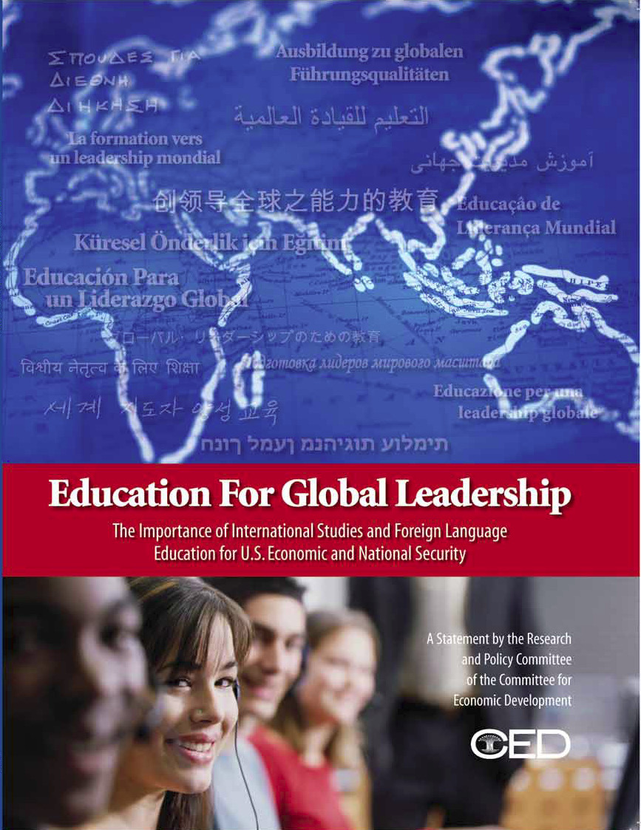

Slide 10


Slide 11
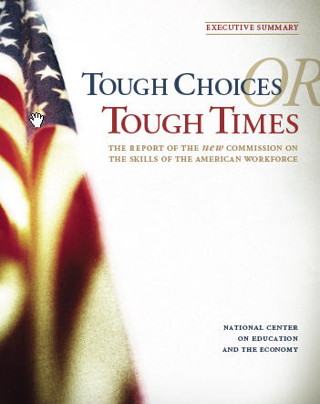
Notes:
New Commission on the Skills of the American Workforce
It is becoming progressively less expensive to automate functions that used to be performed by people. As the cost of labor rises and the cost of automating jobs continues to fall, it becomes both possible and necessary for firms simply to eliminate job after job now being done by humans. Earlier, almost all the jobs subject to automation were low-skill jobs. That is no longer true. Now it is more accurate to say that the jobs that are most vulnerable are the jobs involving routine work. If someone can figure out the algorithm for a routine job, chances are that it is economical to automate it. Many good, well-paying, middle-class jobs involve routine work of this kind and are rapidly being automated. [Think tax preparers, lawyers… being replaced by software]

Slide 12
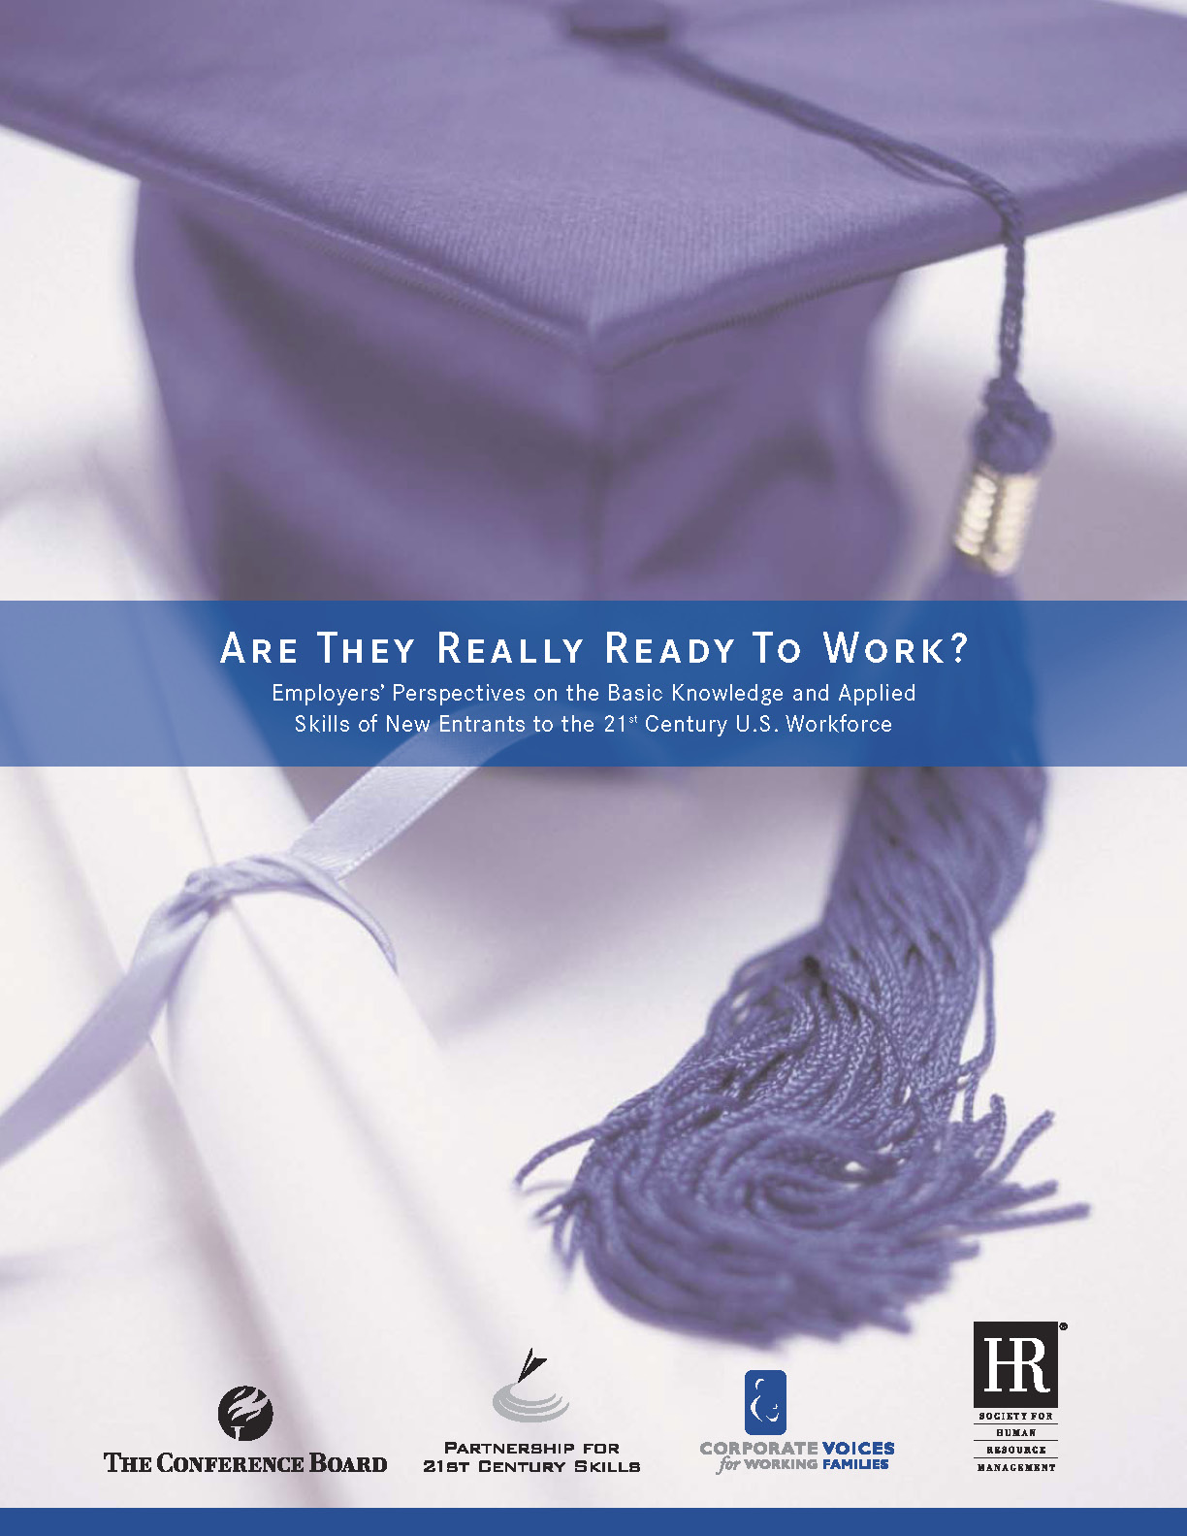

Slide 13


Slide 14


Slide 15


Slide 16
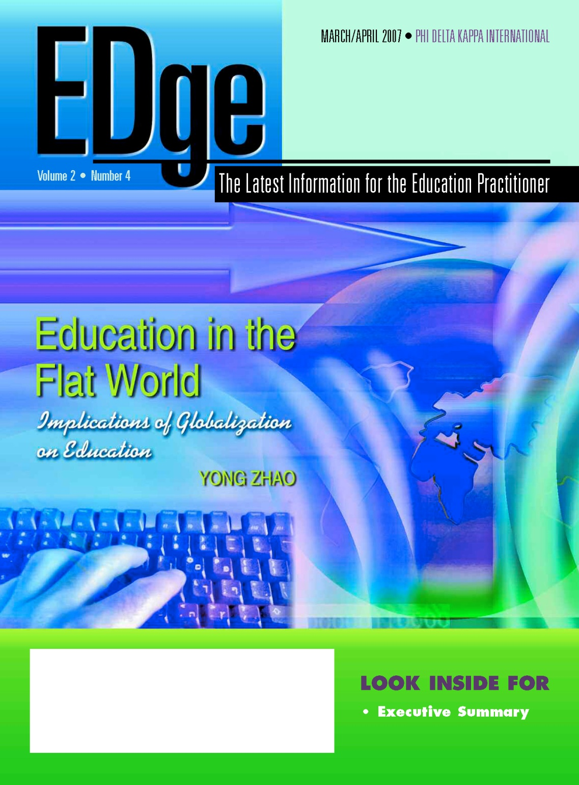

Slide 17
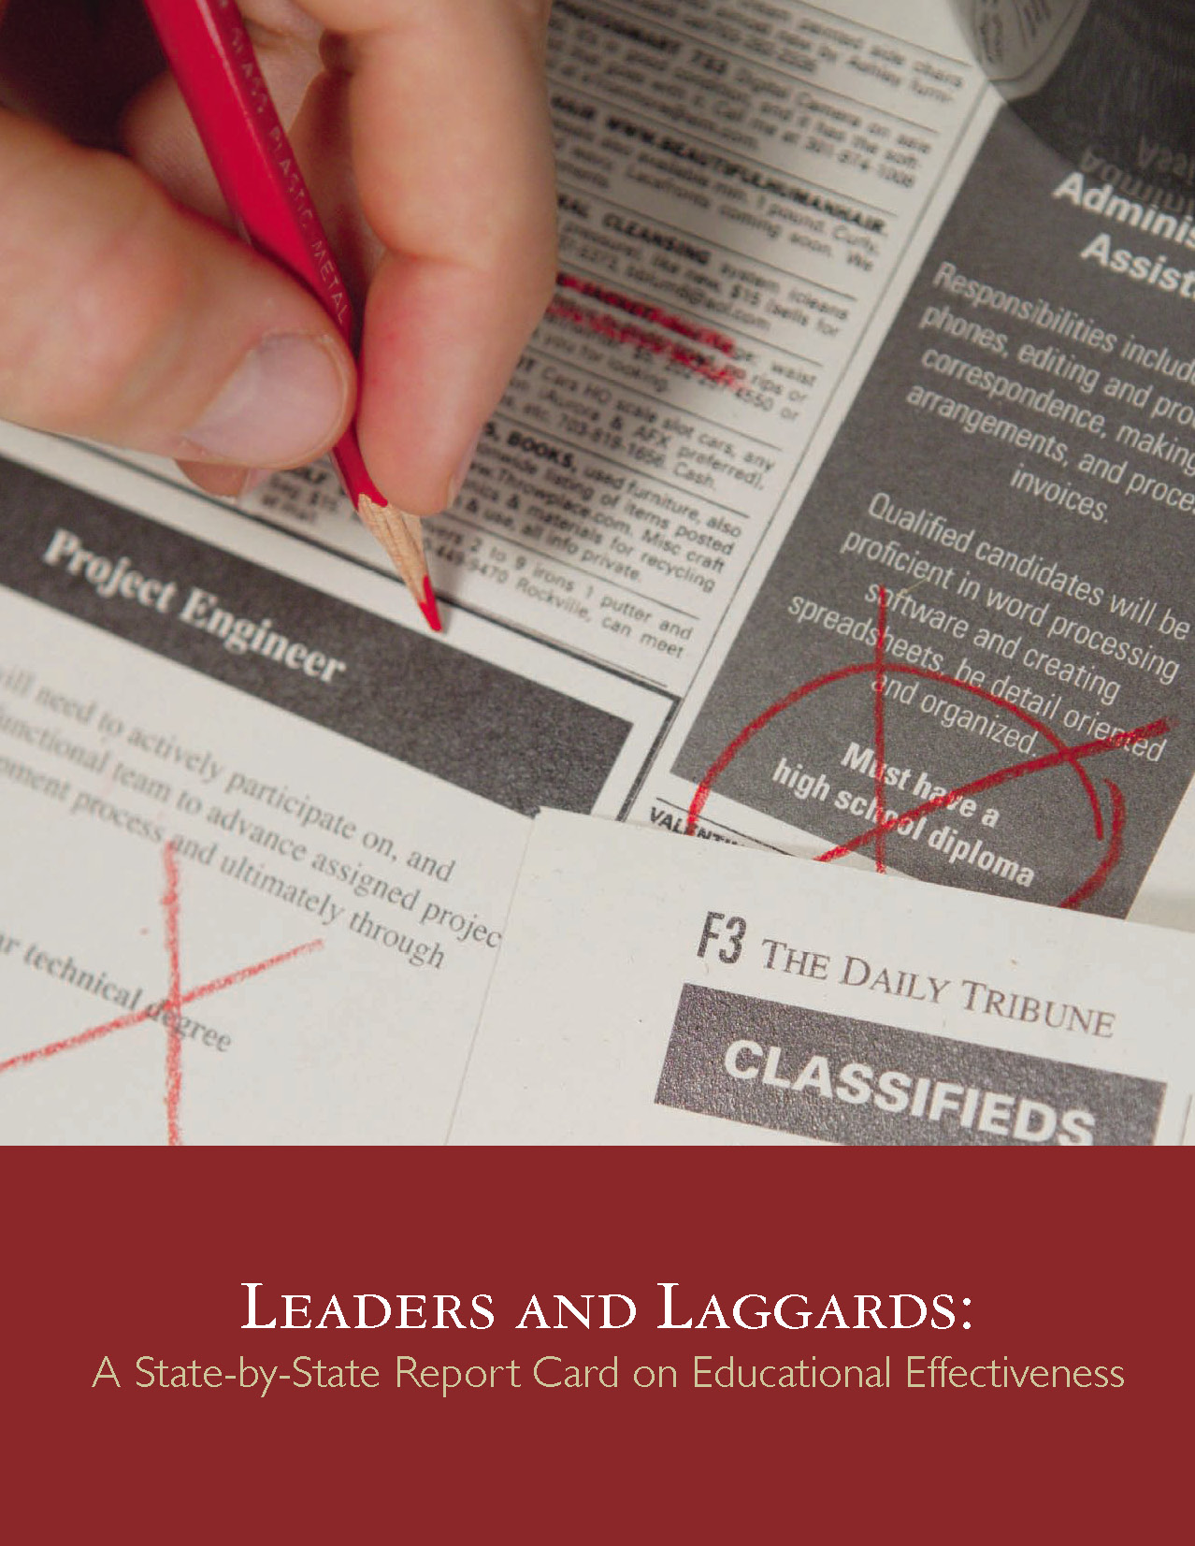
Notes:
After report…
have come to the same conclusion: our schools are not up to snuff.
2005 – Bill Gates - America's high schools are obsolete. By obsolete, I don't just mean that our high schools are broken, flawed, and under-funded--though a case could be made for every one of those points. By obsolete, I mean that our high schools--even when they're working exactly as designed--cannot teach our kids what they need to know today. This isn't an accident or a flaw in the system; it is the system.
Today, most jobs that allow you to support a family require some postsecondary education. This could mean a four-year college, a community college, or technical school. Unfortunately, only half of all students who enter high school ever enroll in a postsecondary institution. That means that half of all students starting high school today are unlikely to get a job that allows them to support a family.
Our high schools were designed fifty years ago to meet the needs of another age. Until we design them to meet the needs of this century, we will keep limiting--even ruining--the lives of millions of Americans every year.

Slide 18
What we have right now
uniqueness
uniqueness
one right answer
Notes:
18

Slide 19

Notes:
19

Slide 20


Slide 21

Notes:
21
- not entirely educators’ fault – the system is the issue – governed by an essential 19th century paradigm – one that was appropriate for our grandparents but not our children and grandchildren

Slide 22

Notes:
22

Slide 23

Notes:
For the past five years, the national conversation on education has focused on reading scores, math tests and closing the "achievement gap" between social classes. This is not a story about that conversation.
This is a story about the big public conversation the nation is not having about education, the one that will ultimately determine not merely whether some fraction of our children get "left behind" but also whether an entire generation of kids will fail to make the grade in the global economy because they can't think their way through abstract problems, work in teams, distinguish good information from bad or speak a language other than English.

Slide 24

While we teach whatever we teach at school, the kids go home and learn the skills they need to survive and prosper in an interconnected global economy.
Clarence Fisher
Notes:
As a result…
http://remoteaccess.typepad.com/remote_access/2005/11/educational_lea.html
Incrementally changing our teaching methods, slowly bringing people up to speed . . . worked fine when ideas of literacy and education were not rapidly changing; but they are. We need to be able to leapfrog in our understandings, in our methods, and in our tools, allowing us to move to where the kids are. If we do not become leaders to our students, we will be followers, seen as irrelevant, and left to cry in our books.

Slide 25

No generation in history has ever been so
thoroughly prepared for the industrial age.
David Warlick
http://davidwarlick.com/2cents/?p=298
dangerouslyirrelevant.org
Notes:
We desperately need . . . we may not survive without . . . a generation of young people who are imaginative, inventive, fearless learners, and compassionate leaders. Yet, what can we say, as educators, about the students we are producing? We can prove that they can read, do basic math on paper, and they are able to sit for hours filling in bubble sheets.
http://davidwarlick.com/2cents/?p=298

Slide 26


Slide 27
120 119 118 117 116 115 114 113 112 111
110 109 108 107 106 105 104 103 102 101
100 99 98 97 96 95 94 93 92 91
90 89 88 87 86 85 84 83 82 81
80 79 78 77 76 75 74 73 72 71
70 69 68 67 66 65 64 63 62 61
60

Slide 28
60 59 58 57 56 55 54 53 52 51
50 49 48 47 46 45 44 43 42 41
40 39 38 37 36 35 34 33 32 31
30 29 28 27 26 25 24 23 22 21
20 19 18 17 16 15 14 13 12 11
10 9 8 7 6 5 4 3 2 1

Slide 29
ACT 5
Time to
get moving!

Slide 30
  Insist on a different kind of curriculum (and assessment)
Notes:
New Commission on the Skills of the American Workforce
It is becoming progressively less expensive to automate functions that used to be performed by people. As the cost of labor rises and the cost of automating jobs continues to fall, it becomes both possible and necessary for firms simply to eliminate job after job now being done by humans. Earlier, almost all the jobs subject to automation were low-skill jobs. That is no longer true. Now it is more accurate to say that the jobs that are most vulnerable are the jobs involving routine work. If someone can figure out the algorithm for a routine job, chances are that it is economical to automate it. Many good, well-paying, middle-class jobs involve routine work of this kind and are rapidly being automated. [Think tax preparers, lawyers… being replaced by software]
Daniel Pink
If you say yes to 1 or 2, or no to 3, you’re in trouble
Forging relationship rather than executing transactions
Tackling novel, complex challenges instead of solving routine problems
Synthesizing and connecting disparate parts, thus creating or adding value
The capacity to detect patterns and opportunities, to combine seemingly unrelated ideas into something new, to craft a satisfying narrative, to create artistic and emotional beauty
Creativity is the ultimate economic resource. The ability to come up with new ideas and better ways of doing things is ultimately what raises productivity and thus living standards. In virtually every industry, the winners in the long run are those who can create and keep creating. This has always been true.
As we have moved from an agricultural age to an industrial age to an information age, our primary economic resource no longer is raw materials from the ground or human labor. We have to recognize that information is now the primary and most lucrative raw material.

Slide 31
global awareness
effective speaking
critical thinking
problem solving
adaptability
information literacy
collaboration
creativity
media fluency
analytical skills
entrepeneurialism
innovation
effective writing
synthesis
curiosity
Notes:
1. critical thinking and problem solving in networks of cross-functional teams
world is complex and answers are not in the books
world is moving too fast for inflexible, hierarchical organizations
2. collaboration across networks and leadership by influence rather than positional authority
command and control increasingly less valued in organizations
schools are very much command and control institutions
3. agility and adaptability
intensifying rate of change, overwhelming amount of data, increasing complexity of problems
4. initiative and entrepeneurialism
people who can seek out new opportunities, ideas, and strategies
don’t want students or workers who are apathetic about their experiences
achievement orientation, drive for results, self-starters
5. effective written and oral communication
presentation skills, being clear and concise; creating focus, energy, and passion around the points they want to make
6. accessing and analyzing information
people who can access, evaluate, conceptualize, and synthesize multiple and large streams of incoming information to make meaningful decisions
7. curiosity and imagination
inquisitiveness, analytical skills that are more ‘out of the box’ than in the past, asking great questions is more important than knowing the ‘right answer’

Slide 32
  Insist on a different kind of curriculum (and assessment)
  Insist on a different kind of instruction
Notes:
New Commission on the Skills of the American Workforce
It is becoming progressively less expensive to automate functions that used to be performed by people. As the cost of labor rises and the cost of automating jobs continues to fall, it becomes both possible and necessary for firms simply to eliminate job after job now being done by humans. Earlier, almost all the jobs subject to automation were low-skill jobs. That is no longer true. Now it is more accurate to say that the jobs that are most vulnerable are the jobs involving routine work. If someone can figure out the algorithm for a routine job, chances are that it is economical to automate it. Many good, well-paying, middle-class jobs involve routine work of this kind and are rapidly being automated. [Think tax preparers, lawyers… being replaced by software]
Daniel Pink
If you say yes to 1 or 2, or no to 3, you’re in trouble
Forging relationship rather than executing transactions
Tackling novel, complex challenges instead of solving routine problems
Synthesizing and connecting disparate parts, thus creating or adding value
The capacity to detect patterns and opportunities, to combine seemingly unrelated ideas into something new, to craft a satisfying narrative, to create artistic and emotional beauty
Creativity is the ultimate economic resource. The ability to come up with new ideas and better ways of doing things is ultimately what raises productivity and thus living standards. In virtually every industry, the winners in the long run are those who can create and keep creating. This has always been true.
As we have moved from an agricultural age to an industrial age to an information age, our primary economic resource no longer is raw materials from the ground or human labor. We have to recognize that information is now the primary and most lucrative raw material.

Slide 33
student
engagement
elementary school
high school
Notes:
Student learning curiosity / engagement with content

Slide 34

www.flickr.com/photos/jahansell/251755048
dangerouslyirrelevant.org
Our kids have tasted the honey.
Notes:
Licensed under a Creative Commons attribution-share alike license.
http://creativecommons.org/licenses/by-sa/3.0
Scott McLeod, J.D., Ph.D.
scottmcleod.net/contact
dangerouslyirrelevant.org
schooltechleadership.org
Our kids have tasted the honey.
www.flickr.com/photos/jahansell/251755048

Slide 35
  Insist on a different kind of curriculum (and assessment)
  Insist on a different kind of instruction
  Advocate for e-learning
Notes:
New Commission on the Skills of the American Workforce
It is becoming progressively less expensive to automate functions that used to be performed by people. As the cost of labor rises and the cost of automating jobs continues to fall, it becomes both possible and necessary for firms simply to eliminate job after job now being done by humans. Earlier, almost all the jobs subject to automation were low-skill jobs. That is no longer true. Now it is more accurate to say that the jobs that are most vulnerable are the jobs involving routine work. If someone can figure out the algorithm for a routine job, chances are that it is economical to automate it. Many good, well-paying, middle-class jobs involve routine work of this kind and are rapidly being automated. [Think tax preparers, lawyers… being replaced by software]
Daniel Pink
If you say yes to 1 or 2, or no to 3, you’re in trouble
Forging relationship rather than executing transactions
Tackling novel, complex challenges instead of solving routine problems
Synthesizing and connecting disparate parts, thus creating or adding value
The capacity to detect patterns and opportunities, to combine seemingly unrelated ideas into something new, to craft a satisfying narrative, to create artistic and emotional beauty
Creativity is the ultimate economic resource. The ability to come up with new ideas and better ways of doing things is ultimately what raises productivity and thus living standards. In virtually every industry, the winners in the long run are those who can create and keep creating. This has always been true.
As we have moved from an agricultural age to an industrial age to an information age, our primary economic resource no longer is raw materials from the ground or human labor. We have to recognize that information is now the primary and most lucrative raw material.

Slide 36


Slide 37
  A computer in every hand
Notes:
New Commission on the Skills of the American Workforce
It is becoming progressively less expensive to automate functions that used to be performed by people. As the cost of labor rises and the cost of automating jobs continues to fall, it becomes both possible and necessary for firms simply to eliminate job after job now being done by humans. Earlier, almost all the jobs subject to automation were low-skill jobs. That is no longer true. Now it is more accurate to say that the jobs that are most vulnerable are the jobs involving routine work. If someone can figure out the algorithm for a routine job, chances are that it is economical to automate it. Many good, well-paying, middle-class jobs involve routine work of this kind and are rapidly being automated. [Think tax preparers, lawyers… being replaced by software]
Daniel Pink
If you say yes to 1 or 2, or no to 3, you’re in trouble
Forging relationship rather than executing transactions
Tackling novel, complex challenges instead of solving routine problems
Synthesizing and connecting disparate parts, thus creating or adding value
The capacity to detect patterns and opportunities, to combine seemingly unrelated ideas into something new, to craft a satisfying narrative, to create artistic and emotional beauty
Creativity is the ultimate economic resource. The ability to come up with new ideas and better ways of doing things is ultimately what raises productivity and thus living standards. In virtually every industry, the winners in the long run are those who can create and keep creating. This has always been true.
As we have moved from an agricultural age to an industrial age to an information age, our primary economic resource no longer is raw materials from the ground or human labor. We have to recognize that information is now the primary and most lucrative raw material.

Slide 38

Notes:
Technology needs to be like oxygen. Ubiquitous, necessary, and invisible.
- Chris Lehmann

Slide 39


Slide 40


Slide 41


Slide 42
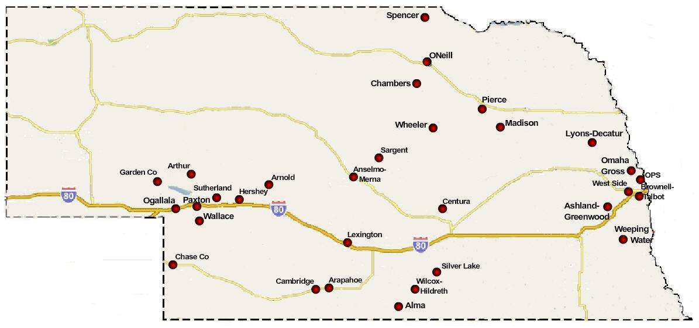

Slide 43
  A computer in every hand
  Focus on leaders, not just students and teachers
Notes:
New Commission on the Skills of the American Workforce
It is becoming progressively less expensive to automate functions that used to be performed by people. As the cost of labor rises and the cost of automating jobs continues to fall, it becomes both possible and necessary for firms simply to eliminate job after job now being done by humans. Earlier, almost all the jobs subject to automation were low-skill jobs. That is no longer true. Now it is more accurate to say that the jobs that are most vulnerable are the jobs involving routine work. If someone can figure out the algorithm for a routine job, chances are that it is economical to automate it. Many good, well-paying, middle-class jobs involve routine work of this kind and are rapidly being automated. [Think tax preparers, lawyers… being replaced by software]
Daniel Pink
If you say yes to 1 or 2, or no to 3, you’re in trouble
Forging relationship rather than executing transactions
Tackling novel, complex challenges instead of solving routine problems
Synthesizing and connecting disparate parts, thus creating or adding value
The capacity to detect patterns and opportunities, to combine seemingly unrelated ideas into something new, to craft a satisfying narrative, to create artistic and emotional beauty
Creativity is the ultimate economic resource. The ability to come up with new ideas and better ways of doing things is ultimately what raises productivity and thus living standards. In virtually every industry, the winners in the long run are those who can create and keep creating. This has always been true.
As we have moved from an agricultural age to an industrial age to an information age, our primary economic resource no longer is raw materials from the ground or human labor. We have to recognize that information is now the primary and most lucrative raw material.

Slide 44

Notes:
Anticipatory v. reactionary

Slide 45

Notes:
Future oriented v. compliance oriented

Slide 46

The people in charge
of leading school
organizations into the
21st century …
often are the
least knowledgeable
about the 21st century.
dangerouslyirrelevant.org
Notes:
Licensed under a Creative Commons attribution-share alike license.
http://creativecommons.org/licenses/by-sa/3.0
Scott McLeod, J.D., Ph.D.
scottmcleod.net/contact
dangerouslyirrelevant.org
schooltechleadership.org

Slide 47

If the leaders
don’t get it,
it’s not going
to happen.
dangerouslyirrelevant.org
Notes:
Licensed under a Creative Commons attribution-share alike license.
http://creativecommons.org/licenses/by-sa/3.0
Scott McLeod, J.D., Ph.D.
scottmcleod.net/contact
dangerouslyirrelevant.org
schooltechleadership.org

Slide 48
  A computer in every hand
  Focus on leaders, not just students and teachers
  Revolution, not evolution
Notes:
New Commission on the Skills of the American Workforce
It is becoming progressively less expensive to automate functions that used to be performed by people. As the cost of labor rises and the cost of automating jobs continues to fall, it becomes both possible and necessary for firms simply to eliminate job after job now being done by humans. Earlier, almost all the jobs subject to automation were low-skill jobs. That is no longer true. Now it is more accurate to say that the jobs that are most vulnerable are the jobs involving routine work. If someone can figure out the algorithm for a routine job, chances are that it is economical to automate it. Many good, well-paying, middle-class jobs involve routine work of this kind and are rapidly being automated. [Think tax preparers, lawyers… being replaced by software]
Daniel Pink
If you say yes to 1 or 2, or no to 3, you’re in trouble
Forging relationship rather than executing transactions
Tackling novel, complex challenges instead of solving routine problems
Synthesizing and connecting disparate parts, thus creating or adding value
The capacity to detect patterns and opportunities, to combine seemingly unrelated ideas into something new, to craft a satisfying narrative, to create artistic and emotional beauty
Creativity is the ultimate economic resource. The ability to come up with new ideas and better ways of doing things is ultimately what raises productivity and thus living standards. In virtually every industry, the winners in the long run are those who can create and keep creating. This has always been true.
As we have moved from an agricultural age to an industrial age to an information age, our primary economic resource no longer is raw materials from the ground or human labor. We have to recognize that information is now the primary and most lucrative raw material.

Slide 49

Notes:
We need to somehow
change faster
No one jumps a 20 foot chasm in two
10 foot jumps. – Miguel Guhlin
When the world changes so fast that we have no reasonable way to forecast what it will look like in a mere decade or two, all we can do is teach kids how to be adaptive – to be learners in the truest sense of the word –
We’ve always talked about preparing lifelong learners in schools, but our practices typically haven’t matched our rhetoric. It’s time to put some bite into our toothless vision statements and recognize that we have to teach kids how to learn to learn if they want to be successful in this new technology-suffused, globally-interconnected world
Credits: http://tinyurl.com/2urbsm and http://tinyurl.com/37em64 (see Guhlin comment)
http://remoteaccess.typepad.com/remote_access/
2006/06/literacy_as_bat.html (see Guhlin comment)
http://headrush.typepad.com/creating_passionate_users/2005/03/incremental_vs_.html

Slide 50

dangerouslyirrelevant.org
No one jumps a
20 foot chasm
in two
10 foot jumps.
Miguel Guhlin
http://www.flickr.com/photos/midnight-digital/3086238863/in/pool-jumping
Notes:
Licensed under a Creative Commons attribution-share alike license.
http://creativecommons.org/licenses/by-sa/3.0
Scott McLeod, J.D., Ph.D.
scottmcleod.net/contact
dangerouslyirrelevant.org
schooltechleadership.org
http://www.flickr.com/photos/midnight-digital/3086238863/in/pool-jumping
http://remoteaccess.typepad.com/remote_access/2006/06/literacy_as_bat.html

Slide 51
  Inform yourself
Notes:
New Commission on the Skills of the American Workforce
It is becoming progressively less expensive to automate functions that used to be performed by people. As the cost of labor rises and the cost of automating jobs continues to fall, it becomes both possible and necessary for firms simply to eliminate job after job now being done by humans. Earlier, almost all the jobs subject to automation were low-skill jobs. That is no longer true. Now it is more accurate to say that the jobs that are most vulnerable are the jobs involving routine work. If someone can figure out the algorithm for a routine job, chances are that it is economical to automate it. Many good, well-paying, middle-class jobs involve routine work of this kind and are rapidly being automated. [Think tax preparers, lawyers… being replaced by software]
Daniel Pink
If you say yes to 1 or 2, or no to 3, you’re in trouble
Forging relationship rather than executing transactions
Tackling novel, complex challenges instead of solving routine problems
Synthesizing and connecting disparate parts, thus creating or adding value
The capacity to detect patterns and opportunities, to combine seemingly unrelated ideas into something new, to craft a satisfying narrative, to create artistic and emotional beauty
Creativity is the ultimate economic resource. The ability to come up with new ideas and better ways of doing things is ultimately what raises productivity and thus living standards. In virtually every industry, the winners in the long run are those who can create and keep creating. This has always been true.
As we have moved from an agricultural age to an industrial age to an information age, our primary economic resource no longer is raw materials from the ground or human labor. We have to recognize that information is now the primary and most lucrative raw material.

Slide 52
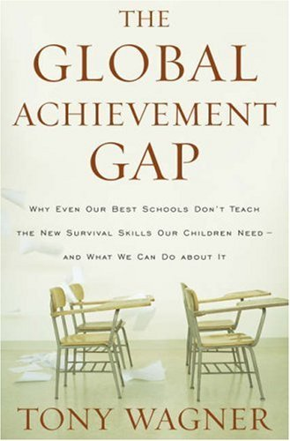

Slide 53
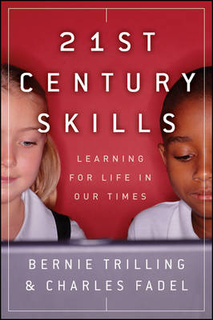

Slide 54
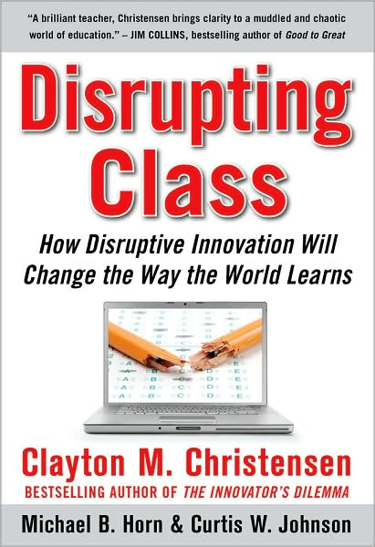

Slide 55


Slide 56
  Inform yourself
  Ask (and be ready for) questions
Notes:
New Commission on the Skills of the American Workforce
It is becoming progressively less expensive to automate functions that used to be performed by people. As the cost of labor rises and the cost of automating jobs continues to fall, it becomes both possible and necessary for firms simply to eliminate job after job now being done by humans. Earlier, almost all the jobs subject to automation were low-skill jobs. That is no longer true. Now it is more accurate to say that the jobs that are most vulnerable are the jobs involving routine work. If someone can figure out the algorithm for a routine job, chances are that it is economical to automate it. Many good, well-paying, middle-class jobs involve routine work of this kind and are rapidly being automated. [Think tax preparers, lawyers… being replaced by software]
Daniel Pink
If you say yes to 1 or 2, or no to 3, you’re in trouble
Forging relationship rather than executing transactions
Tackling novel, complex challenges instead of solving routine problems
Synthesizing and connecting disparate parts, thus creating or adding value
The capacity to detect patterns and opportunities, to combine seemingly unrelated ideas into something new, to craft a satisfying narrative, to create artistic and emotional beauty
Creativity is the ultimate economic resource. The ability to come up with new ideas and better ways of doing things is ultimately what raises productivity and thus living standards. In virtually every industry, the winners in the long run are those who can create and keep creating. This has always been true.
As we have moved from an agricultural age to an industrial age to an information age, our primary economic resource no longer is raw materials from the ground or human labor. We have to recognize that information is now the primary and most lucrative raw material.

Slide 57
What are you doing to prepare students to be successful in the digital, global age?

Slide 58
Why do students do so
much of their work on paper?

Slide 59

dangerouslyirrelevant.org
Given the realities of our modern age and the demands of our children's future, is it really okay to allow teachers to choose whether or not they incorporate digital technologies into their instruction?
Notes:
Licensed under a Creative Commons attribution-share alike license.
http://creativecommons.org/licenses/by-sa/3.0
Scott McLeod, J.D., Ph.D.
scottmcleod.net/contact
dangerouslyirrelevant.org
schooltechleadership.org

Slide 60
How much time per week
does the average student
get to utilize higher-level
thinking skills as part of
his or her learning?

Slide 61
How much time per week
does the average student
get to utilize digital
technologies as part of
his or her learning?

Slide 62
The world has changed.
Why haven’t our schools?

Slide 63
  Inform yourself
  Ask (and be ready for) questions
  Invest now or pay later
Notes:
New Commission on the Skills of the American Workforce
It is becoming progressively less expensive to automate functions that used to be performed by people. As the cost of labor rises and the cost of automating jobs continues to fall, it becomes both possible and necessary for firms simply to eliminate job after job now being done by humans. Earlier, almost all the jobs subject to automation were low-skill jobs. That is no longer true. Now it is more accurate to say that the jobs that are most vulnerable are the jobs involving routine work. If someone can figure out the algorithm for a routine job, chances are that it is economical to automate it. Many good, well-paying, middle-class jobs involve routine work of this kind and are rapidly being automated. [Think tax preparers, lawyers… being replaced by software]
Daniel Pink
If you say yes to 1 or 2, or no to 3, you’re in trouble
Forging relationship rather than executing transactions
Tackling novel, complex challenges instead of solving routine problems
Synthesizing and connecting disparate parts, thus creating or adding value
The capacity to detect patterns and opportunities, to combine seemingly unrelated ideas into something new, to craft a satisfying narrative, to create artistic and emotional beauty
Creativity is the ultimate economic resource. The ability to come up with new ideas and better ways of doing things is ultimately what raises productivity and thus living standards. In virtually every industry, the winners in the long run are those who can create and keep creating. This has always been true.
As we have moved from an agricultural age to an industrial age to an information age, our primary economic resource no longer is raw materials from the ground or human labor. We have to recognize that information is now the primary and most lucrative raw material.

Slide 64

No one will thank you
for taking care of today
if you have failed
to take care of tomorrow.
Joel Barker

Slide 65
Final thoughts

Slide 66


Slide 67


Slide 68


Slide 69

Notes:
69
We can’t be refugees
We have to be honest with ourselves
- most teachers and administrators (and professors) are refugees when it comes to most of this
- not worth the time investment to learn
- satisfied with the status quo

Slide 70


Slide 71


Slide 72


Slide 73

Notes:
73

Slide 74
Thank you!
Scott McLeod, J.D., Ph.D.
Director, CASTLE
dangerouslyirrelevant.org/nebraska.html
Notes:
74
URL

Slide 75
120 119 118 117 116 115 114 113 112 111
110 109 108 107 106 105 104 103 102 101
100 99 98 97 96 95 94 93 92 91
90 89 88 87 86 85 84 83 82 81
80 79 78 77 76 75 74 73 72 71
70 69 68 67 66 65 64 63 62 61
60

Slide 76
60 59 58 57 56 55 54 53 52 51
50 49 48 47 46 45 44 43 42 41
40 39 38 37 36 35 34 33 32 31
30 29 28 27 26 25 24 23 22 21
20 19 18 17 16 15 14 13 12 11
10 9 8 7 6 5 4 3 2 1

Slide 77
dangerouslyirrelevant.org/ nebraska.html

Slide 78


Slide 79

CHANGE
OR DIE

