Slide 1
uceacastle.wikispaces.com/ saitraining
Say hi to your neighbor!

Slide 2

The information society is HERE
Are you ready?
Dr. Scott McLeod
CASTLE
Notes:
Good morning. My name is Dr. Scott McLeod. I’m coordinator of the educational administration at Iowa State University. I used to be at the University of Minnesota. I’m also the Director of CASTLE, the only university center in the country dedicated to the technology leadership needs of school administrators.
Today I’m going to talk to you about schools.

Slide 3
What impact have the Internet and other technologies had on … news, newspapers, magazines?

Slide 4
What impact have the Internet and other technologies had on … banking, money management, personal finance?

Slide 5
What impact have the Internet and other technologies had on … television, movies, video?

Slide 6
What impact have the Internet and other technologies had on … maps, car/airline travel, travel agencies?

Slide 7
What impact have the Internet and other technologies had on … music, records, CDs, radio?

Slide 8
What impact have the Internet and other technologies had on … medicine, personal health?

Slide 9
What impact have the Internet and other technologies had on … reading, books?

Slide 10
What impact have the Internet and other technologies had on … how we connect, network, communicate with each other?

Slide 11
What impact have the Internet and other technologies had on … universities?

Slide 12
What impact have the Internet and other technologies had on … K-12 schools?

Slide 13


Slide 14
ACT 1
Our tools have changed

Slide 15
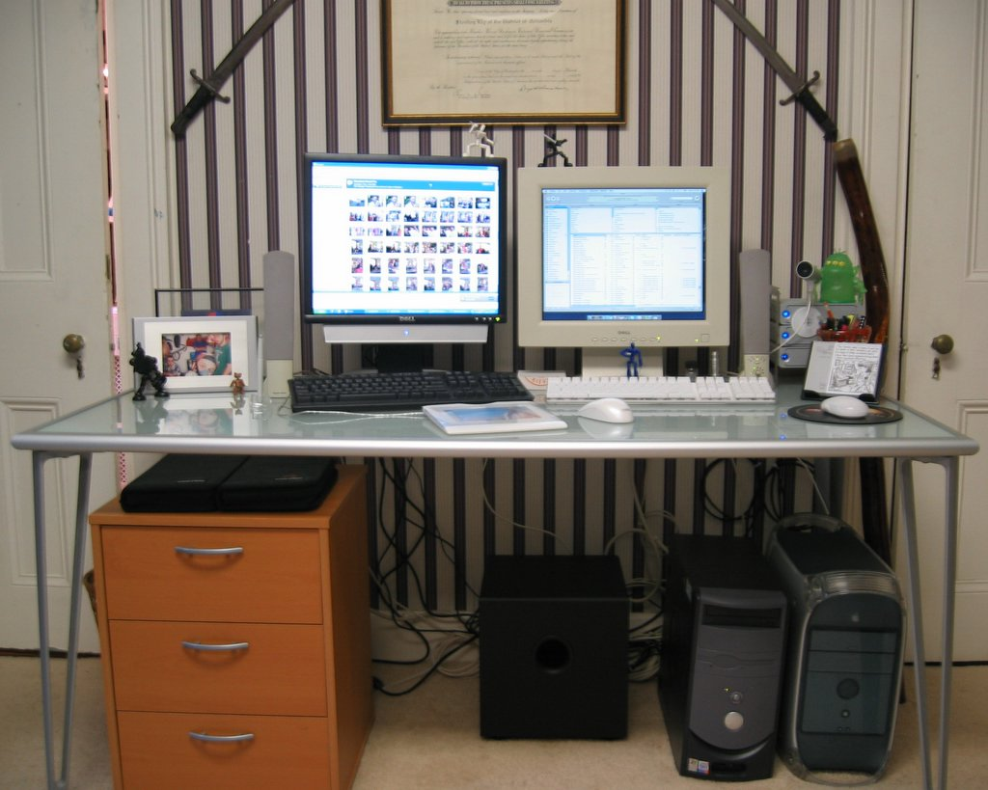

Slide 16
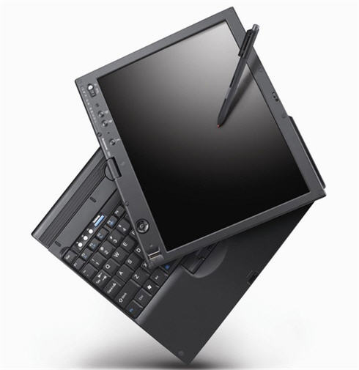

Slide 17

Notes:
Talking went digital.
On the personal level, we now carry around portable little computers (also known as cell phones) that not only let us talk to anyone in the world but also can send text messages, photographs, and videos. They also can hold our calendar, contacts, and music that we like to listen to. All in our pocket.
Hands up – how many of you own a cell phone?
http://www.flickr.com/photos/davyrocket/82339986/
How many of you have heard of a service called Jott that lets you can send yourself an e-mail reminder simply by calling and talking into the phone?

Slide 18
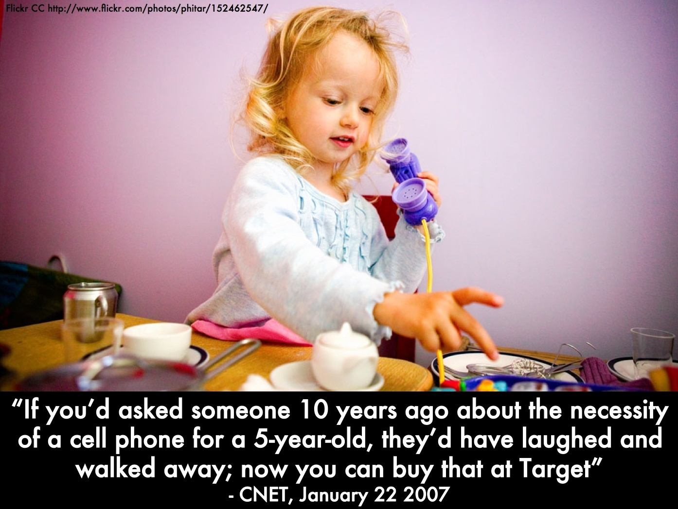

Slide 19
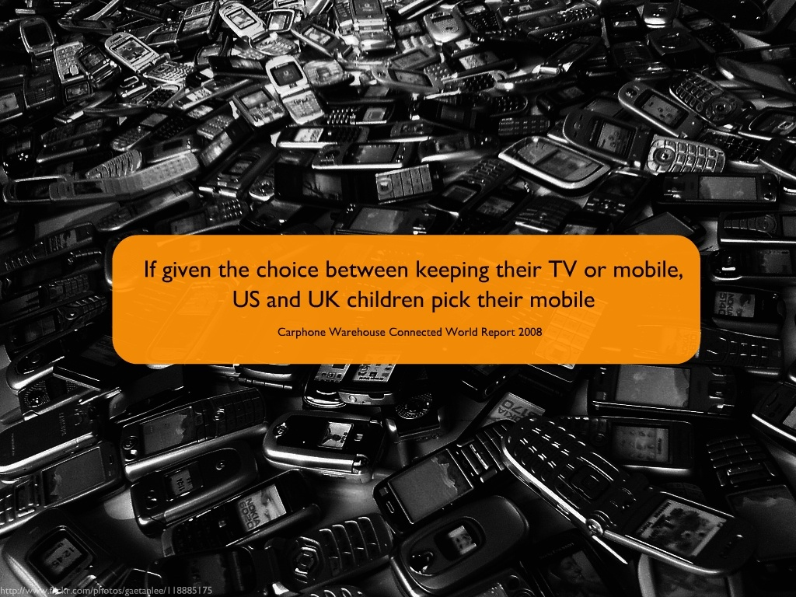

Slide 20
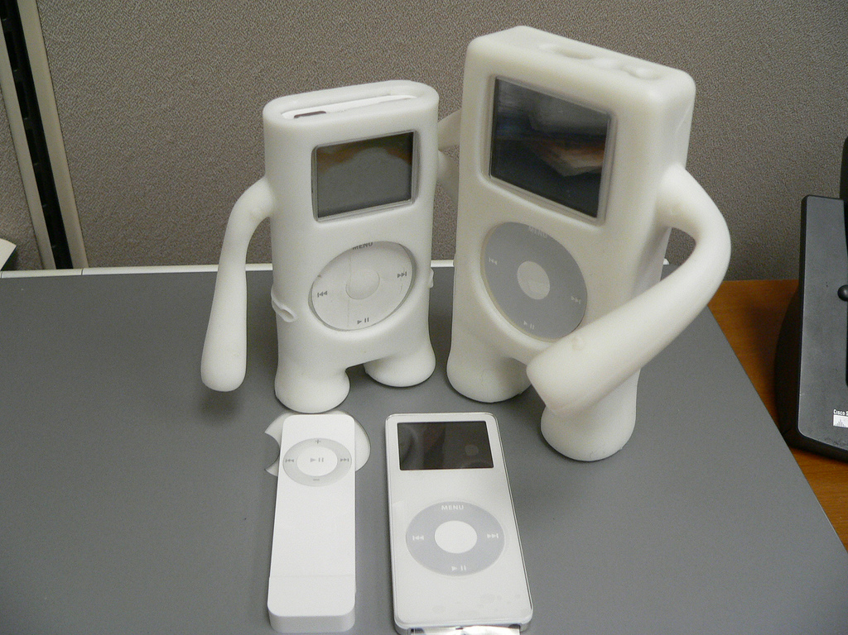
Notes:
Music went digital.
Many of us have iPods or other portable music devices that let us carry around a lifetime’s worth of music. And, again, they fit in our pocket or purse.
And, in addition to being both wonderfully useful and kinda cool, these little devices also are making us completely rethink a number of issues related to intellectual property and copyright.
Hands up – how many of you own an iPod or other kind of portable music player?
http://www.flickr.com/photos/zengame/42914294/sizes/l/

Slide 21
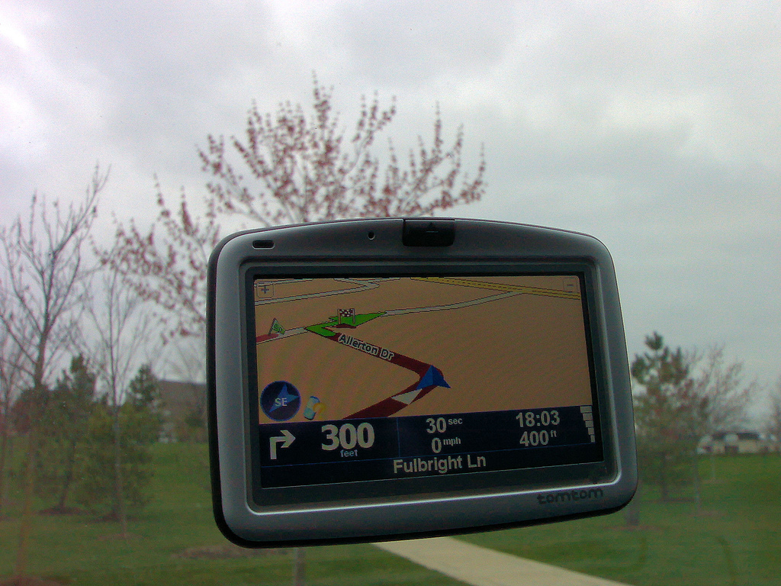
Notes:
Maps went digital.
For a few hundred dollars, we can buy a portable GPS unit and never have to get lost again.
Hands up – how many of you own a GPS unit?
http://www.flickr.com/photos/soumit/450204342/in/photostream/
http://www.flickr.com/photos/mdumlao98/976279763/

Slide 22

Notes:
Photos went digital.
The world of photography has been completely upended in the past couple of decades, as digital cameras infiltrate both the personal and professional realms.
Hands up – how many of you own a digital camera? Those of you who do know the affordances they lend us over regular film photography.
http://www.flickr.com/photos/parl/89822733/
http://www.flickr.com/photos/dhammza/140868495/
http://www.flickr.com/photos/purprin/2070805989/

Slide 23

Notes:
Movies went digital.
Like the digital camera, the digital camcorder also is replacing earlier, often bulky versions, allowing individuals to capture video wherever they might be.
http://www.flickr.com/photos/oldonliner/1571194587/
http://www.flickr.com/photos/checiap/164147687/

Slide 24
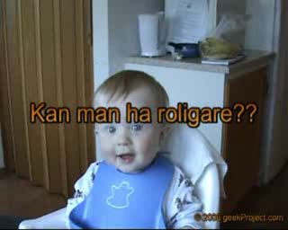
Notes:
And there’s YouTube, now the #3 place on the Web. About 1 in 6 Internet users has visited YouTube in the past 24 hours.
Just ask Judson Laipply, a previously obscure comedian from Cleveland, what it’s done to his career to have his Evolution of Dance routine viewed by over 80 million people. Most major television and film production channels, faced with declining viewership, are trying to establish a YouTube presence.
Hands up – how many of you have watched a video on YouTube? uploaded a video to YouTube?
We now live in a world where a comedian from Cleveland can be viewed by over 50 million people…
hahaha 17 million people
hey 15 million people
ever watched?
ever uploaded?
YouTube is now the #2 most-visited site on the Internet – ahead of Google
Not bad for a company that barely existed 2 years ago
As the Alexa trend graph shows, the percentage of global Internet users who visited YouTube yesterday is nearly 15%. This means that about 1 in 7 Internet users across the globe visited YouTube in the past 24 hours.
The only sites more popular than YouTube are Yahoo, MSN.com, and Google.

Slide 25


Notes:
And then there’s Facebook and MySpace, which are the #5 and #7 places on the Web, respectively. Why? Because they do one thing extremely well – they allow us to connect with each other in ways that we find meaningful and engaging.
Hands up – how many of you belong to MySpace, Facebook, or some other social networking site?
http://www.alexa.com/site/ds/top_sites?ts_mode=global&lang=none

Slide 26


Slide 27


Slide 28
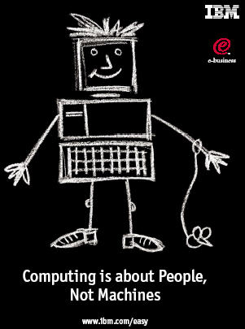
Notes:
But ultimately it is about empowerment. The reason these technologies are going like wildfire is because they allow people to be more efficient, to be more effective, to do things they want to do, and to do things they never could before.
Collaboration
Creativity
Disintermediation
Reach
Putting the power in the hands of the users
Technology allows us to communicate and collaborate with folks halfway across the globe just about as easily as we can the folks across town
Just like the printing press ushered in a new era where the general population could afford to be literate, to read, we are seeing similar transformations today
No longer need to be a publishing company to publish a book
Record studio to create a hit song or album
Movie studio to create a hit movie or music video
- Digital cameras, camcorders, software – a few hundred dollars, an Internet connection, and an idea and you’re all set
Disintermediation – tools are there that allow us to bypass the “middle man” – used to have to rely on publishers, record companies, movie studios, etc. to reach our audience – now we can reach them directly and they can find us through search engines, video hosting sites, tags, etc.
Not only can we reach them by bypassing traditional entities – we can reach them in the thousands, hundreds of thousands, millions

Slide 29
120 119 118 117 116 115 114 113 112 111
110 109 108 107 106 105 104 103 102 101
100 99 98 97 96 95 94 93 92 91
90 89 88 87 86 85 84 83 82 81
80 79 78 77 76 75 74 73 72 71
70 69 68 67 66 65 64 63 62 61
60

Slide 30
60 59 58 57 56 55 54 53 52 51
50 49 48 47 46 45 44 43 42 41
40 39 38 37 36 35 34 33 32 31
30 29 28 27 26 25 24 23 22 21
20 19 18 17 16 15 14 13 12 11
10 9 8 7 6 5 4 3 2 1

Slide 31
ACT 2
Information has changed

Slide 32


Slide 33

Notes:
33

Slide 34


Slide 35
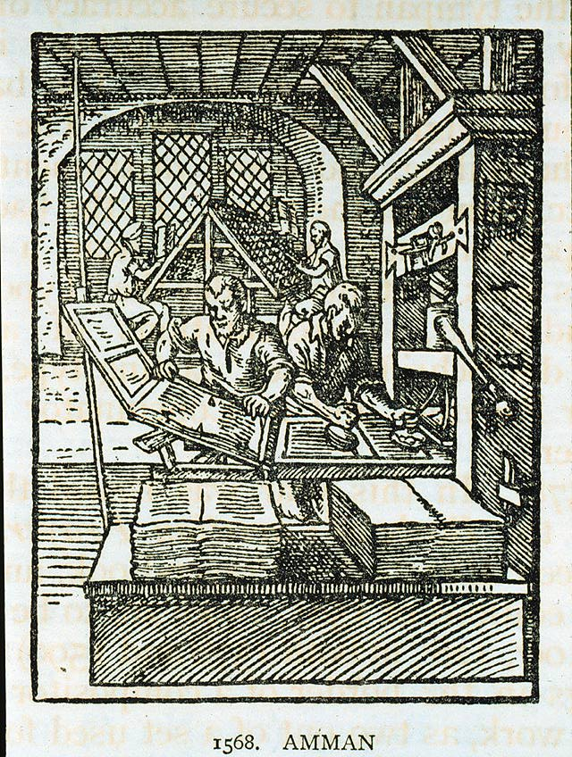

Slide 36
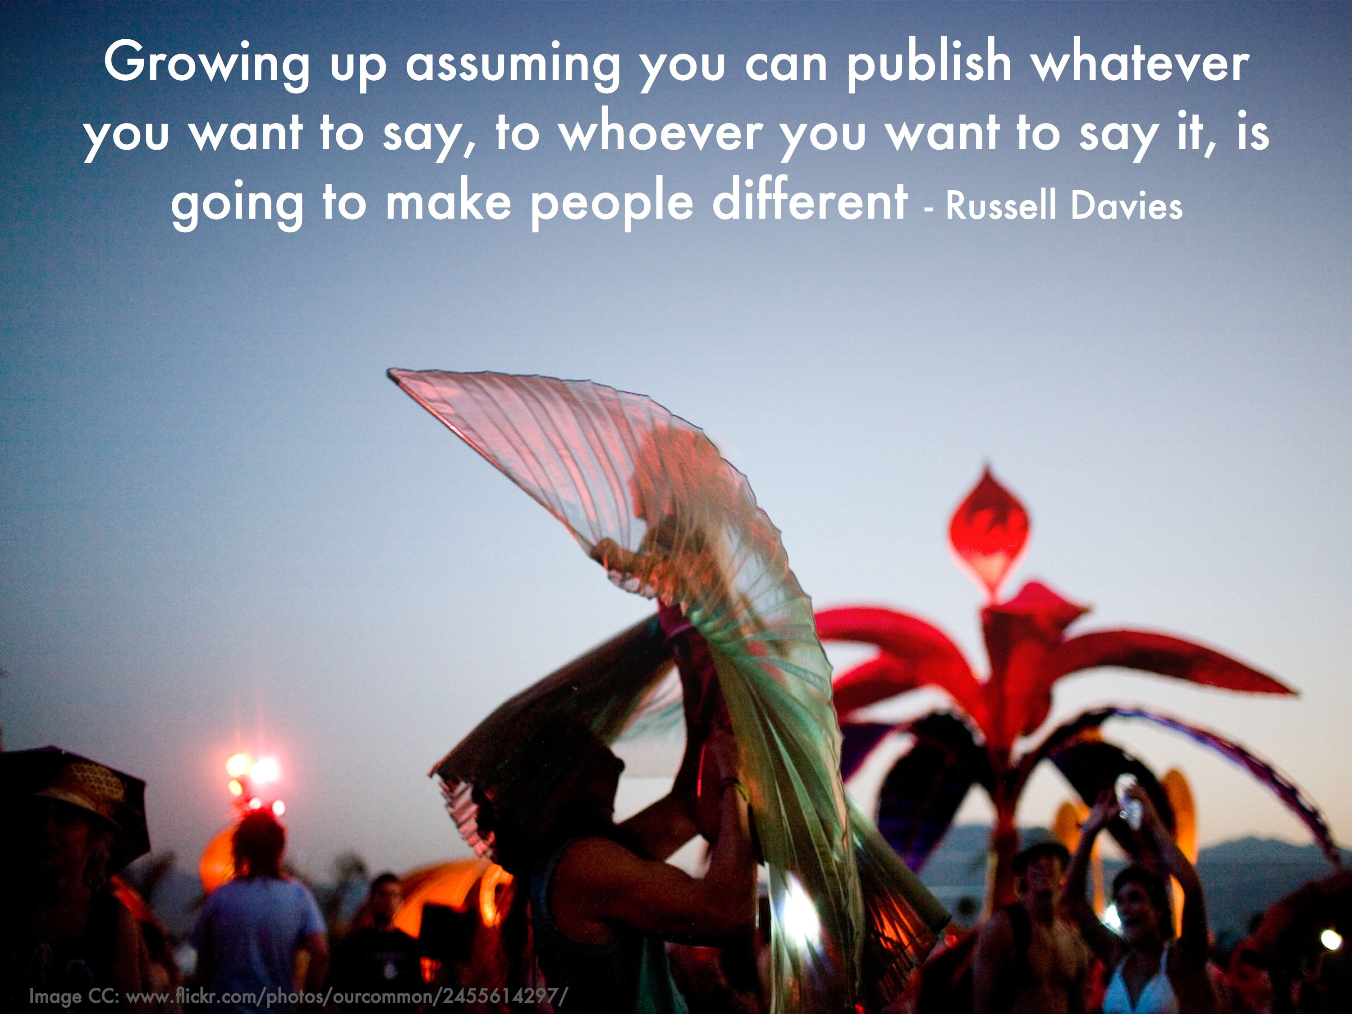

Slide 37
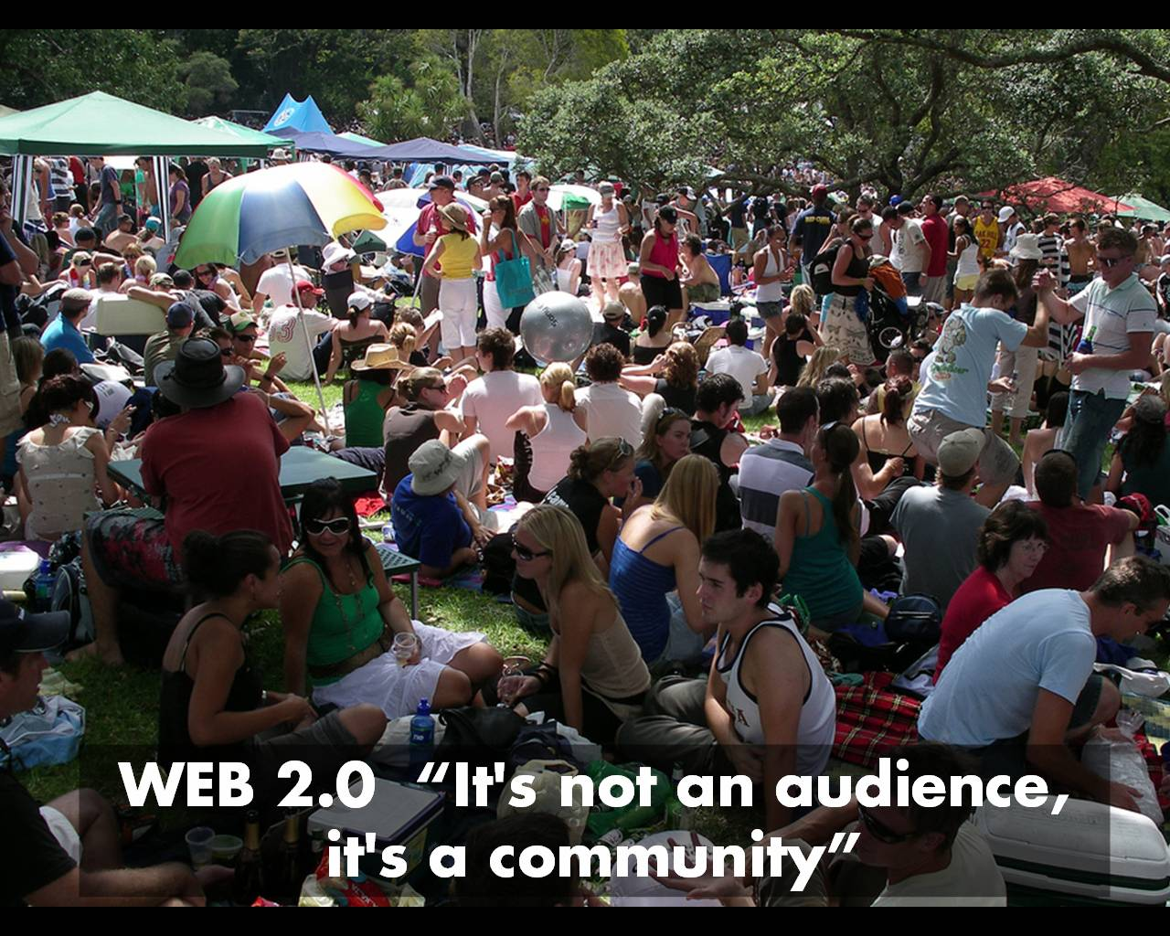

Slide 38
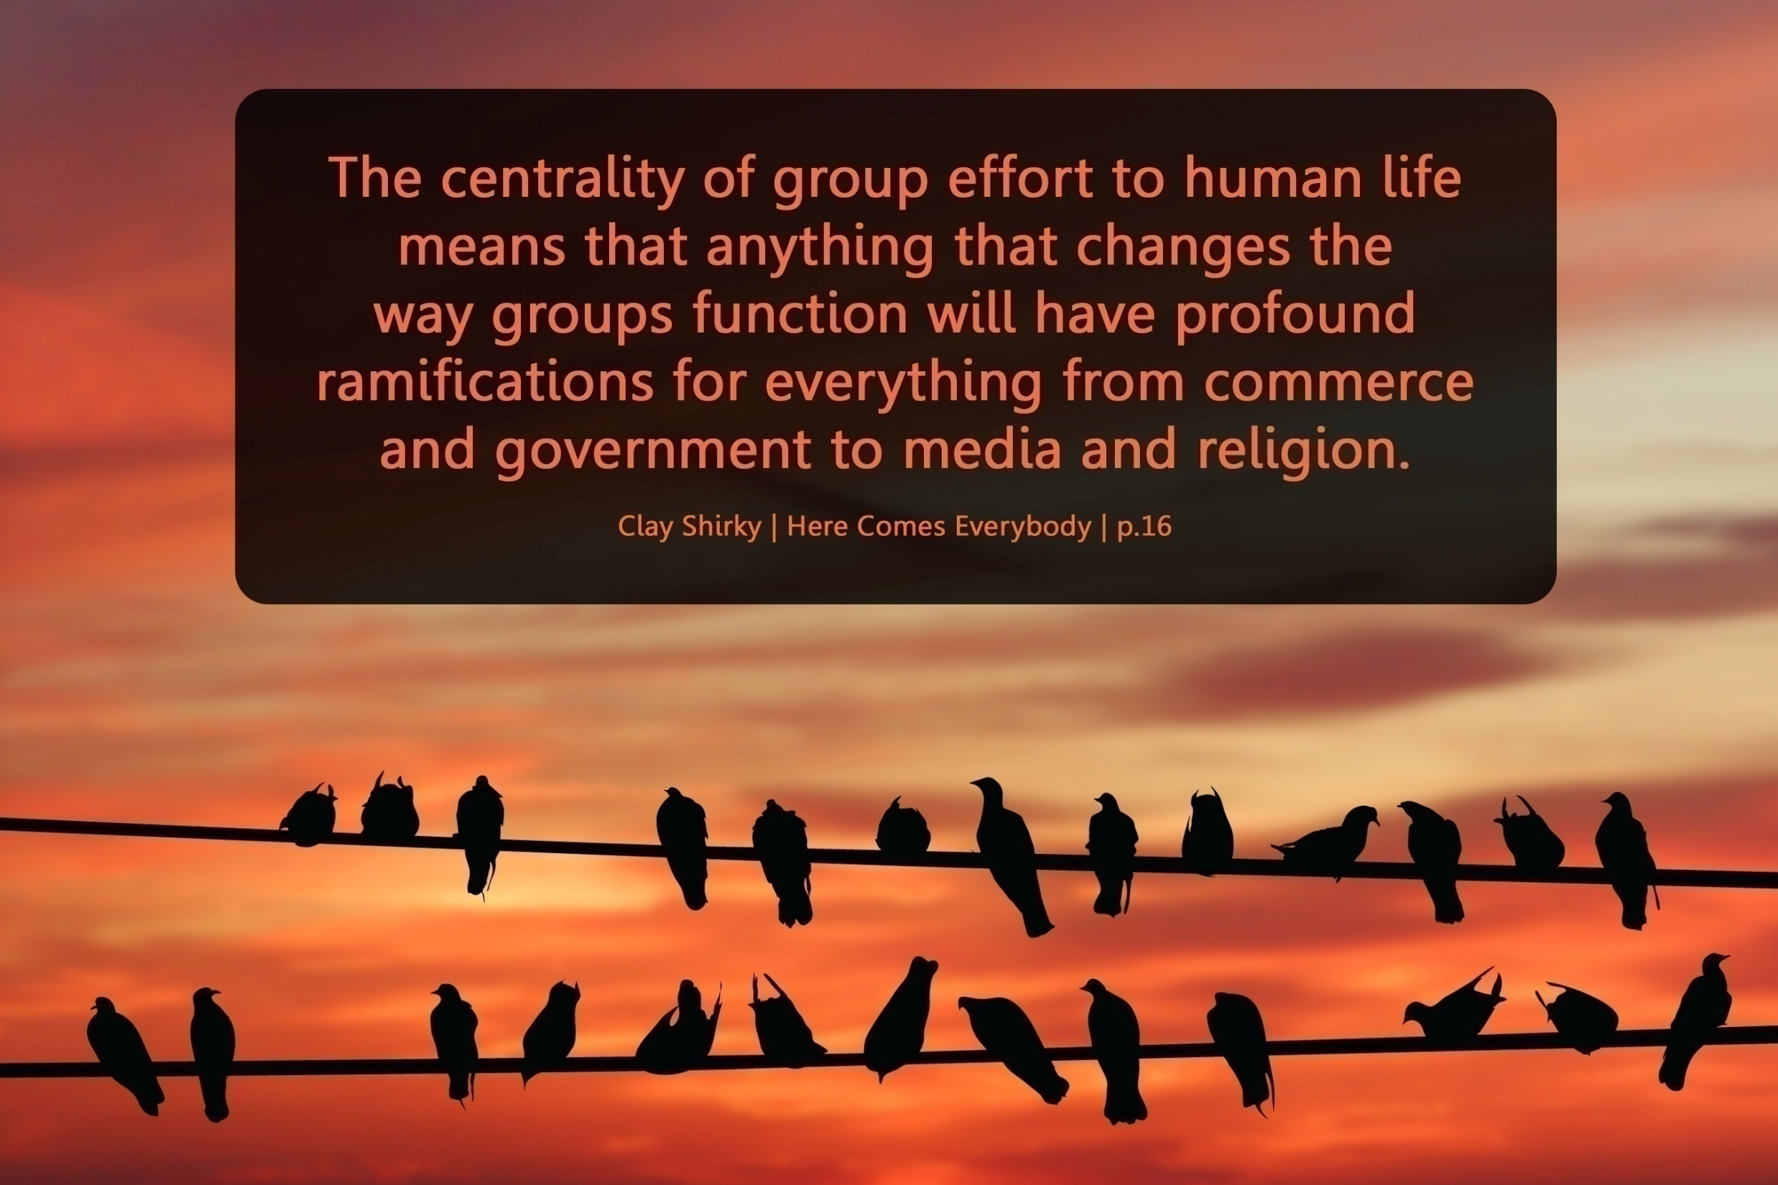

Slide 39
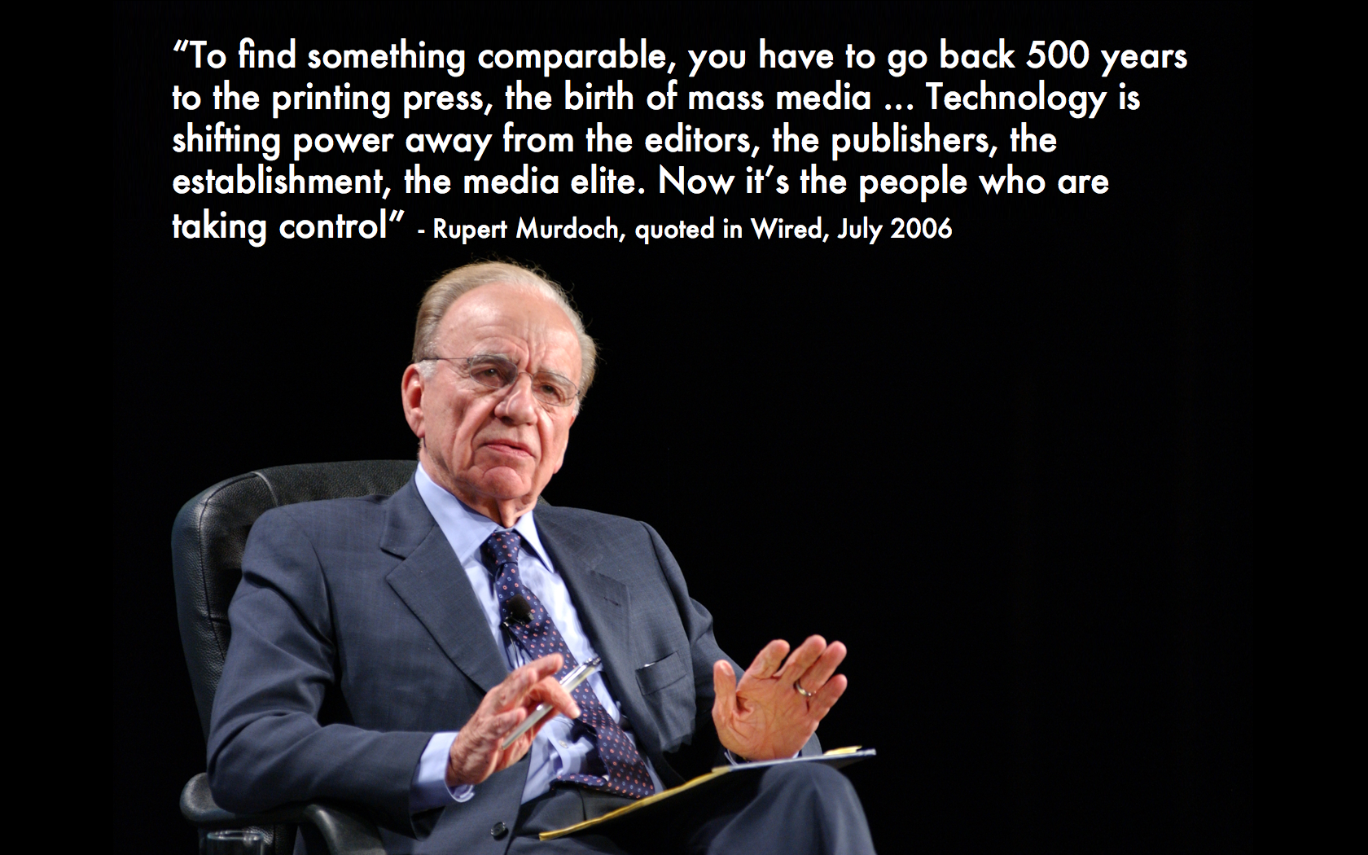

Slide 40
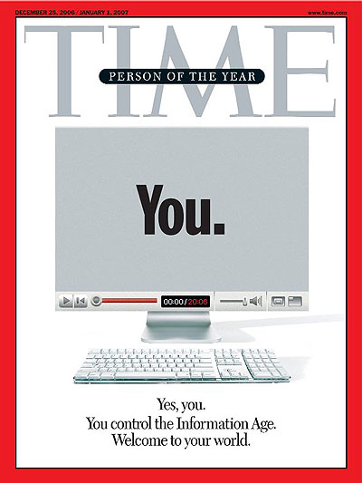
Notes:
The new Web is a very different thing. It’s a tool for bringing together the small contributions of millions of people and making them matter. [As these tools get put in the hands of ordinary people, we are seeing] an explosion of productivity and innovation. It’s just getting started, as millions of minds that would otherwise have drowned in obscurity get backhauled into the global intellectual economy.
A story about community and collaboration on a scale never seen before. It’s about the many wresting the power from the few and helping one another for nothing and how that will not only change the world, but also change the way the world changes.

Slide 41
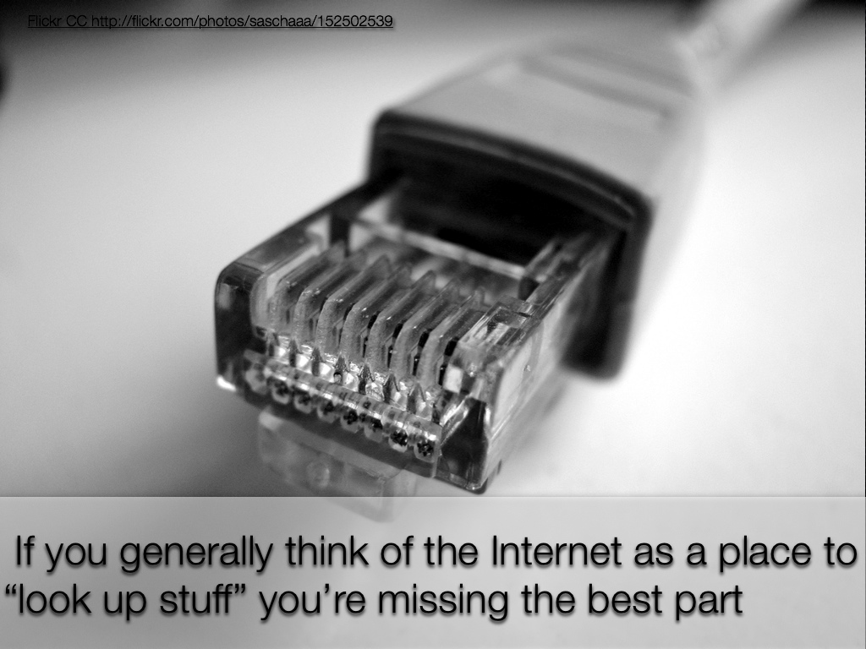

Slide 42
120 119 118 117 116 115 114 113 112 111
110 109 108 107 106 105 104 103 102 101
100 99 98 97 96 95 94 93 92 91
90 89 88 87 86 85 84 83 82 81
80 79 78 77 76 75 74 73 72 71
70 69 68 67 66 65 64 63 62 61
60

Slide 43
60 59 58 57 56 55 54 53 52 51
50 49 48 47 46 45 44 43 42 41
40 39 38 37 36 35 34 33 32 31
30 29 28 27 26 25 24 23 22 21
20 19 18 17 16 15 14 13 12 11
10 9 8 7 6 5 4 3 2 1

Slide 44
ACT 3
Jobs have changed

Slide 45
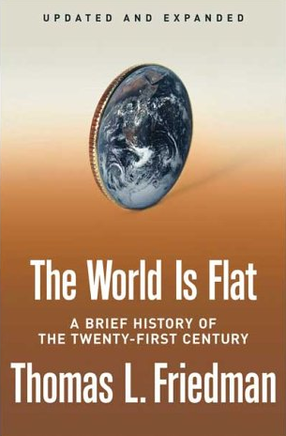
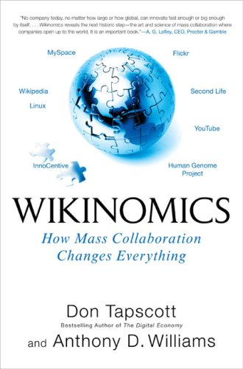
Notes:
45
If you haven’t noticed, our world has flattened around us. Geography, and time, are disappearing as barriers. Technology lets us communicate and work with people halfway around the world about as easily as we can with people on the other side of town. After we go to bed, businesses in other countries are working away during their daylight hours, ready to interact with us when we wake up again in the morning. The global economy never sleeps.

Slide 46
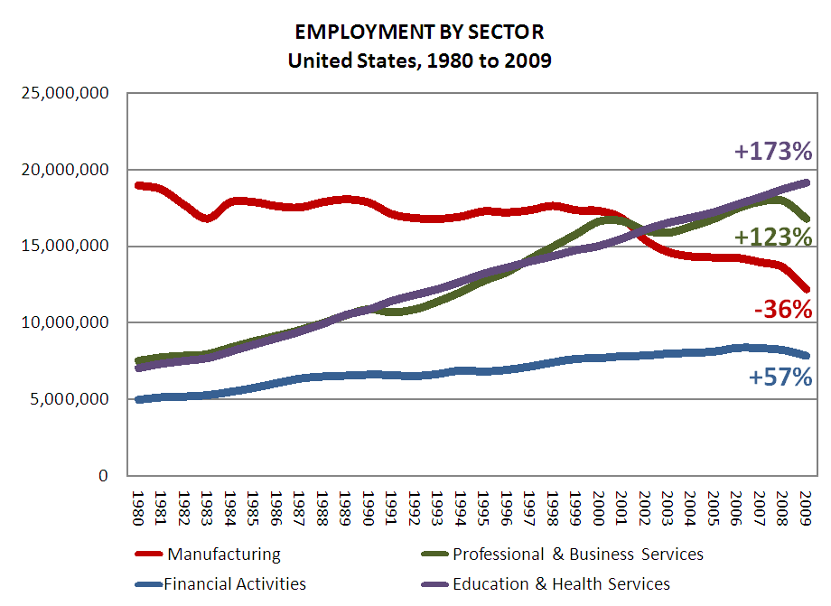

Slide 47
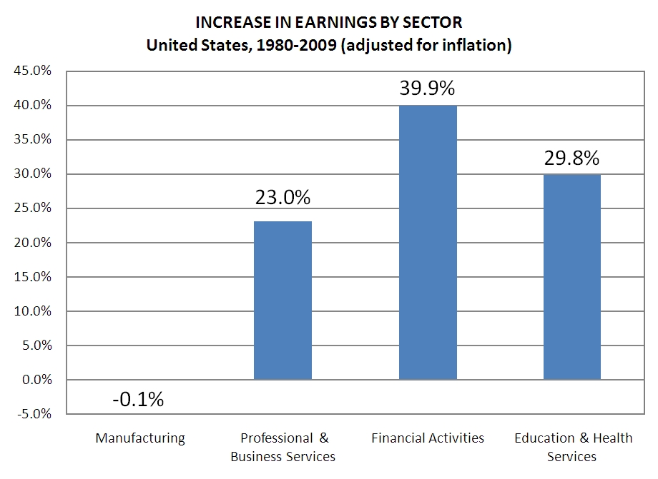

Slide 48
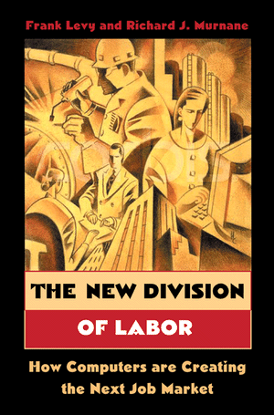

Slide 49
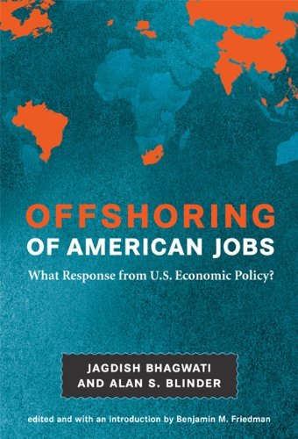

Slide 50
Percentile change in importance of task type in U.S. economy
Abstract
Routine
Manual
Autor, D., Levy, F., & Murnane, R. J. (2003). The skill content of recent technological change: An empirical exploration. Quarterly Journal of Economics 188, 4. [updated, D. Autor, 2008]

Slide 51
global awareness
effective speaking
critical thinking
problem solving
adaptability
information literacy
collaboration
creativity
media fluency
analytical skills
entrepeneurialism
innovation
effective writing
synthesis
curiosity
Notes:
1. critical thinking and problem solving in networks of cross-functional teams
world is complex and answers are not in the books
world is moving too fast for inflexible, hierarchical organizations
2. collaboration across networks and leadership by influence rather than positional authority
command and control increasingly less valued in organizations
schools are very much command and control institutions
3. agility and adaptability
intensifying rate of change, overwhelming amount of data, increasing complexity of problems
4. initiative and entrepeneurialism
people who can seek out new opportunities, ideas, and strategies
don’t want students or workers who are apathetic about their experiences
achievement orientation, drive for results, self-starters
5. effective written and oral communication
presentation skills, being clear and concise; creating focus, energy, and passion around the points they want to make
6. accessing and analyzing information
people who can access, evaluate, conceptualize, and synthesize multiple and large streams of incoming information to make meaningful decisions
7. curiosity and imagination
inquisitiveness, analytical skills that are more ‘out of the box’ than in the past, asking great questions is more important than knowing the ‘right answer’

Slide 52
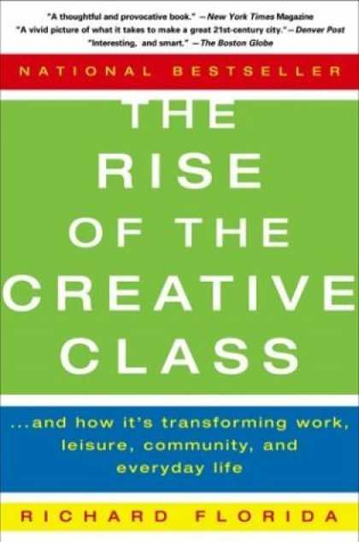

Slide 53
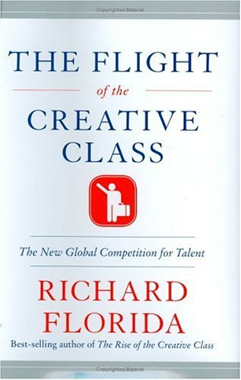

Slide 54
Growth of the creative class
Florida, R. (2002). The rise of the creative class (p. 332). New York, NY: Basic Books.
Notes:
Since 1950…
agriculture = less than 2%
working = primarily high school diploma, some have a little bit of college - factory workers, construction workers, food service workers, custodians, truck drivers – low levels of education, highly manual labor
service = beauticians, secretaries, paralegals, workers in retail stores, tourism and hotel workers, personal health care assistants
creative = scientists, engineers, technology workers, architects, lawyers, doctors, nurses, K-12 educators, university professors, poets, musicians, and entertainers - from 5% in 1900 to 14% in 1945 to 33% in 2008
2005 – Bill Gates - Today, only one-third of our students graduate from high school ready for college, work, and citizenship. . . . The first group goes on to college and careers; the second group will struggle to make a living wage. Let's be clear. Thanks to dedicated teachers and principals around the country, the best-educated kids in the United States are the best-educated kids in the world. We should be proud of that. But only a fraction of our kids are getting the best education.

Slide 55
Growth of the creative class
Florida, R. (2002). The rise of the creative class (p. 332). New York, NY: Basic Books.
Notes:
Since 1950…
agriculture = less than 2%
working = primarily high school diploma, some have a little bit of college - factory workers, construction workers, food service workers, custodians, truck drivers – low levels of education, highly manual labor
service = beauticians, secretaries, paralegals, workers in retail stores, tourism and hotel workers, personal health care assistants
creative = scientists, engineers, technology workers, architects, lawyers, doctors, nurses, K-12 educators, university professors, poets, musicians, and entertainers - from 5% in 1900 to 14% in 1945 to 33% in 2008
2005 – Bill Gates - Today, only one-third of our students graduate from high school ready for college, work, and citizenship. . . . The first group goes on to college and careers; the second group will struggle to make a living wage. Let's be clear. Thanks to dedicated teachers and principals around the country, the best-educated kids in the United States are the best-educated kids in the world. We should be proud of that. But only a fraction of our kids are getting the best education.

Slide 56
MANUFACTURING IN IOWA
% of all Iowa jobs in May ‘08
% of overall job losses by Sep ‘09

Slide 57
Can someone overseas do it cheaper?
Can a computer do it faster?
Is what I’m offering in demand in an age of abundance?
Notes:
New Commission on the Skills of the American Workforce
It is becoming progressively less expensive to automate functions that used to be performed by people. As the cost of labor rises and the cost of automating jobs continues to fall, it becomes both possible and necessary for firms simply to eliminate job after job now being done by humans. Earlier, almost all the jobs subject to automation were low-skill jobs. That is no longer true. Now it is more accurate to say that the jobs that are most vulnerable are the jobs involving routine work. If someone can figure out the algorithm for a routine job, chances are that it is economical to automate it. Many good, well-paying, middle-class jobs involve routine work of this kind and are rapidly being automated. [Think tax preparers, lawyers… being replaced by software]
Daniel Pink
If you say yes to 1 or 2, or no to 3, you’re in trouble
Forging relationship rather than executing transactions
Tackling novel, complex challenges instead of solving routine problems
Synthesizing and connecting disparate parts, thus creating or adding value
The capacity to detect patterns and opportunities, to combine seemingly unrelated ideas into something new, to craft a satisfying narrative, to create artistic and emotional beauty
Creativity is the ultimate economic resource. The ability to come up with new ideas and better ways of doing things is ultimately what raises productivity and thus living standards. In virtually every industry, the winners in the long run are those who can create and keep creating. This has always been true.
As we have moved from an agricultural age to an industrial age to an information age, our primary economic resource no longer is raw materials from the ground or human labor. We have to recognize that information is now the primary and most lucrative raw material.

Slide 58
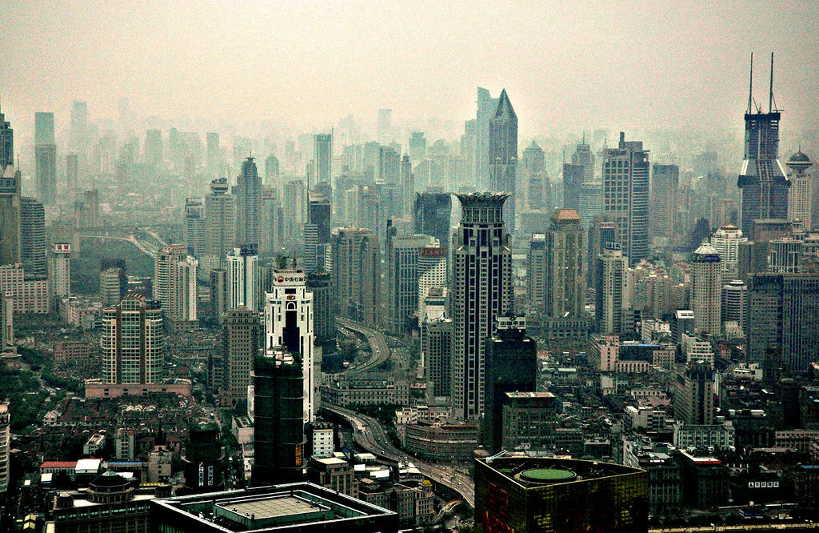

Slide 59
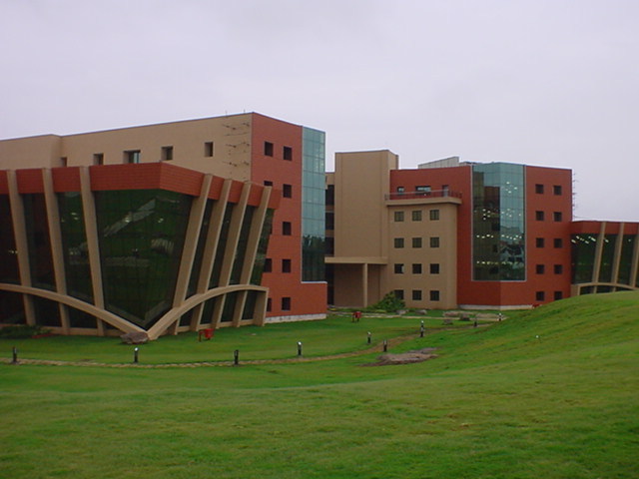

Slide 60
2.5 billion

Slide 61


Slide 62
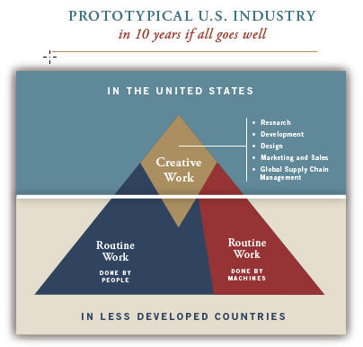
Notes:
New Commission on the Skills of the American Workforce
Today Indian engineers make $7,500 a year against $45,000 for a similarly-qualified American engineer. Why would the world’s employers pay our engineers more? They would be willing to do that only if we could offer something the Indian engineers cannot.
Producing the most important new products and services depends on a deep vein of creativity that is constantly renewing itself, and on a myriad of people who can imagine how people can use things that have never been available before
Creativity and innovation, facility with the use of ideas and abstractions, the self-discipline and organization needed to manage one’s work and drive it through to a successful conclusion, the ability to function well as a member of a team, the ability to use digital technologies to do everything just mentioned…

Slide 63
Globalization
doesn’t care
about us

Slide 64
120 119 118 117 116 115 114 113 112 111
110 109 108 107 106 105 104 103 102 101
100 99 98 97 96 95 94 93 92 91
90 89 88 87 86 85 84 83 82 81
80 79 78 77 76 75 74 73 72 71
70 69 68 67 66 65 64 63 62 61
60

Slide 65
60 59 58 57 56 55 54 53 52 51
50 49 48 47 46 45 44 43 42 41
40 39 38 37 36 35 34 33 32 31
30 29 28 27 26 25 24 23 22 21
20 19 18 17 16 15 14 13 12 11
10 9 8 7 6 5 4 3 2 1

Slide 66
ACT 4
Schools have NOT changed

Slide 67
The fundamental dilemma
but now are expected to
do this
Schools were designed for this …
Notes:
Since 1950…
agriculture = less than 2%
working = primarily high school diploma, some have a little bit of college - factory workers, construction workers, food service workers, custodians, truck drivers – low levels of education, highly manual labor
service = beauticians, secretaries, paralegals, workers in retail stores, tourism and hotel workers, personal health care assistants
creative = scientists, engineers, technology workers, architects, lawyers, doctors, nurses, K-12 educators, university professors, poets, musicians, and entertainers - from 5% in 1900 to 14% in 1945 to 33% in 2008
2005 – Bill Gates - Today, only one-third of our students graduate from high school ready for college, work, and citizenship. . . . The first group goes on to college and careers; the second group will struggle to make a living wage. Let's be clear. Thanks to dedicated teachers and principals around the country, the best-educated kids in the United States are the best-educated kids in the world. We should be proud of that. But only a fraction of our kids are getting the best education.

Slide 68
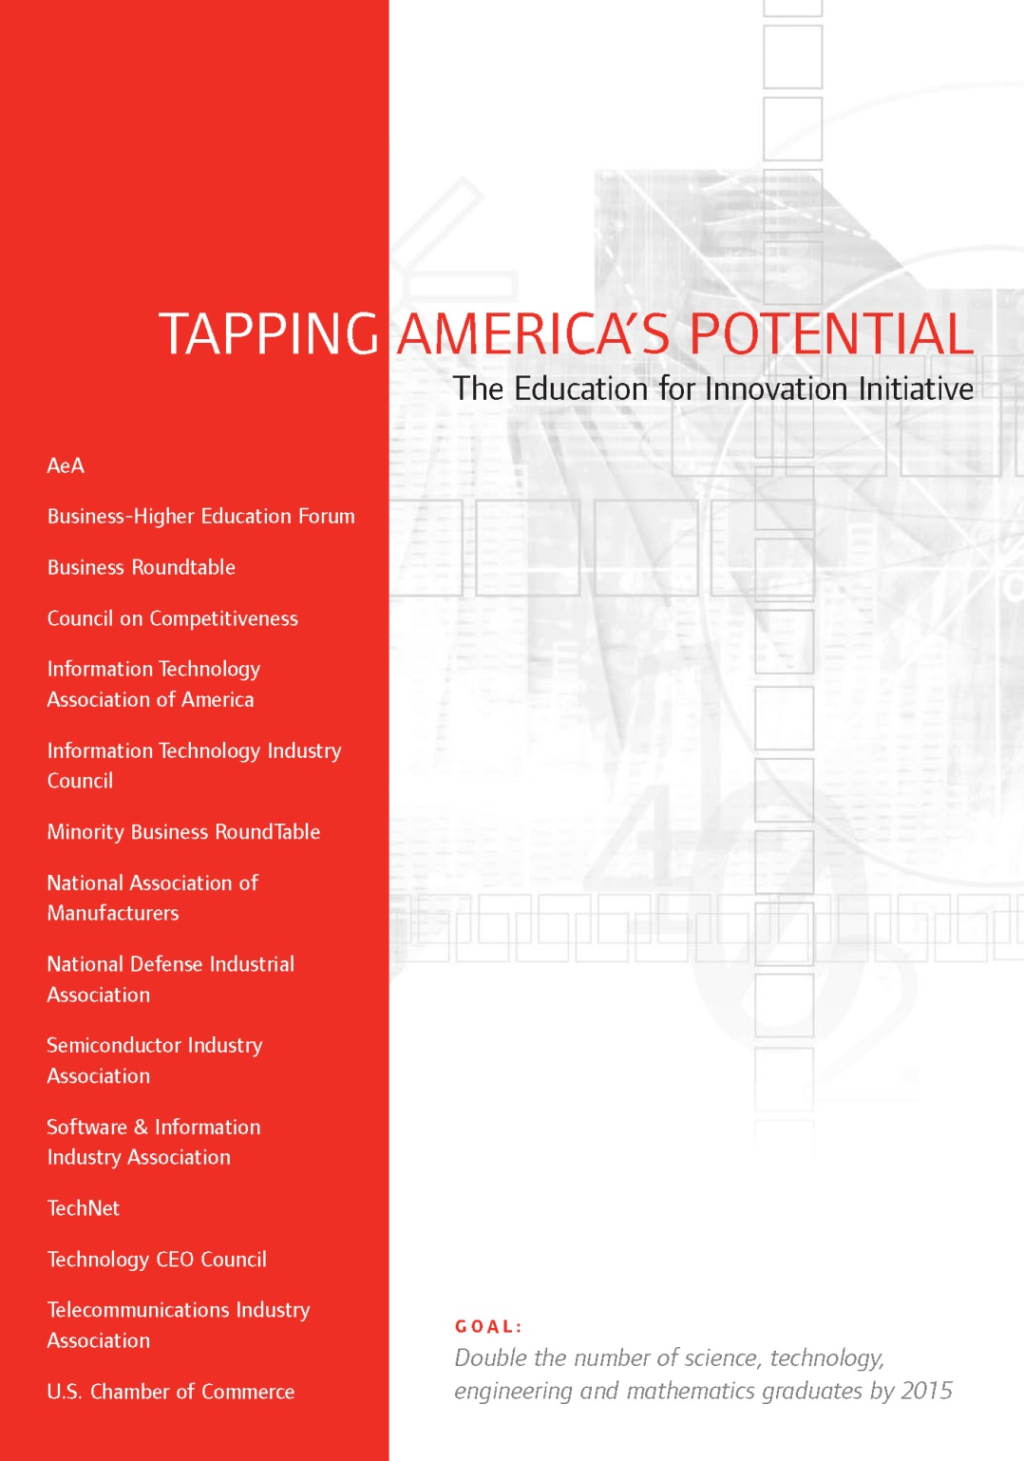
Notes:
A number of high-powered organizations, task forces, and committees have looked around the world as it is today and have asked a simple question: are schools doing what they need to do to prepare students for this new reality?
And report…

Slide 69


Slide 70
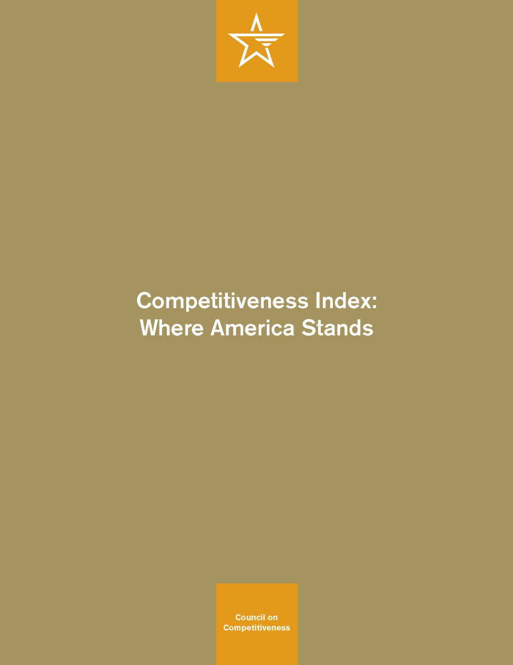

Slide 71
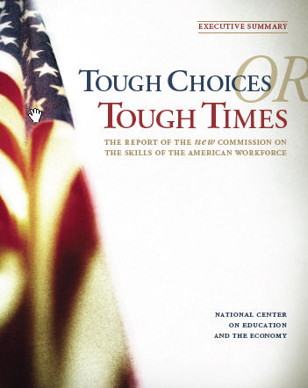
Notes:
New Commission on the Skills of the American Workforce
It is becoming progressively less expensive to automate functions that used to be performed by people. As the cost of labor rises and the cost of automating jobs continues to fall, it becomes both possible and necessary for firms simply to eliminate job after job now being done by humans. Earlier, almost all the jobs subject to automation were low-skill jobs. That is no longer true. Now it is more accurate to say that the jobs that are most vulnerable are the jobs involving routine work. If someone can figure out the algorithm for a routine job, chances are that it is economical to automate it. Many good, well-paying, middle-class jobs involve routine work of this kind and are rapidly being automated. [Think tax preparers, lawyers… being replaced by software]

Slide 72


Slide 73
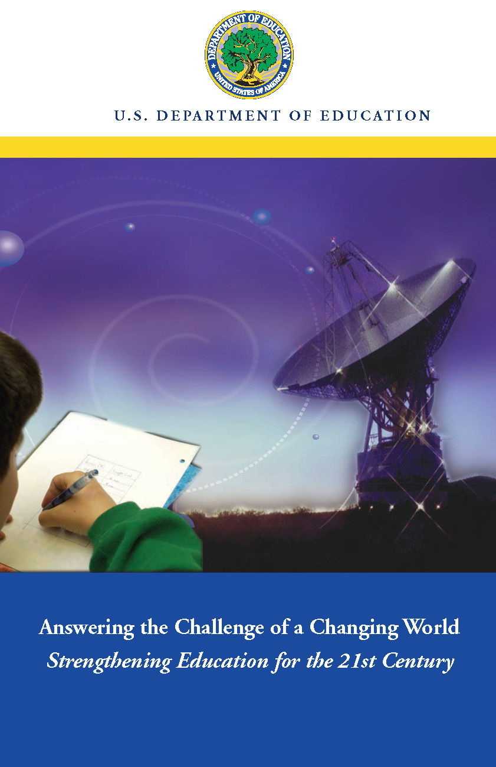

Slide 74


Slide 75


Slide 76
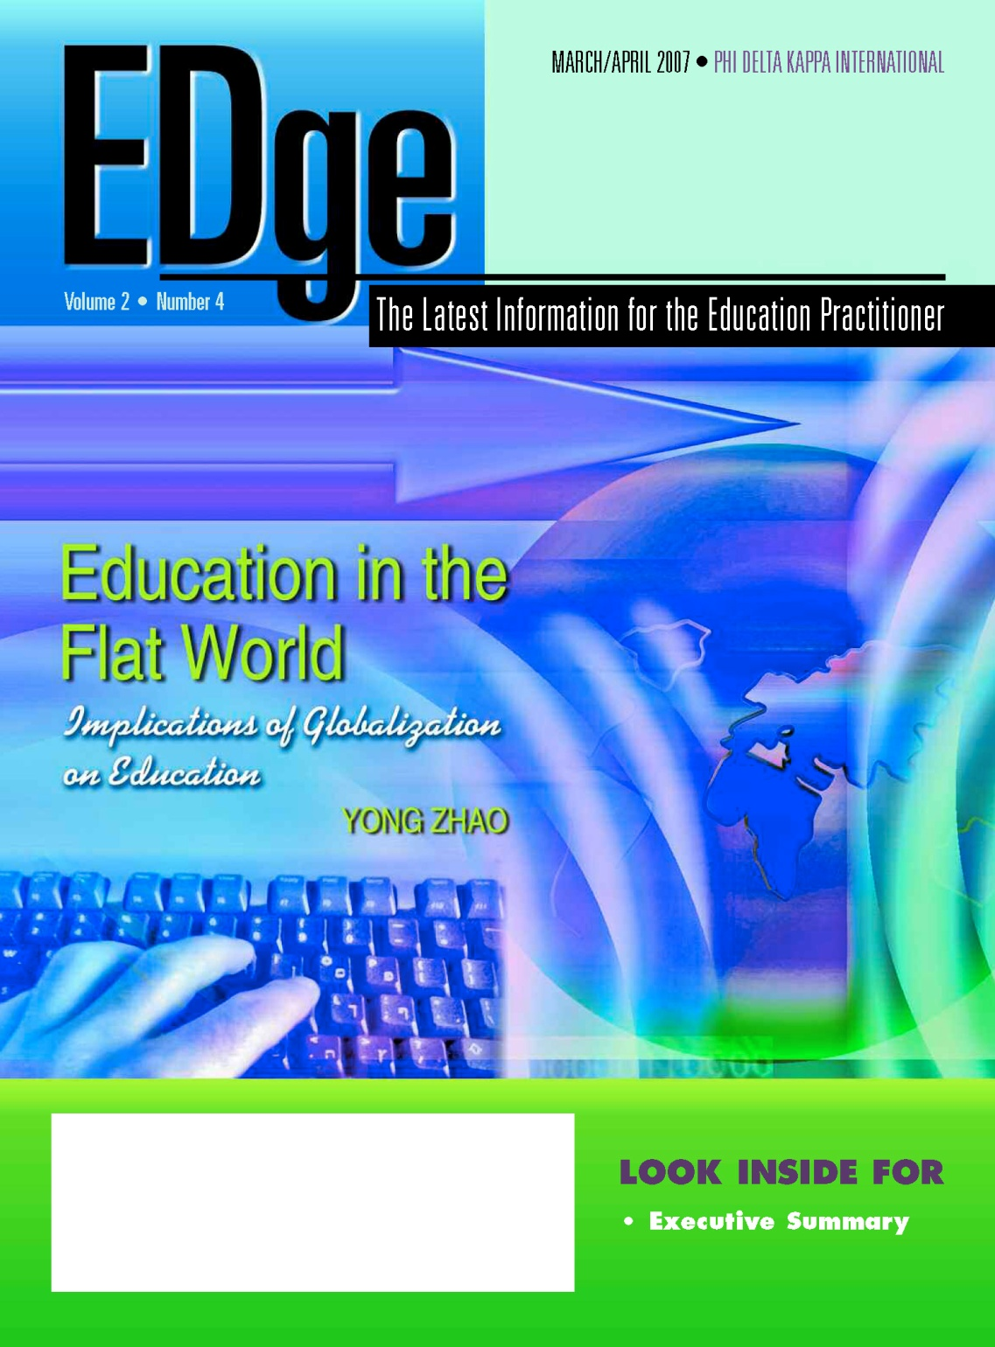

Slide 77
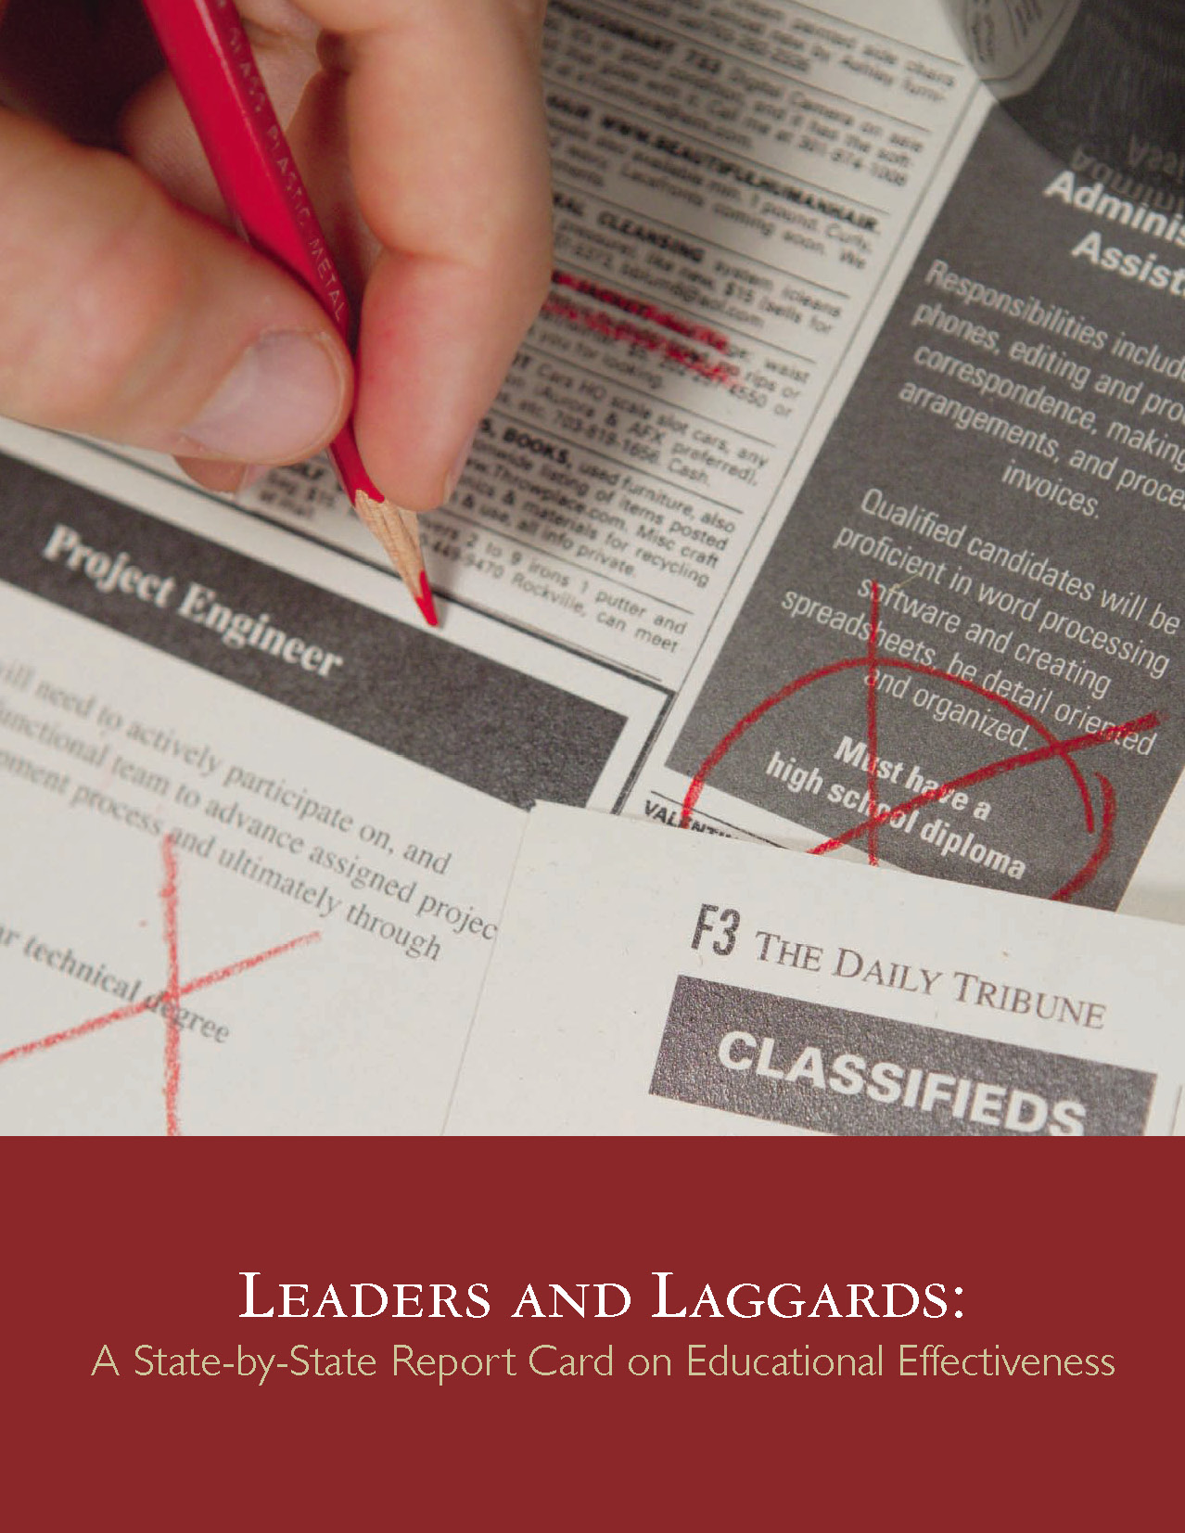
Notes:
After report…
have come to the same conclusion: our schools are not up to snuff.
2005 – Bill Gates - America's high schools are obsolete. By obsolete, I don't just mean that our high schools are broken, flawed, and under-funded--though a case could be made for every one of those points. By obsolete, I mean that our high schools--even when they're working exactly as designed--cannot teach our kids what they need to know today. This isn't an accident or a flaw in the system; it is the system.
Today, most jobs that allow you to support a family require some postsecondary education. This could mean a four-year college, a community college, or technical school. Unfortunately, only half of all students who enter high school ever enroll in a postsecondary institution. That means that half of all students starting high school today are unlikely to get a job that allows them to support a family.
Our high schools were designed fifty years ago to meet the needs of another age. Until we design them to meet the needs of this century, we will keep limiting--even ruining--the lives of millions of Americans every year.

Slide 78
What we have right now
uniqueness
uniqueness
one right answer
Notes:
78

Slide 79
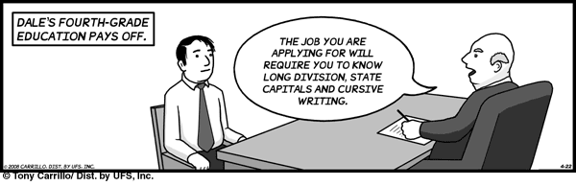
Notes:
79

Slide 80
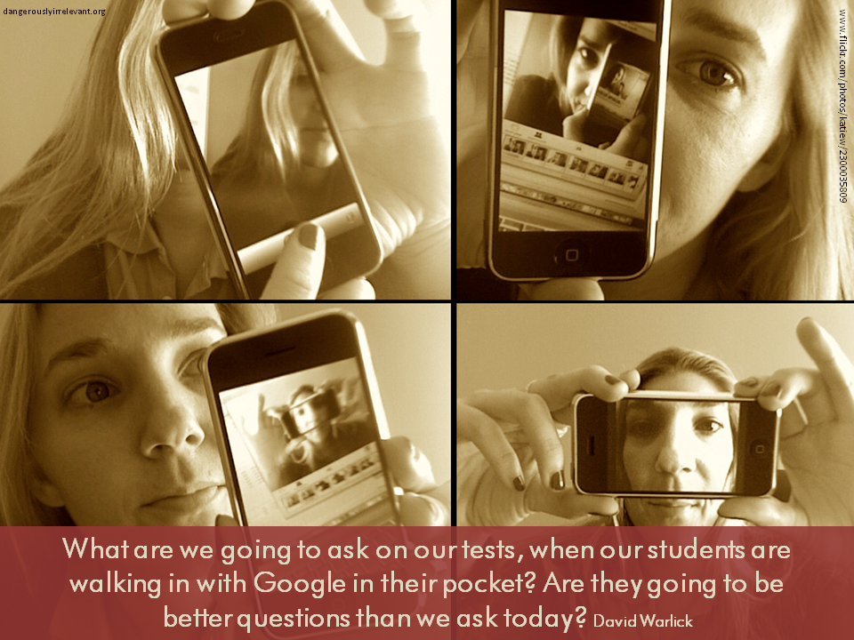

Slide 81
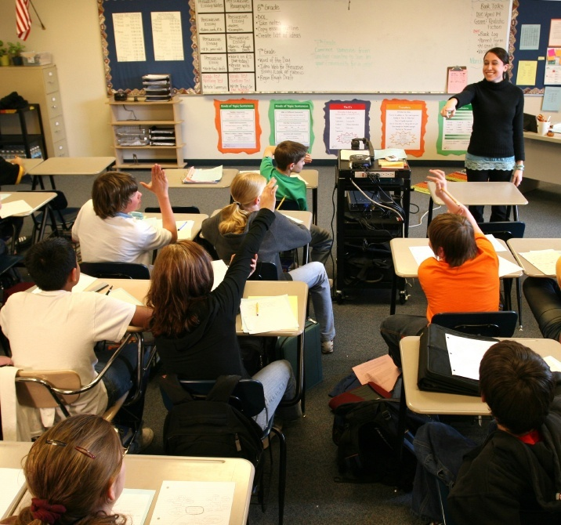
Notes:
81
- not entirely educators’ fault – the system is the issue – governed by an essential 19th century paradigm – one that was appropriate for our grandparents but not our children and grandchildren

Slide 82
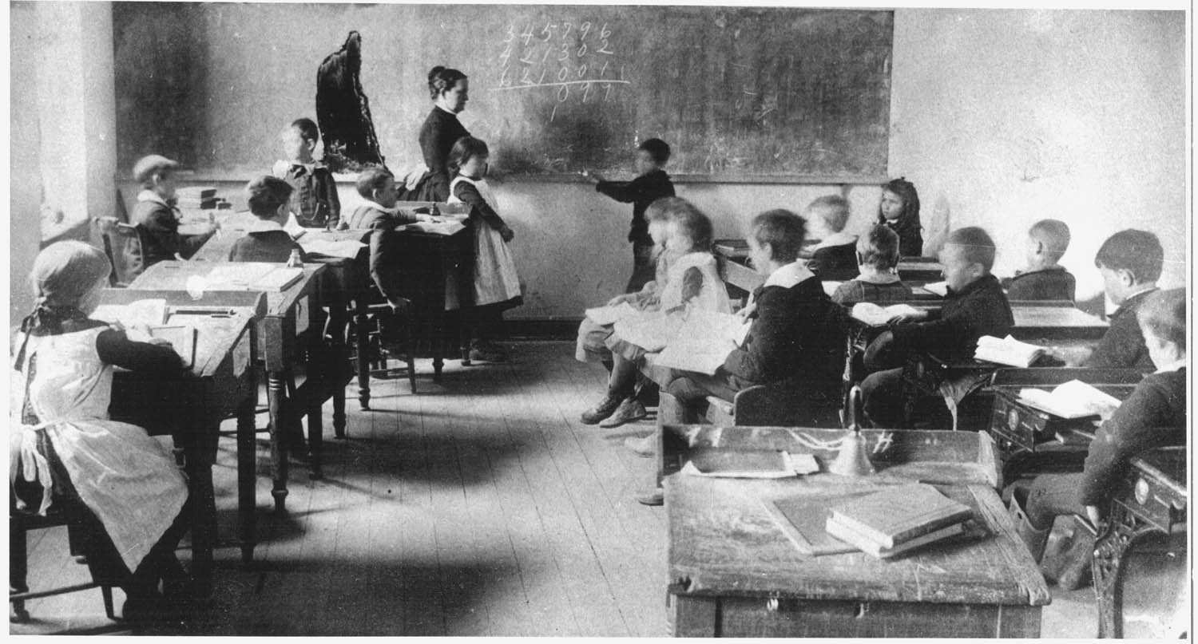
Notes:
82

Slide 83
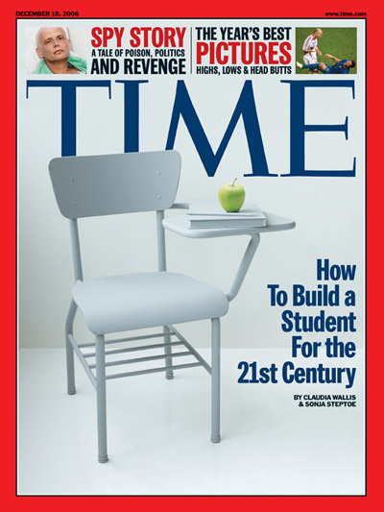
Notes:
For the past five years, the national conversation on education has focused on reading scores, math tests and closing the "achievement gap" between social classes. This is not a story about that conversation.
This is a story about the big public conversation the nation is not having about education, the one that will ultimately determine not merely whether some fraction of our children get "left behind" but also whether an entire generation of kids will fail to make the grade in the global economy because they can't think their way through abstract problems, work in teams, distinguish good information from bad or speak a language other than English.

Slide 84

While we teach whatever we teach at school, the kids go home and learn the skills they need to survive and prosper in an interconnected global economy.
Clarence Fisher
Notes:
As a result…
http://remoteaccess.typepad.com/remote_access/2005/11/educational_lea.html
Incrementally changing our teaching methods, slowly bringing people up to speed . . . worked fine when ideas of literacy and education were not rapidly changing; but they are. We need to be able to leapfrog in our understandings, in our methods, and in our tools, allowing us to move to where the kids are. If we do not become leaders to our students, we will be followers, seen as irrelevant, and left to cry in our books.

Slide 85

No generation in history has ever been so thoroughly prepared for the industrial age.
David Warlick
http://davidwarlick.com/2cents/?p=298
dangerouslyirrelevant.org
Notes:
We desperately need . . . we may not survive without . . . a generation of young people who are imaginative, inventive, fearless learners, and compassionate leaders. Yet, what can we say, as educators, about the students we are producing? We can prove that they can read, do basic math on paper, and they are able to sit for hours filling in bubble sheets.
http://davidwarlick.com/2cents/?p=298

Slide 86


Slide 87
120 119 118 117 116 115 114 113 112 111
110 109 108 107 106 105 104 103 102 101
100 99 98 97 96 95 94 93 92 91
90 89 88 87 86 85 84 83 82 81
80 79 78 77 76 75 74 73 72 71
70 69 68 67 66 65 64 63 62 61
60

Slide 88
60 59 58 57 56 55 54 53 52 51
50 49 48 47 46 45 44 43 42 41
40 39 38 37 36 35 34 33 32 31
30 29 28 27 26 25 24 23 22 21
20 19 18 17 16 15 14 13 12 11
10 9 8 7 6 5 4 3 2 1

Slide 89
ACT 5
Time to get moving!

Slide 90
Insist on a different kind of curriculum (and assessment)
Notes:
New Commission on the Skills of the American Workforce
It is becoming progressively less expensive to automate functions that used to be performed by people. As the cost of labor rises and the cost of automating jobs continues to fall, it becomes both possible and necessary for firms simply to eliminate job after job now being done by humans. Earlier, almost all the jobs subject to automation were low-skill jobs. That is no longer true. Now it is more accurate to say that the jobs that are most vulnerable are the jobs involving routine work. If someone can figure out the algorithm for a routine job, chances are that it is economical to automate it. Many good, well-paying, middle-class jobs involve routine work of this kind and are rapidly being automated. [Think tax preparers, lawyers… being replaced by software]
Daniel Pink
If you say yes to 1 or 2, or no to 3, you’re in trouble
Forging relationship rather than executing transactions
Tackling novel, complex challenges instead of solving routine problems
Synthesizing and connecting disparate parts, thus creating or adding value
The capacity to detect patterns and opportunities, to combine seemingly unrelated ideas into something new, to craft a satisfying narrative, to create artistic and emotional beauty
Creativity is the ultimate economic resource. The ability to come up with new ideas and better ways of doing things is ultimately what raises productivity and thus living standards. In virtually every industry, the winners in the long run are those who can create and keep creating. This has always been true.
As we have moved from an agricultural age to an industrial age to an information age, our primary economic resource no longer is raw materials from the ground or human labor. We have to recognize that information is now the primary and most lucrative raw material.

Slide 91
global awareness
effective speaking
critical thinking
problem solving
adaptability
information literacy
collaboration
creativity
media fluency
analytical skills
entrepeneurialism
innovation
effective writing
synthesis
curiosity
Notes:
1. critical thinking and problem solving in networks of cross-functional teams
world is complex and answers are not in the books
world is moving too fast for inflexible, hierarchical organizations
2. collaboration across networks and leadership by influence rather than positional authority
command and control increasingly less valued in organizations
schools are very much command and control institutions
3. agility and adaptability
intensifying rate of change, overwhelming amount of data, increasing complexity of problems
4. initiative and entrepeneurialism
people who can seek out new opportunities, ideas, and strategies
don’t want students or workers who are apathetic about their experiences
achievement orientation, drive for results, self-starters
5. effective written and oral communication
presentation skills, being clear and concise; creating focus, energy, and passion around the points they want to make
6. accessing and analyzing information
people who can access, evaluate, conceptualize, and synthesize multiple and large streams of incoming information to make meaningful decisions
7. curiosity and imagination
inquisitiveness, analytical skills that are more ‘out of the box’ than in the past, asking great questions is more important than knowing the ‘right answer’

Slide 92
Insist on a different kind of curriculum (and assessment)
Insist on a different kind of instruction
Notes:
New Commission on the Skills of the American Workforce
It is becoming progressively less expensive to automate functions that used to be performed by people. As the cost of labor rises and the cost of automating jobs continues to fall, it becomes both possible and necessary for firms simply to eliminate job after job now being done by humans. Earlier, almost all the jobs subject to automation were low-skill jobs. That is no longer true. Now it is more accurate to say that the jobs that are most vulnerable are the jobs involving routine work. If someone can figure out the algorithm for a routine job, chances are that it is economical to automate it. Many good, well-paying, middle-class jobs involve routine work of this kind and are rapidly being automated. [Think tax preparers, lawyers… being replaced by software]
Daniel Pink
If you say yes to 1 or 2, or no to 3, you’re in trouble
Forging relationship rather than executing transactions
Tackling novel, complex challenges instead of solving routine problems
Synthesizing and connecting disparate parts, thus creating or adding value
The capacity to detect patterns and opportunities, to combine seemingly unrelated ideas into something new, to craft a satisfying narrative, to create artistic and emotional beauty
Creativity is the ultimate economic resource. The ability to come up with new ideas and better ways of doing things is ultimately what raises productivity and thus living standards. In virtually every industry, the winners in the long run are those who can create and keep creating. This has always been true.
As we have moved from an agricultural age to an industrial age to an information age, our primary economic resource no longer is raw materials from the ground or human labor. We have to recognize that information is now the primary and most lucrative raw material.

Slide 93
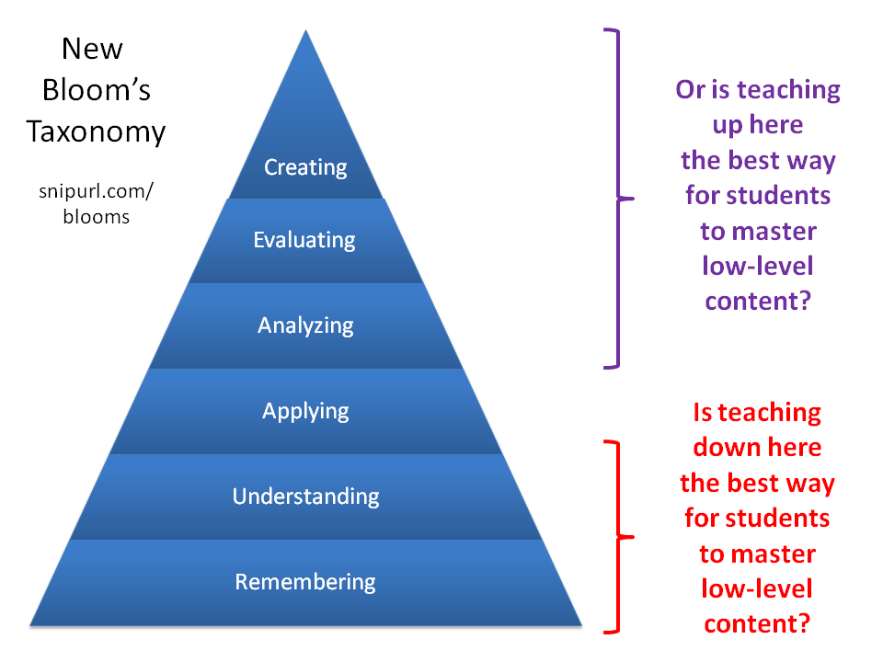

Slide 94
student engagement
elementary school
high school
Notes:
Student learning curiosity / engagement with content

Slide 95

www.flickr.com/photos/jahansell/251755048
dangerouslyirrelevant.org
Our kids have tasted the honey.
Notes:
Licensed under a Creative Commons attribution-share alike license.
http://creativecommons.org/licenses/by-sa/3.0
Scott McLeod, J.D., Ph.D.
scottmcleod.net/contact
dangerouslyirrelevant.org
schooltechleadership.org
Our kids have tasted the honey.
www.flickr.com/photos/jahansell/251755048

Slide 96
Insist on a different kind of curriculum (and assessment)
Insist on a different kind of instruction
Advocate for e-learning
Notes:
New Commission on the Skills of the American Workforce
It is becoming progressively less expensive to automate functions that used to be performed by people. As the cost of labor rises and the cost of automating jobs continues to fall, it becomes both possible and necessary for firms simply to eliminate job after job now being done by humans. Earlier, almost all the jobs subject to automation were low-skill jobs. That is no longer true. Now it is more accurate to say that the jobs that are most vulnerable are the jobs involving routine work. If someone can figure out the algorithm for a routine job, chances are that it is economical to automate it. Many good, well-paying, middle-class jobs involve routine work of this kind and are rapidly being automated. [Think tax preparers, lawyers… being replaced by software]
Daniel Pink
If you say yes to 1 or 2, or no to 3, you’re in trouble
Forging relationship rather than executing transactions
Tackling novel, complex challenges instead of solving routine problems
Synthesizing and connecting disparate parts, thus creating or adding value
The capacity to detect patterns and opportunities, to combine seemingly unrelated ideas into something new, to craft a satisfying narrative, to create artistic and emotional beauty
Creativity is the ultimate economic resource. The ability to come up with new ideas and better ways of doing things is ultimately what raises productivity and thus living standards. In virtually every industry, the winners in the long run are those who can create and keep creating. This has always been true.
As we have moved from an agricultural age to an industrial age to an information age, our primary economic resource no longer is raw materials from the ground or human labor. We have to recognize that information is now the primary and most lucrative raw material.

Slide 97
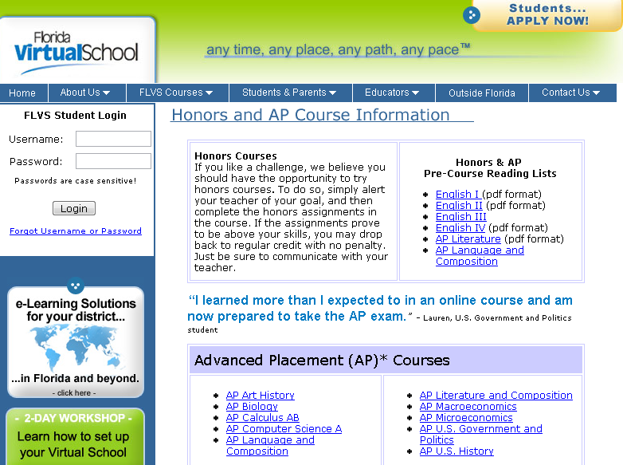

Slide 98
A computer in every hand
Notes:
New Commission on the Skills of the American Workforce
It is becoming progressively less expensive to automate functions that used to be performed by people. As the cost of labor rises and the cost of automating jobs continues to fall, it becomes both possible and necessary for firms simply to eliminate job after job now being done by humans. Earlier, almost all the jobs subject to automation were low-skill jobs. That is no longer true. Now it is more accurate to say that the jobs that are most vulnerable are the jobs involving routine work. If someone can figure out the algorithm for a routine job, chances are that it is economical to automate it. Many good, well-paying, middle-class jobs involve routine work of this kind and are rapidly being automated. [Think tax preparers, lawyers… being replaced by software]
Daniel Pink
If you say yes to 1 or 2, or no to 3, you’re in trouble
Forging relationship rather than executing transactions
Tackling novel, complex challenges instead of solving routine problems
Synthesizing and connecting disparate parts, thus creating or adding value
The capacity to detect patterns and opportunities, to combine seemingly unrelated ideas into something new, to craft a satisfying narrative, to create artistic and emotional beauty
Creativity is the ultimate economic resource. The ability to come up with new ideas and better ways of doing things is ultimately what raises productivity and thus living standards. In virtually every industry, the winners in the long run are those who can create and keep creating. This has always been true.
As we have moved from an agricultural age to an industrial age to an information age, our primary economic resource no longer is raw materials from the ground or human labor. We have to recognize that information is now the primary and most lucrative raw material.

Slide 99

Notes:
Technology needs to be like oxygen. Ubiquitous, necessary, and invisible.
- Chris Lehmann

Slide 100
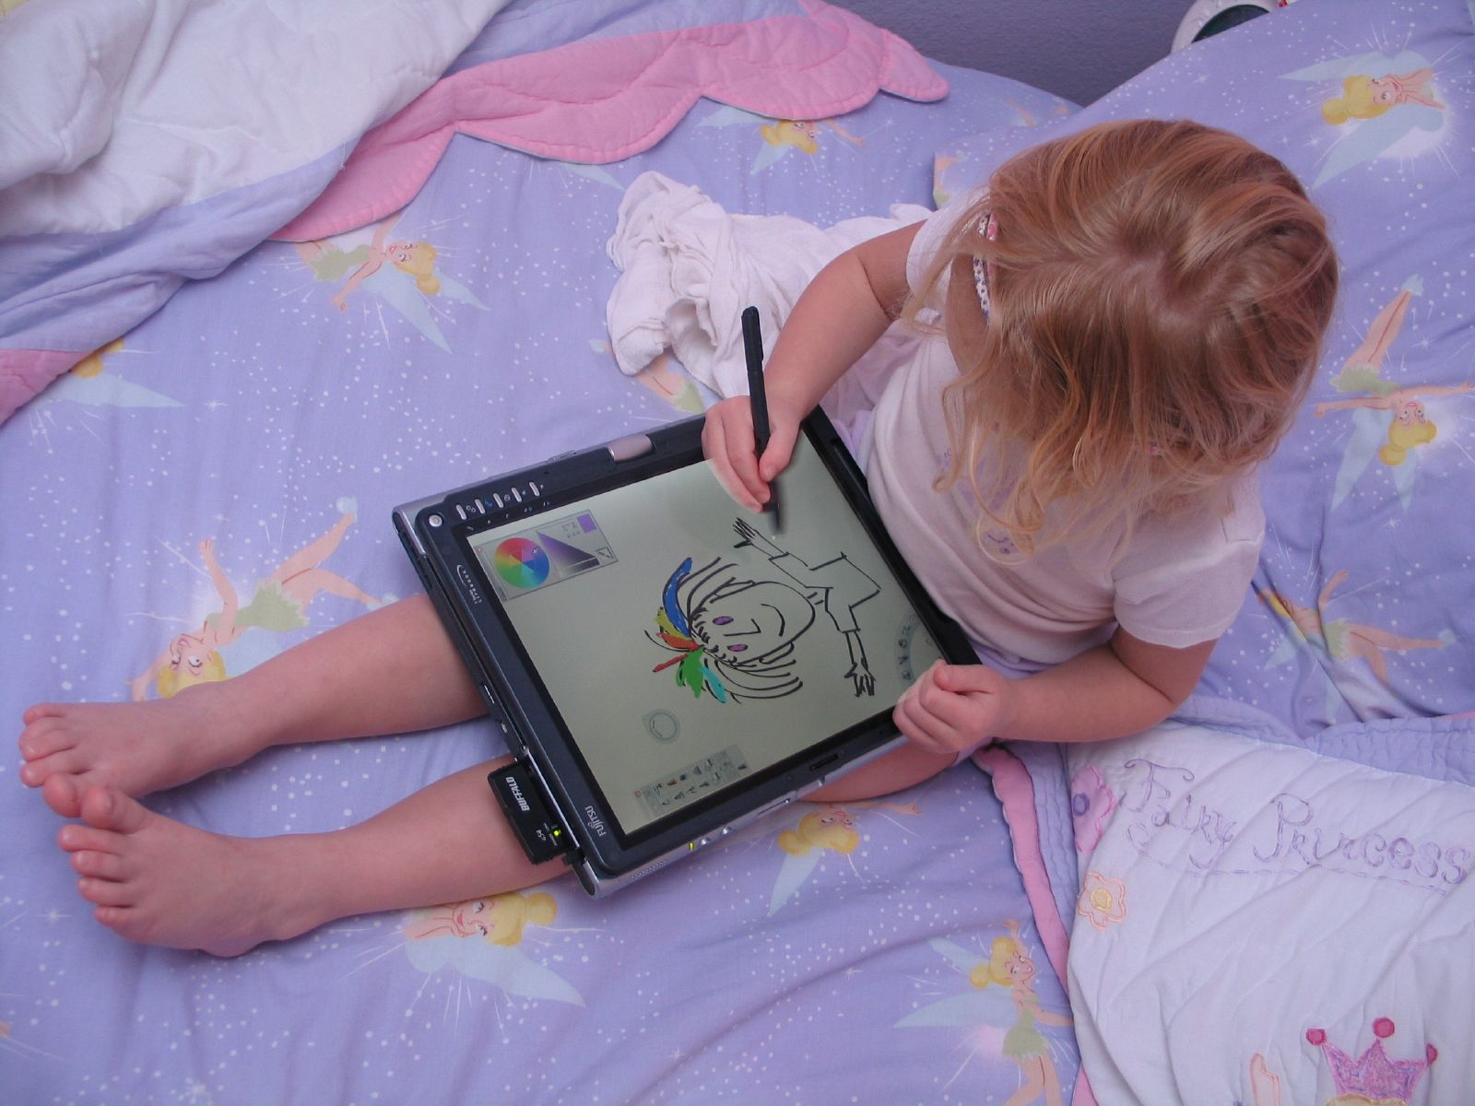

Slide 101
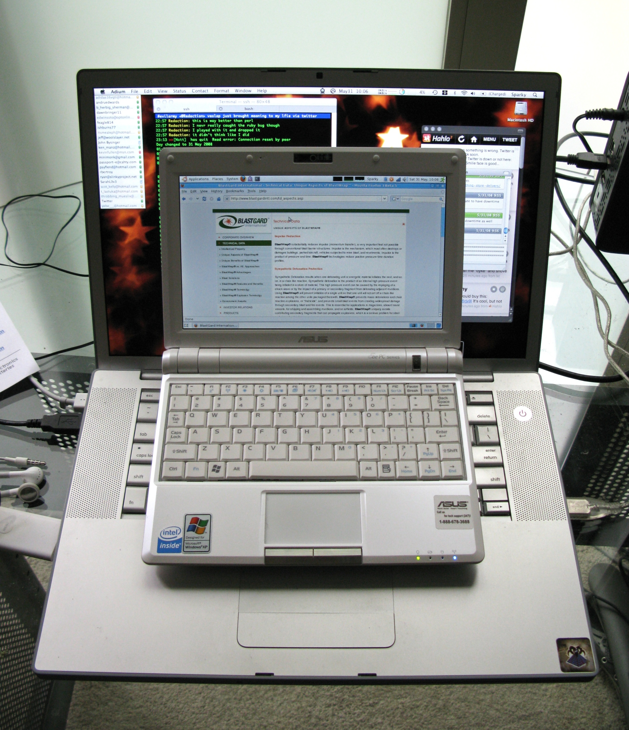

Slide 102
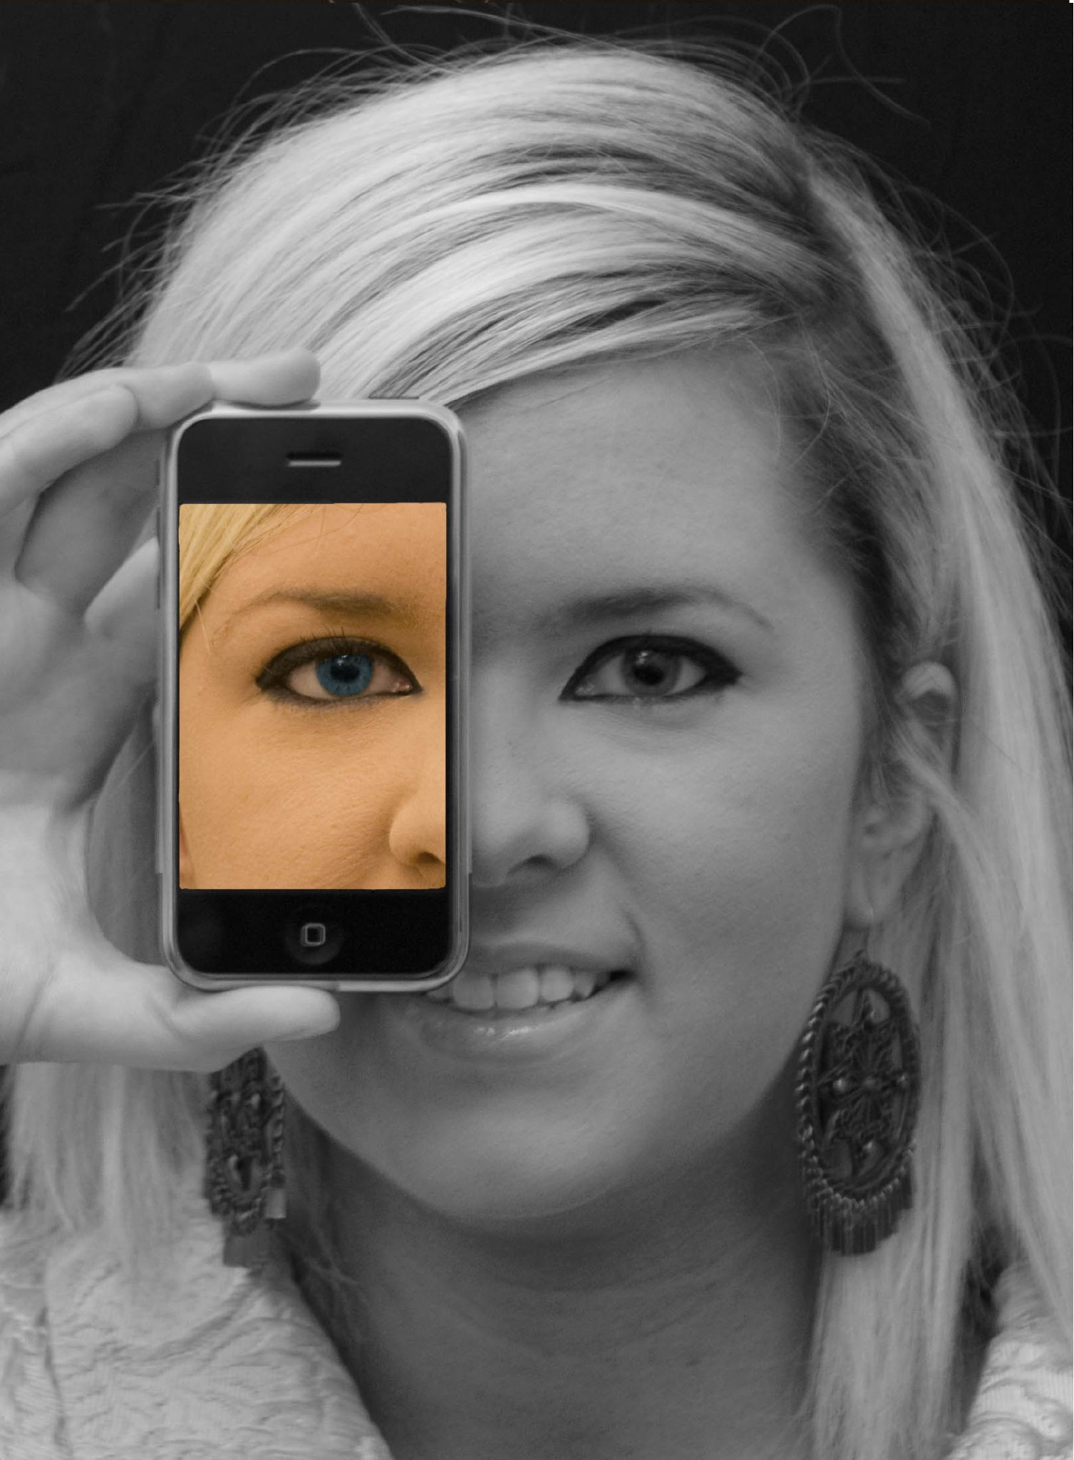

Slide 103
A computer in every hand
Focus on leaders, not just students and teachers
Notes:
New Commission on the Skills of the American Workforce
It is becoming progressively less expensive to automate functions that used to be performed by people. As the cost of labor rises and the cost of automating jobs continues to fall, it becomes both possible and necessary for firms simply to eliminate job after job now being done by humans. Earlier, almost all the jobs subject to automation were low-skill jobs. That is no longer true. Now it is more accurate to say that the jobs that are most vulnerable are the jobs involving routine work. If someone can figure out the algorithm for a routine job, chances are that it is economical to automate it. Many good, well-paying, middle-class jobs involve routine work of this kind and are rapidly being automated. [Think tax preparers, lawyers… being replaced by software]
Daniel Pink
If you say yes to 1 or 2, or no to 3, you’re in trouble
Forging relationship rather than executing transactions
Tackling novel, complex challenges instead of solving routine problems
Synthesizing and connecting disparate parts, thus creating or adding value
The capacity to detect patterns and opportunities, to combine seemingly unrelated ideas into something new, to craft a satisfying narrative, to create artistic and emotional beauty
Creativity is the ultimate economic resource. The ability to come up with new ideas and better ways of doing things is ultimately what raises productivity and thus living standards. In virtually every industry, the winners in the long run are those who can create and keep creating. This has always been true.
As we have moved from an agricultural age to an industrial age to an information age, our primary economic resource no longer is raw materials from the ground or human labor. We have to recognize that information is now the primary and most lucrative raw material.

Slide 104

Notes:
Anticipatory v. reactionary

Slide 105

Notes:
Future oriented v. compliance oriented

Slide 106

The people in charge of leading school organizations into the 21st century …
often are the least knowledgeable about the 21st century.
dangerouslyirrelevant.org
Notes:
Licensed under a Creative Commons attribution-share alike license.
http://creativecommons.org/licenses/by-sa/3.0
Scott McLeod, J.D., Ph.D.
scottmcleod.net/contact
dangerouslyirrelevant.org
schooltechleadership.org

Slide 107

If the leaders don’t get it,
it’s not going to happen.
dangerouslyirrelevant.org
Notes:
Licensed under a Creative Commons attribution-share alike license.
http://creativecommons.org/licenses/by-sa/3.0
Scott McLeod, J.D., Ph.D.
scottmcleod.net/contact
dangerouslyirrelevant.org
schooltechleadership.org

Slide 108
A computer in every hand
Focus on leaders, not just students and teachers
Revolution, not evolution
Notes:
New Commission on the Skills of the American Workforce
It is becoming progressively less expensive to automate functions that used to be performed by people. As the cost of labor rises and the cost of automating jobs continues to fall, it becomes both possible and necessary for firms simply to eliminate job after job now being done by humans. Earlier, almost all the jobs subject to automation were low-skill jobs. That is no longer true. Now it is more accurate to say that the jobs that are most vulnerable are the jobs involving routine work. If someone can figure out the algorithm for a routine job, chances are that it is economical to automate it. Many good, well-paying, middle-class jobs involve routine work of this kind and are rapidly being automated. [Think tax preparers, lawyers… being replaced by software]
Daniel Pink
If you say yes to 1 or 2, or no to 3, you’re in trouble
Forging relationship rather than executing transactions
Tackling novel, complex challenges instead of solving routine problems
Synthesizing and connecting disparate parts, thus creating or adding value
The capacity to detect patterns and opportunities, to combine seemingly unrelated ideas into something new, to craft a satisfying narrative, to create artistic and emotional beauty
Creativity is the ultimate economic resource. The ability to come up with new ideas and better ways of doing things is ultimately what raises productivity and thus living standards. In virtually every industry, the winners in the long run are those who can create and keep creating. This has always been true.
As we have moved from an agricultural age to an industrial age to an information age, our primary economic resource no longer is raw materials from the ground or human labor. We have to recognize that information is now the primary and most lucrative raw material.

Slide 109
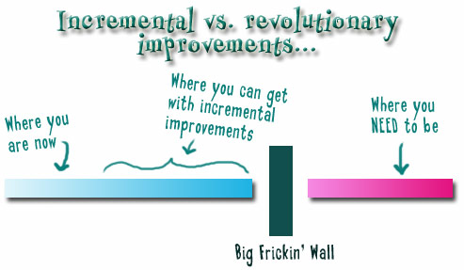
Notes:
We need to somehow change faster
No one jumps a 20 foot chasm in two
10 foot jumps. – Miguel Guhlin
When the world changes so fast that we have no reasonable way to forecast what it will look like in a mere decade or two, all we can do is teach kids how to be adaptive – to be learners in the truest sense of the word –
We’ve always talked about preparing lifelong learners in schools, but our practices typically haven’t matched our rhetoric. It’s time to put some bite into our toothless vision statements and recognize that we have to teach kids how to learn to learn if they want to be successful in this new technology-suffused, globally-interconnected world
Credits: http://tinyurl.com/2urbsm and http://tinyurl.com/37em64 (see Guhlin comment)
http://remoteaccess.typepad.com/remote_access/ 2006/06/literacy_as_bat.html (see Guhlin comment)
http://headrush.typepad.com/creating_passionate_users/2005/03/incremental_vs_.html

Slide 110

dangerouslyirrelevant.org
No one jumps a 20 foot chasm in two 10 foot jumps.
Miguel Guhlin
http://www.flickr.com/photos/midnight-digital/3086238863/in/pool-jumping
Notes:
Licensed under a Creative Commons attribution-share alike license.
http://creativecommons.org/licenses/by-sa/3.0
Scott McLeod, J.D., Ph.D.
scottmcleod.net/contact
dangerouslyirrelevant.org
schooltechleadership.org
http://www.flickr.com/photos/midnight-digital/3086238863/in/pool-jumping
http://remoteaccess.typepad.com/remote_access/2006/06/literacy_as_bat.html

Slide 111
Inform yourself
Notes:
New Commission on the Skills of the American Workforce
It is becoming progressively less expensive to automate functions that used to be performed by people. As the cost of labor rises and the cost of automating jobs continues to fall, it becomes both possible and necessary for firms simply to eliminate job after job now being done by humans. Earlier, almost all the jobs subject to automation were low-skill jobs. That is no longer true. Now it is more accurate to say that the jobs that are most vulnerable are the jobs involving routine work. If someone can figure out the algorithm for a routine job, chances are that it is economical to automate it. Many good, well-paying, middle-class jobs involve routine work of this kind and are rapidly being automated. [Think tax preparers, lawyers… being replaced by software]
Daniel Pink
If you say yes to 1 or 2, or no to 3, you’re in trouble
Forging relationship rather than executing transactions
Tackling novel, complex challenges instead of solving routine problems
Synthesizing and connecting disparate parts, thus creating or adding value
The capacity to detect patterns and opportunities, to combine seemingly unrelated ideas into something new, to craft a satisfying narrative, to create artistic and emotional beauty
Creativity is the ultimate economic resource. The ability to come up with new ideas and better ways of doing things is ultimately what raises productivity and thus living standards. In virtually every industry, the winners in the long run are those who can create and keep creating. This has always been true.
As we have moved from an agricultural age to an industrial age to an information age, our primary economic resource no longer is raw materials from the ground or human labor. We have to recognize that information is now the primary and most lucrative raw material.

Slide 112
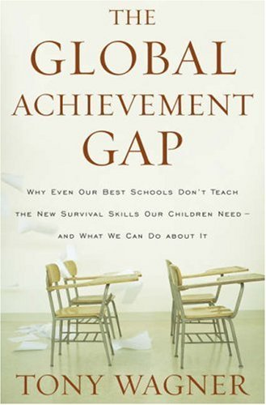

Slide 113
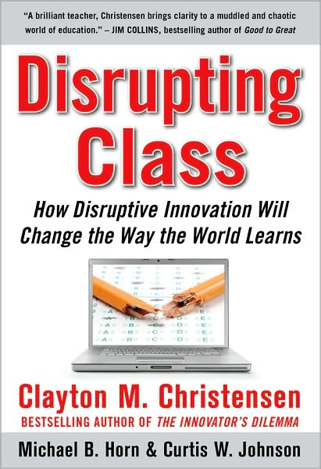

Slide 114
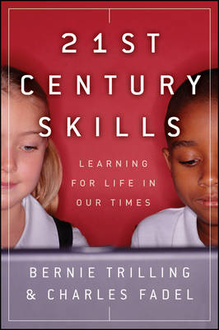

Slide 115


Slide 116
Inform yourself
Ask (and be ready for) questions
Notes:
New Commission on the Skills of the American Workforce
It is becoming progressively less expensive to automate functions that used to be performed by people. As the cost of labor rises and the cost of automating jobs continues to fall, it becomes both possible and necessary for firms simply to eliminate job after job now being done by humans. Earlier, almost all the jobs subject to automation were low-skill jobs. That is no longer true. Now it is more accurate to say that the jobs that are most vulnerable are the jobs involving routine work. If someone can figure out the algorithm for a routine job, chances are that it is economical to automate it. Many good, well-paying, middle-class jobs involve routine work of this kind and are rapidly being automated. [Think tax preparers, lawyers… being replaced by software]
Daniel Pink
If you say yes to 1 or 2, or no to 3, you’re in trouble
Forging relationship rather than executing transactions
Tackling novel, complex challenges instead of solving routine problems
Synthesizing and connecting disparate parts, thus creating or adding value
The capacity to detect patterns and opportunities, to combine seemingly unrelated ideas into something new, to craft a satisfying narrative, to create artistic and emotional beauty
Creativity is the ultimate economic resource. The ability to come up with new ideas and better ways of doing things is ultimately what raises productivity and thus living standards. In virtually every industry, the winners in the long run are those who can create and keep creating. This has always been true.
As we have moved from an agricultural age to an industrial age to an information age, our primary economic resource no longer is raw materials from the ground or human labor. We have to recognize that information is now the primary and most lucrative raw material.

Slide 117
What are you doing to prepare students to be successful in the digital, global age?

Slide 118
Why do students do so much of their work on paper?

Slide 119

dangerouslyirrelevant.org
Given the realities of our modern age and the demands of our children's future, is it really okay to allow teachers to choose whether or not they incorporate digital technologies into their instruction?
Notes:
Licensed under a Creative Commons attribution-share alike license.
http://creativecommons.org/licenses/by-sa/3.0
Scott McLeod, J.D., Ph.D.
scottmcleod.net/contact
dangerouslyirrelevant.org
schooltechleadership.org

Slide 120
The world has changed. Why haven’t our schools?

Slide 121
Inform yourself
Ask (and be ready for) questions
Invest now or pay later
Notes:
New Commission on the Skills of the American Workforce
It is becoming progressively less expensive to automate functions that used to be performed by people. As the cost of labor rises and the cost of automating jobs continues to fall, it becomes both possible and necessary for firms simply to eliminate job after job now being done by humans. Earlier, almost all the jobs subject to automation were low-skill jobs. That is no longer true. Now it is more accurate to say that the jobs that are most vulnerable are the jobs involving routine work. If someone can figure out the algorithm for a routine job, chances are that it is economical to automate it. Many good, well-paying, middle-class jobs involve routine work of this kind and are rapidly being automated. [Think tax preparers, lawyers… being replaced by software]
Daniel Pink
If you say yes to 1 or 2, or no to 3, you’re in trouble
Forging relationship rather than executing transactions
Tackling novel, complex challenges instead of solving routine problems
Synthesizing and connecting disparate parts, thus creating or adding value
The capacity to detect patterns and opportunities, to combine seemingly unrelated ideas into something new, to craft a satisfying narrative, to create artistic and emotional beauty
Creativity is the ultimate economic resource. The ability to come up with new ideas and better ways of doing things is ultimately what raises productivity and thus living standards. In virtually every industry, the winners in the long run are those who can create and keep creating. This has always been true.
As we have moved from an agricultural age to an industrial age to an information age, our primary economic resource no longer is raw materials from the ground or human labor. We have to recognize that information is now the primary and most lucrative raw material.

Slide 122

No one will thank you
for taking care of today
if you have failed
to take care of tomorrow.
Joel Barker

Slide 123
Final thoughts

Slide 124
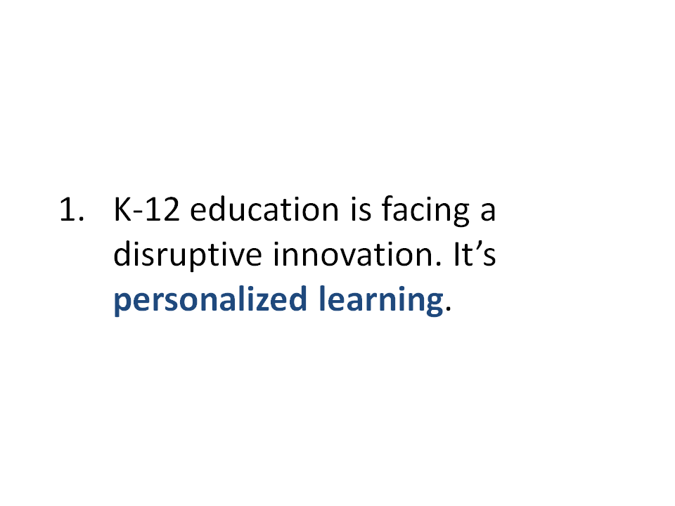

Slide 125
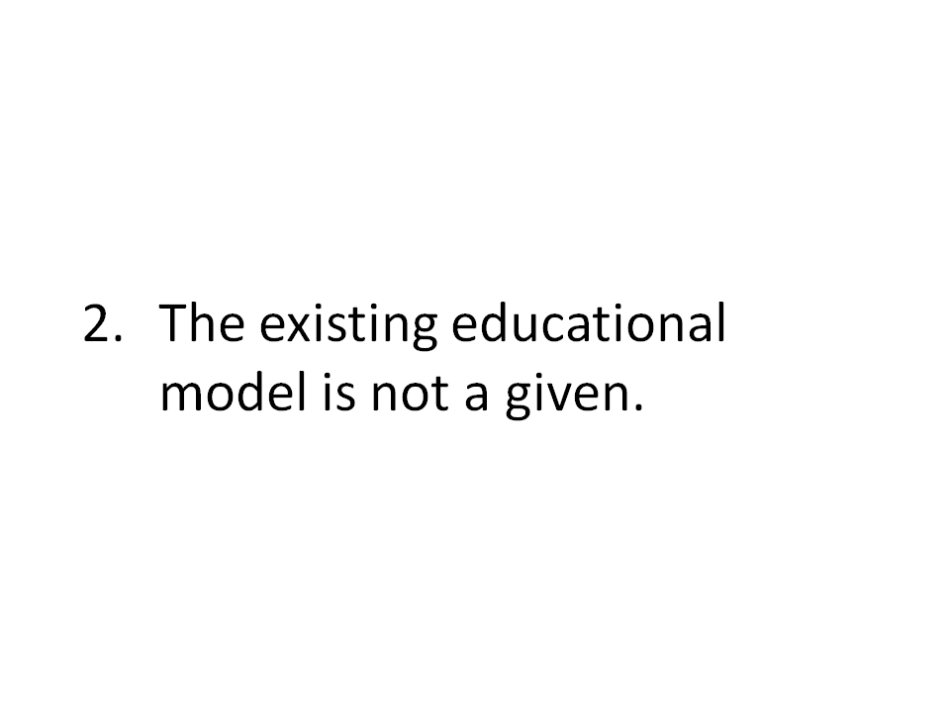

Slide 126
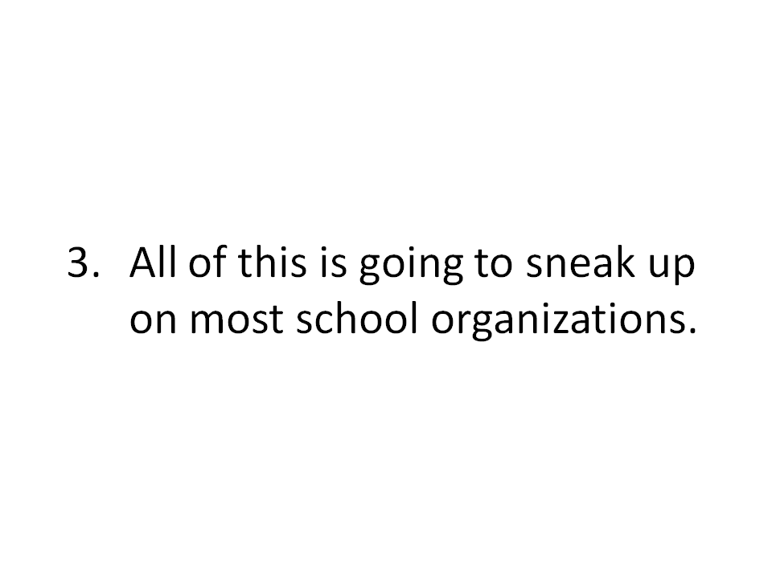

Slide 127

Notes:
127
We can’t be refugees
We have to be honest with ourselves
- most teachers and administrators (and professors) are refugees when it comes to most of this
- not worth the time investment to learn
- satisfied with the status quo

Slide 128
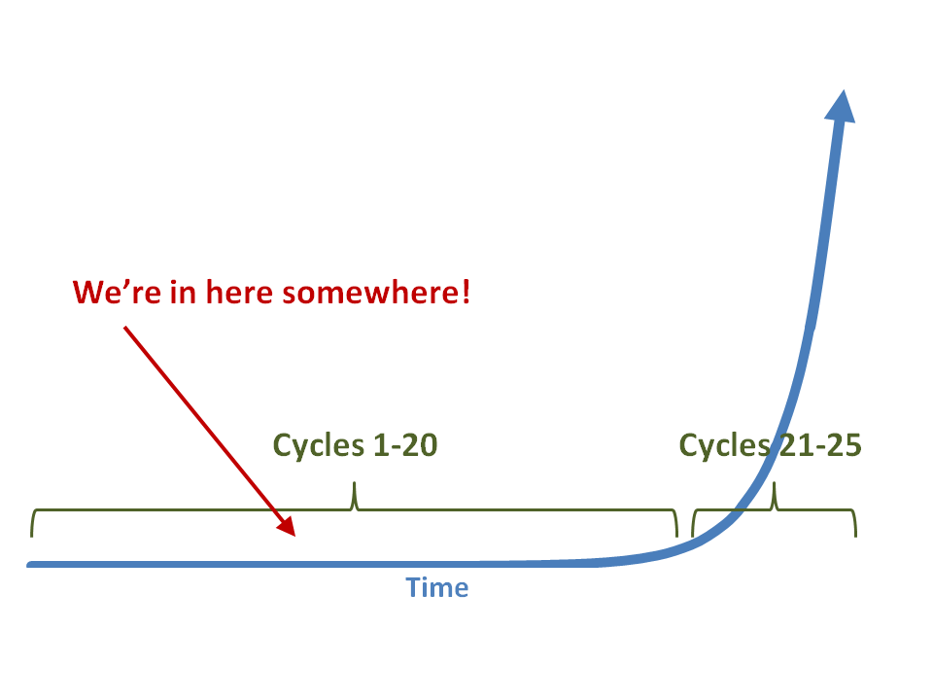

Slide 129


Slide 130


Slide 131

Notes:
131

Slide 132
Thank you!
Scott McLeod, J.D., Ph.D.
Director, CASTLE
uceacastle.wikispaces.com/saitraining
Notes:
132
URL

Slide 133
global awareness
effective speaking
critical thinking
problem solving
adaptability
information literacy
collaboration
creativity
media fluency
analytical skills
entrepeneurialism
innovation
effective writing
synthesis
curiosity
Notes:
1. critical thinking and problem solving in networks of cross-functional teams
world is complex and answers are not in the books
world is moving too fast for inflexible, hierarchical organizations
2. collaboration across networks and leadership by influence rather than positional authority
command and control increasingly less valued in organizations
schools are very much command and control institutions
3. agility and adaptability
intensifying rate of change, overwhelming amount of data, increasing complexity of problems
4. initiative and entrepeneurialism
people who can seek out new opportunities, ideas, and strategies
don’t want students or workers who are apathetic about their experiences
achievement orientation, drive for results, self-starters
5. effective written and oral communication
presentation skills, being clear and concise; creating focus, energy, and passion around the points they want to make
6. accessing and analyzing information
people who can access, evaluate, conceptualize, and synthesize multiple and large streams of incoming information to make meaningful decisions
7. curiosity and imagination
inquisitiveness, analytical skills that are more ‘out of the box’ than in the past, asking great questions is more important than knowing the ‘right answer’

Slide 135

CHANGE
OR DIE

