Slide 1

The lines
are blurring
Translating changes
in our information,
economic, and
learning landscapes
into school and
university practice
Dr. Scott McLeod
CASTLE

Slide 2
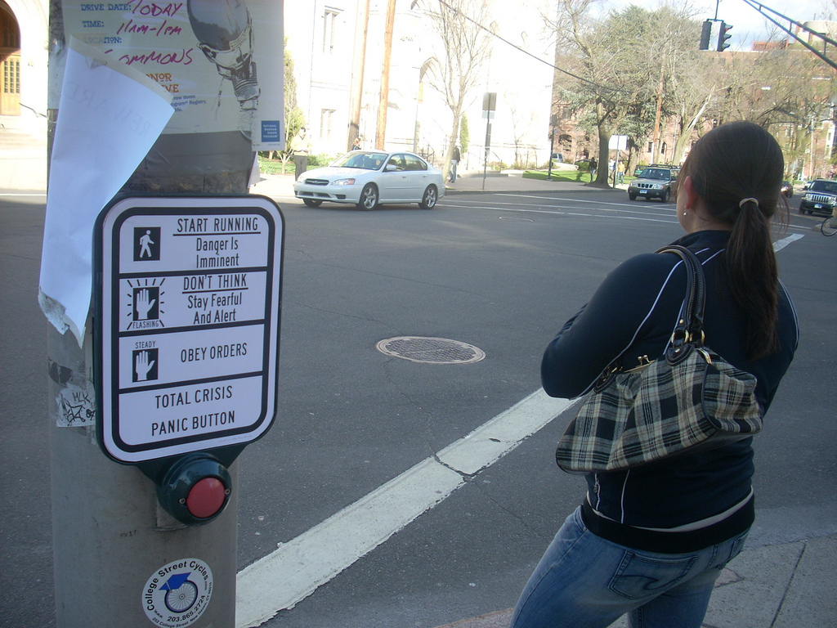
flickr.com/photos/28017515@N03/3470276439/in/photostream

Slide 3


Slide 4


Slide 5
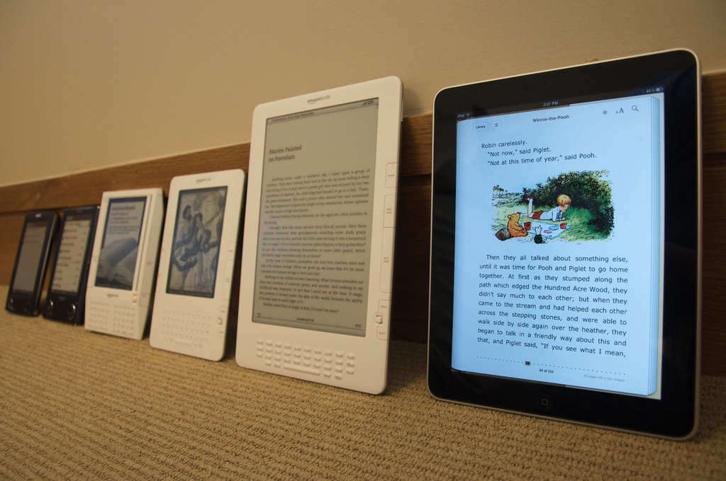
Notes:
http://www.flickr.com/photos/jblyberg/4505413539/sizes/l/in/photostream/

Slide 6


Slide 7


Slide 8


Slide 9


Slide 10


Slide 11


Slide 12


Slide 13


Slide 14


Slide 15


Slide 16


Slide 17
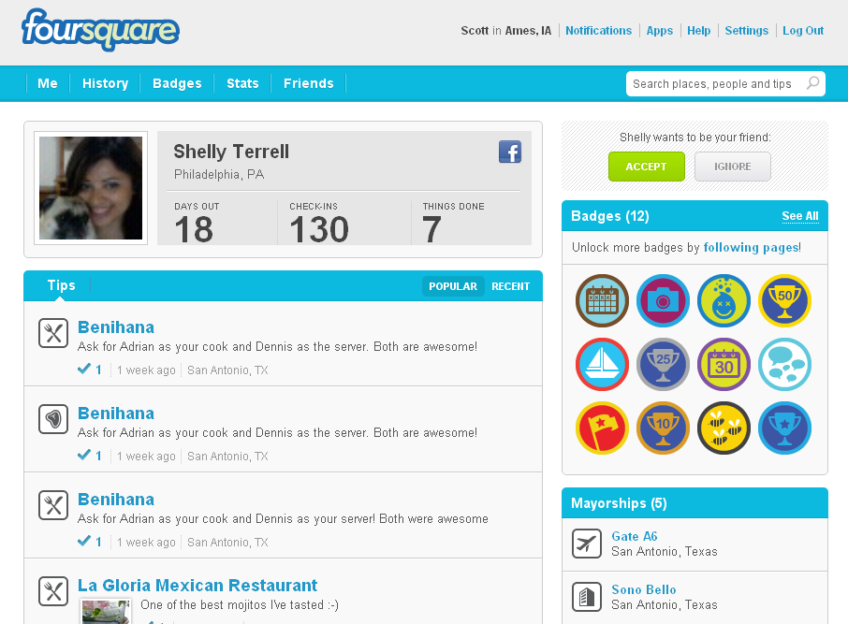

Slide 18
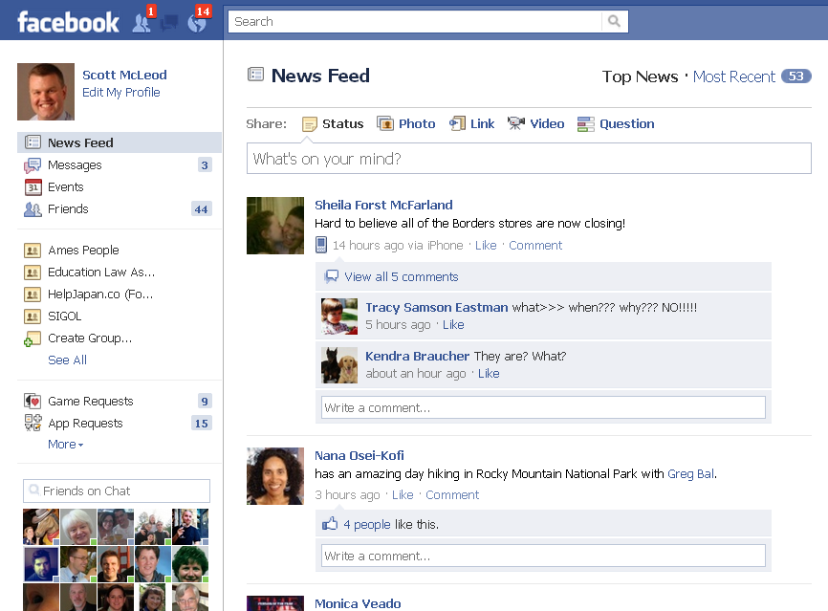

Slide 19


Slide 20


Slide 21
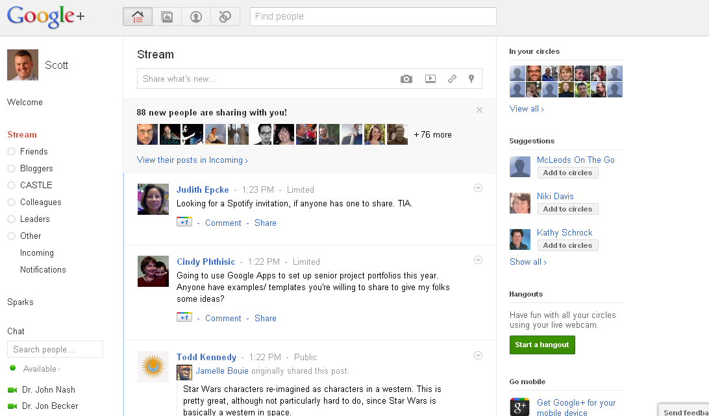

Slide 22


Slide 23


Slide 24


Slide 25
We all now have a voice

Slide 26
We can easily find each other

Slide 27
We can easily work together

Slide 28


Slide 29
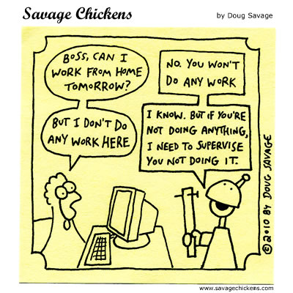

Slide 30
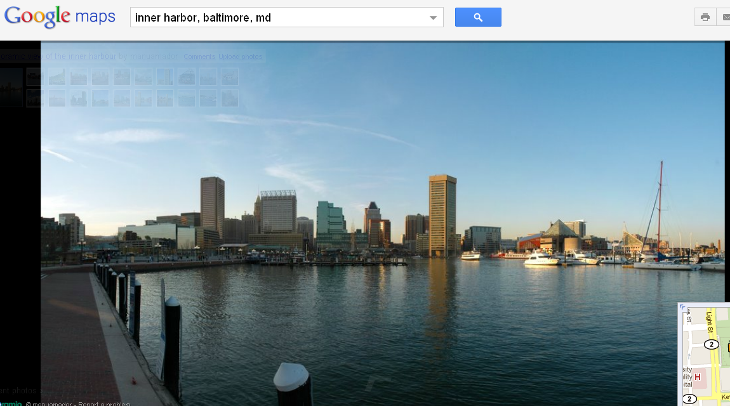

Slide 31
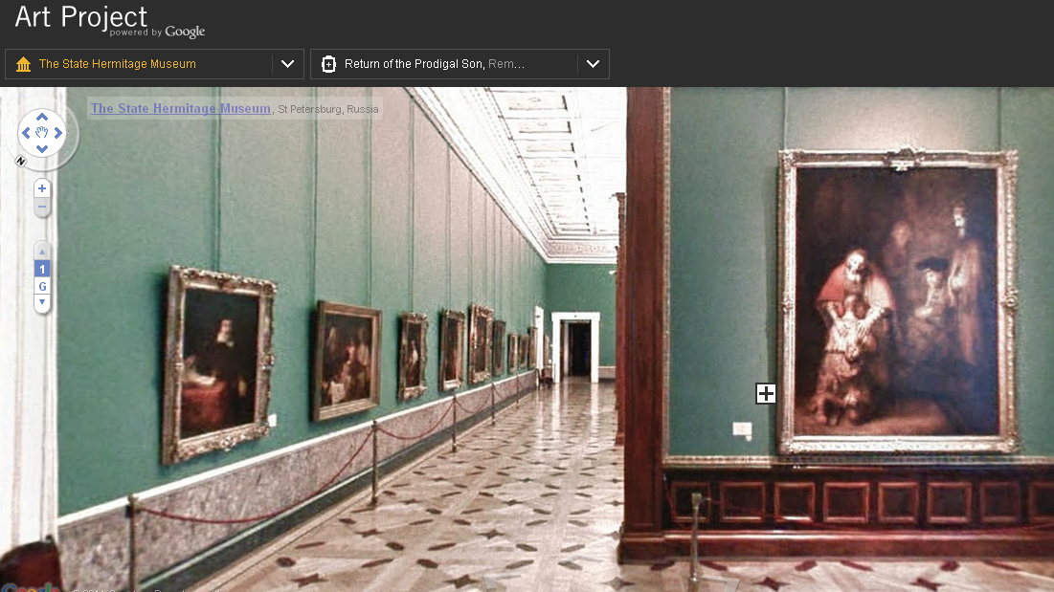

Slide 32
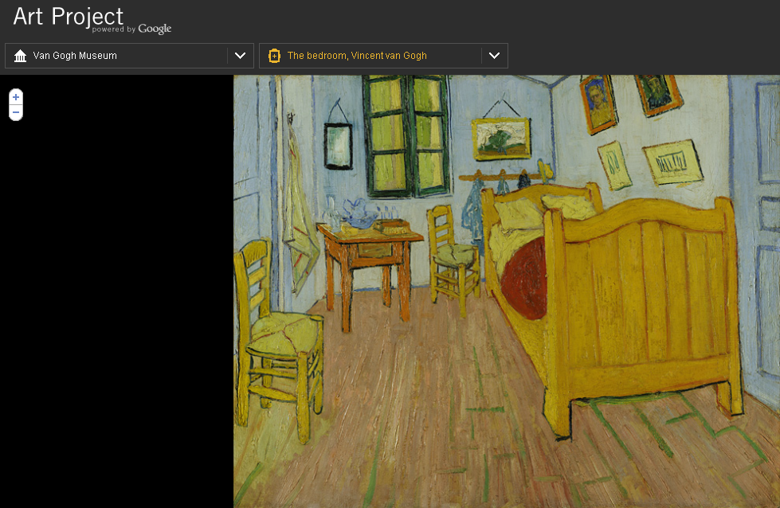

Slide 33
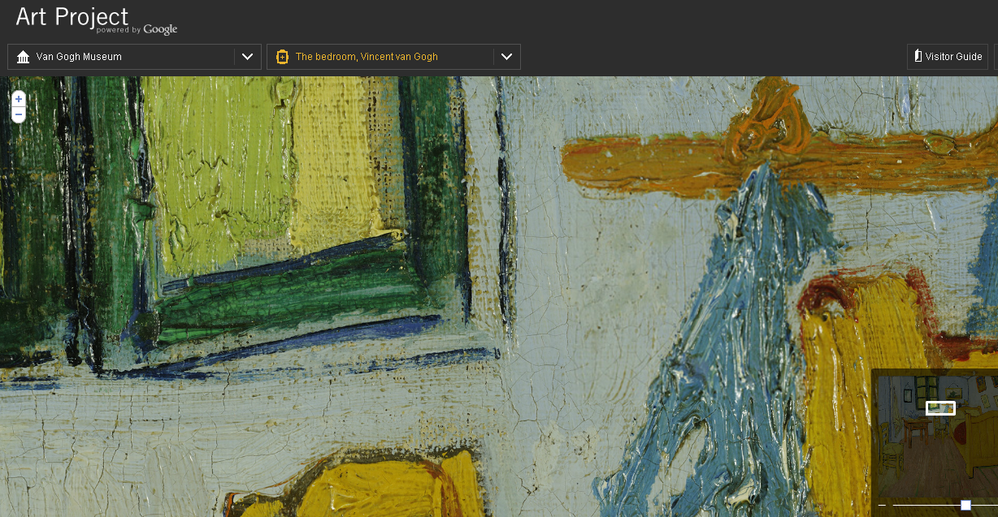

Slide 34
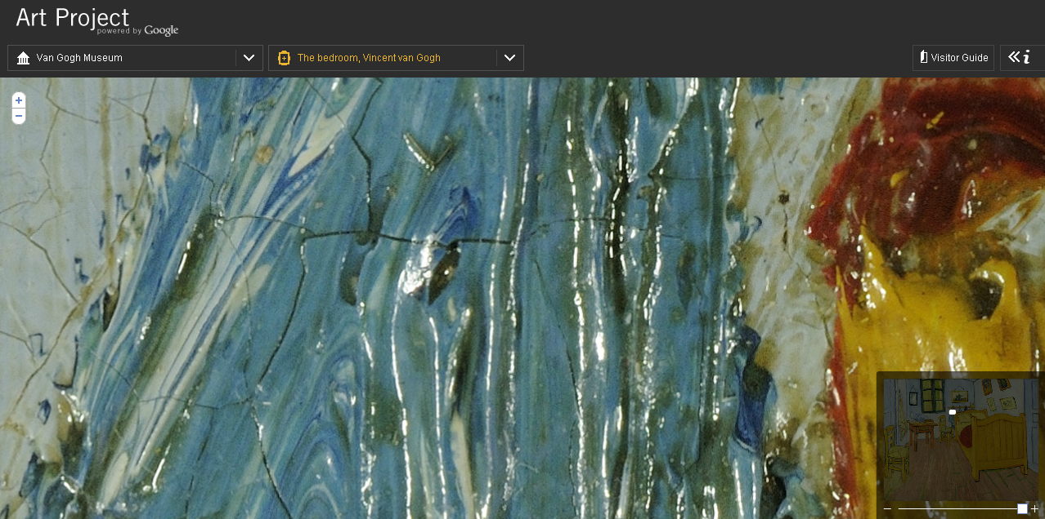

Slide 35


Slide 36


Slide 37
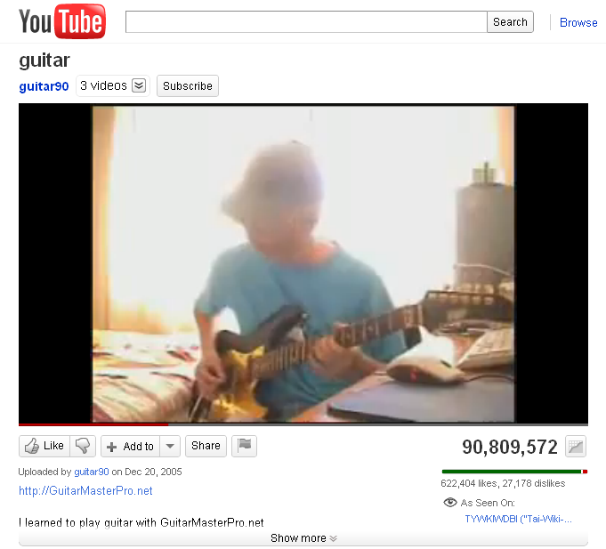

Slide 38
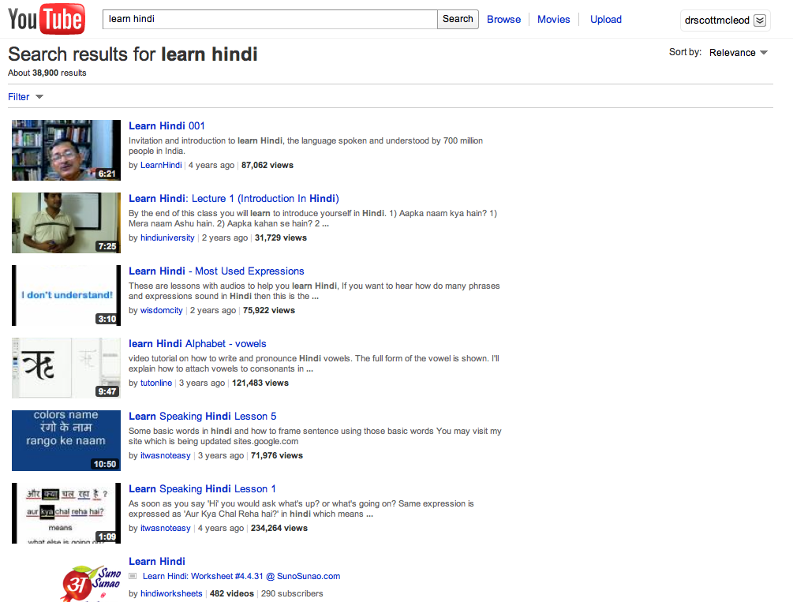

Slide 39
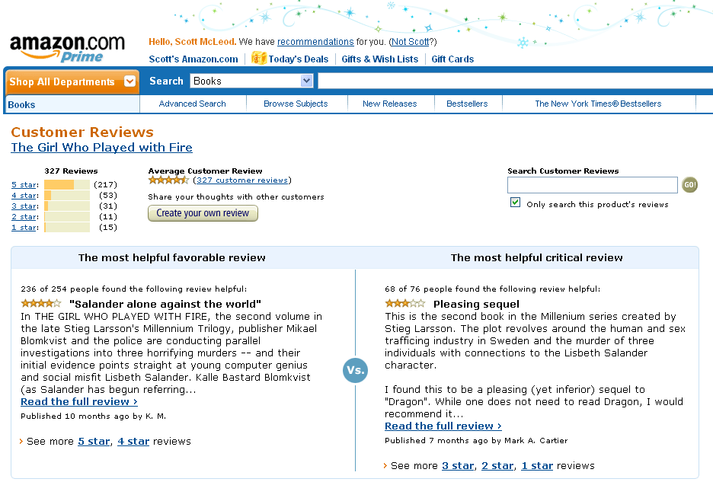

Slide 40


Slide 41
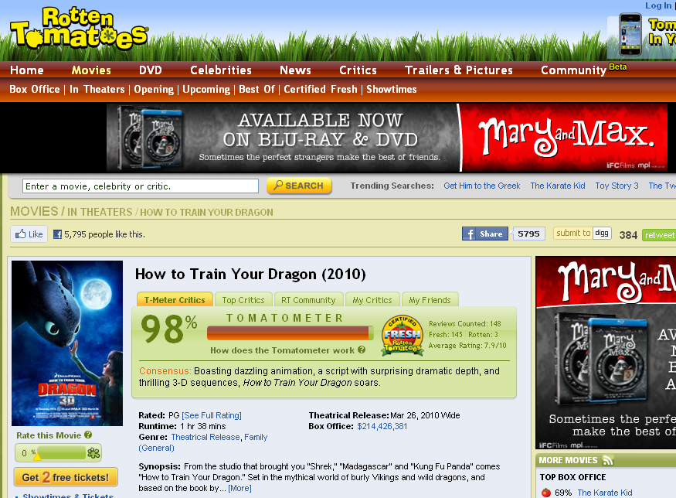

Slide 42
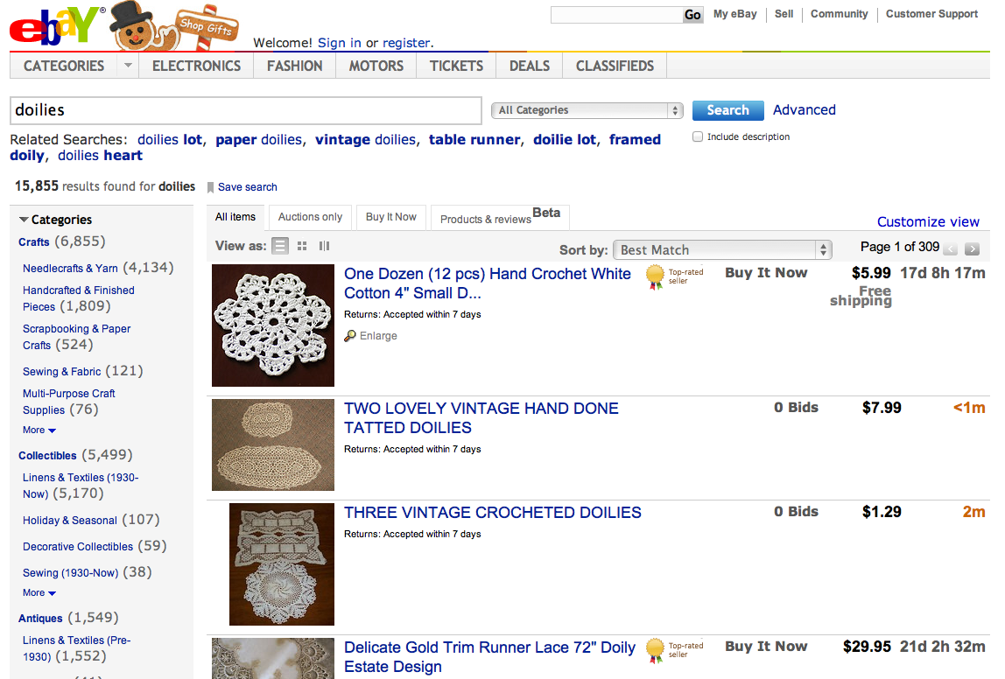

Slide 43
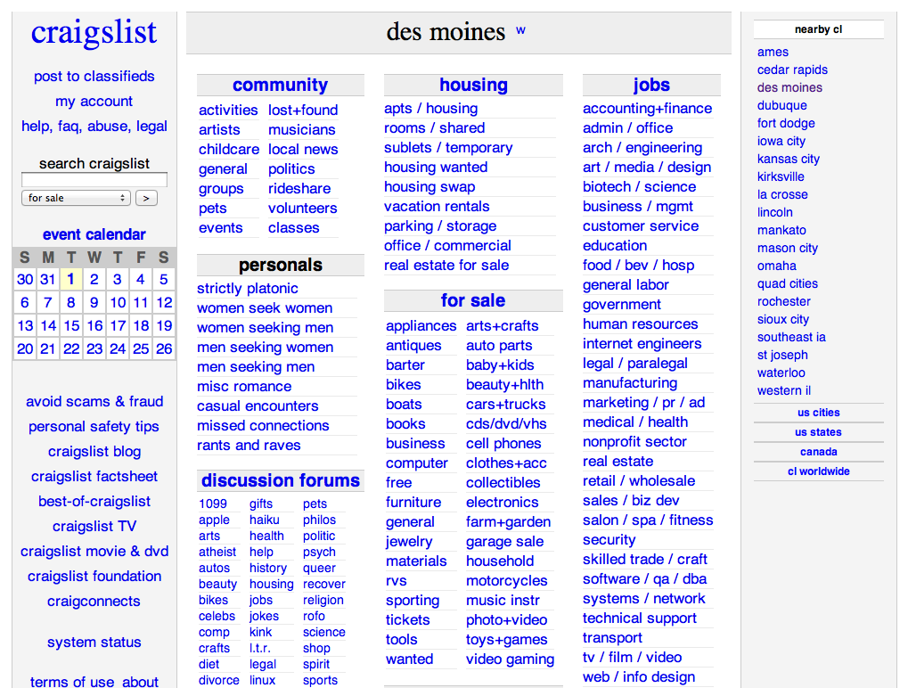

Slide 44


Slide 45


Slide 46
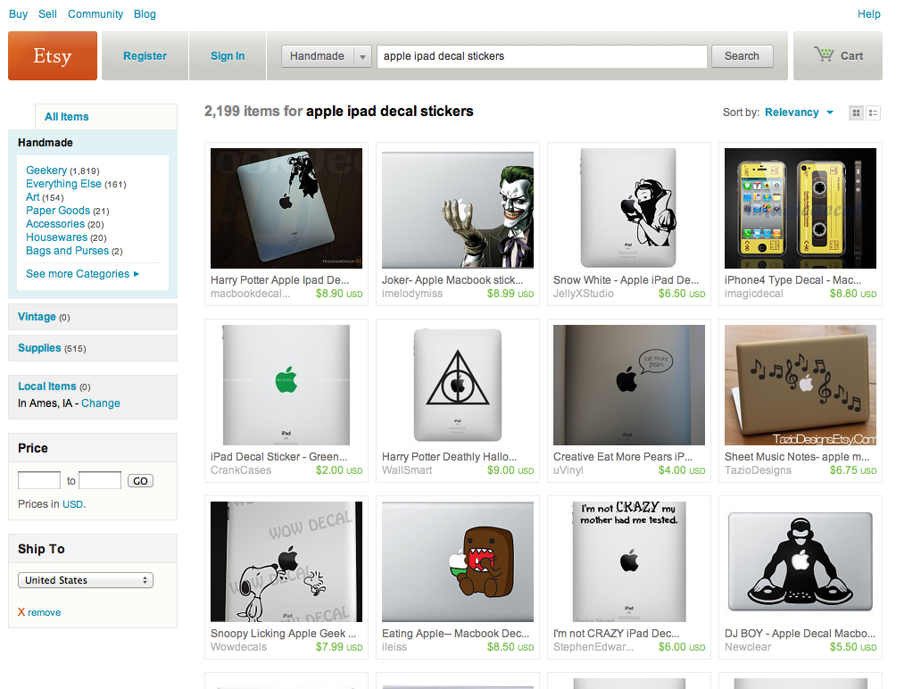

Slide 47
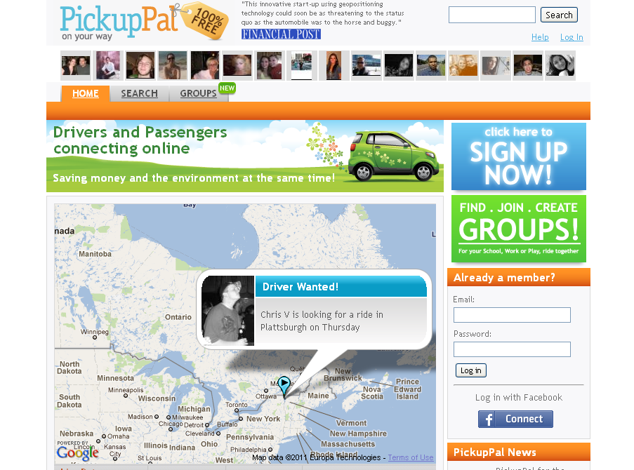

Slide 48
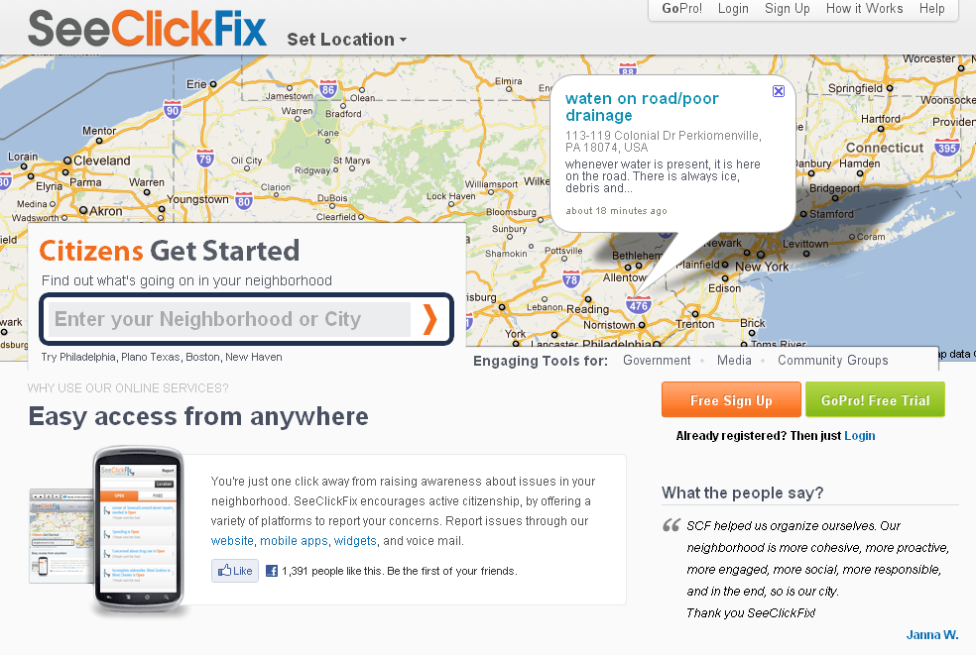

Slide 49
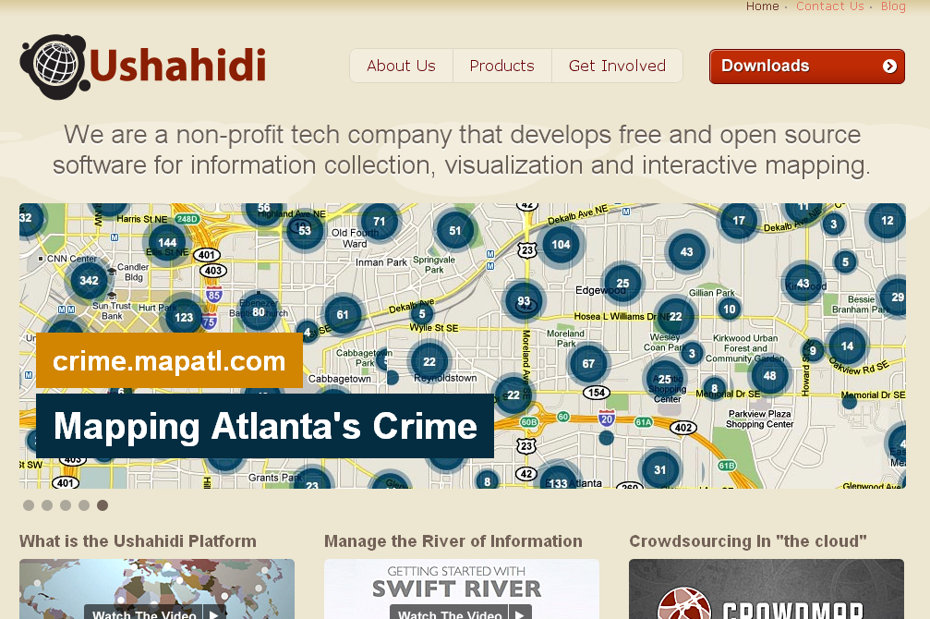

Slide 50


Slide 51
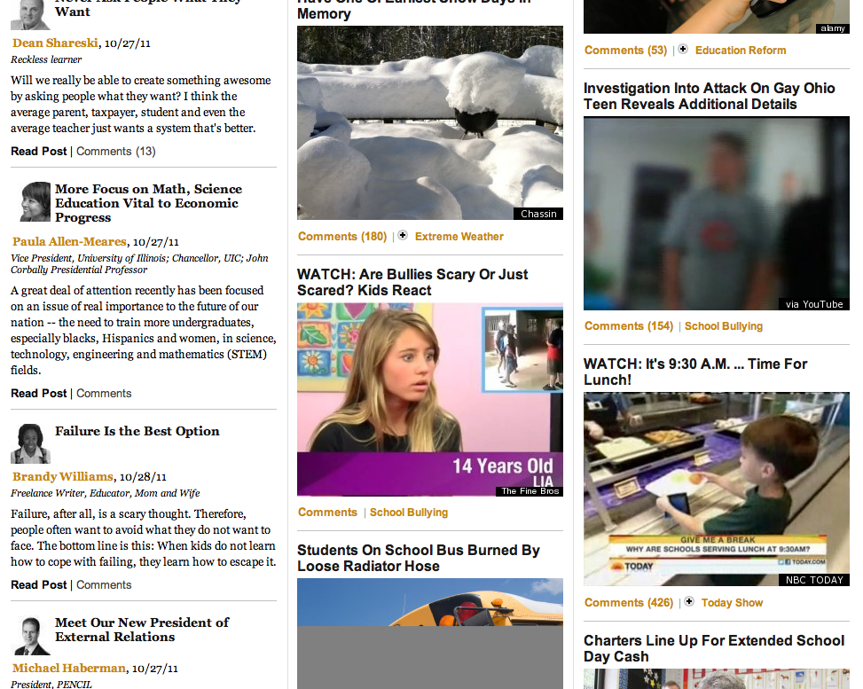

Slide 52
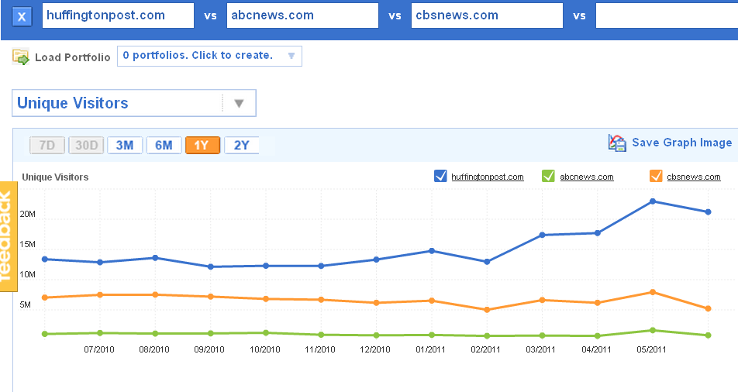

Slide 53
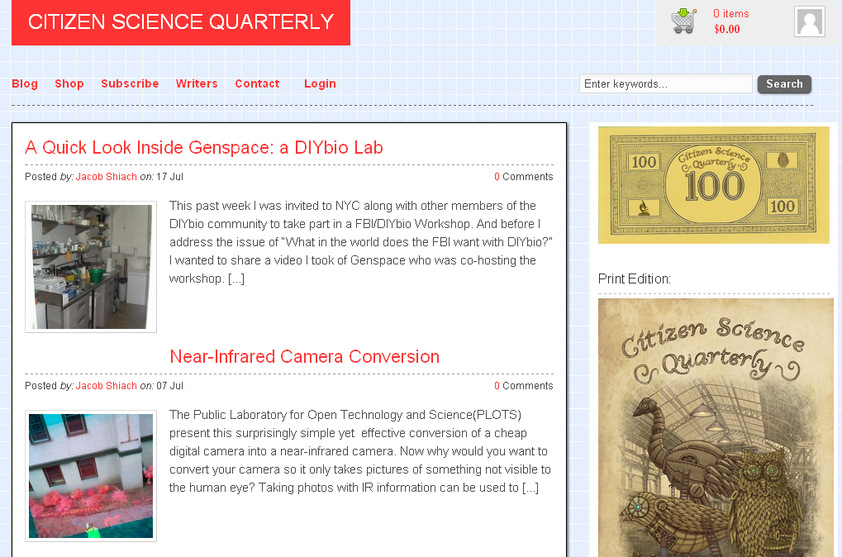

Slide 54
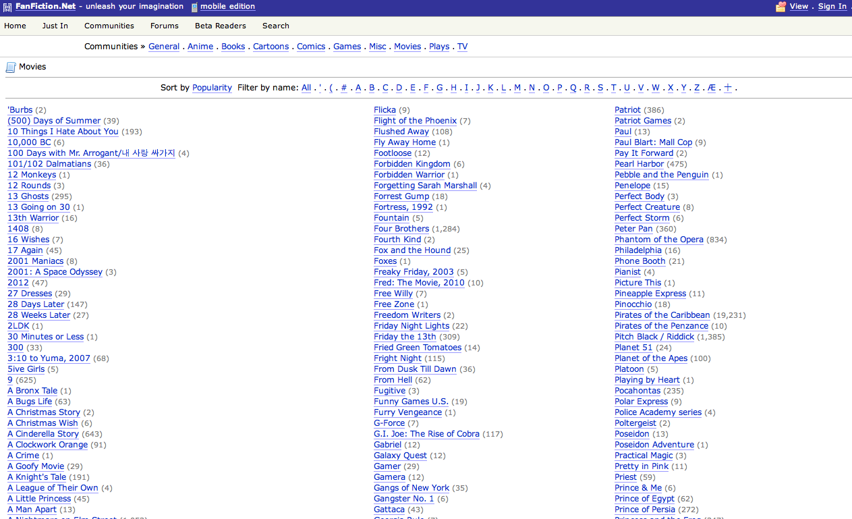

Slide 55
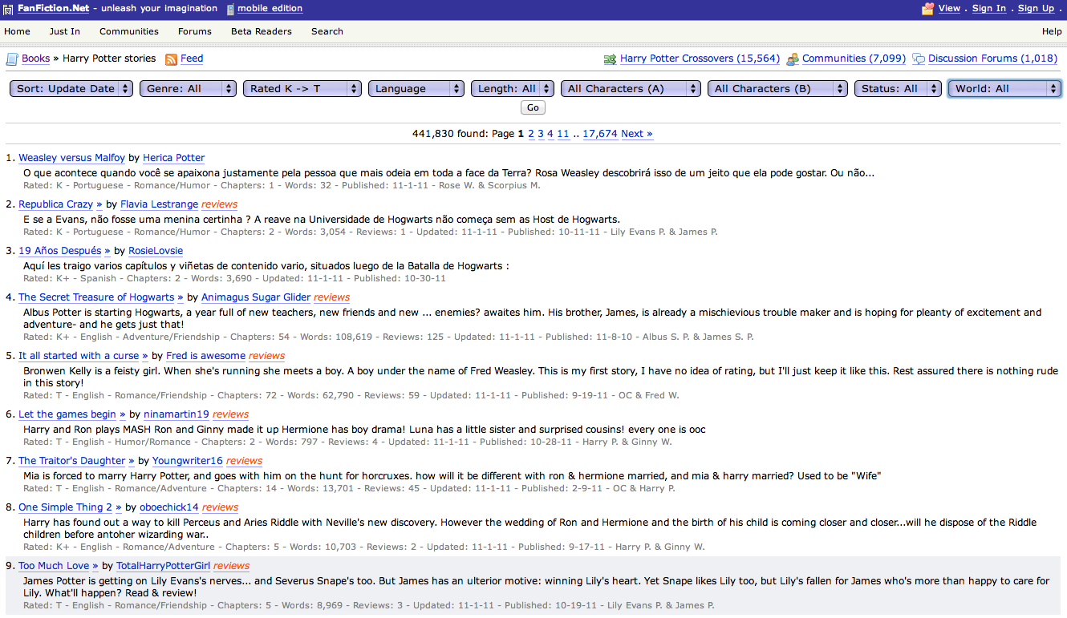

Slide 56


Slide 57
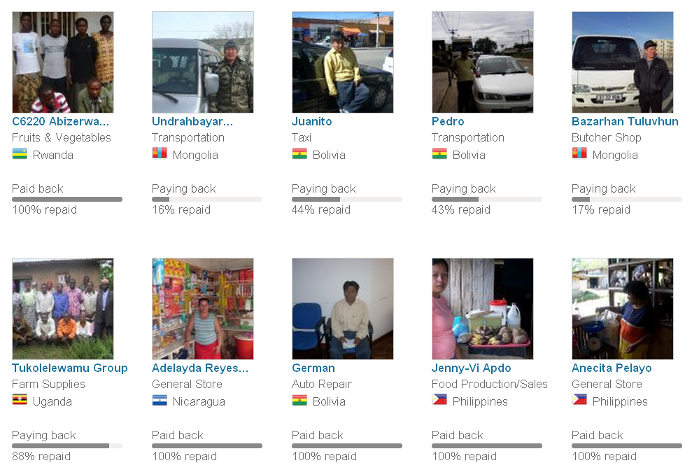

Slide 58
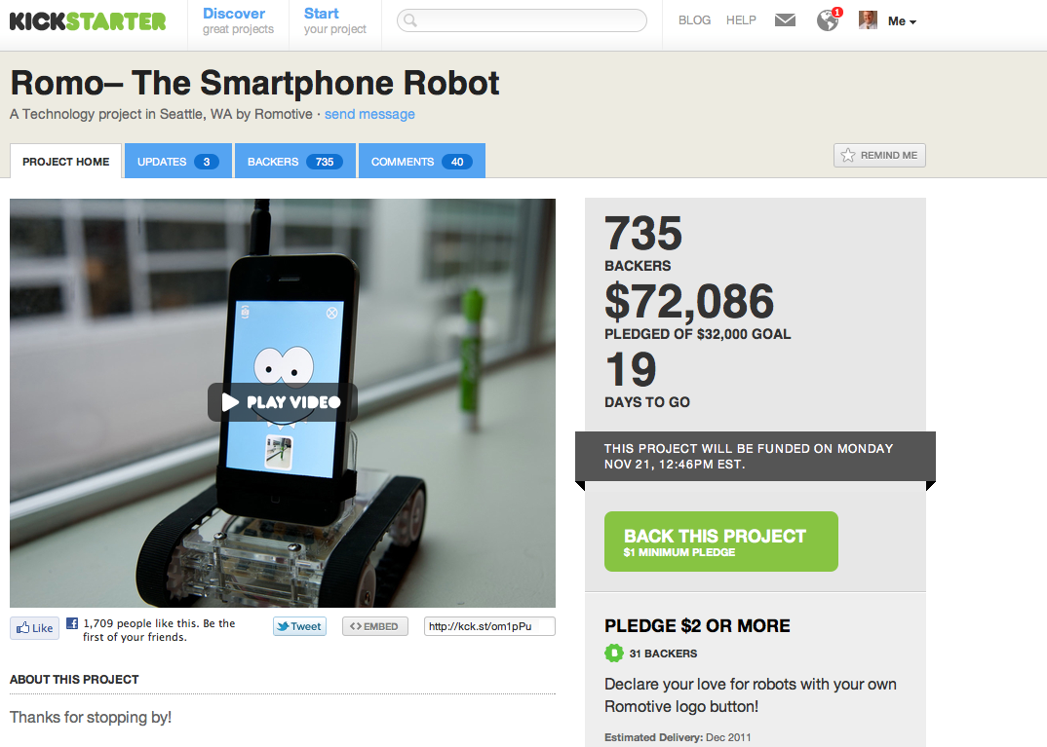

Slide 59
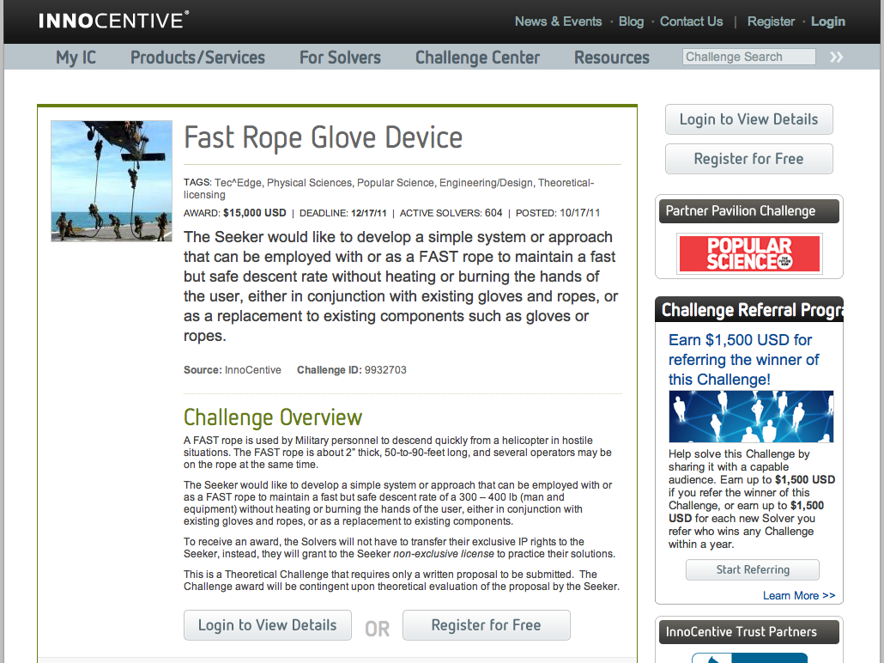

Slide 60
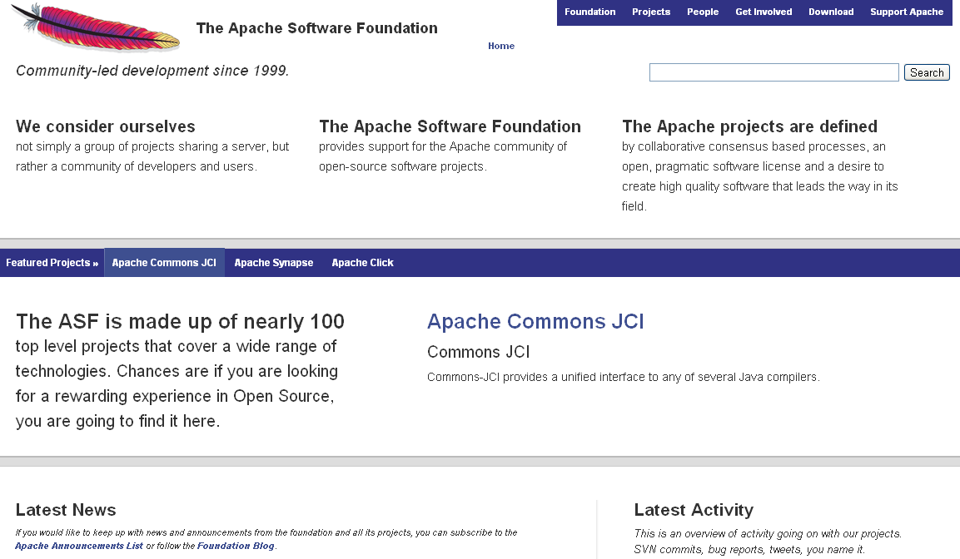

Slide 61
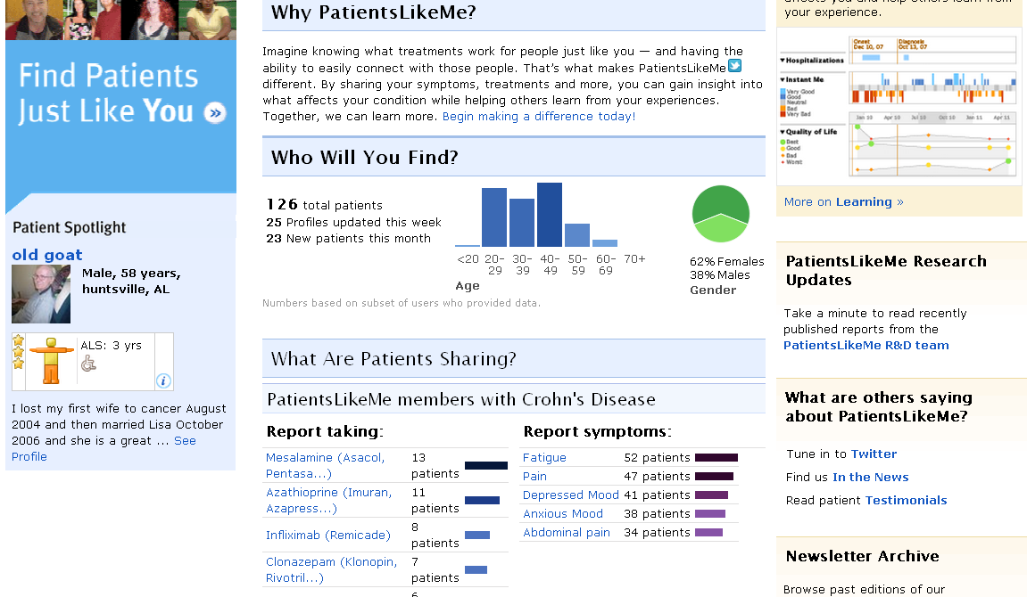

Slide 62
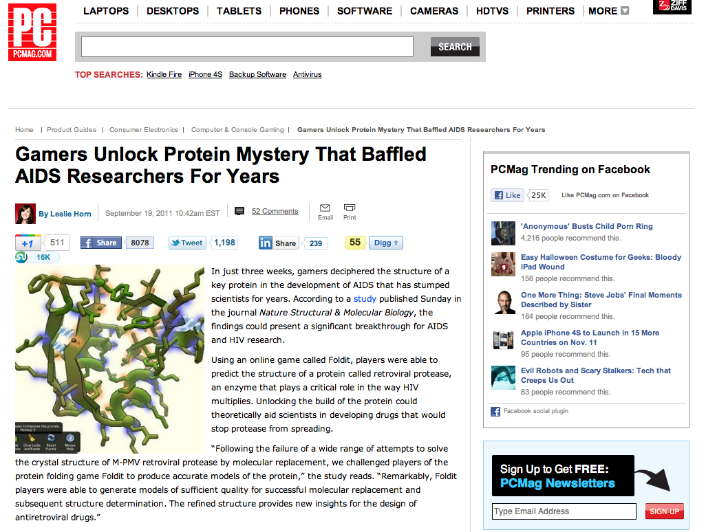

Slide 63
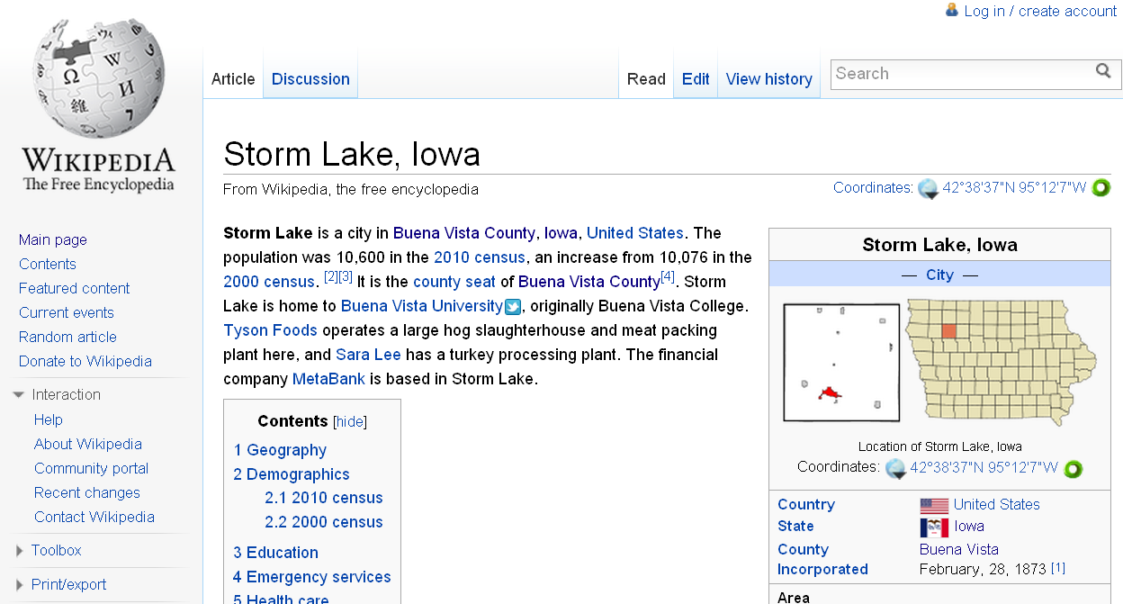

Slide 64
What’s in your head right now?

Slide 65

Notes:
http://www.flickr.com/photos/deks/711658920/sizes/z/

Slide 66

Notes:
http://www.flickr.com/photos/sepblog/3527825643/sizes/o/

Slide 67

Notes:
http://www.flickr.com/photos/13638129@N00/118245563/

Slide 68

Notes:
http://www.flickr.com/photos/7337467@N04/3052065204/

Slide 69

Notes:
http://www.flickr.com/photos/77136818@N00/3202144482/

Slide 70

Notes:
http://www.flickr.com/photos/20532289@N00/59083917/

Slide 71

Notes:
http://www.flickr.com/photos/48973657@N00/4556156477/

Slide 72

Notes:
http://www.flickr.com/photos/88442983@N00/1604241264/

Slide 73

Notes:
http://www.flickr.com/photos/28473961@N02/3229296247/

Slide 74

Notes:
http://www.flickr.com/photos/28473961@N02/4320982975/

Slide 75

Notes:
http://www.flickr.com/photos/28473961@N02/2757755401/

Slide 76

Notes:
http://www.flickr.com/photos/26416016@N02/4479154715/

Slide 77

Notes:
http://www.flickr.com/photos/9031691@N08/2670224692/

Slide 78

Notes:
http://www.flickr.com/photos/28567825@N03/5129325457/

Slide 79

Notes:
http://www.flickr.com/photos/47477979@N00/2453748088/

Slide 80

CHANGE
OR DIE

Slide 81

Notes:
http://www.flickr.com/photos/30624156@N00/4820259304/

Slide 82
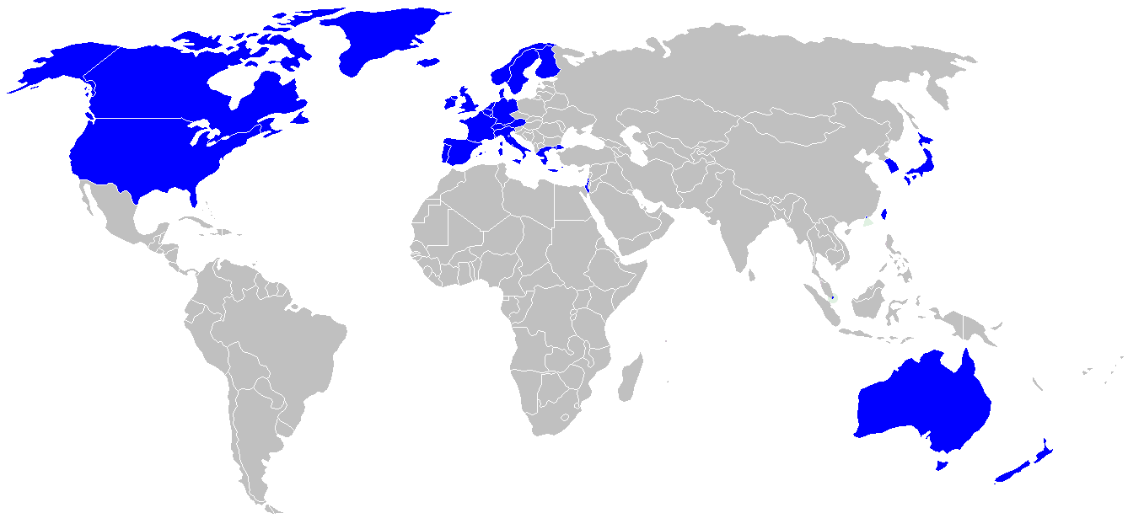

Slide 83
location
dependent?
location
independent?

Slide 84

I sell books!
I’m an
accountant!
I have
an idea!

Slide 85
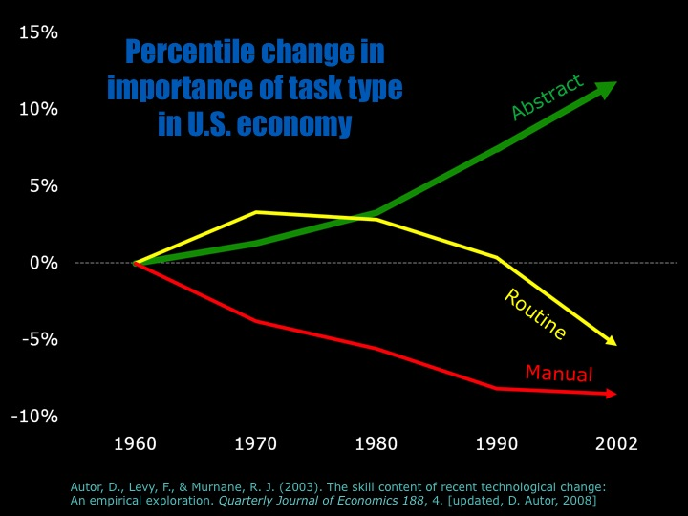

Slide 86
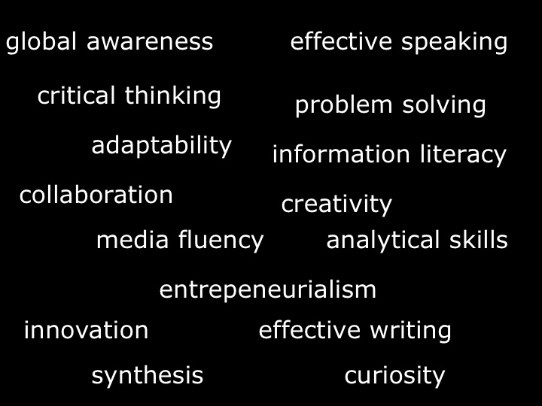

Slide 88


Slide 89
low skill
low wage
low skill
high wage
high skill
high wage

Slide 90
low skill
low wage
low skill
high wage
high skill
high wage

Slide 91
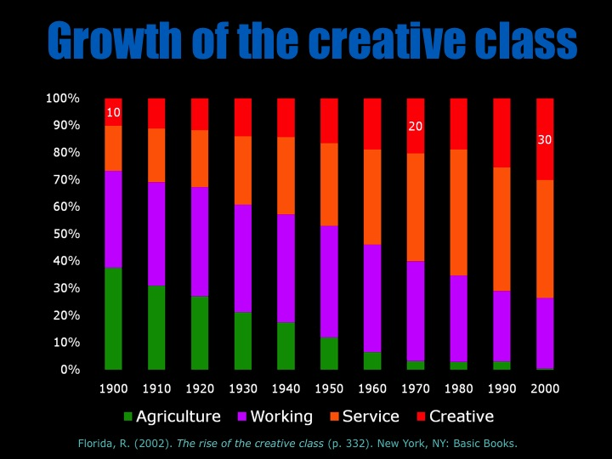

Slide 92
  Can someone overseas
  do it cheaper?
  Can a computer
  do it faster?

Slide 93
2 billion

Slide 94


Slide 95


Slide 96


Slide 97


Slide 98
What’s in your head right now?

Slide 99
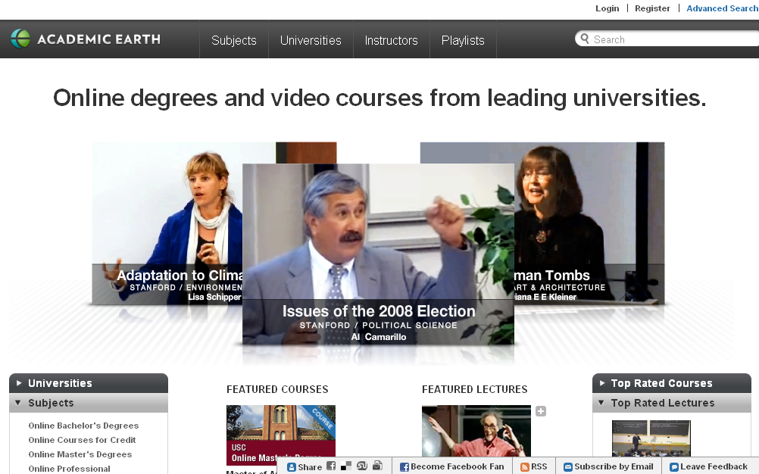

Slide 100
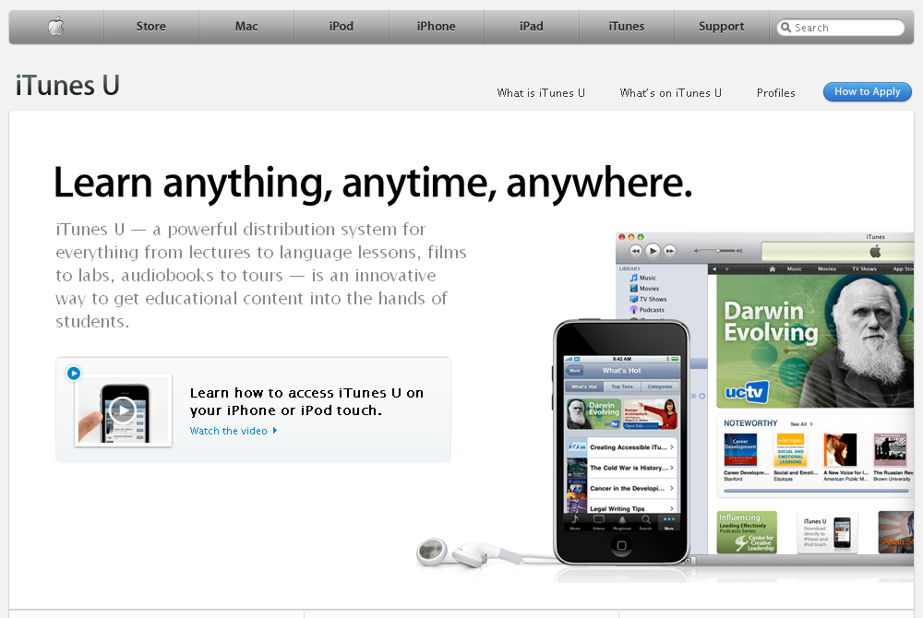

Slide 101


Slide 102
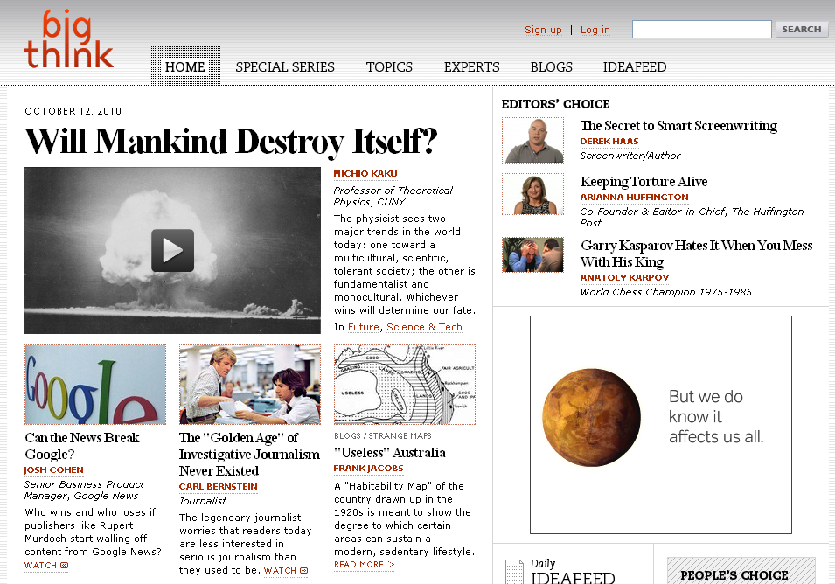

Slide 103
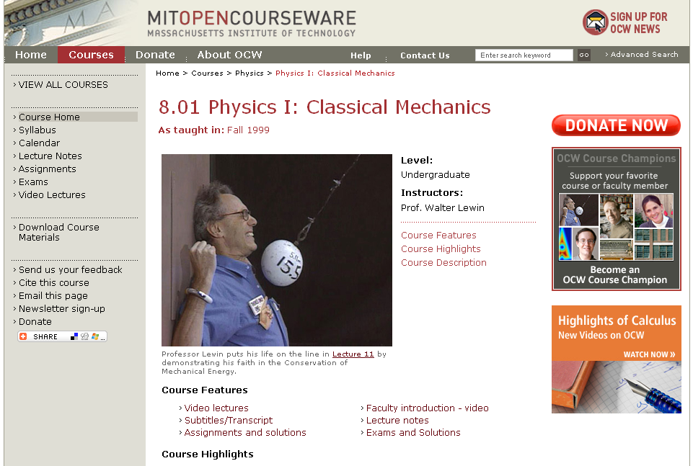

Slide 104


Slide 105
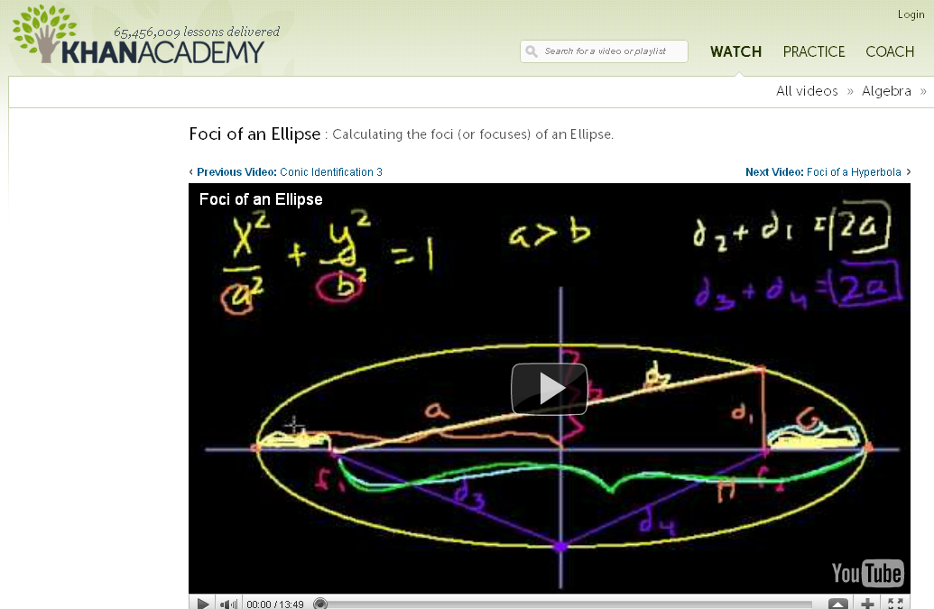

Slide 106
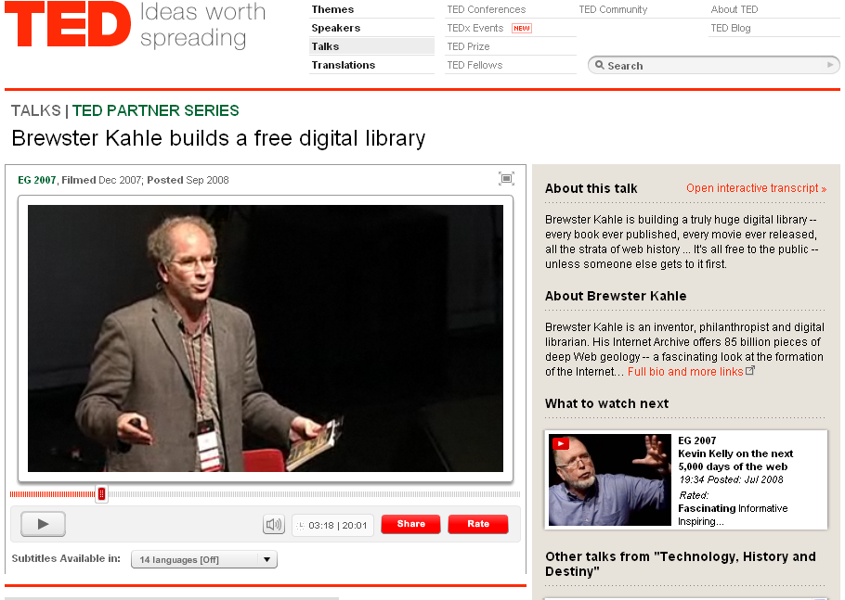

Slide 107
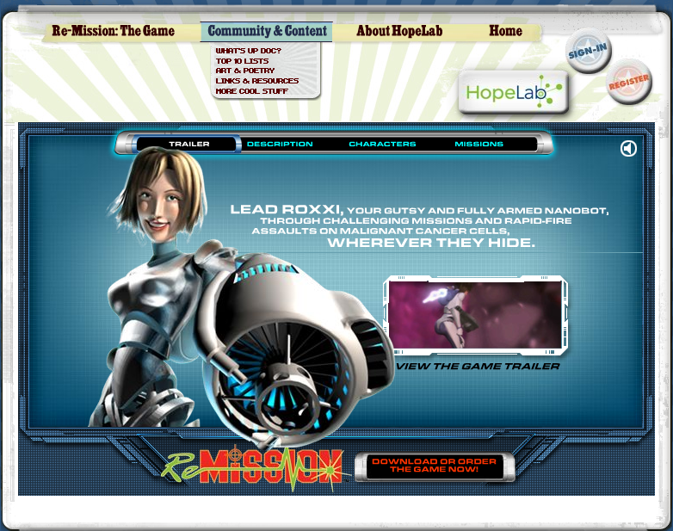
Notes:
Re-Mission

Slide 108
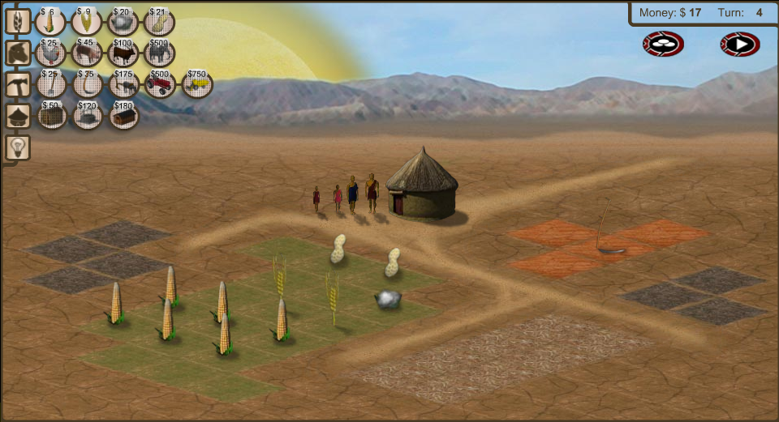
Notes:
3rd World Farmer

Slide 109
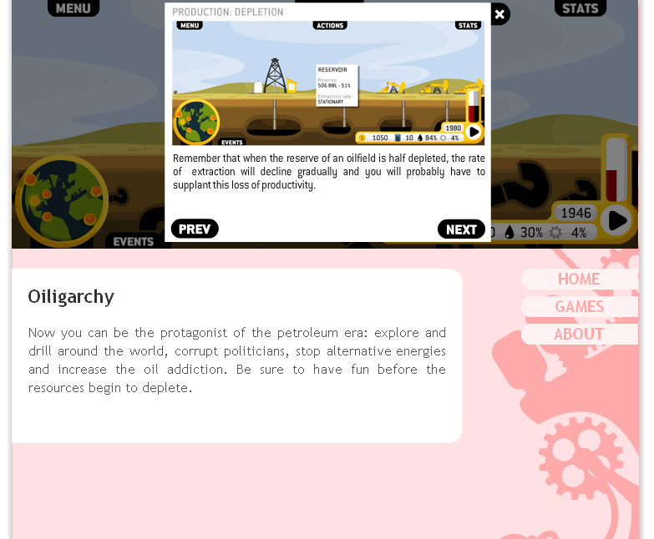

Slide 110
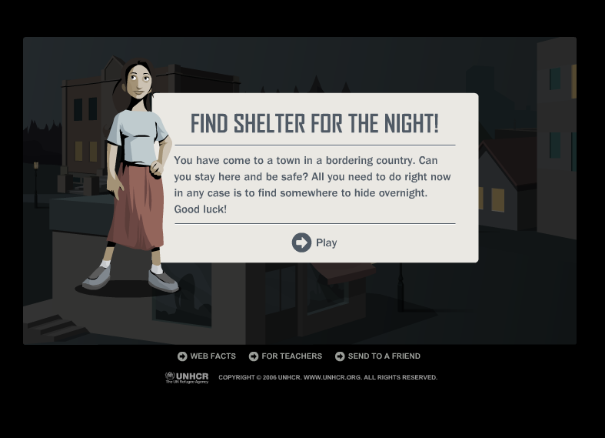
Notes:
Against All Odds, United Nations High Commissioner for Refugees

Slide 111
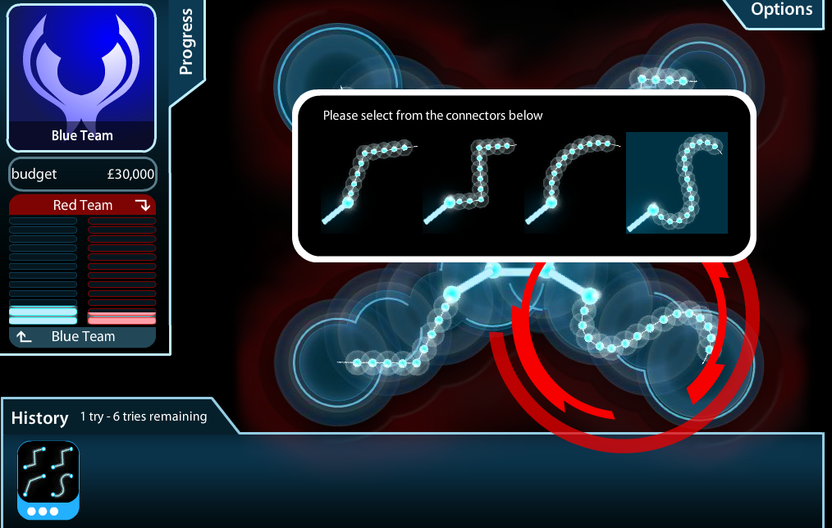
Notes:
Masterminding Molecules

Slide 112

Notes:
Conspiracy Code

Slide 113
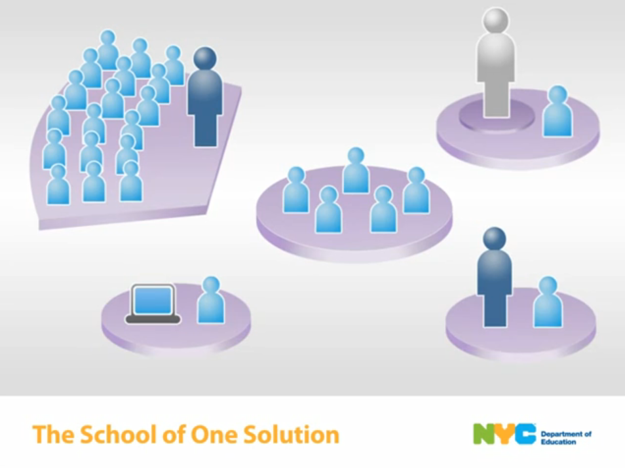

Slide 114
  Societally functional
  Mastery of information landscape
  Economically productive

Slide 115

Notes:
115

Slide 116
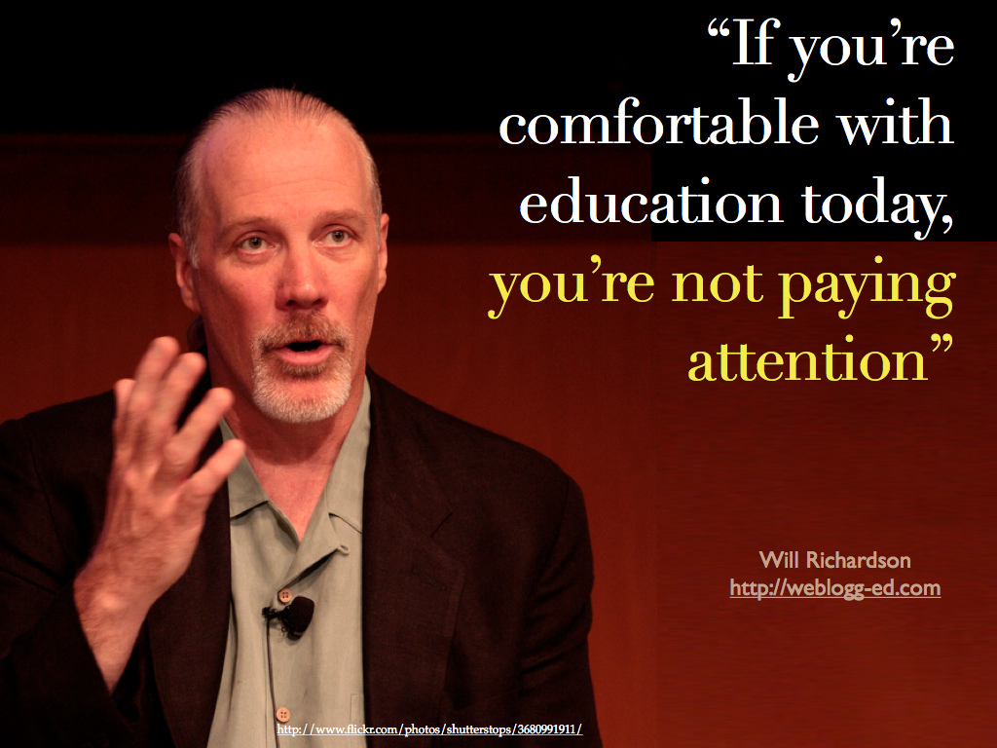

Slide 117


Slide 118


Slide 120


Slide 121


Slide 122


Slide 123


Slide 124

If the leaders
don’t get it,
it’s not going
to happen.
dangerouslyirrelevant.org
Notes:
Licensed under a Creative Commons attribution-share alike license.
http://creativecommons.org/licenses/by-sa/3.0
Scott McLeod, J.D., Ph.D.
scottmcleod.net/contact
dangerouslyirrelevant.org
schooltechleadership.org

Slide 125


Slide 126

Notes:
We need to somehow
change faster
No one jumps a 20 foot chasm in two
10 foot jumps. – Miguel Guhlin
When the world changes so fast that we have no reasonable way to forecast what it will look like in a mere decade or two, all we can do is teach kids how to be adaptive – to be learners in the truest sense of the word –
We’ve always talked about preparing lifelong learners in schools, but our practices typically haven’t matched our rhetoric. It’s time to put some bite into our toothless vision statements and recognize that we have to teach kids how to learn to learn if they want to be successful in this new technology-suffused, globally-interconnected world
Credits: http://tinyurl.com/2urbsm and http://tinyurl.com/37em64 (see Guhlin comment)
http://remoteaccess.typepad.com/remote_access/
2006/06/literacy_as_bat.html (see Guhlin comment)
http://headrush.typepad.com/creating_passionate_users/2005/03/incremental_vs_.html

Slide 127

No one will thank you
for taking care of today
if you have failed
to take care of tomorrow.
Joel Barker

Slide 128

flickr.com/photos/28017515@N03/3470276351/in/photostream

Slide 129

Notes:
129

Slide 130


Slide 131
Thank you!
Scott McLeod, J.D., Ph.D.
Director, CASTLE
scottmcleod.net/grundycenter
Notes:
131
All of my materials are licensed under a Creative Commons attribution-share alike license (http://creativecommons.org/licenses/by-sa/3.0). That means not only that you are welcome to share and/or remix my content but that you are encouraged to do so! All I ask is that you properly credit me for my content and that you not place any greater copyright restrictions than I have on the content that utilizes my material. If possible, including the URL of Dangerously Irrelevant in your content would be most appreciated.
Scott McLeod, J.D., Ph.D.
dangerouslyirrelevant.org
schooltechleadership.org
dangerouslyirrelevant.org/contact.html

Slide 132
What’s in your head right now?

