Slide 1


The lines
are blurring
Translating changes
in our information,
economic, and
learning landscapes
into school and
university practice
Dr. Scott McLeod
CASTLE

Slide 2
Tech is
changing
everything
New
info
landscape
New
economic
landscape
New
learning
landscape

Slide 3
http://goo.gl/k7WNi or www.ia-sb.org

Slide 4
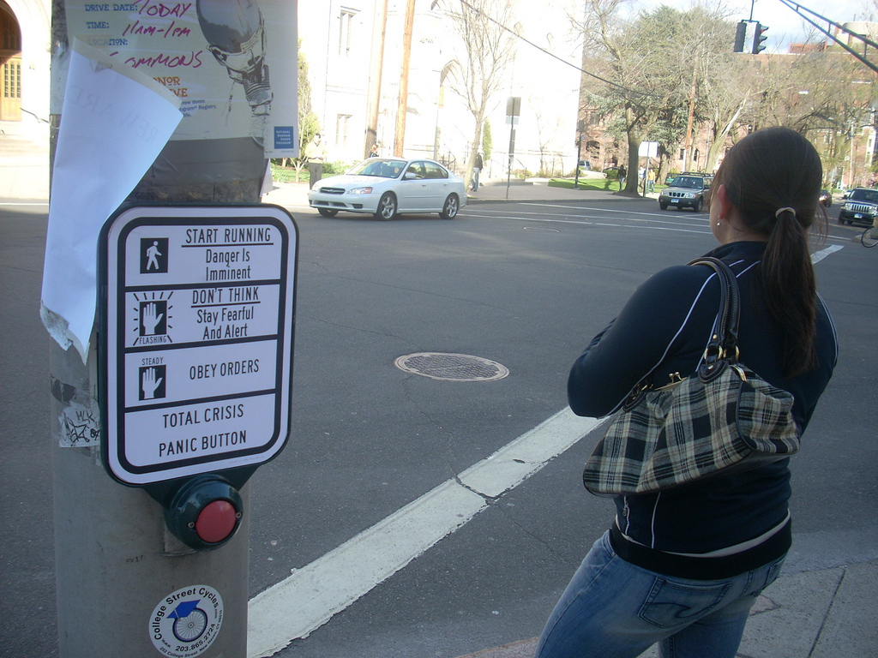
flickr.com/photos/28017515@N03/3470276439/in/photostream

Slide 5


Slide 6


Slide 7
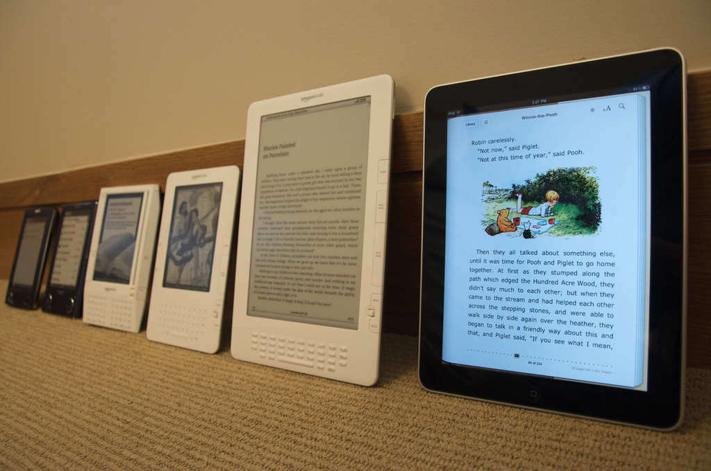
Notes:
http://www.flickr.com/photos/jblyberg/4505413539/sizes/l/in/photostream/

Slide 8


Slide 9


Slide 10


Slide 11


Slide 12


Slide 13


Slide 14


Slide 15


Slide 16


Slide 17


Slide 18


Slide 19
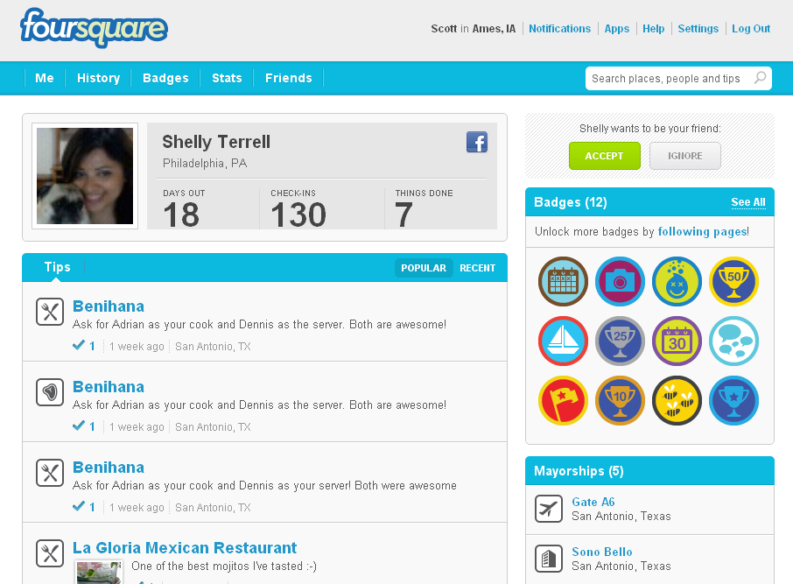

Slide 20
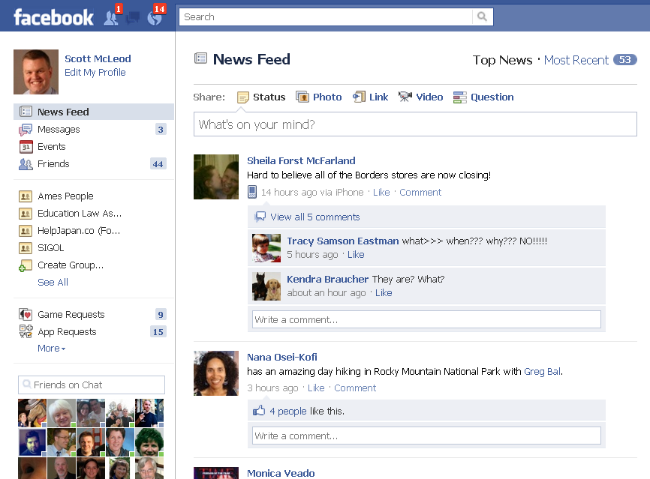

Slide 21


Slide 22


Slide 23
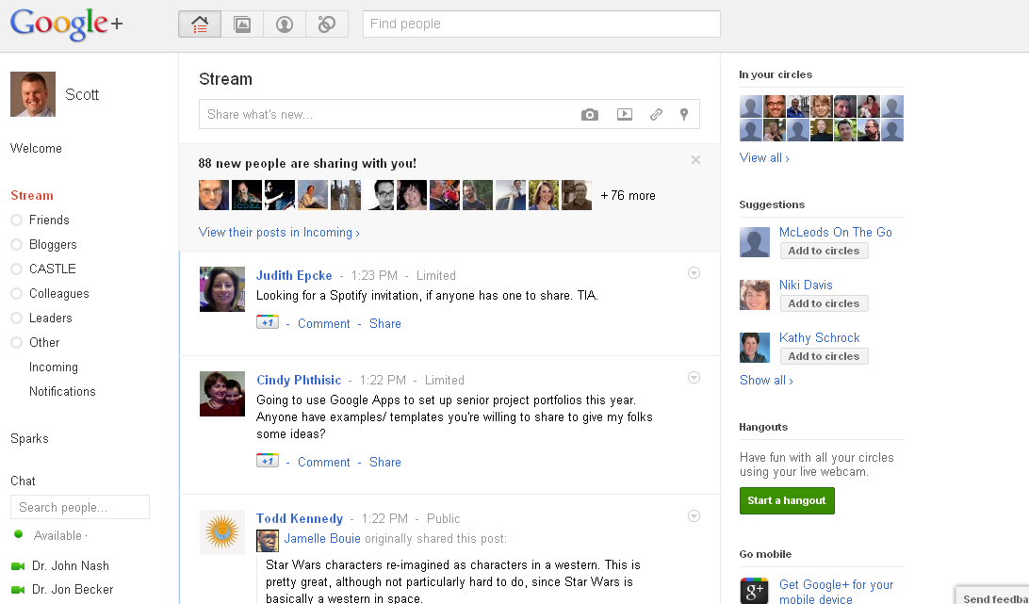

Slide 24


Slide 25


Slide 26


Slide 27
We all now have a voice

Slide 28
We can easily find each other

Slide 29
We can easily work together

Slide 30


Slide 31
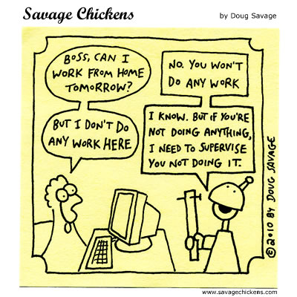

Slide 32
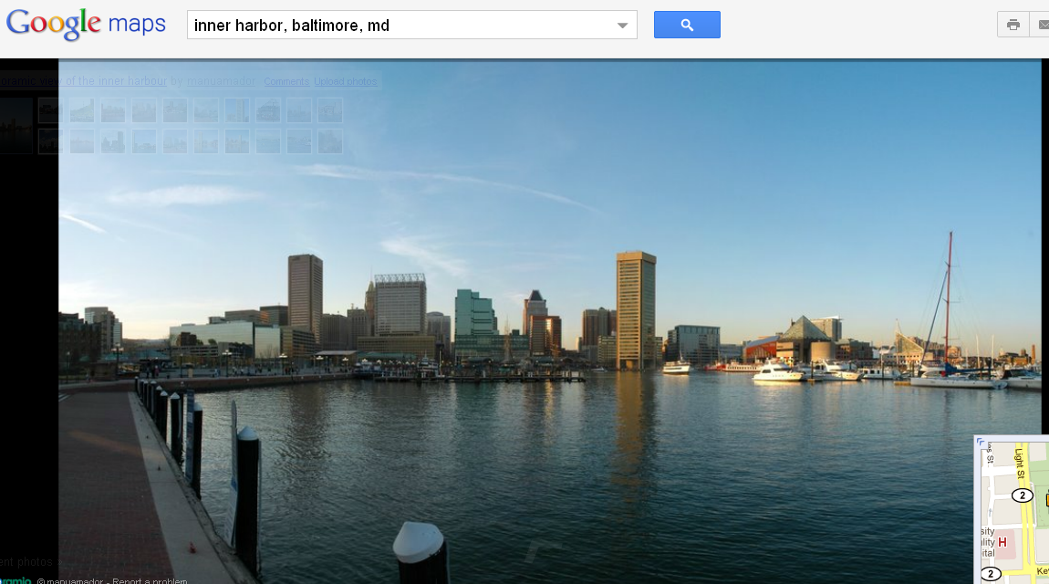

Slide 33
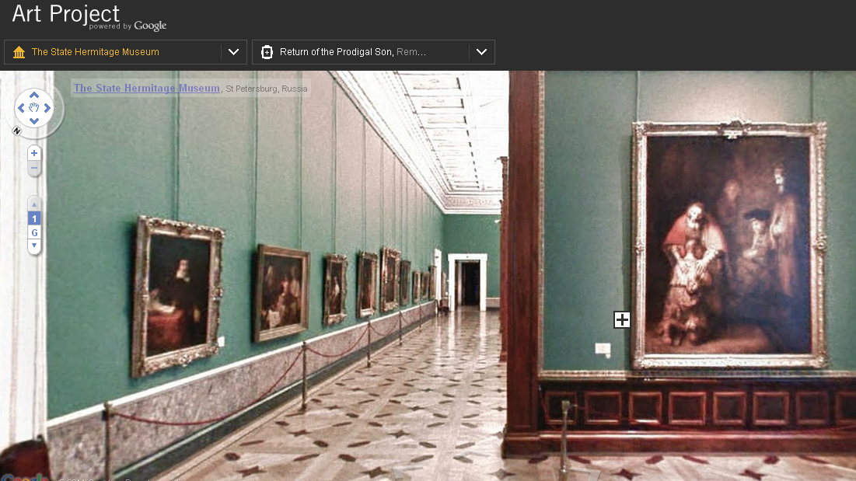

Slide 34
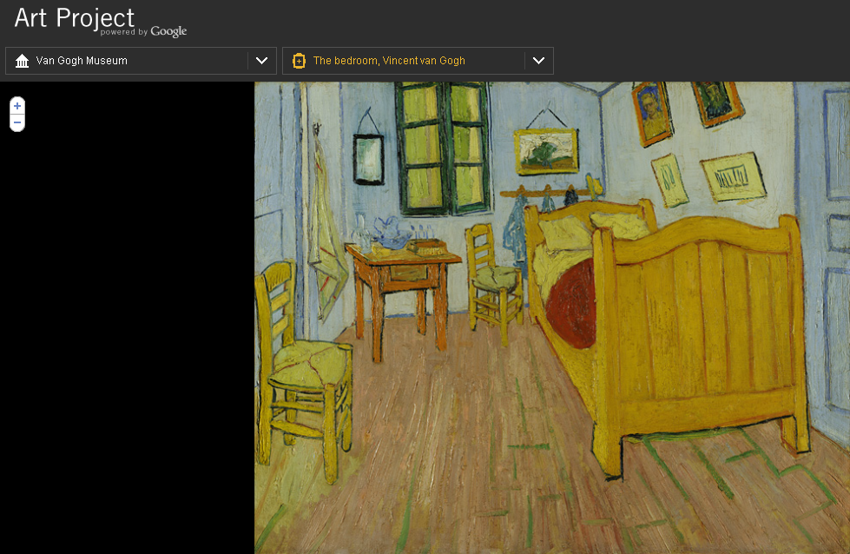

Slide 35
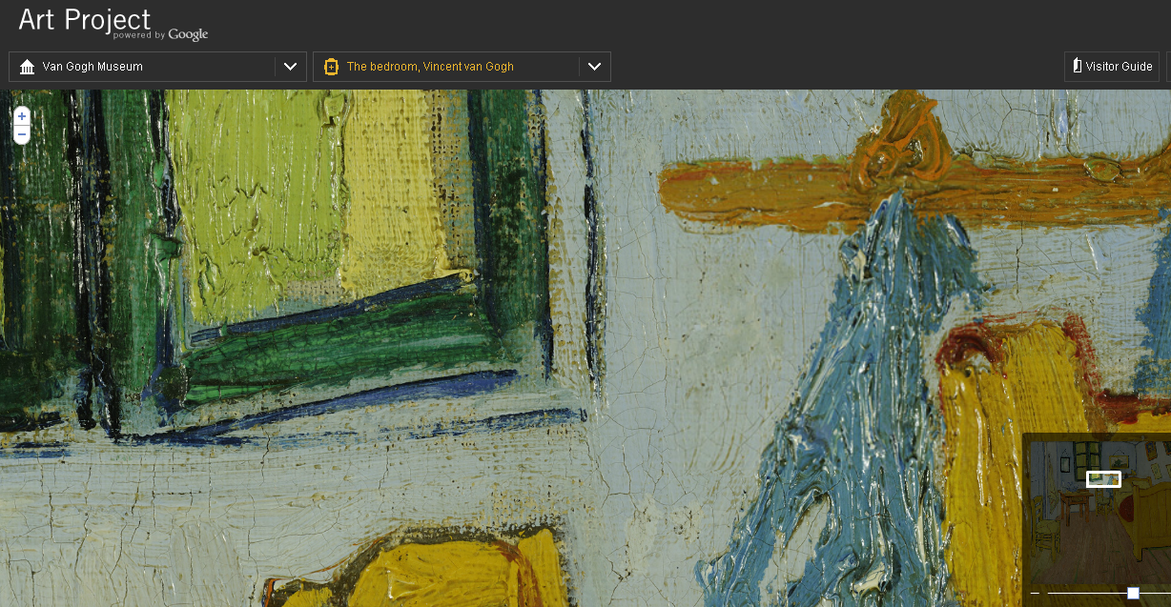

Slide 36
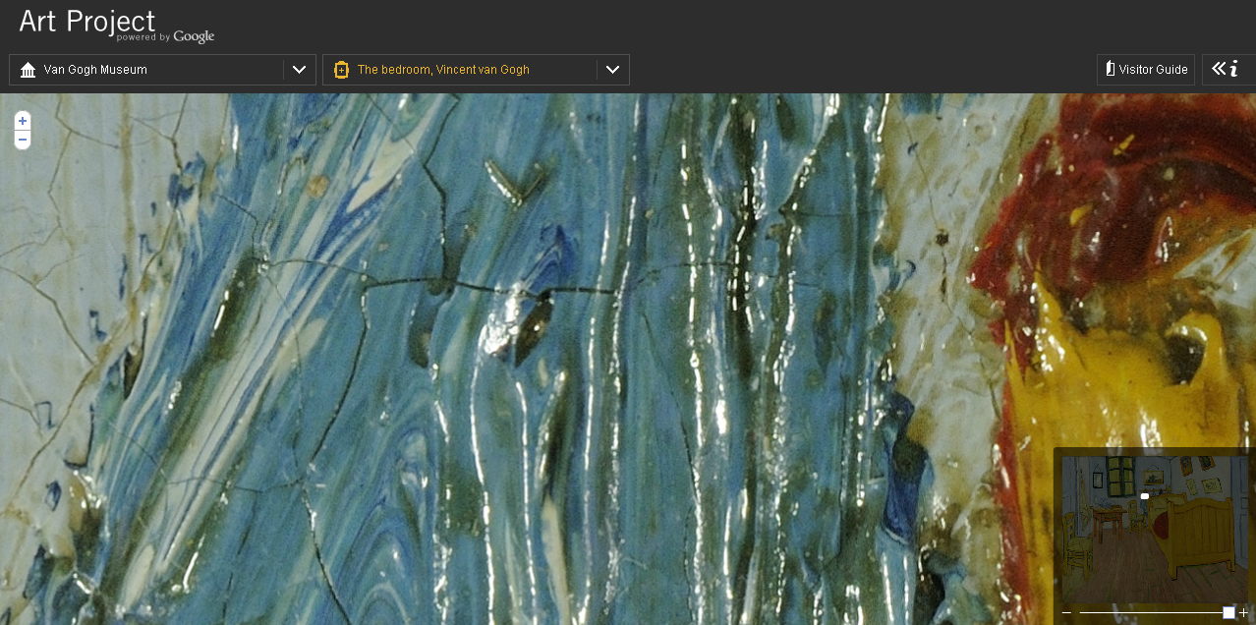

Slide 37


Slide 38


Slide 39
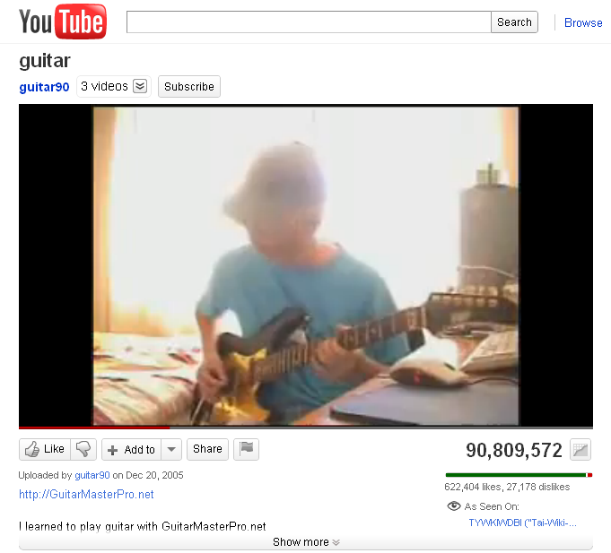

Slide 40
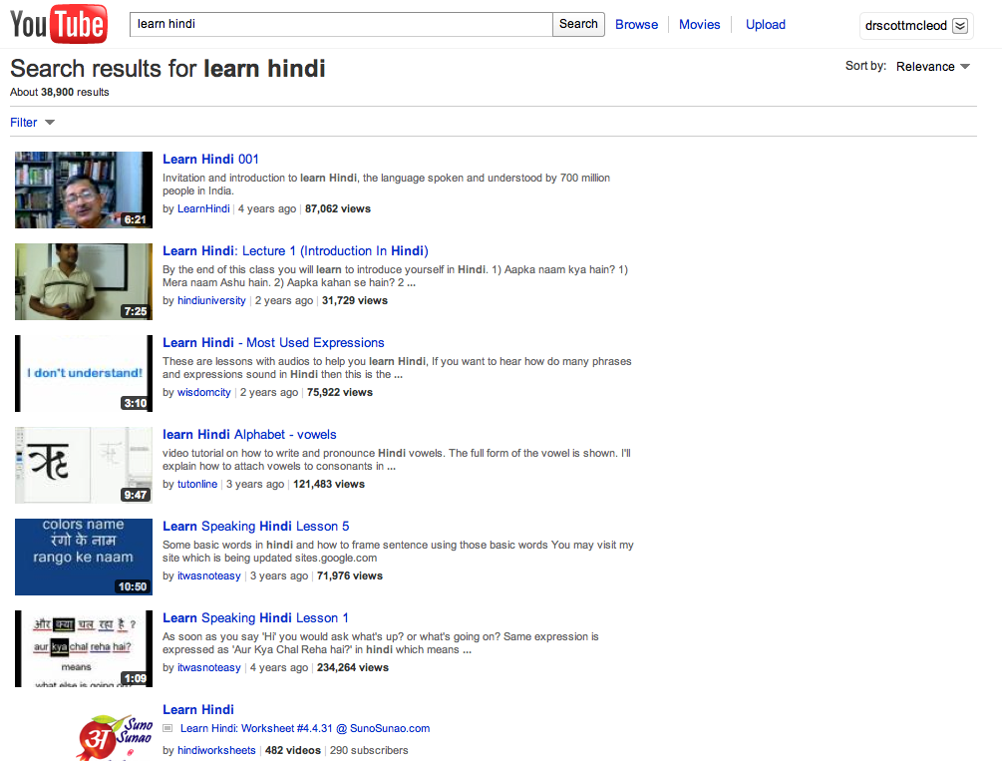

Slide 41


Slide 42


Slide 43


Slide 44


Slide 45
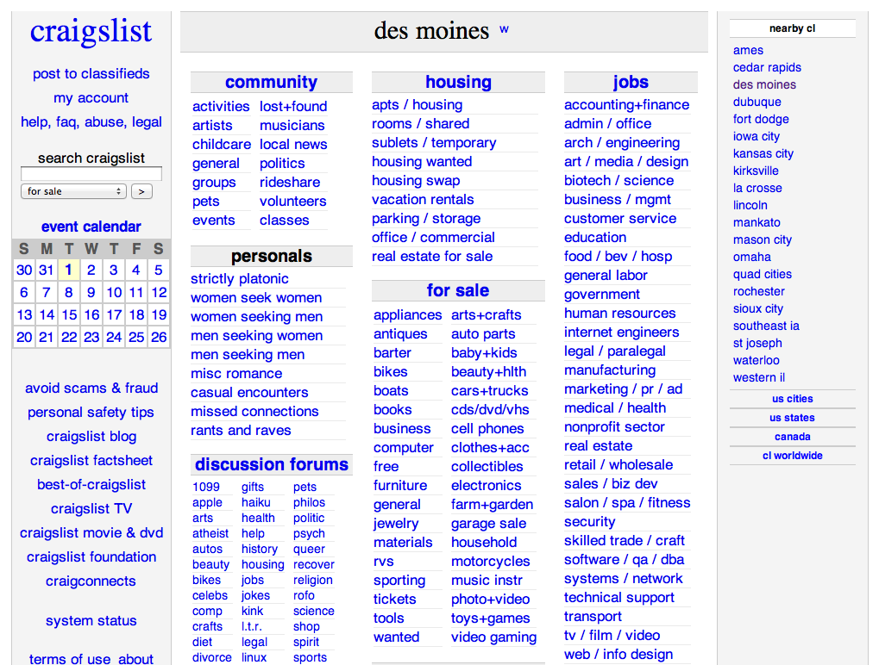

Slide 46


Slide 47


Slide 48
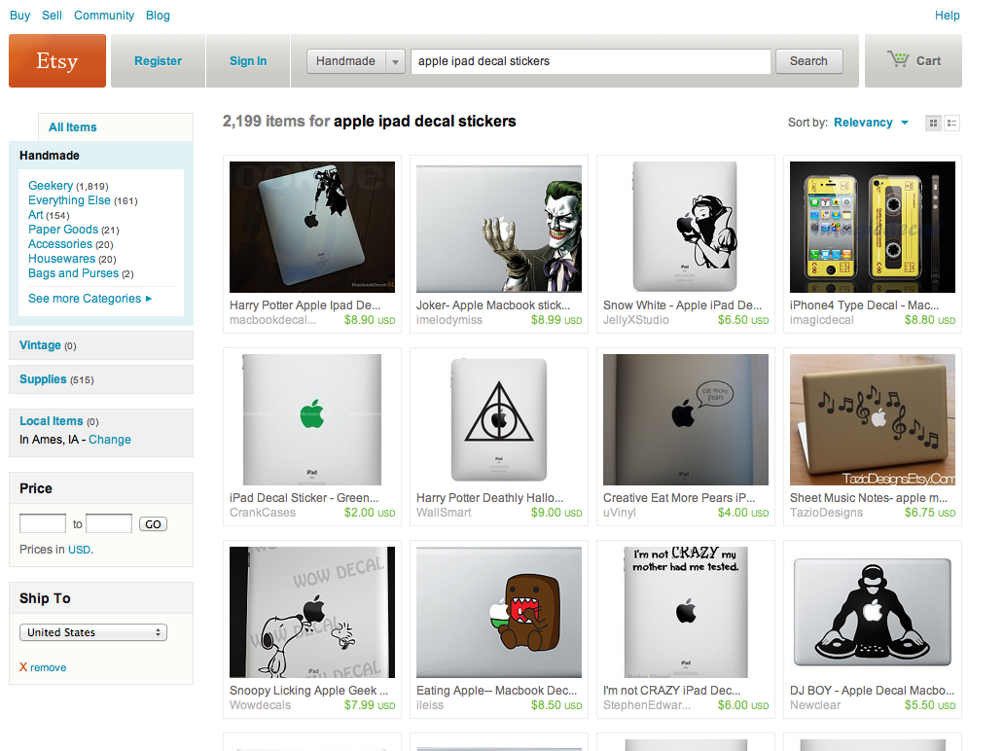

Slide 49
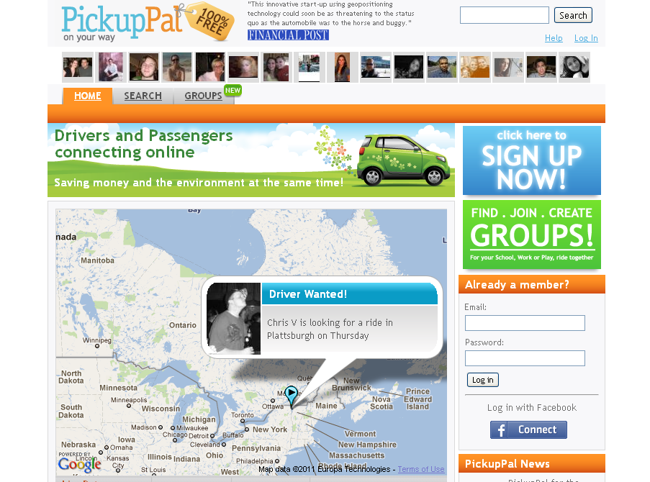

Slide 50
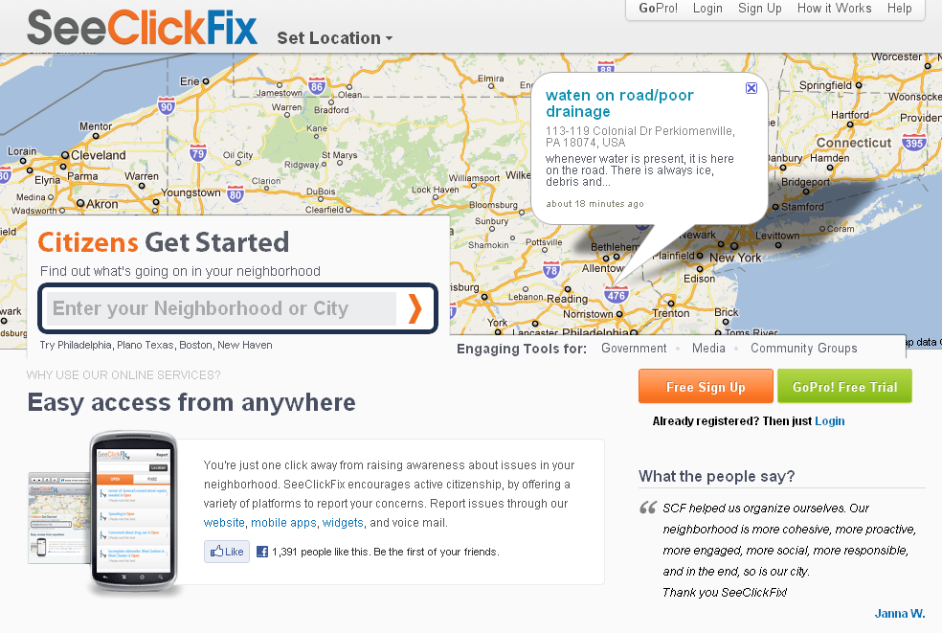

Slide 51
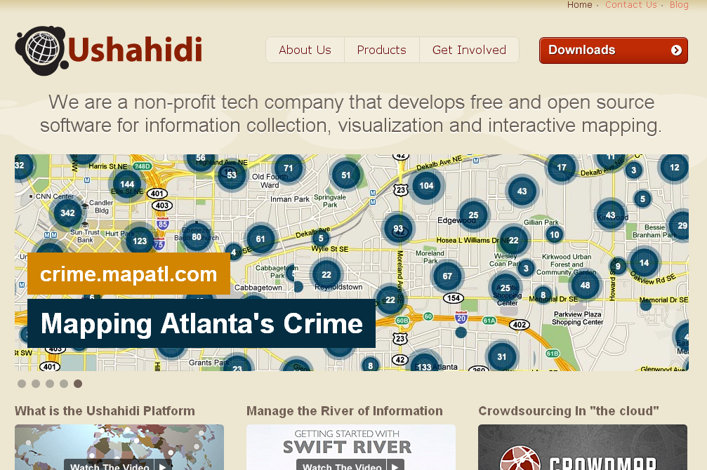

Slide 52


Slide 53
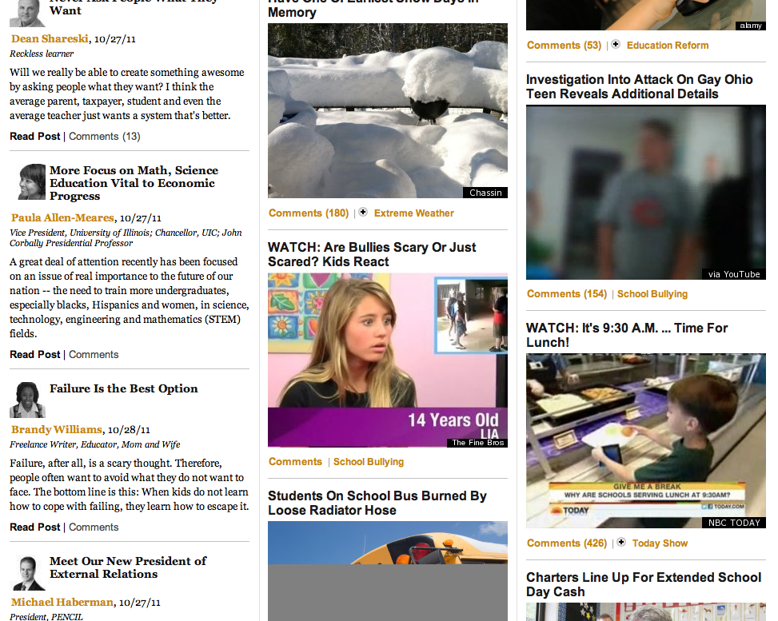

Slide 54
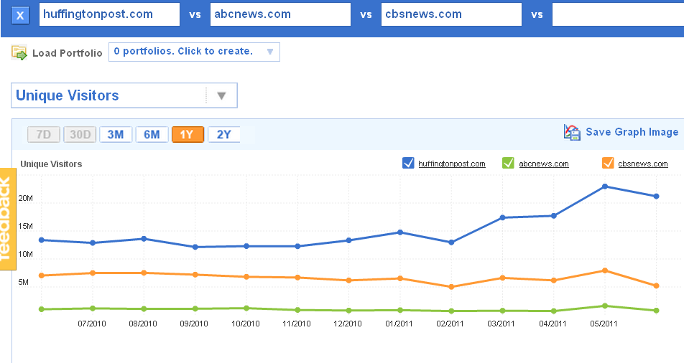

Slide 55
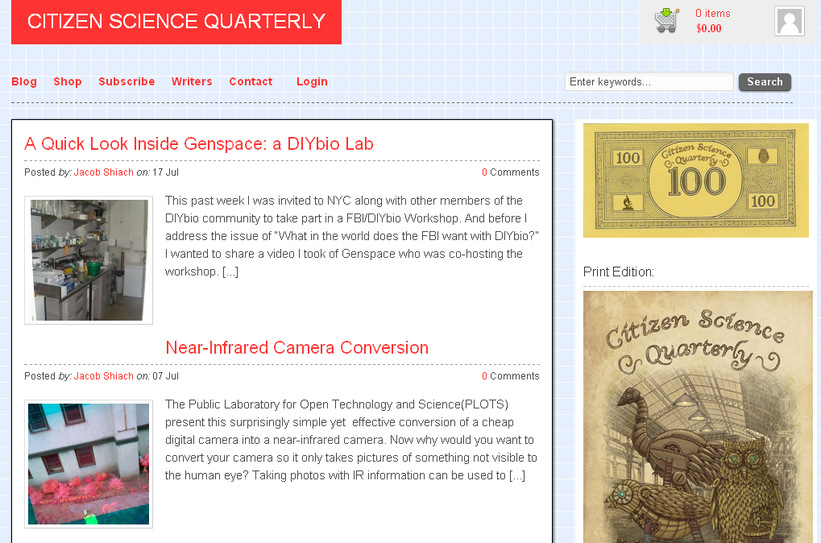

Slide 56
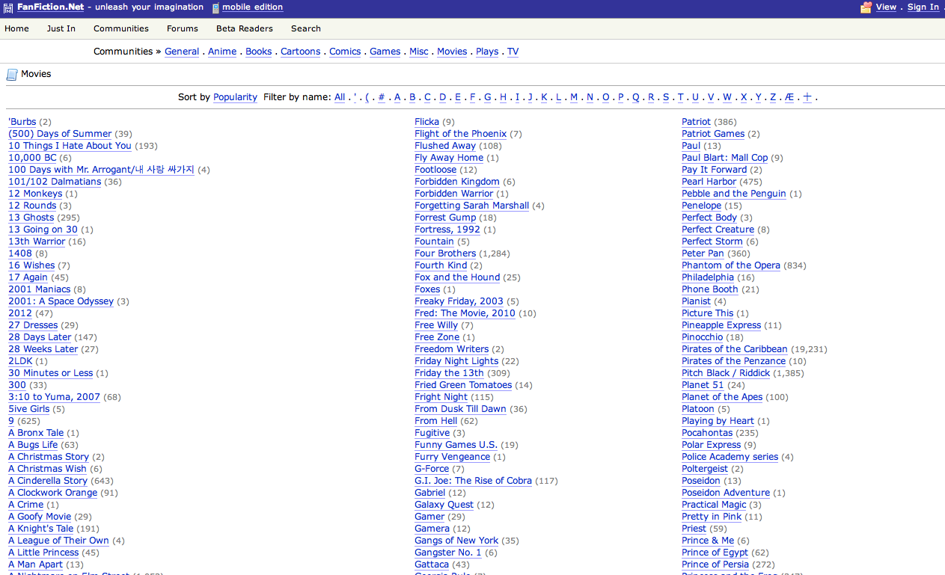

Slide 57
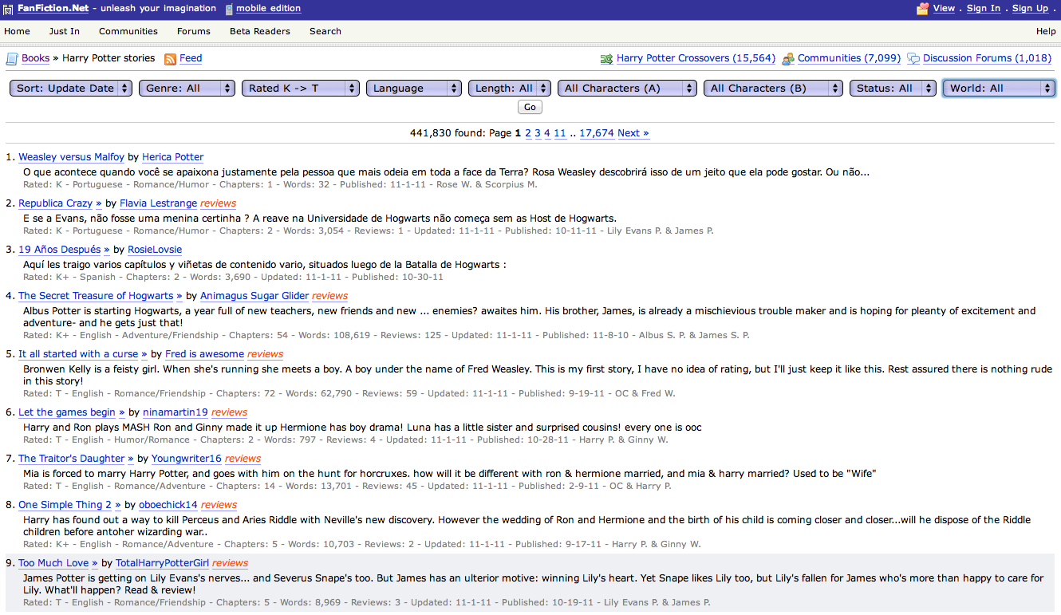

Slide 58


Slide 59
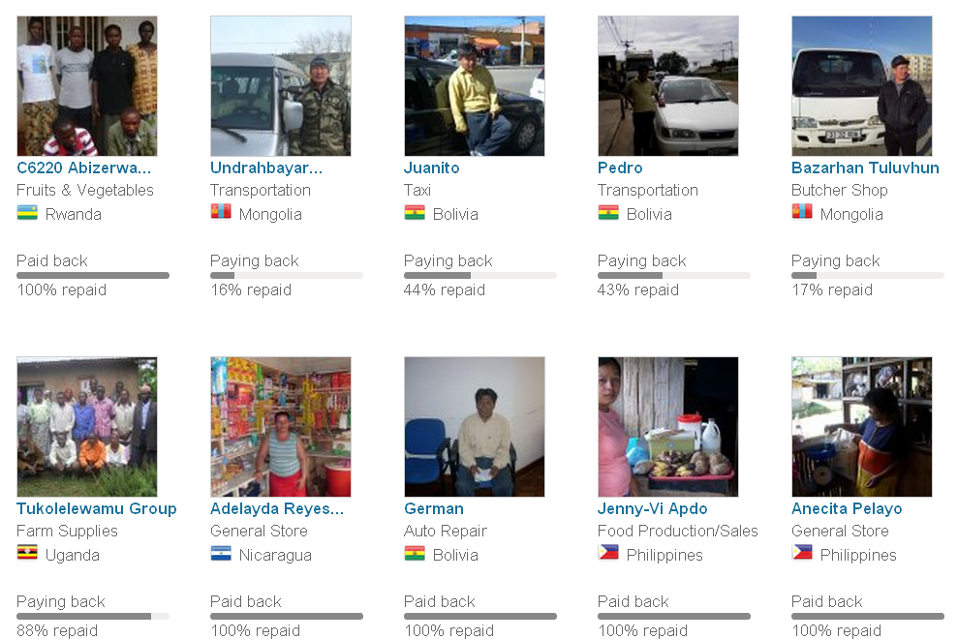

Slide 60
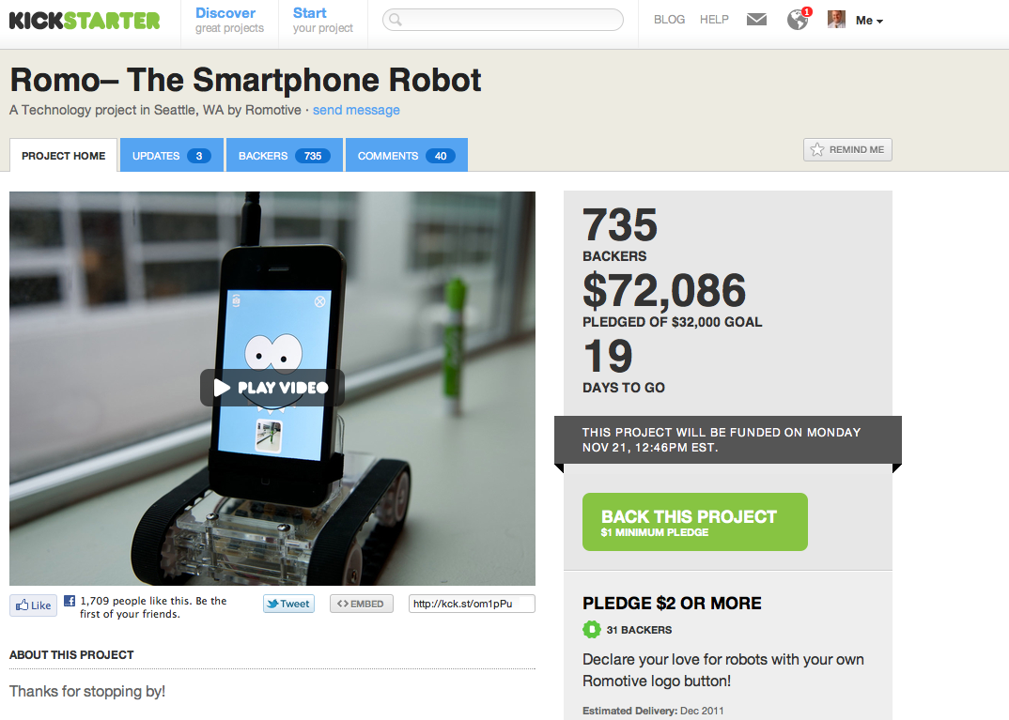

Slide 61
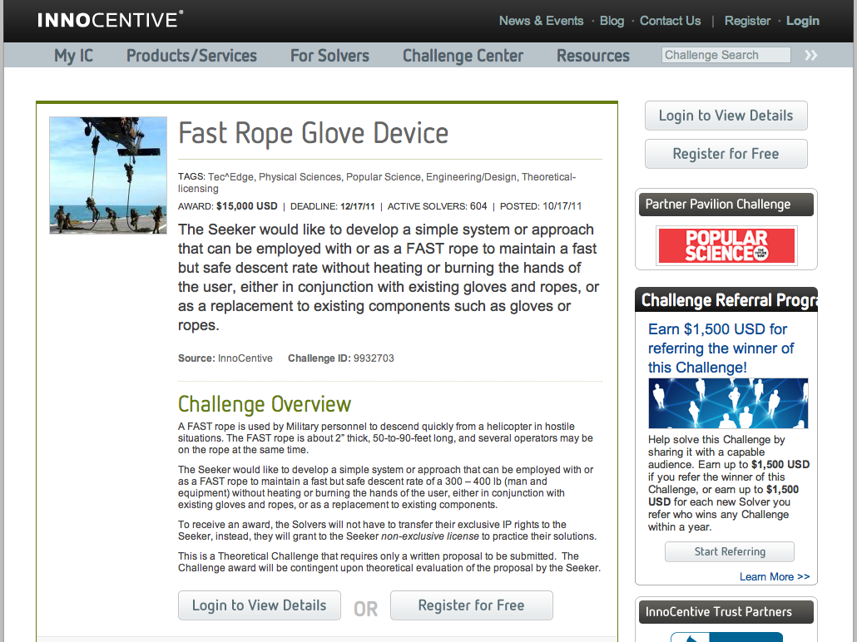

Slide 62
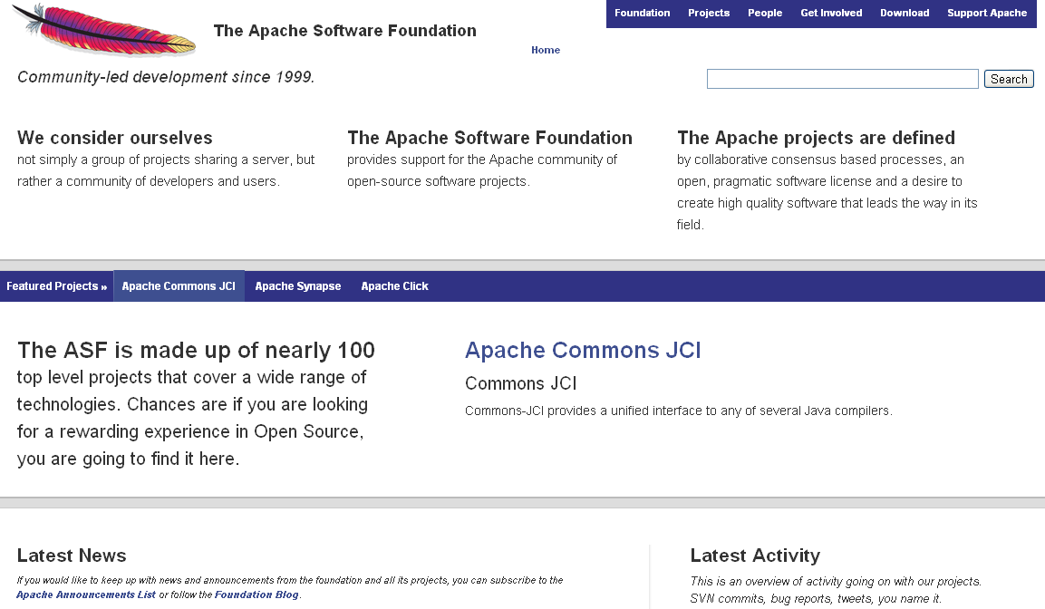

Slide 63


Slide 64
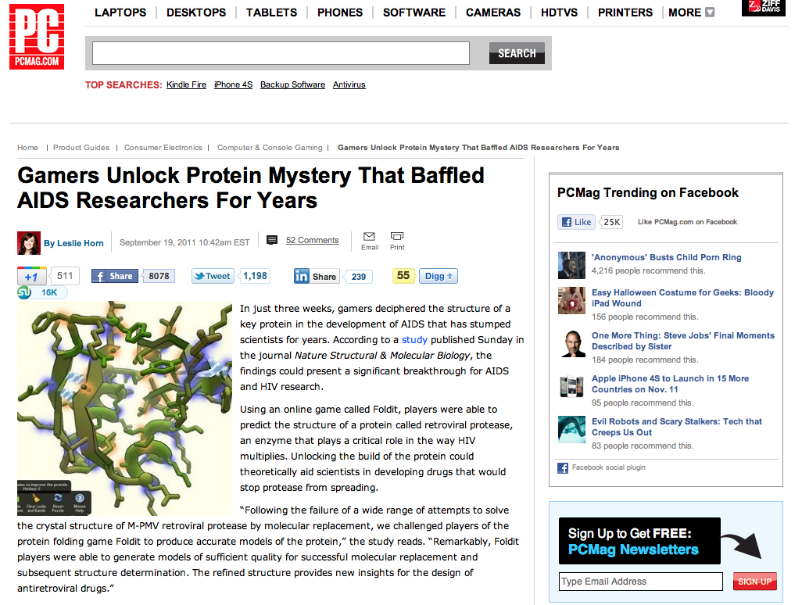

Slide 65
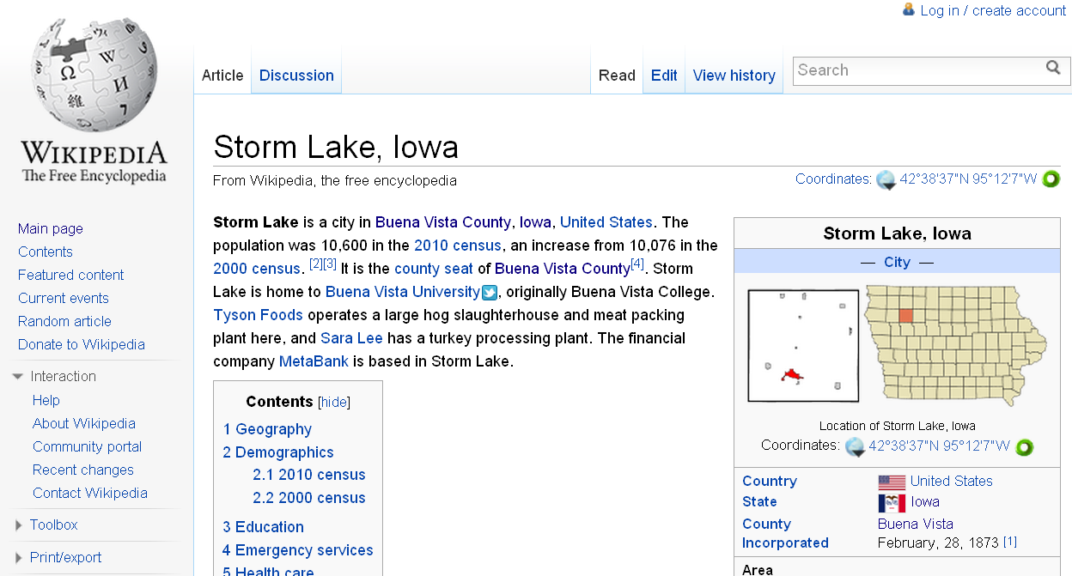

Slide 66
What’s in your head right now?

Slide 67

Notes:
http://www.flickr.com/photos/deks/711658920/sizes/z/

Slide 68

Notes:
http://www.flickr.com/photos/sepblog/3527825643/sizes/o/

Slide 69

Notes:
http://www.flickr.com/photos/13638129@N00/118245563/

Slide 70

Notes:
http://www.flickr.com/photos/7337467@N04/3052065204/

Slide 71

Notes:
http://www.flickr.com/photos/77136818@N00/3202144482/

Slide 72

Notes:
http://www.flickr.com/photos/20532289@N00/59083917/

Slide 73

Notes:
http://www.flickr.com/photos/48973657@N00/4556156477/

Slide 74

Notes:
http://www.flickr.com/photos/88442983@N00/1604241264/

Slide 75

Notes:
http://www.flickr.com/photos/28473961@N02/3229296247/

Slide 76

Notes:
http://www.flickr.com/photos/28473961@N02/4320982975/

Slide 77

Notes:
http://www.flickr.com/photos/28473961@N02/2757755401/

Slide 78

Notes:
http://www.flickr.com/photos/26416016@N02/4479154715/

Slide 79

Notes:
http://www.flickr.com/photos/9031691@N08/2670224692/

Slide 80

Notes:
http://www.flickr.com/photos/28567825@N03/5129325457/

Slide 81

Notes:
http://www.flickr.com/photos/47477979@N00/2453748088/

Slide 82

CHANGE
OR DIE

Slide 83

Notes:
http://www.flickr.com/photos/30624156@N00/4820259304/

Slide 84
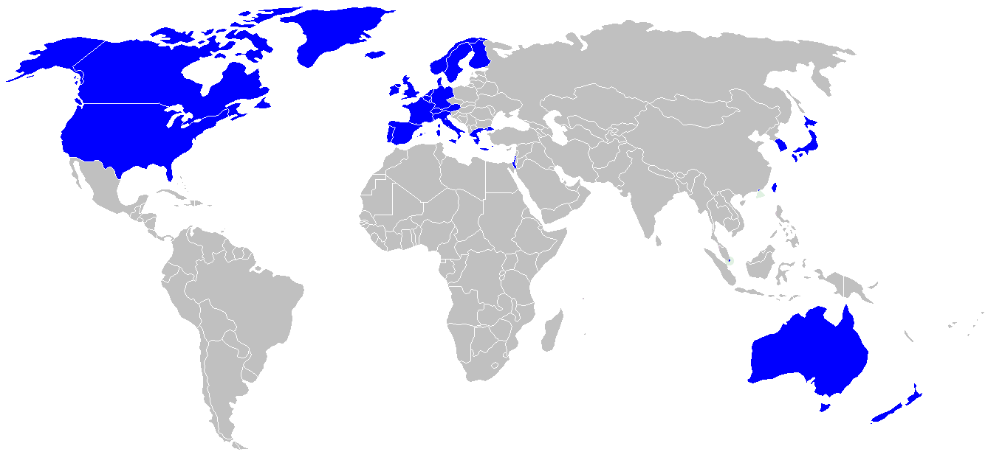

Slide 85
location
dependent?
location
independent?

Slide 86

I sell books!
I’m an
accountant!
I have
an idea!

Slide 87
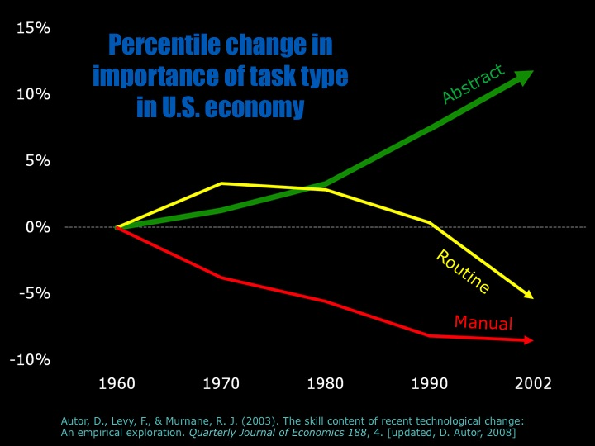

Slide 88
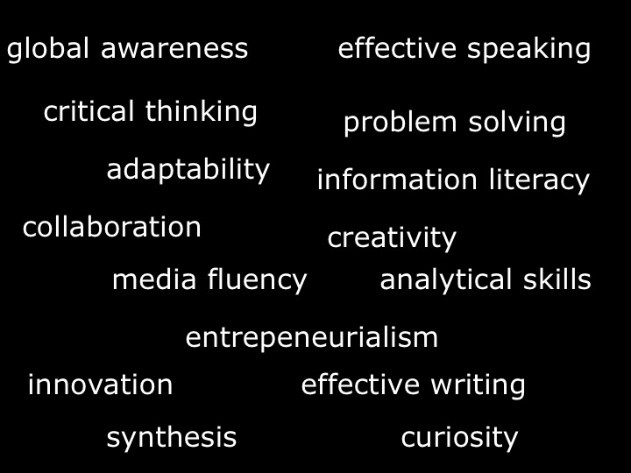

Slide 90


Slide 91
low skill
low wage
low skill
high wage
high skill
high wage

Slide 92
low skill
low wage
low skill
high wage
high skill
high wage

Slide 93
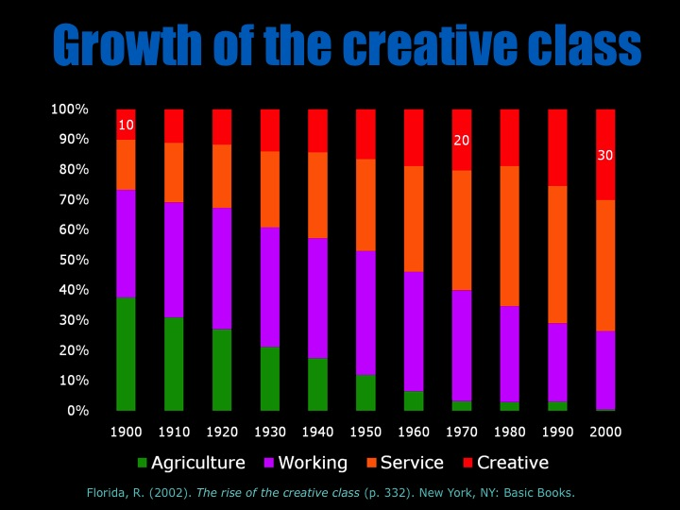

Slide 94
  Can someone overseas
  do it cheaper?
  Can a computer
  do it faster?

Slide 95
2 billion

Slide 96


Slide 97


Slide 98


Slide 99


Slide 100
What’s in your head right now?

Slide 101
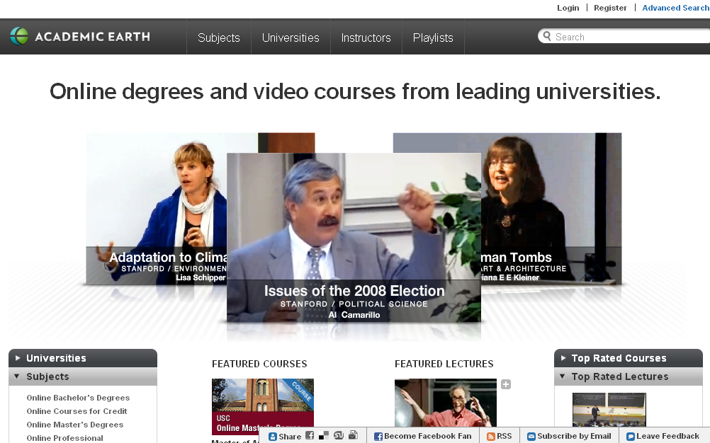

Slide 102


Slide 103


Slide 104
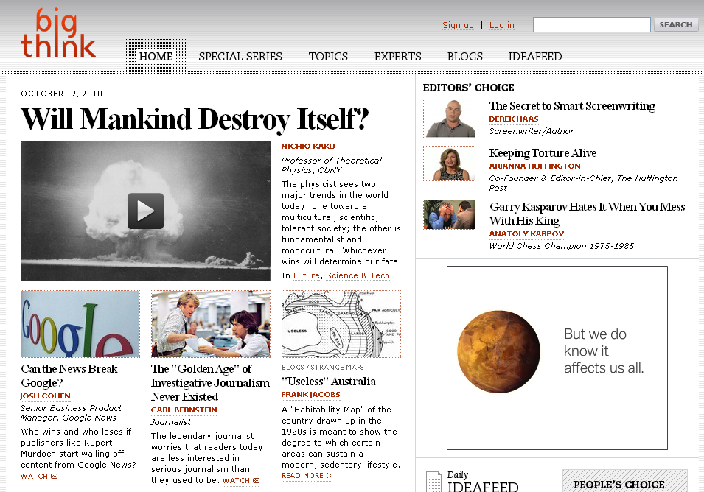

Slide 105
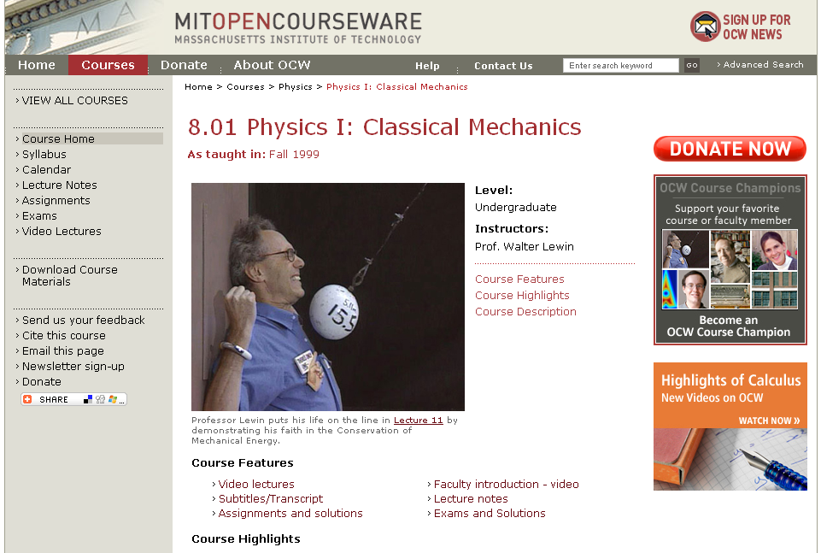

Slide 106


Slide 107
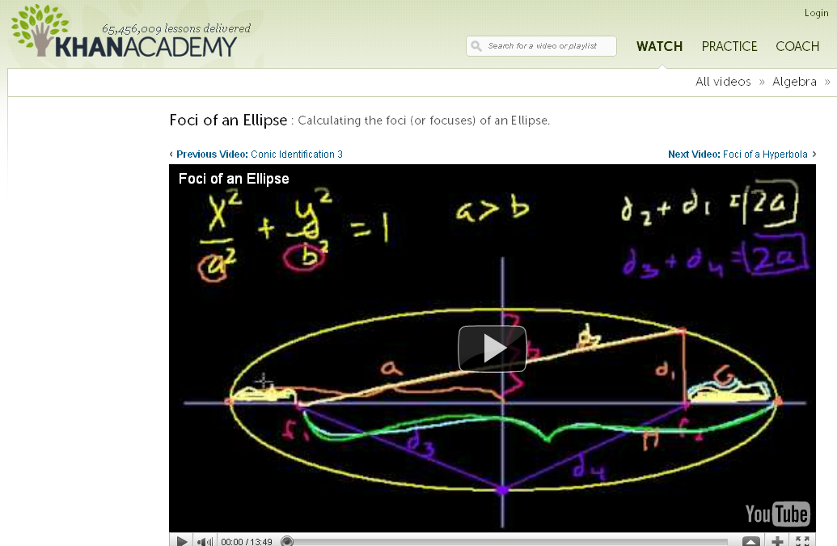

Slide 108
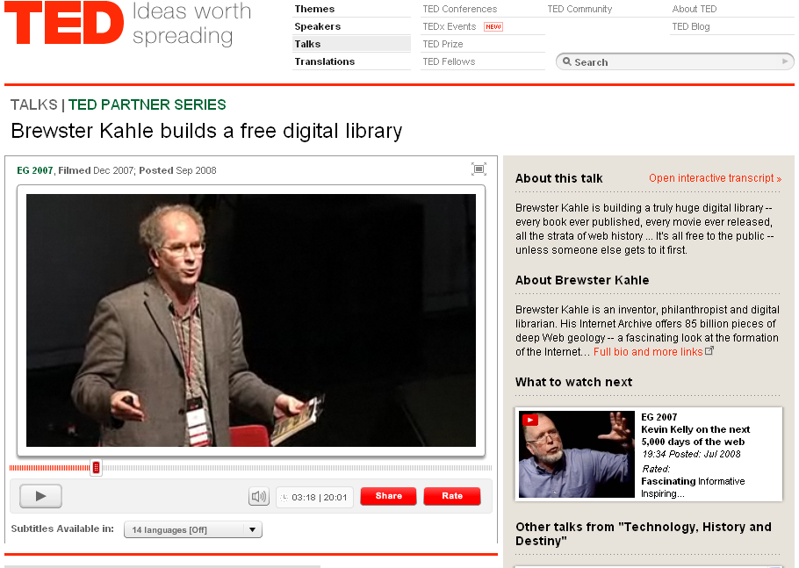

Slide 109
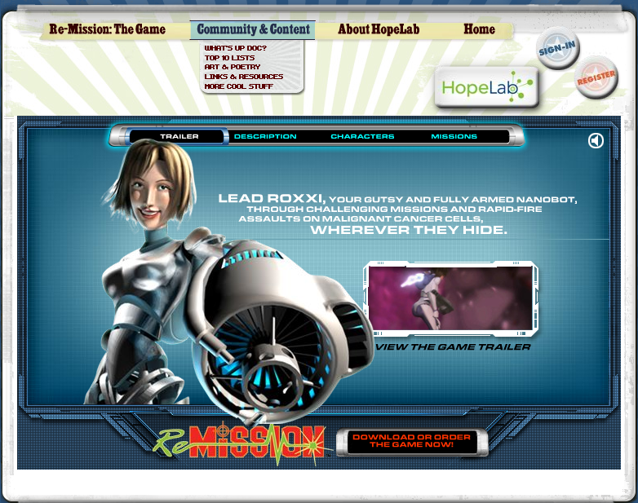
Notes:
Re-Mission

Slide 110
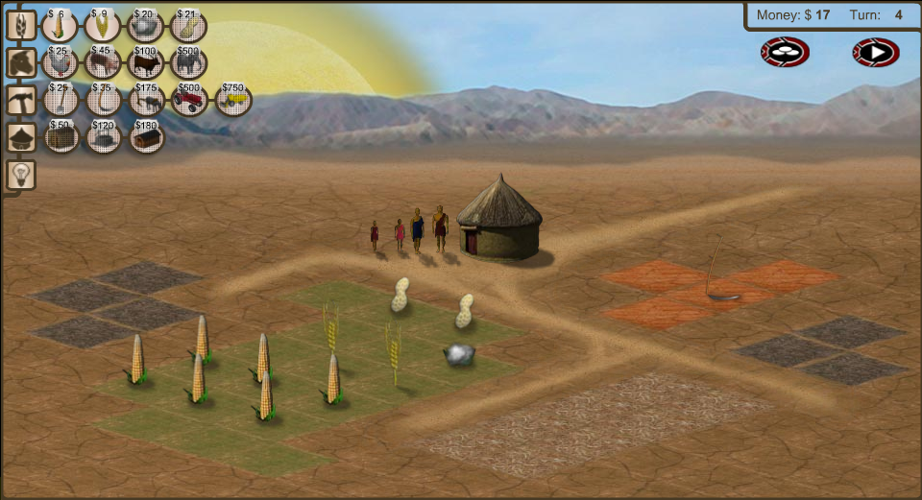
Notes:
3rd World Farmer

Slide 111
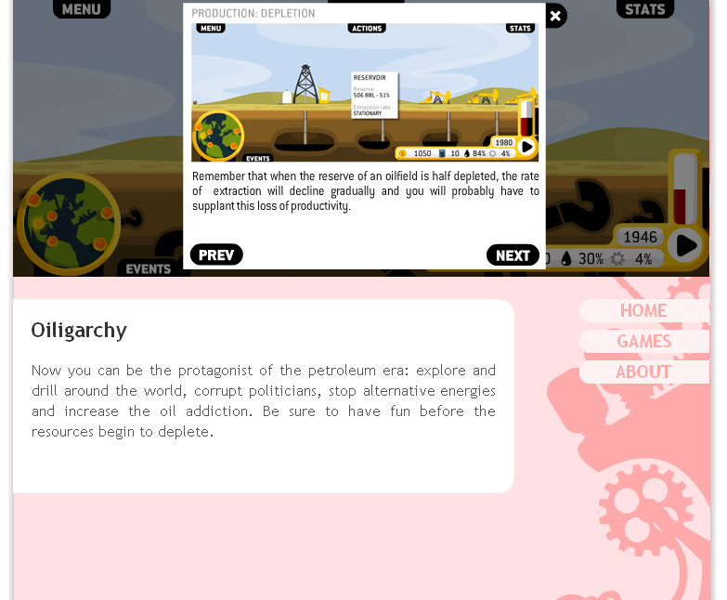

Slide 112
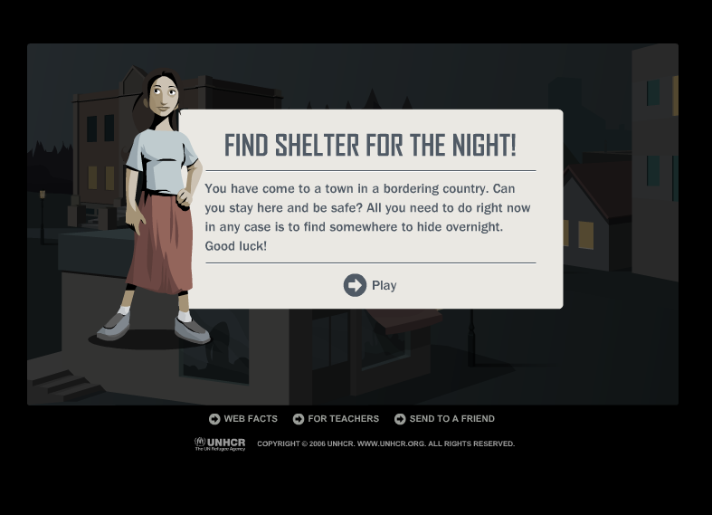
Notes:
Against All Odds, United Nations High Commissioner for Refugees

Slide 113
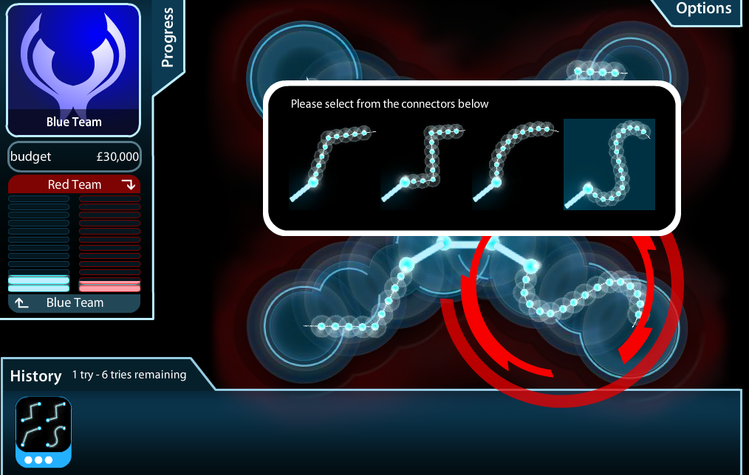
Notes:
Masterminding Molecules

Slide 114

Notes:
Conspiracy Code

Slide 115


Slide 116
  Societally functional
  Mastery of information landscape
  Economically productive

Slide 117

Notes:
117

Slide 118
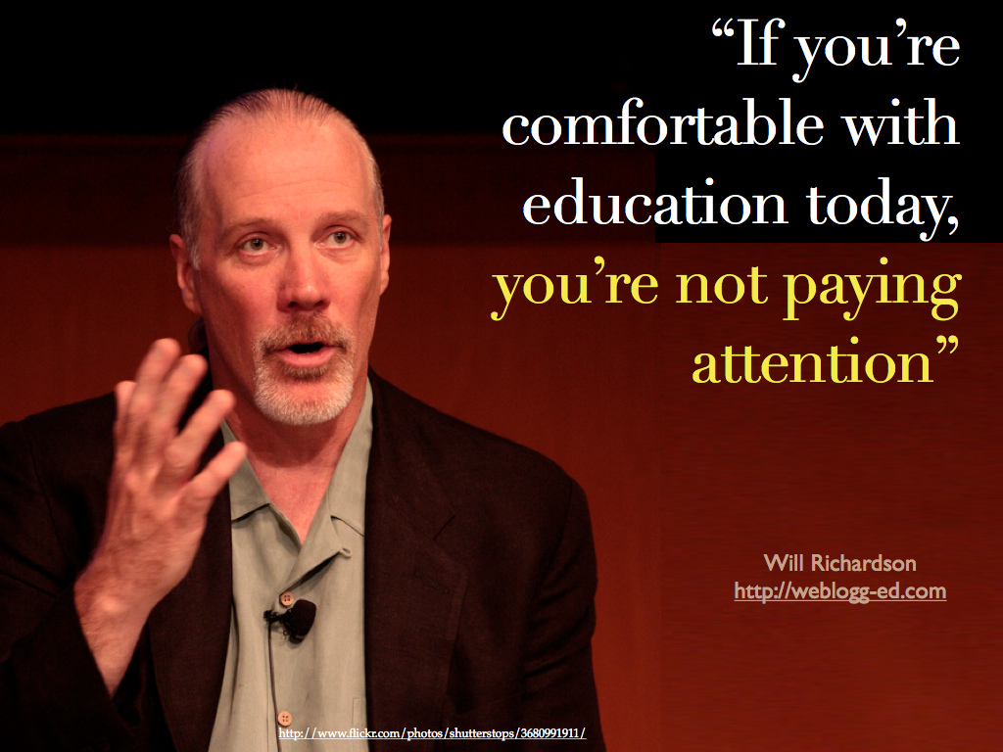

Slide 119


Slide 120


Slide 122
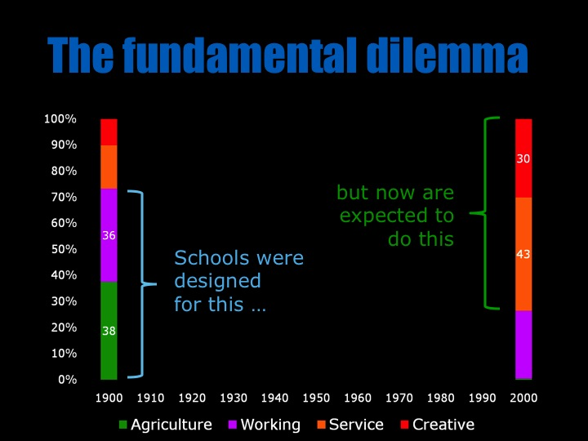

Slide 123


Slide 124


Slide 125


Slide 126

If the leaders
don’t get it,
it’s not going
to happen.
dangerouslyirrelevant.org
Notes:
Licensed under a Creative Commons attribution-share alike license.
http://creativecommons.org/licenses/by-sa/3.0
Scott McLeod, J.D., Ph.D.
scottmcleod.net/contact
dangerouslyirrelevant.org
schooltechleadership.org

Slide 127


Slide 128

Notes:
We need to somehow
change faster
No one jumps a 20 foot chasm in two
10 foot jumps. – Miguel Guhlin
When the world changes so fast that we have no reasonable way to forecast what it will look like in a mere decade or two, all we can do is teach kids how to be adaptive – to be learners in the truest sense of the word –
We’ve always talked about preparing lifelong learners in schools, but our practices typically haven’t matched our rhetoric. It’s time to put some bite into our toothless vision statements and recognize that we have to teach kids how to learn to learn if they want to be successful in this new technology-suffused, globally-interconnected world
Credits: http://tinyurl.com/2urbsm and http://tinyurl.com/37em64 (see Guhlin comment)
http://remoteaccess.typepad.com/remote_access/
2006/06/literacy_as_bat.html (see Guhlin comment)
http://headrush.typepad.com/creating_passionate_users/2005/03/incremental_vs_.html

Slide 129

No one will thank you
for taking care of today
if you have failed
to take care of tomorrow.
Joel Barker

Slide 130
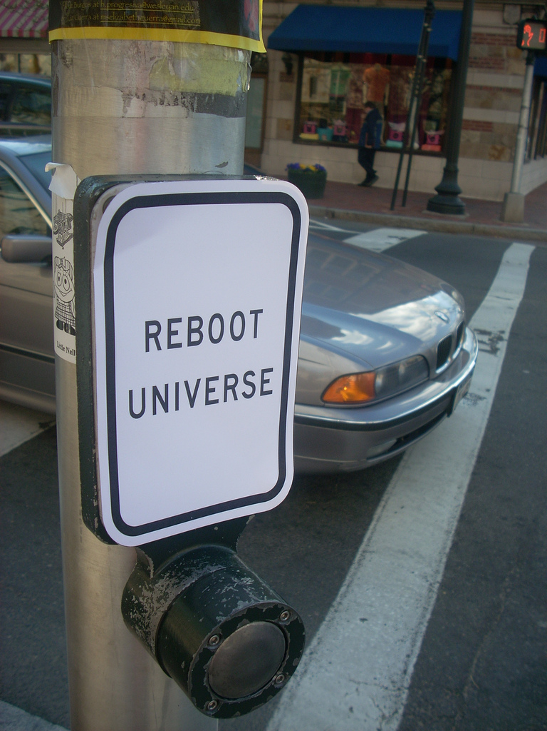
flickr.com/photos/28017515@N03/3470276351/in/photostream

Slide 131

Notes:
131

Slide 132
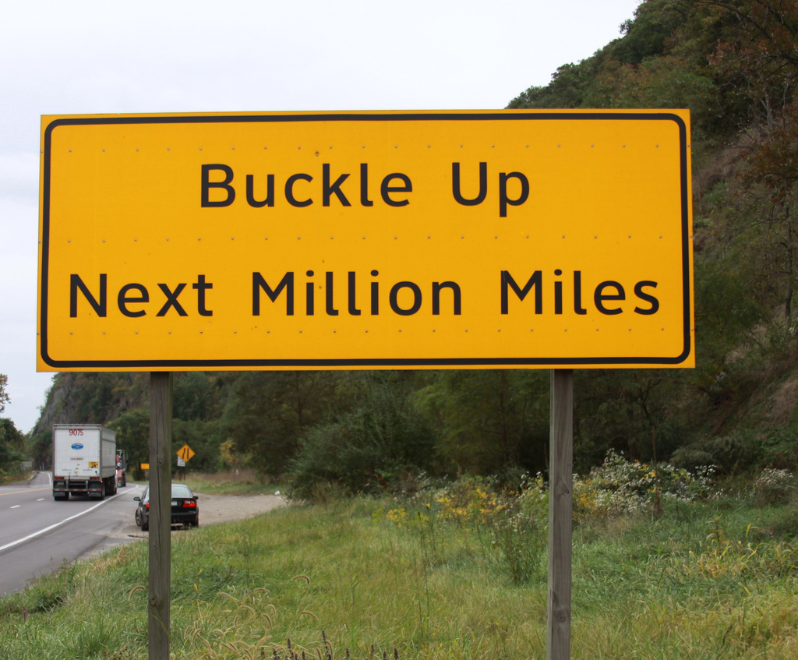

Slide 133
Thank you!
Scott McLeod, J.D., Ph.D.
Director, CASTLE
scottmcleod.net/iasb
Notes:
133
All of my materials are licensed under a Creative Commons attribution-share alike license (http://creativecommons.org/licenses/by-sa/3.0). That means not only that you are welcome to share and/or remix my content but that you are encouraged to do so! All I ask is that you properly credit me for my content and that you not place any greater copyright restrictions than I have on the content that utilizes my material. If possible, including the URL of Dangerously Irrelevant in your content would be most appreciated.
Scott McLeod, J.D., Ph.D.
dangerouslyirrelevant.org
schooltechleadership.org
dangerouslyirrelevant.org/contact.html

Slide 134
What’s in your head right now?

