Slide 1
Say hi to your neighbor!

Slide 2
5 act play

Slide 3
snipurl.com/saitraining

Slide 4
ACT 1
Our tools have changed

Slide 5


Slide 6
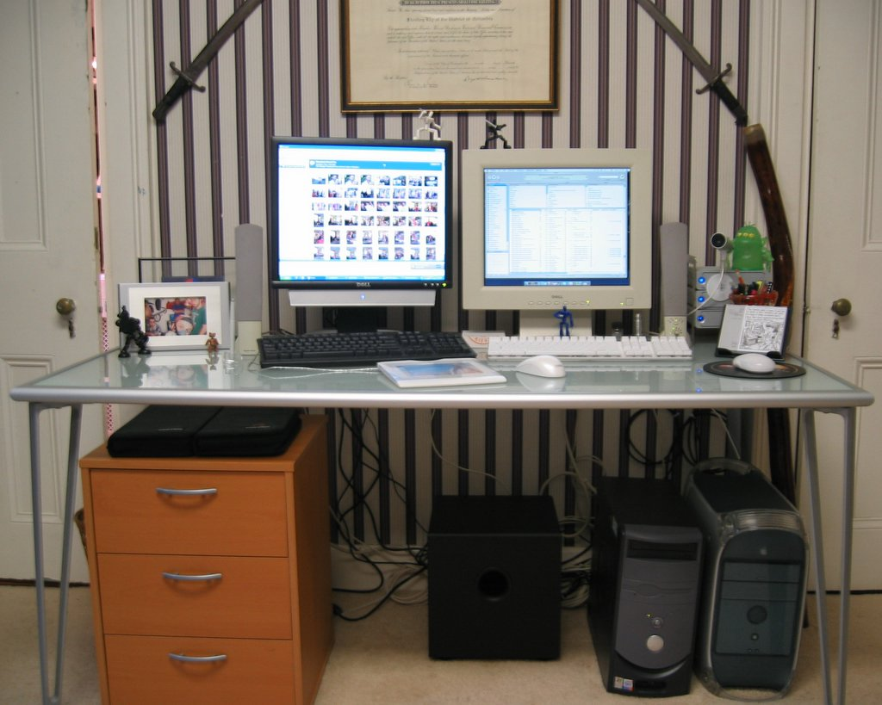

Slide 7
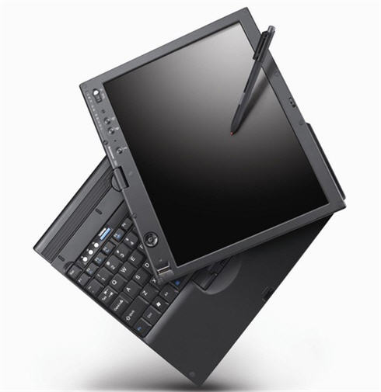

Slide 8
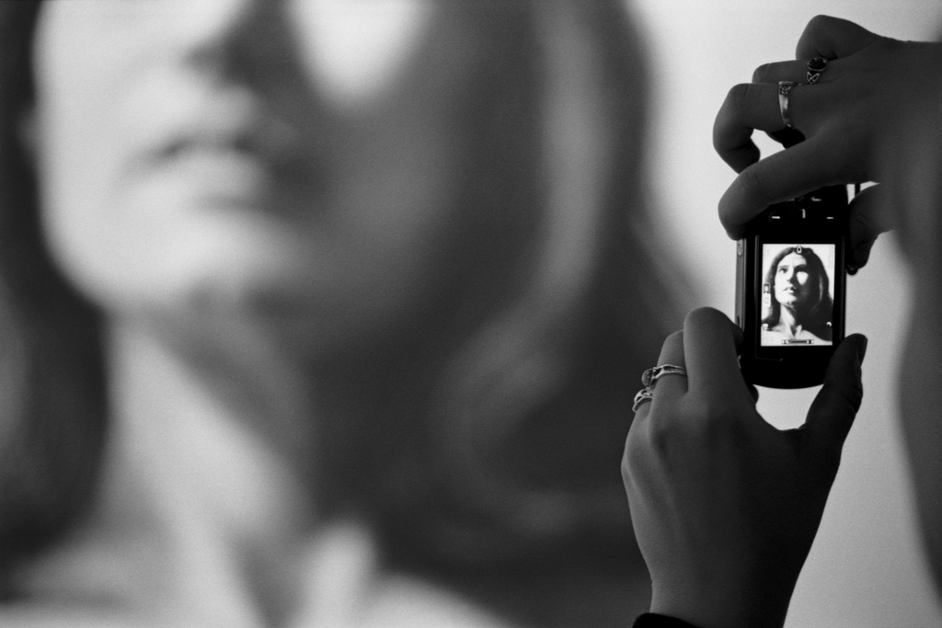
Notes:
Talking went digital.
On the personal level, we now carry around portable little computers (also known as cell phones) that not only let us talk to anyone in the world but also can send text messages, photographs, and videos. They also can hold our calendar, contacts, and music that we like to listen to. All in our pocket.
Hands up – how many of you own a cell phone?
http://www.flickr.com/photos/davyrocket/82339986/
How many of you have heard of a service called Jott that lets you can send yourself an e-mail reminder simply by calling and talking into the phone?

Slide 9
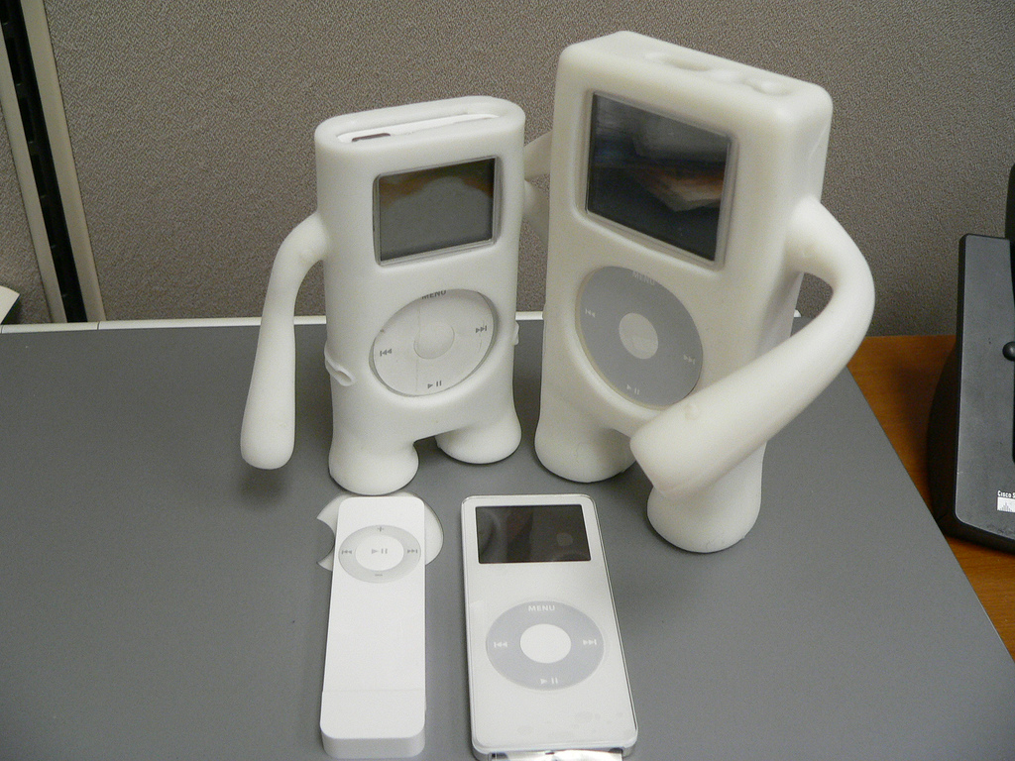
Notes:
Music went digital.
Many of us have iPods or other portable music devices that let us carry around a lifetime’s worth of music. And, again, they fit in our pocket or purse.
And, in addition to being both wonderfully useful and kinda cool, these little devices also are making us completely rethink a number of issues related to intellectual property and copyright.
Hands up – how many of you own an iPod or other kind of portable music player?
http://www.flickr.com/photos/zengame/42914294/sizes/l/

Slide 10
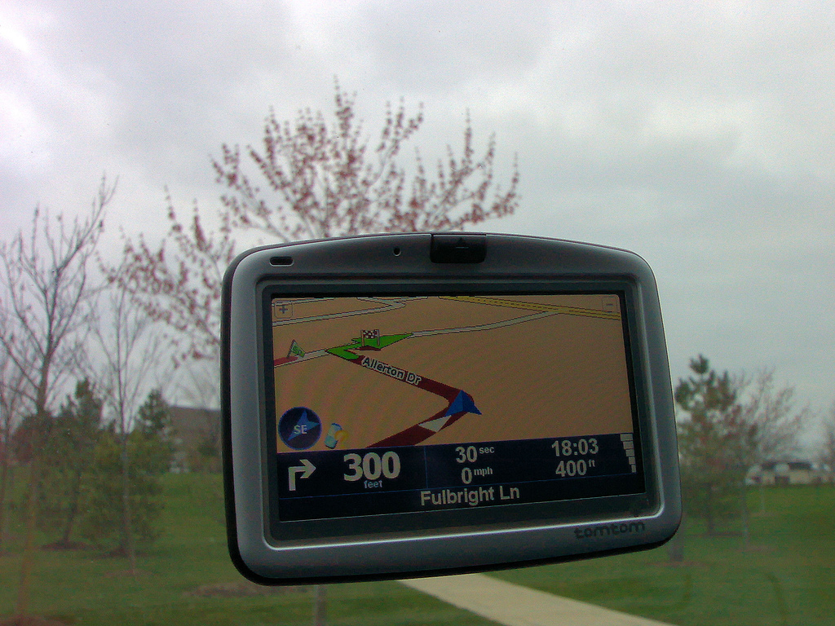
Notes:
Maps went digital.
For a few hundred dollars, we can buy a portable GPS unit and never have to get lost again.
Hands up – how many of you own a GPS unit?
http://www.flickr.com/photos/soumit/450204342/in/photostream/
http://www.flickr.com/photos/mdumlao98/976279763/

Slide 11
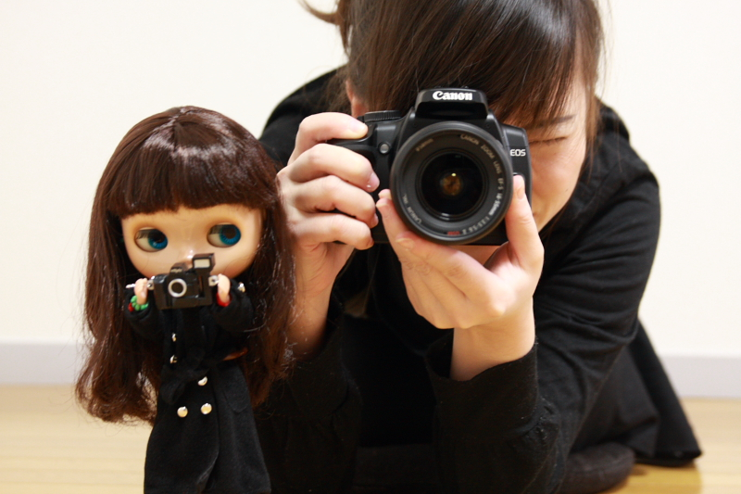
Notes:
Photos went digital.
The world of photography has been completely upended in the past couple of decades, as digital cameras infiltrate both the personal and professional realms.
Hands up – how many of you own a digital camera? Those of you who do know the affordances they lend us over regular film photography.
http://www.flickr.com/photos/parl/89822733/
http://www.flickr.com/photos/dhammza/140868495/
http://www.flickr.com/photos/purprin/2070805989/

Slide 12
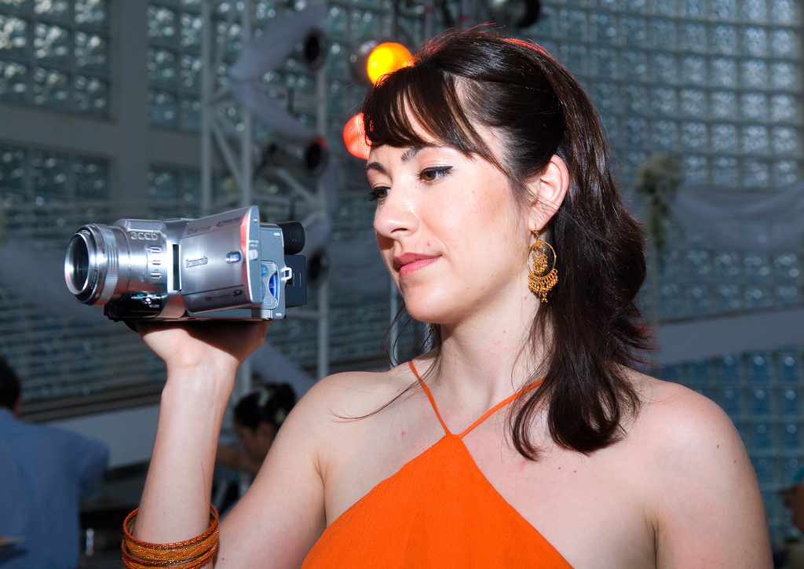
Notes:
Movies went digital.
Like the digital camera, the digital camcorder also is replacing earlier, often bulky versions, allowing individuals to capture video wherever they might be.
http://www.flickr.com/photos/oldonliner/1571194587/
http://www.flickr.com/photos/checiap/164147687/

Slide 13
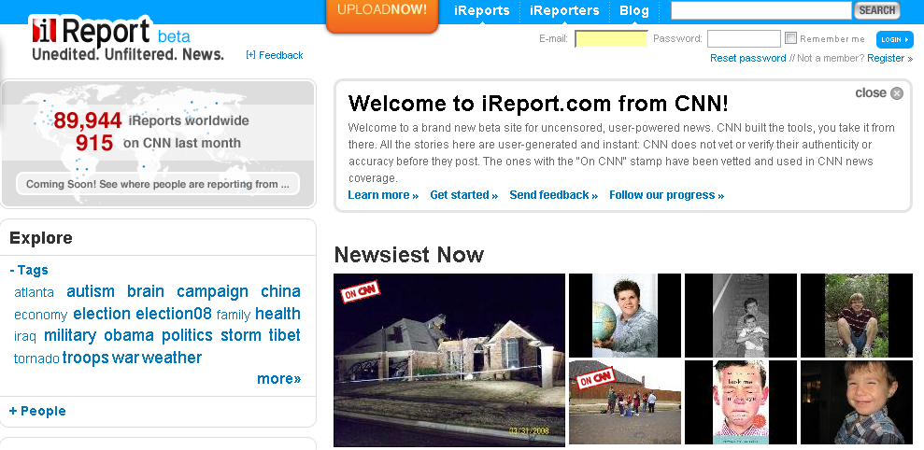
Notes:
Even the news has gone digital.
One interesting aspect of having ordinary citizens carry along cell phone cameras, digital cameras, and digital camcorders is that not only do they empower us personally but they also are giving rise to what are called ‘citizen journalists.’ The basic idea is that now, if anything interesting is happening anywhere in the world, most likely someone is taking a picture or video of it.
CNN has its new iReport service, where it aggregates news-oriented video from individuals across the globe. The South Korean online newspaper, OhMyNews, has as its motto ‘Every Citizen Is a Reporter.’ It gets several million hits a day and over 80% of its content is from ordinary citizens like you and me.

Slide 14
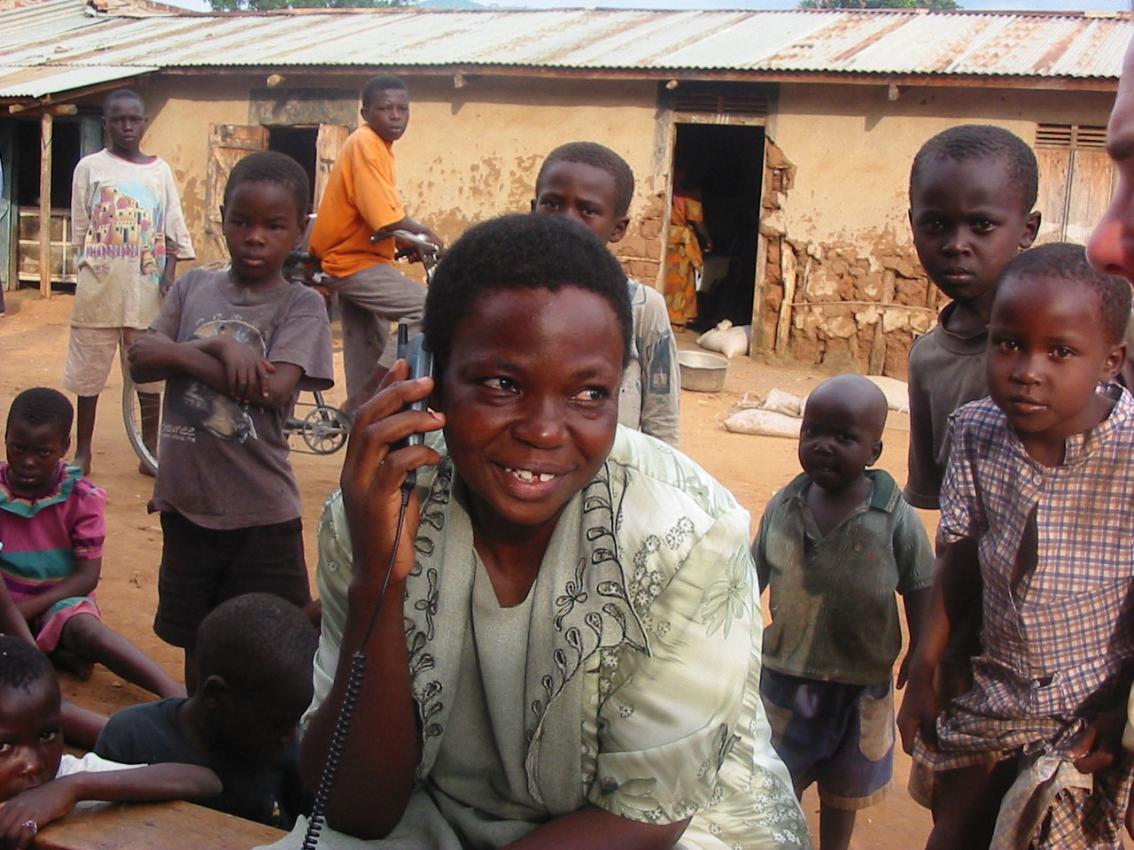
Notes:
54% annual growth in Africa;
http://microfinancegateway.org/uploaded_files/woman%20in%20crowd%20with%20phone%202.jpg
http://www.wikinvest.com/concept/Mobile_Phone_Adoption_in_Developing_Countries

Slide 15
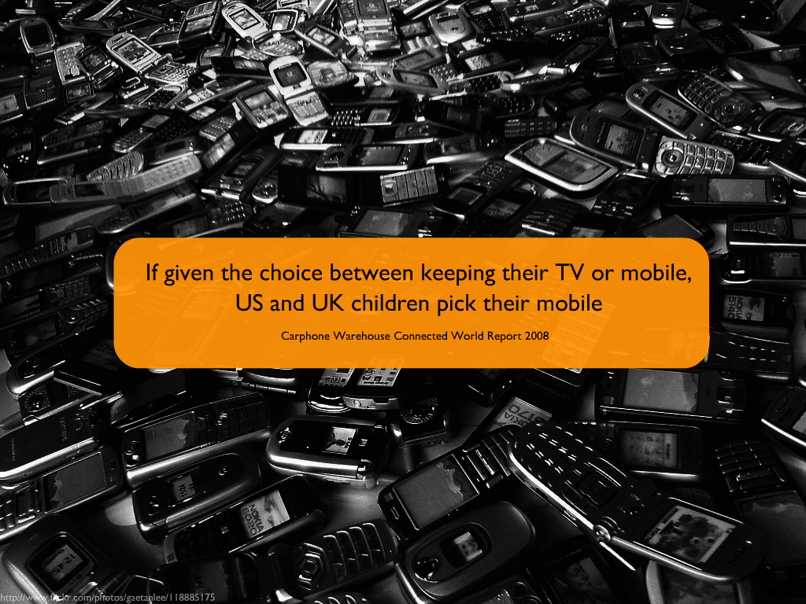

Slide 16
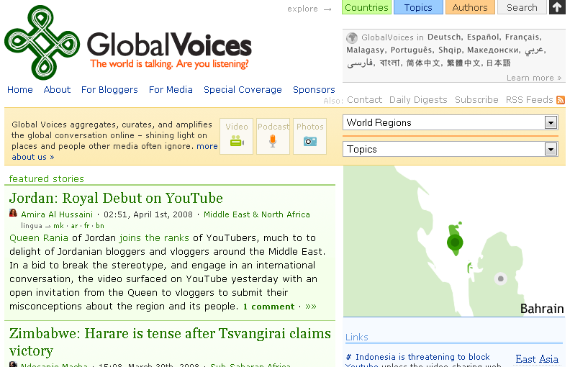
Notes:
In fact, we are starting to hear that human rights abuses in several developing countries have been curbed somewhat - simply by putting cellphones with cameras into the hands of local citizens and creating places like Global Voices Online for them to upload their content.

Slide 17
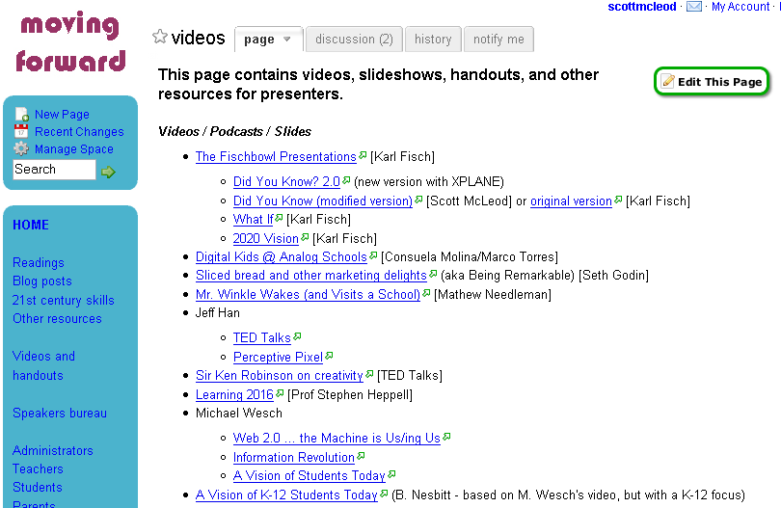
Notes:
And the interesting effect of everything going digital is that everyone now has a voice…
Blogs, wikis, podcasts, social networking sites, online photo, online video, social bookmarking, microblogging. The tools are all there for anyone who wants to use them.

Slide 18
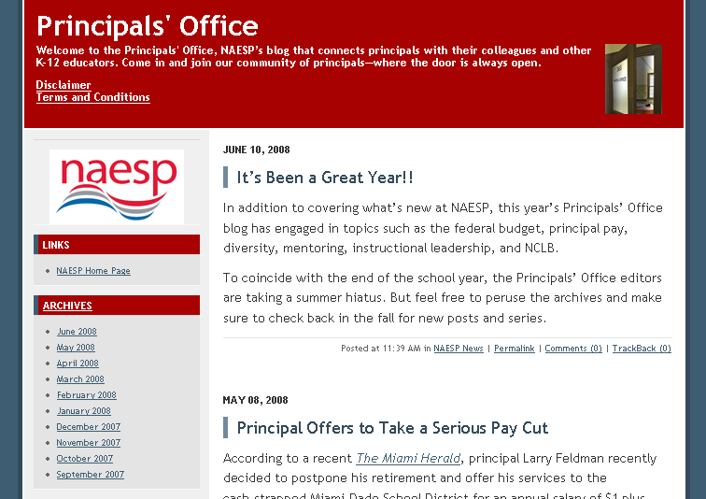

Slide 19
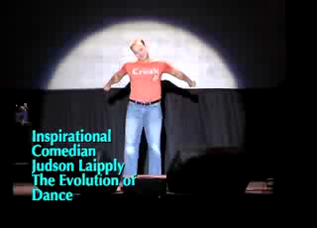

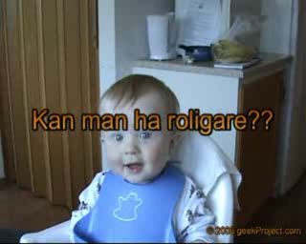
Notes:
And there’s YouTube, now the #3 place on the Web. About 1 in 6 Internet users has visited YouTube in the past 24 hours.
Just ask Judson Laipply, a previously obscure comedian from Cleveland, what it’s done to his career to have his Evolution of Dance routine viewed by over 80 million people. Most major television and film production channels, faced with declining viewership, are trying to establish a YouTube presence.
Hands up – how many of you have watched a video on YouTube? uploaded a video to YouTube?
We now live in a world where a comedian from Cleveland can be viewed by over 50 million people…
hahaha 17 million people
hey 15 million people
ever watched?
ever uploaded?
YouTube is now the #2 most-visited site on the Internet – ahead of Google
Not bad for a company that barely existed 2 years ago
As the Alexa trend graph shows, the percentage of global Internet users who visited YouTube yesterday is nearly 15%. This means that about 1 in 7 Internet users across the globe visited YouTube in the past 24 hours.
The only sites more popular than YouTube are Yahoo, MSN.com, and Google.

Slide 20


Notes:
And then there’s Facebook and MySpace, which are the #5 and #7 places on the Web, respectively. Why? Because they do one thing extremely well – they allow us to connect with each other in ways that we find meaningful and engaging.
Hands up – how many of you belong to MySpace, Facebook, or some other social networking site?
http://www.alexa.com/site/ds/top_sites?ts_mode=global&lang=none

Slide 21
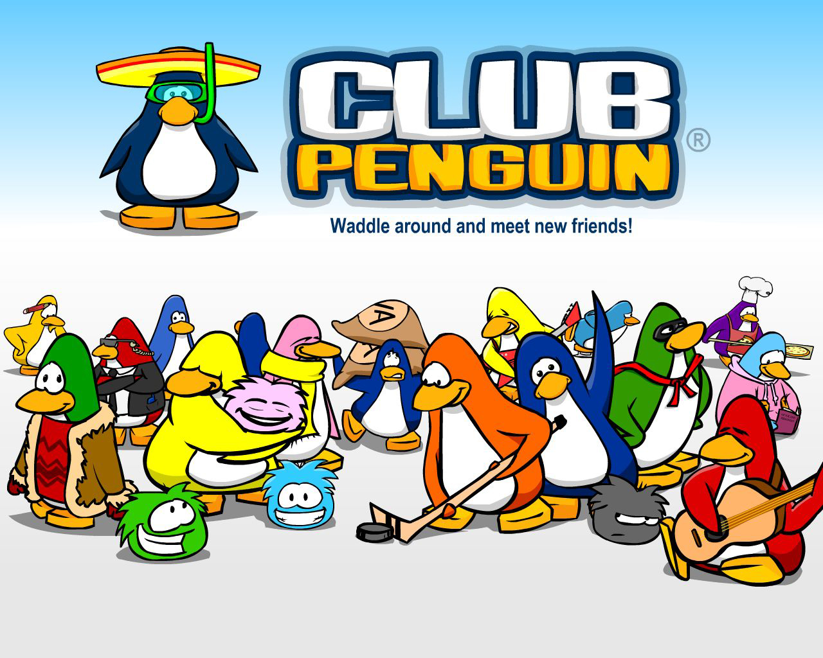

Slide 22
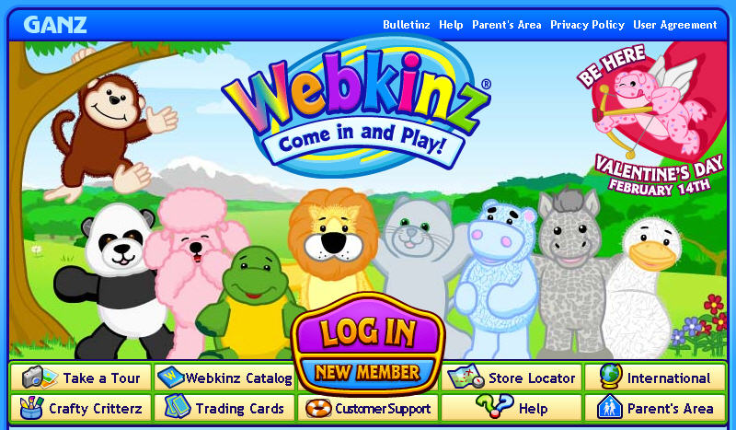

Slide 23
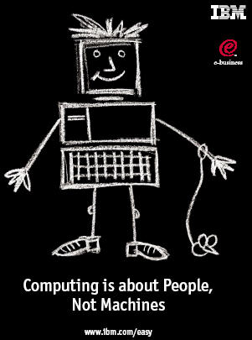
Notes:
But ultimately it is about empowerment. The reason these technologies are going like wildfire is because they allow people to be more efficient, to be more effective, to do things they want to do, and to do things they never could before.
Collaboration
Creativity
Disintermediation
Reach
Putting the power in the hands of the users
Technology allows us to communicate and collaborate with folks halfway across the globe just about as easily as we can the folks across town
Just like the printing press ushered in a new era where the general population could afford to be literate, to read, we are seeing similar transformations today
No longer need to be a publishing company to publish a book
Record studio to create a hit song or album
Movie studio to create a hit movie or music video
- Digital cameras, camcorders, software – a few hundred dollars, an Internet connection, and an idea and you’re all set
Disintermediation – tools are there that allow us to bypass the “middle man” – used to have to rely on publishers, record companies, movie studios, etc. to reach our audience – now we can reach them directly and they can find us through search engines, video hosting sites, tags, etc.
Not only can we reach them by bypassing traditional entities – we can reach them in the thousands, hundreds of thousands, millions

Slide 24
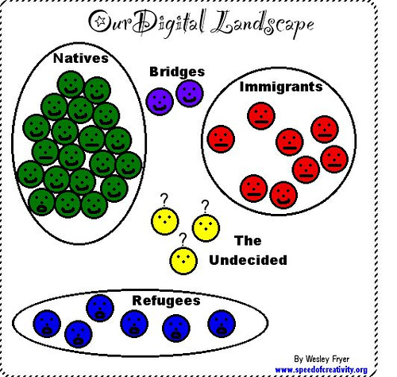
Notes:
The challenge, of course, is that much of this world is invisible to older adults and educators (in the bubble)
Why? b/c didn’t grow up with it
For the first time in history, kids know more than adults about something that’s important
- this is scary to adults!
Wesley Fryer
http://www.speedofcreativity.org/2006/10/21/beyond-the-digital-native-immigrant-dichotomy/

Slide 25
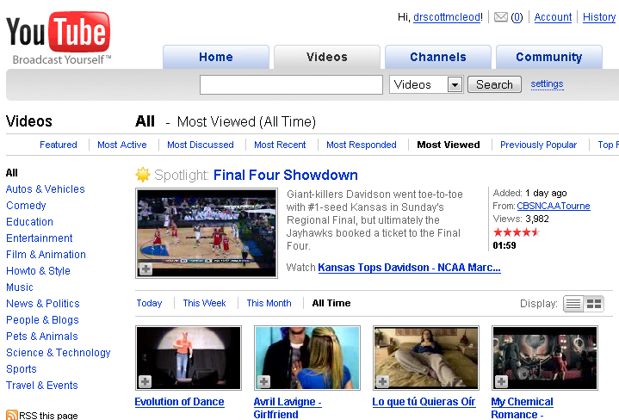
Notes:
And the interesting effect of everything going digital is that everyone now has a voice…
Blogs, wikis, podcasts, social networking sites, online photo, online video, social bookmarking, microblogging,
Then of course there’s YouTube, now the #2 place on the Web. About 1 in 6 Internet users has visited YouTube in the past 24 hours.
Just ask Judson Laipply, a previously obscure comedian from Cleveland, what it’s done to his career to have his Evolution of Dance routine viewed by over 80 million people. Most major television and film production channels, faced with declining viewership, are trying to establish a YouTube presence.
Hands up – how many of you have watched a video on YouTube? uploaded a video to YouTube?

Slide 26
Notes:
Blogs, wikis, podcasts, social networking sites, online photo, online video, social bookmarking, microblogging. The tools are all there for anyone who wants to use them.
As Shirky notes, the web has become a participatory space, and there’s no going back.
What does it mean for your ability to be effective 21st century leaders when so few of you are using or are even familiar with the new social tools that are revolutionizing our personal lives?

