Slide 1
ACT 2
Information has changed

Slide 2
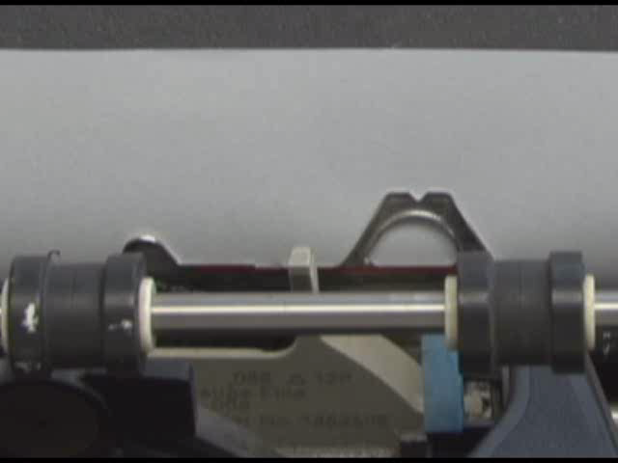
Notes:
2

Slide 3

Notes:
3

Slide 4
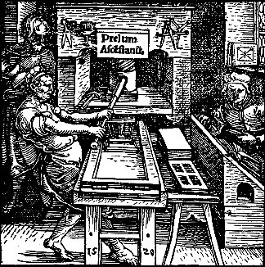

Slide 5


Slide 6
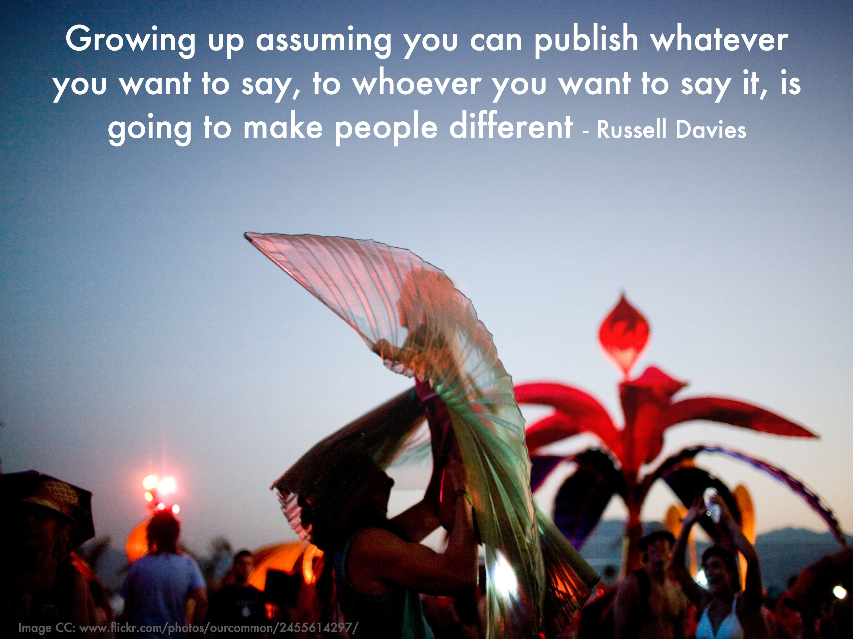

Slide 7
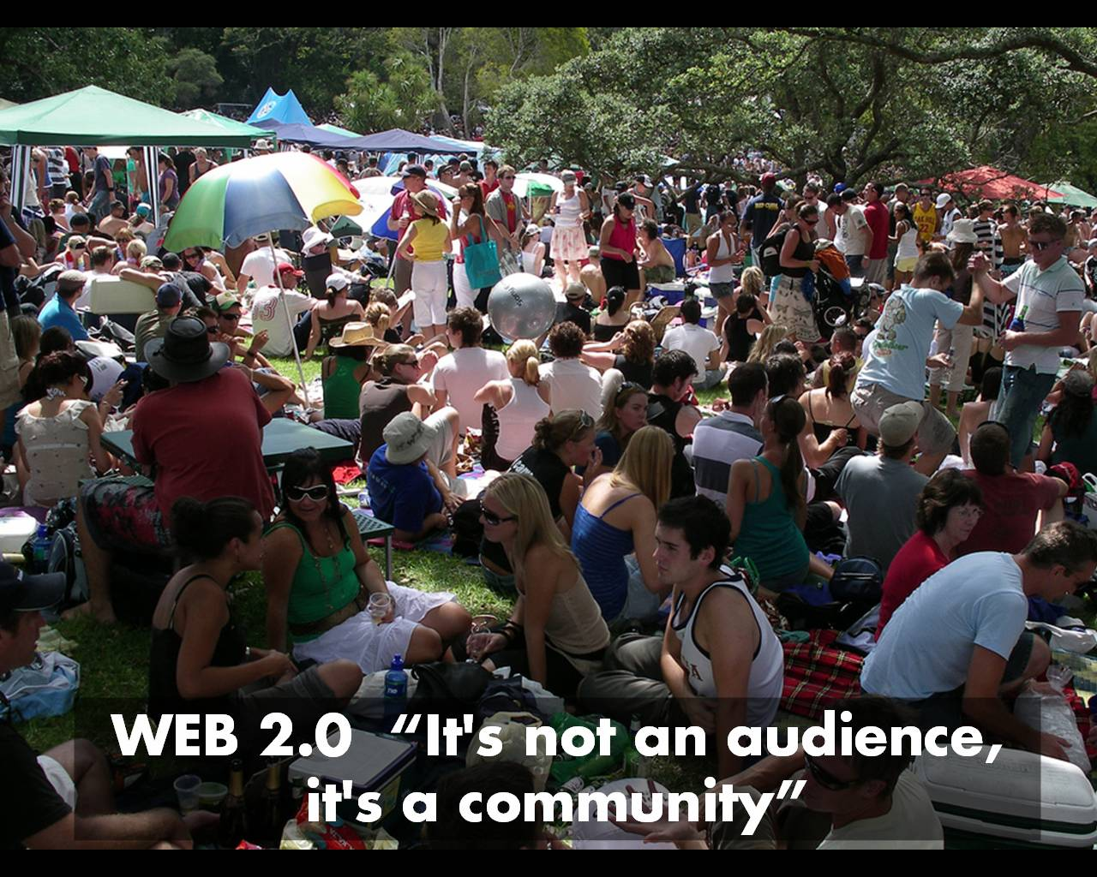

Slide 8
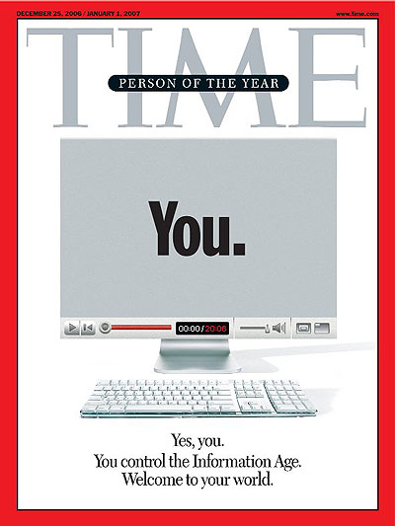
Notes:
The new Web is a very different thing. It’s a tool for bringing together the small contributions of millions of people and making them matter. [As these tools get put in the hands of ordinary people, we are seeing] an explosion of productivity and innovation. It’s just getting started, as millions of minds that would otherwise have drowned in obscurity get backhauled into the global intellectual economy.
A story about community and collaboration on a scale never seen before. It’s about the many wresting the power from the few and helping one another for nothing and how that will not only change the world, but also change the way the world changes.
But in schools, technology is still seen as an add-on, something that’s optional.

Slide 9
TIME, December 2006
The new Web is a very different thing. It’s a tool for bringing together the small contributions of millions of people and making them matter. [As these tools get put in the hands of ordinary people, we are seeing] an explosion of productivity and innovation. It’s just getting started, as millions of minds that would otherwise have drowned in obscurity get backhauled into the global intellectual economy.

Slide 10
TIME, December 2006
[It’s] a story about community and collaboration on a scale never seen before. It’s about the many wresting the power from the few and helping one another for nothing and how that will not only change the world, but also change the way the world changes.

Slide 11
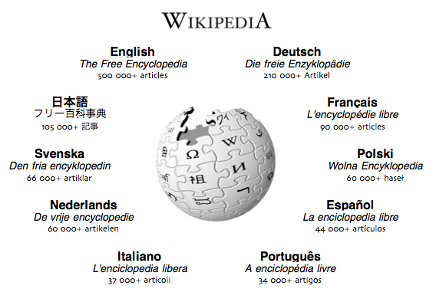
Notes:
We now live in a world where an upstart online encyclopedia created by thousands of volunteers can boast over 2 million entries in English alone, which is several orders of magnitude larger than the august and revered Encyclopedia Britannica. And, of course, Wikipedia corrects and updates itself almost, which means that it already recognizes that Pluto is no longer a planet, that Shimon Peres was elected President of Israel, and that the San Antonio Spurs won the 2007 NBA finals, while none of those facts is in the Britannica edition sitting in your local library.
have you read?
have you edited?
librarian in New Jersey?
Wikipedia is the #9 most-visited site on the Internet
As you can see from the Alexa trend graph, most of that traffic growth has occurred in the past 3 years
7% of all Internet users across the globe visited Wikipedia in the past 24 hours
Just to give you an idea of how popular Wikipedia is, consider some of the other sites you probably visit regularly. eBay is #21, Amazon.com is #34, AOL is #46, and CNN.com is #107. NewYorkTimes.com is only #236.

Slide 12
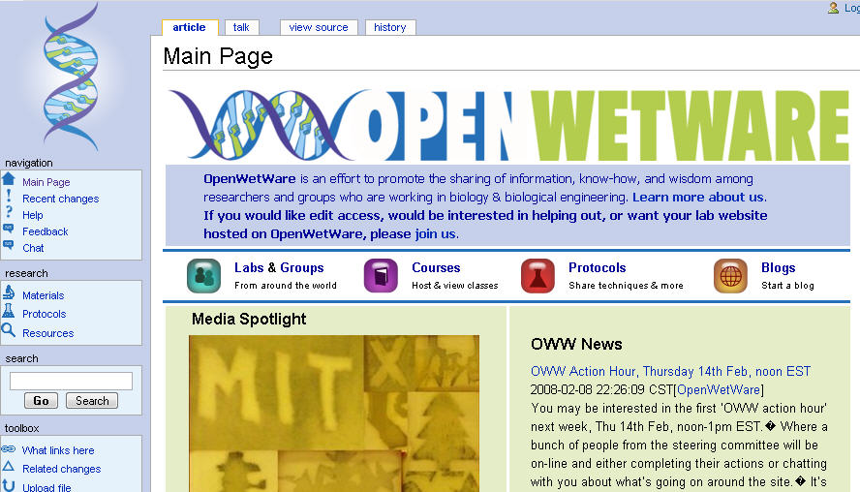

Slide 13
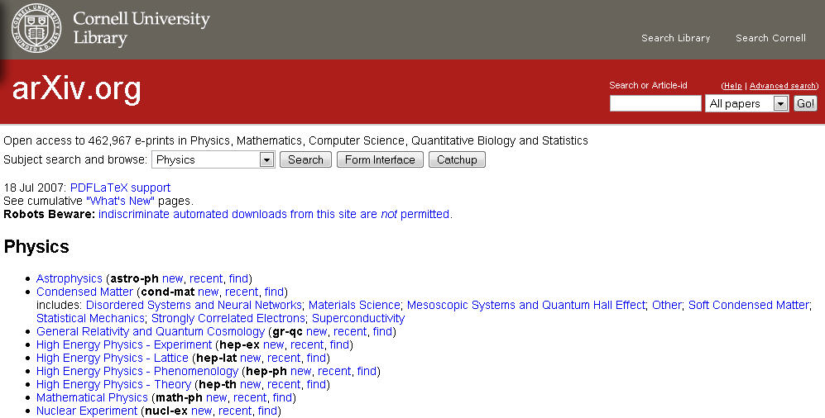
Notes:
arXiv
Human Genome Project
OpenWetWare
European Bioinformatics Institute
Intel Open University Network
We now live in a world where online collaboration tools are allowing scholars and researchers all around the world to not only share and access each other’s work but even access and build off each other’s data. Initiatives like the Human Genome Project allow individuals and organizations from all over the globe to break down institutional and geographic walls and collaborate for the benefit of humanity.
I could go on but the point is clear. The world has changed and it’s changed rapidly. If we imagine the world ten years out, or 20 or 30, it appears quite clear that we have no idea what it will look like on many fronts.
This is societal change at an unprecedented pace, and it’s quite unsettling for many people.

Slide 14
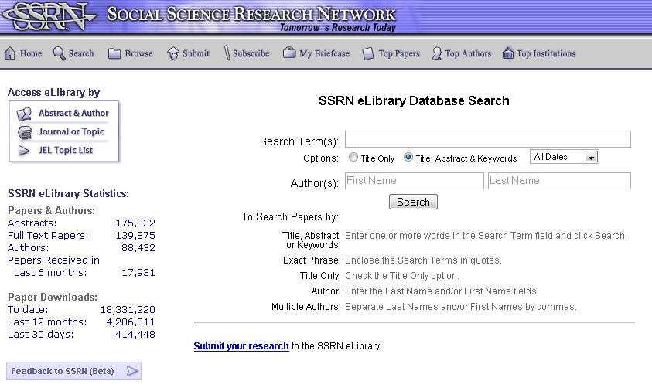

Slide 15








Notes:
Flickr 46
Craigslist 64
Digg 156

Slide 16
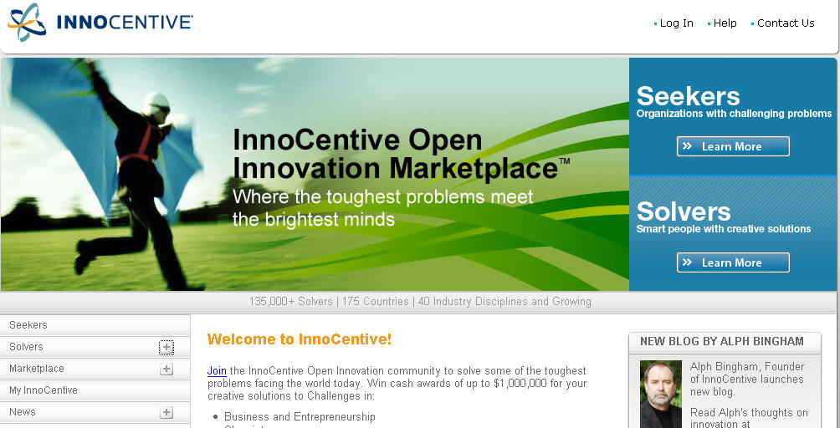
Notes:
global ideagoras
We now live in a world where web sites like Innocentive, Nine-Sigma, and YourEncore connect companies to hundreds of thousands of scientists all over the globe to solve problems and create new solutions. The companies anonymously post R&D problems on these “ideagoras” which scientists can then browse through. If a scientist submits a solution to one of the problems, she receives a cash prize ranging from $5,000 to $100,000. These web sites essentially are like an eBay for innovation. To companies who are sitting on difficult problems or unused patents, the entire world is now available to them as an R&D department.

Slide 17
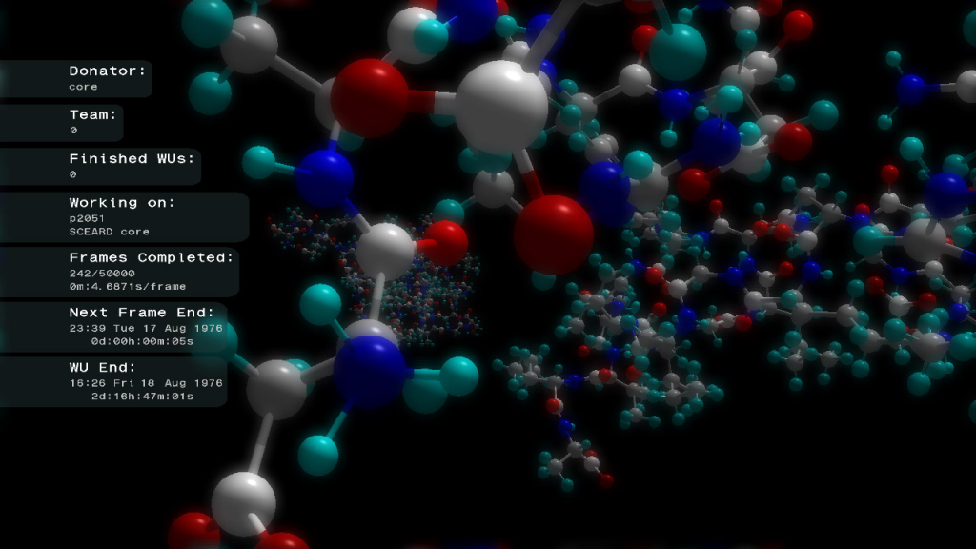
Notes:
We now live in a world where distributed computing initiatives like … allow scientists to harness the collective computing capacity of users at home, when they’re not otherwise using their computers, to work on important problems of humanity. Initiatives are aimed at
fighting AIDS and cancer
understanding why proteins misfold,
eradicating smallpox, ebola, and other infectious diseases
Measuring the mass of neutrinos
Analyzing dust particles collected from space comets
Folding@home
United Devices Smallpox Research Grid Project
Find-a-drug
FightAIDS@Home
Muon1
Stardust@home
Screensaver Lifesaver

Slide 18
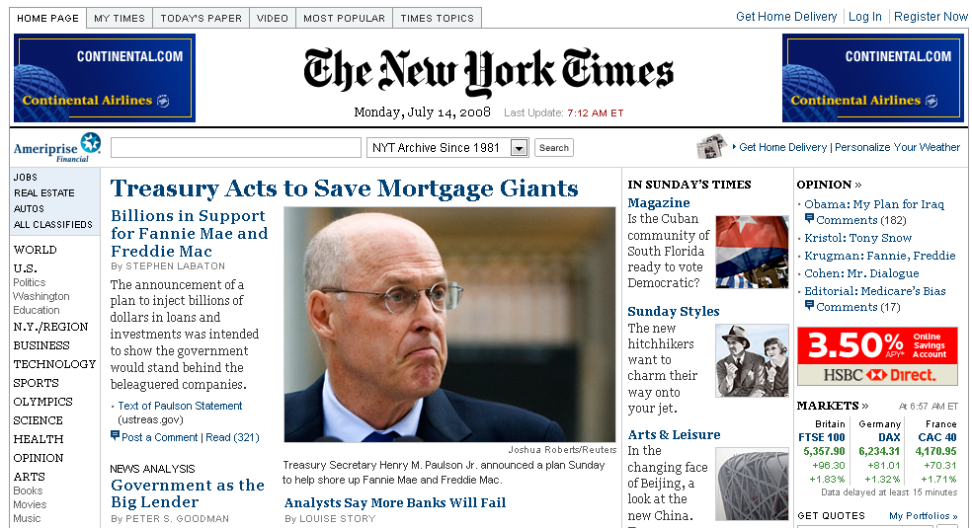
Notes:
Just ask newspapers. The business model is collapsing, ad dollars are disappearing, newsprint prices are at a 12-year high and the Internet is just giving news away for free. Many newspapers are seeing 10x the number of readers but 1/10 the number of dollars generated.

Slide 19
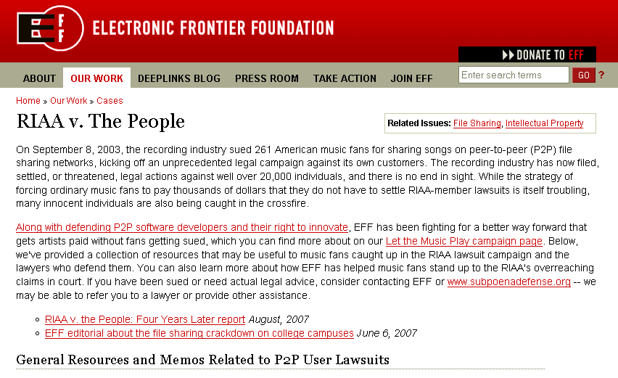

Slide 20
Information as a raw material

Slide 21
The backchannel

Slide 22
Containers

Slide 23
Notes:
Which category do you fall in?

Slide 24

Notes:
Schmap

Slide 25
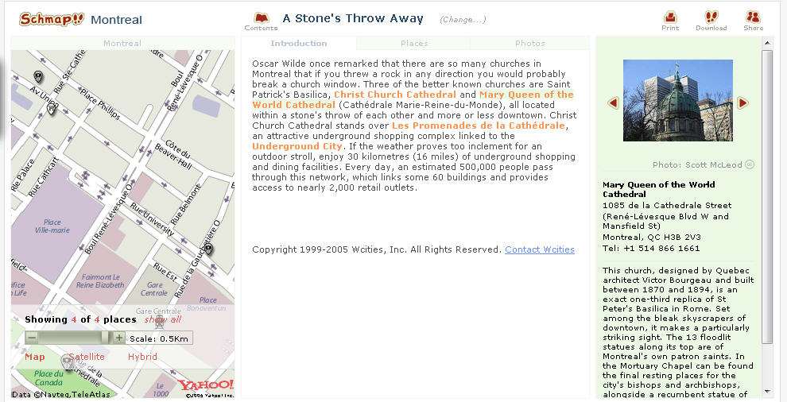

Slide 26


Slide 27
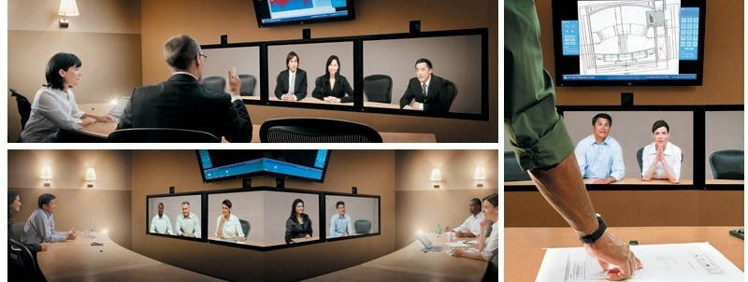
Notes:
Of course the corporate world is taking advantages of these technologies too. Tools such as webcams, videoconferencing, instant messaging, online office software, document sharing, and online calendars are reshaping our ability to do our work. We now can communicate and collaborate with folks halfway across the globe just about as easily as we can the folks across town. For our young people who use MySpace, Facebook, instant messaging, and yes, even pokey e-mail, the use of digital tools to collaborate and share knowledge is almost second nature.

Slide 28
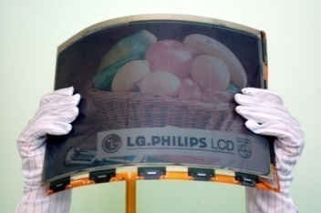

Slide 29
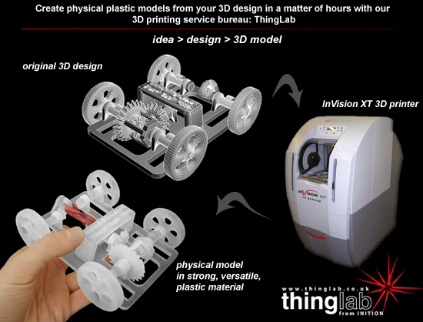

Slide 30


Slide 31
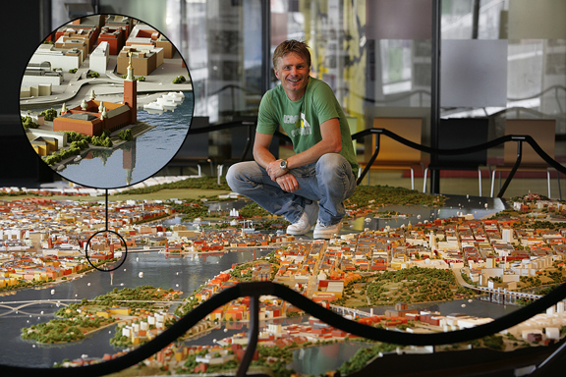

Slide 32
Are you a …
Native
Immigrant
Refugee
Bridge

Slide 33
New paradigms require that we do things differently

