Slide 1
Stand up!

Slide 3
ACT 3
Jobs have changed

Slide 4
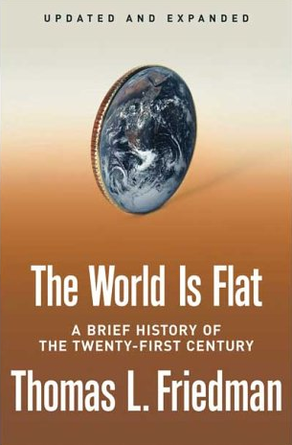
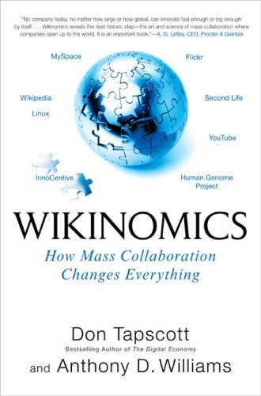
Notes:
4
If you haven’t noticed, our world has flattened around us. Geography, and time, are disappearing as barriers. Technology lets us communicate and work with people halfway around the world about as easily as we can with people on the other side of town. After we go to bed, businesses in other countries are working away during their daylight hours, ready to interact with us when we wake up again in the morning. The global economy never sleeps.

Slide 5
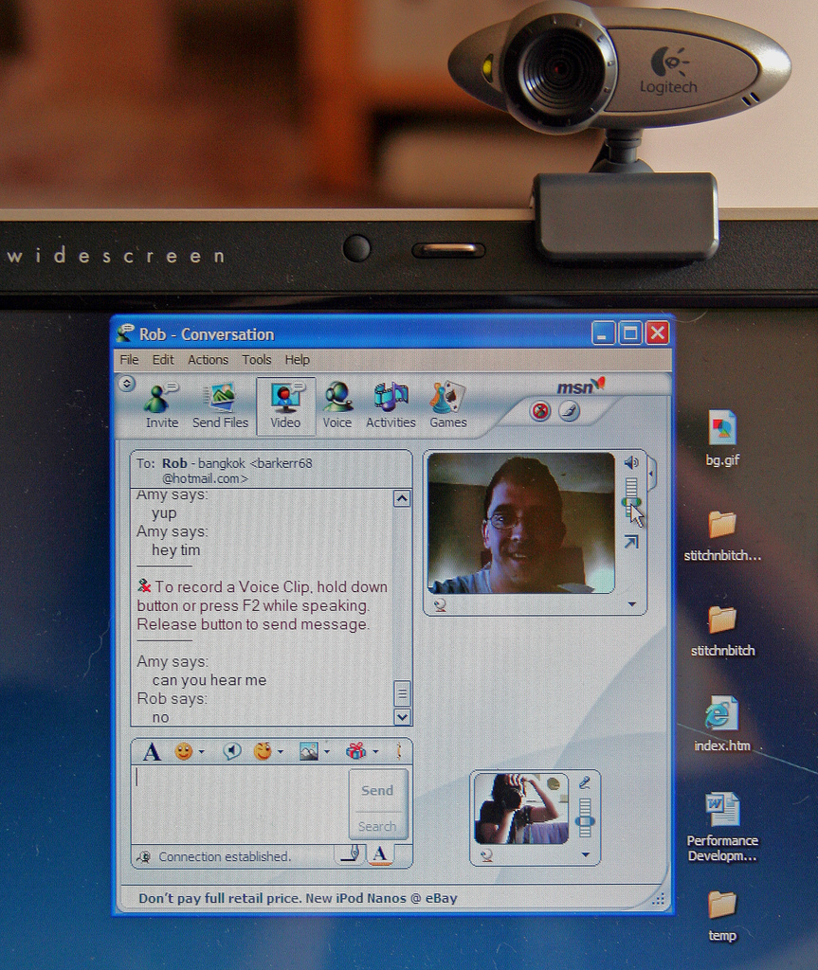
Notes:
http://www.flickr.com/photos/gadgetgirl70/391745663/
webcams, videoconferencing, instant messaging, online office software, document sharing, and calendars
The interesting thing we’re finding is that, when offered the chance to participate, people will take you up on it

Slide 6
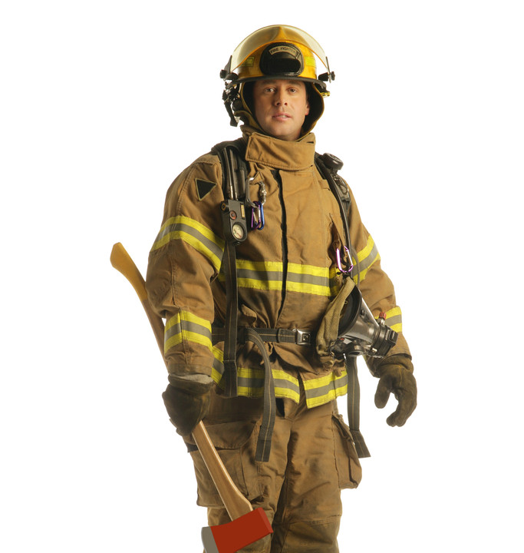
cognitive
manual

Slide 7
Routine manual
Notes:
Routine manual
Installing windshields on new cars
Counting and selecting pills in factories
Filling cans or boxes
http://www.flickr.com/photos/49502995879@N01/105779625
http://www.flickr.com/photos/99232341@N00/733920335
http://www.flickr.com/photos/49503155065@N01/388806044

Slide 8
Non-routine manual
Notes:
Nonroutine manual
Truck driver
Custodian
Jeweler
http://www.flickr.com/photos/48023467@N00/2464781455
http://www.flickr.com/photos/37611179@N00/2295452969
http://www.flickr.com/photos/66606673@N00/363050622
http://www.flickr.com/photos/myconstructionphotos/1525757141/

Slide 9
Routine cognitive
Notes:
Routine cognitive
Expense reports
Registering new insurance accounts
Evaluating mortgage applications
Taxes
Wills
http://www.flickr.com/photos/82312837@N00/1134150708
http://www.flickr.com/photos/42299665@N00/377682726
http://www.flickr.com/photos/sglpix/118808245/
http://www.flickr.com/photos/radiospike/405230803/
http://www.flickr.com/photos/leadenhall/2306180754/

Slide 10
Expert thinking
Notes:
Expert thinking
Chef
Auto mechanic
Doctor
Architect
http://www.flickr.com/photos/chicagoeye/12250868/
http://www.flickr.com/photos/orcoo/345583754/
http://www.flickr.com/photos/analia_manetta/1225147773/
http://www.flickr.com/photos/sircoupe/1937192065/
http://www.flickr.com/photos/private_custard/2348287529/
http://www.flickr.com/photos/marcelock/329351011/

Slide 11
Complex communication
Notes:
Complex communication
Biology teacher
Engineer
Manager
http://www.flickr.com/photos/ifranzmedia/301825396/
http://www.flickr.com/photos/benrussell/1477899923/
http://www.flickr.com/photos/ricephotos/368496639/

Slide 12
Expert thinking
Complex communication
Routine manual
Routine cognitive
Non-routine manual
Autor, D., Levy, F., & Murnane, R. J. (2003). The skill content of recent technological change: An empirical exploration. Quarterly Journal of Economics 188, 4.
Notes:
Routine manual - Installing windshields on new cars, Counting and selecting pills in factories, Filling cans or boxes
Nonroutine manual - Truck driver, Custodian, Jeweler
Routine cognitive - Expense reports, Registering new insurance accounts, Evaluating mortgage applications, Taxes, Wills
Expert thinking – Chef, Auto mechanic, Doctor, Architect
Complex communication - Biology teacher, Engineer, Manager

Slide 13
Growth of the creative class
Florida, R. (2002). The rise of the creative class (p. 332). New York, NY: Basic Books.
Notes:
Since 1950…
agriculture = less than 2%
working = primarily high school diploma, some have a little bit of college - factory workers, construction workers, food service workers, custodians, truck drivers – low levels of education, highly manual labor
service = beauticians, secretaries, paralegals, workers in retail stores, tourism and hotel workers, personal health care assistants
creative = scientists, engineers, technology workers, architects, lawyers, doctors, nurses, K-12 educators, university professors, poets, musicians, and entertainers - from 5% in 1900 to 14% in 1945 to 33% in 2008
2005 – Bill Gates - Today, only one-third of our students graduate from high school ready for college, work, and citizenship. . . . The first group goes on to college and careers; the second group will struggle to make a living wage. Let's be clear. Thanks to dedicated teachers and principals around the country, the best-educated kids in the United States are the best-educated kids in the world. We should be proud of that. But only a fraction of our kids are getting the best education.

Slide 14
Growth of the creative class
Notes:
Since 1950…
agriculture = less than 2%
working = primarily high school diploma, some have a little bit of college - factory workers, construction workers, food service workers, custodians, truck drivers – low levels of education, highly manual labor
service = beauticians, secretaries, paralegals, workers in retail stores, tourism and hotel workers, personal health care assistants
creative = scientists, engineers, technology workers, architects, lawyers, doctors, nurses, K-12 educators, university professors, poets, musicians, and entertainers - from 5% in 1900 to 14% in 1945 to 33% in 2008
2005 – Bill Gates - Today, only one-third of our students graduate from high school ready for college, work, and citizenship. . . . The first group goes on to college and careers; the second group will struggle to make a living wage. Let's be clear. Thanks to dedicated teachers and principals around the country, the best-educated kids in the United States are the best-educated kids in the world. We should be proud of that. But only a fraction of our kids are getting the best education.

Slide 15
Can someone overseas do it cheaper?
Can a computer do it faster?
Is what I’m offering in demand in an age of abundance?
Notes:
New Commission on the Skills of the American Workforce
It is becoming progressively less expensive to automate functions that used to be performed by people. As the cost of labor rises and the cost of automating jobs continues to fall, it becomes both possible and necessary for firms simply to eliminate job after job now being done by humans. Earlier, almost all the jobs subject to automation were low-skill jobs. That is no longer true. Now it is more accurate to say that the jobs that are most vulnerable are the jobs involving routine work. If someone can figure out the algorithm for a routine job, chances are that it is economical to automate it. Many good, well-paying, middle-class jobs involve routine work of this kind and are rapidly being automated. [Think tax preparers, lawyers… being replaced by software]
Daniel Pink
If you say yes to 1 or 2, or no to 3, you’re in trouble
Forging relationship rather than executing transactions
Tackling novel, complex challenges instead of solving routine problems
Synthesizing and connecting disparate parts, thus creating or adding value
The capacity to detect patterns and opportunities, to combine seemingly unrelated ideas into something new, to craft a satisfying narrative, to create artistic and emotional beauty
Creativity is the ultimate economic resource. The ability to come up with new ideas and better ways of doing things is ultimately what raises productivity and thus living standards. In virtually every industry, the winners in the long run are those who can create and keep creating. This has always been true.
As we have moved from an agricultural age to an industrial age to an information age, our primary economic resource no longer is raw materials from the ground or human labor. We have to recognize that information is now the primary and most lucrative raw material.

Slide 16
2 billion

Slide 17
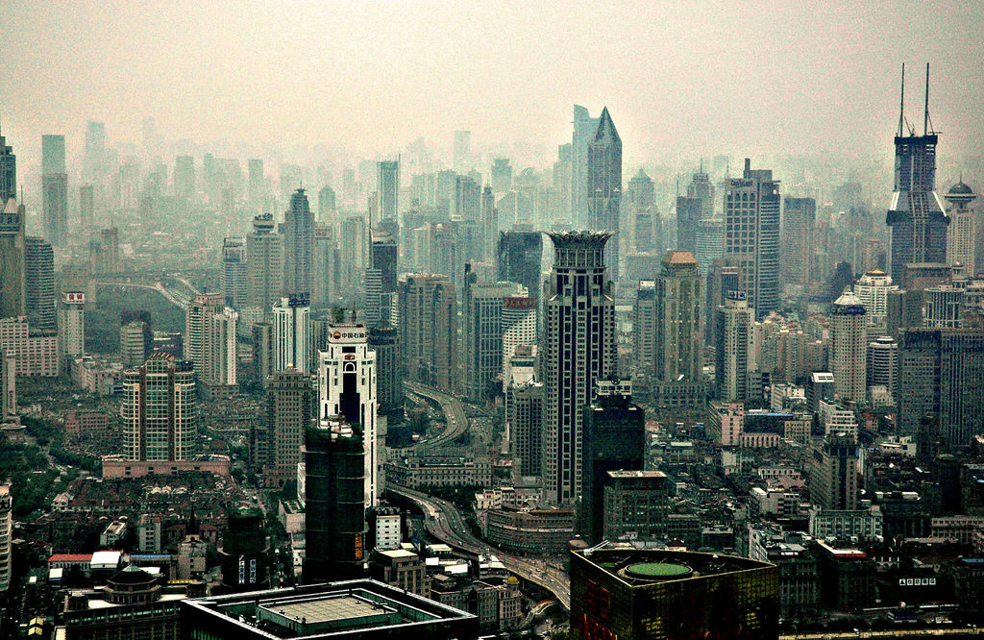

Slide 18
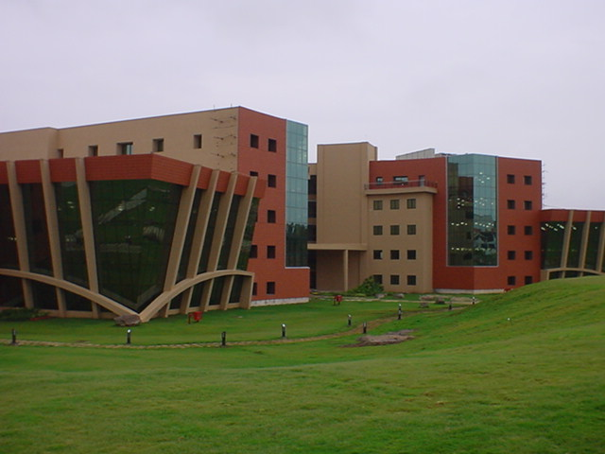

Slide 19
Agricultural class
Working class
Service class
Creative class
Notes:
Since 1950…
agriculture = less than 2%
working = primarily high school diploma, some have a little bit of college - factory workers, construction workers, food service workers, custodians, truck drivers – low levels of education, highly manual labor
service = beauticians, secretaries, paralegals, workers in retail stores, tourism and hotel workers, personal health care assistants
creative = scientists, engineers, technology workers, architects, lawyers, doctors, nurses, K-12 educators, university professors, poets, musicians, and entertainers - from 5% in 1900 to 14% in 1945 to 33% in 2008
2005 – Bill Gates - Today, only one-third of our students graduate from high school ready for college, work, and citizenship. . . . The first group goes on to college and careers; the second group will struggle to make a living wage. Let's be clear. Thanks to dedicated teachers and principals around the country, the best-educated kids in the United States are the best-educated kids in the world. We should be proud of that. But only a fraction of our kids are getting the best education.

Slide 20
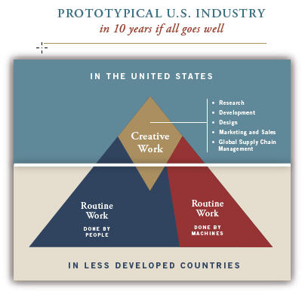
Notes:
New Commission on the Skills of the American Workforce
Today Indian engineers make $7,500 a year against $45,000 for a similarly-qualified American engineer. Why would the world’s employers pay our engineers more? They would be willing to do that only if we could offer something the Indian engineers cannot.
Producing the most important new products and services depends on a deep vein of creativity that is constantly renewing itself, and on a myriad of people who can imagine how people can use things that have never been available before
Creativity and innovation, facility with the use of ideas and abstractions, the self-discipline and organization needed to manage one’s work and drive it through to a successful conclusion, the ability to function well as a member of a team, the ability to use digital technologies to do everything just mentioned…

Slide 21
Notes:
What are you seeing in your local communities? Do you agree with TIME magazine, Fisher, and Warlick?

