Slide 1
ACT 4
Schools
have NOT
changed

Slide 2
The fundamental dilemma
but now are
expected to
do this
Schools were
designed
for this …
Notes:
Since 1950…
agriculture = less than 2%
working = primarily high school diploma, some have a little bit of college - factory workers, construction workers, food service workers, custodians, truck drivers – low levels of education, highly manual labor
service = beauticians, secretaries, paralegals, workers in retail stores, tourism and hotel workers, personal health care assistants
creative = scientists, engineers, technology workers, architects, lawyers, doctors, nurses, K-12 educators, university professors, poets, musicians, and entertainers - from 5% in 1900 to 14% in 1945 to 33% in 2008
2005 – Bill Gates - Today, only one-third of our students graduate from high school ready for college, work, and citizenship. . . . The first group goes on to college and careers; the second group will struggle to make a living wage. Let's be clear. Thanks to dedicated teachers and principals around the country, the best-educated kids in the United States are the best-educated kids in the world. We should be proud of that. But only a fraction of our kids are getting the best education.

Slide 3
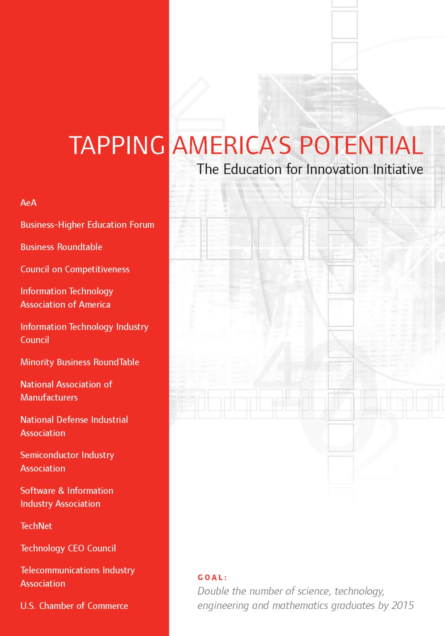
Notes:
A number of high-powered organizations, task forces, and committees have looked around the world as it is today and have asked a simple question: are schools doing what they need to do to prepare students for this new reality?
And report…

Slide 4


Slide 5
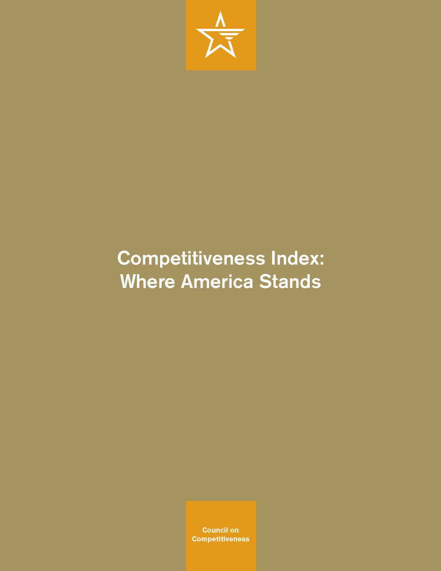

Slide 6

Notes:
New Commission on the Skills of the American Workforce
It is becoming progressively less expensive to automate functions that used to be performed by people. As the cost of labor rises and the cost of automating jobs continues to fall, it becomes both possible and necessary for firms simply to eliminate job after job now being done by humans. Earlier, almost all the jobs subject to automation were low-skill jobs. That is no longer true. Now it is more accurate to say that the jobs that are most vulnerable are the jobs involving routine work. If someone can figure out the algorithm for a routine job, chances are that it is economical to automate it. Many good, well-paying, middle-class jobs involve routine work of this kind and are rapidly being automated. [Think tax preparers, lawyers… being replaced by software]

Slide 7


Slide 8
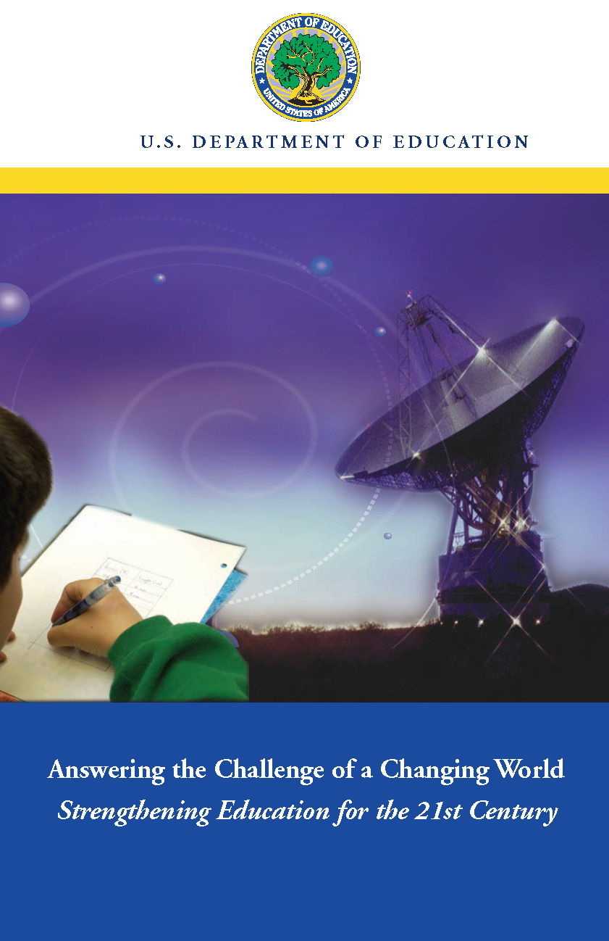

Slide 9


Slide 10


Slide 11


Slide 12
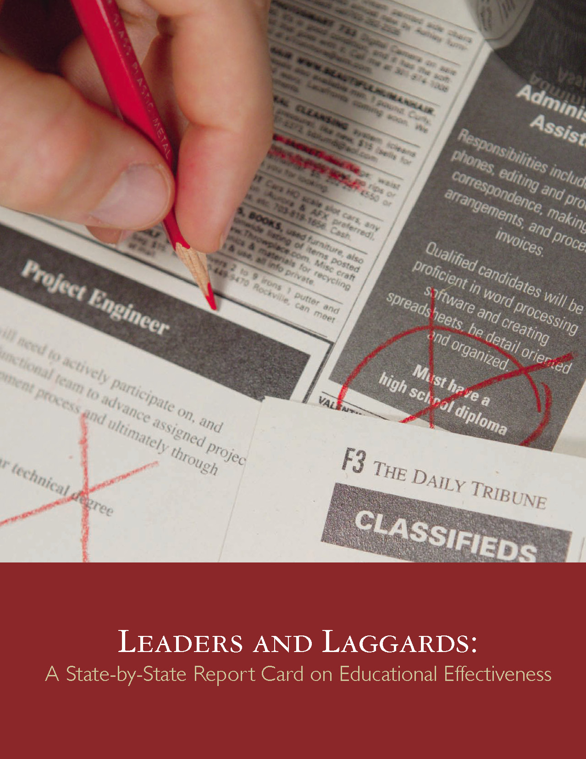
Notes:
After report…
have come to the same conclusion: our schools are not up to snuff.
2005 – Bill Gates - America's high schools are obsolete. By obsolete, I don't just mean that our high schools are broken, flawed, and under-funded--though a case could be made for every one of those points. By obsolete, I mean that our high schools--even when they're working exactly as designed--cannot teach our kids what they need to know today. This isn't an accident or a flaw in the system; it is the system.
Today, most jobs that allow you to support a family require some postsecondary education. This could mean a four-year college, a community college, or technical school. Unfortunately, only half of all students who enter high school ever enroll in a postsecondary institution. That means that half of all students starting high school today are unlikely to get a job that allows them to support a family.
Our high schools were designed fifty years ago to meet the needs of another age. Until we design them to meet the needs of this century, we will keep limiting--even ruining--the lives of millions of Americans every year.

Slide 13
What we have right now
uniqueness
uniqueness
one right answer
Notes:
13

Slide 14


Slide 15
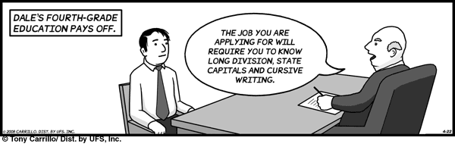
Notes:
15

Slide 16
What we need in a creative economy
possibility
possibility
status quo
Notes:
16

Slide 17
global awareness
effective speaking
critical thinking
problem solving
adaptability
information literacy
collaboration
creativity
media fluency
analytical skills
entrepeneurialism
innovation
effective writing
synthesis
curiosity
Notes:
1. critical thinking and problem solving in networks of cross-functional teams
world is complex and answers are not in the books
world is moving too fast for inflexible, hierarchical organizations
2. collaboration across networks and leadership by influence rather than positional authority
command and control increasingly less valued in organizations
schools are very much command and control institutions
3. agility and adaptability
intensifying rate of change, overwhelming amount of data, increasing complexity of problems
4. initiative and entrepeneurialism
people who can seek out new opportunities, ideas, and strategies
don’t want students or workers who are apathetic about their experiences
achievement orientation, drive for results, self-starters
5. effective written and oral communication
presentation skills, being clear and concise; creating focus, energy, and passion around the points they want to make
6. accessing and analyzing information
people who can access, evaluate, conceptualize, and synthesize multiple and large streams of incoming information to make meaningful decisions
7. curiosity and imagination
inquisitiveness, analytical skills that are more ‘out of the box’ than in the past, asking great questions is more important than knowing the ‘right answer’

Slide 18
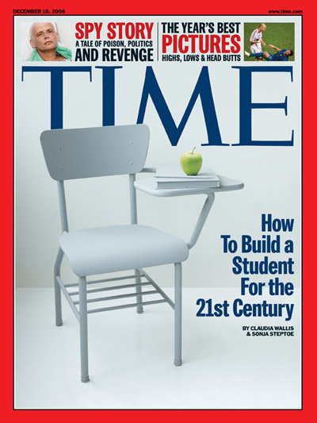
Notes:
Not just the corporate and government leaders… the media has picked up on this too – countless stories out there – for example…
For the past five years, the national conversation on education has focused on reading scores, math tests and closing the "achievement gap" between social classes. This is not a story about that conversation.
This is a story about the big public conversation the nation is not having about education, the one that will ultimately determine not merely whether some fraction of our children get "left behind" but also whether an entire generation of kids will fail to make the grade in the global economy because they can't think their way through abstract problems, work in teams, distinguish good information from bad or speak a language other than English.

Slide 19
TIME, December 2006
For the past five years, the national conversation on education has focused on reading scores, math tests and closing the "achievement gap" between social classes. This is not a story about that conversation.

Slide 20
TIME, December 2006
This is a story about the big public conversation the nation is not having about education, the one that will ultimately determine not merely whether some fraction of our children get "left behind" but also whether an entire generation of kids will fail to make the grade in the global economy because they can't think their way through abstract problems, work in teams, distinguish good information from bad or speak a language other than English.

Slide 21
While we teach whatever we teach at school, the kids go home and learn the skills they need to survive and prosper in an interconnected global economy.
- Clarence Fisher
Notes:
As a result…
http://remoteaccess.typepad.com/remote_access/2005/11/educational_lea.html
Incrementally changing our teaching methods, slowly bringing people up to speed . . . worked fine when ideas of literacy and education were not rapidly changing; but they are. We need to be able to leapfrog in our understandings, in our methods, and in our tools, allowing us to move to where the kids are. If we do not become leaders to our students, we will be followers, seen as irrelevant, and left to cry in our books.

Slide 22
No generation in history has ever been so thoroughly prepared for the industrial age.
- David Warlick
Notes:
We need to ask ourselves…
Does the work that our students do in our classrooms on a regular basis reflect this burgeoning movement toward autonomy and creativity?
We desperately need . . . we may not survive without . . . a generation of young people who are imaginative, inventive, fearless learners, and compassionate leaders. Yet, what can we say, as educators, about the students we are producing? We can prove that they can read, do basic math on paper, and they are able to sit for hours filling in bubble sheets.
We can’t keep doing it this way. It’s not what we need for the future and it’s arguably not working very well right now.

Slide 23

Notes:
23
We can’t be refugees
We have to be honest with ourselves
- most teachers and administrators (and professors) are refugees when it comes to most of this
- not worth the time investment to learn
- satisfied with the status quo

Slide 24
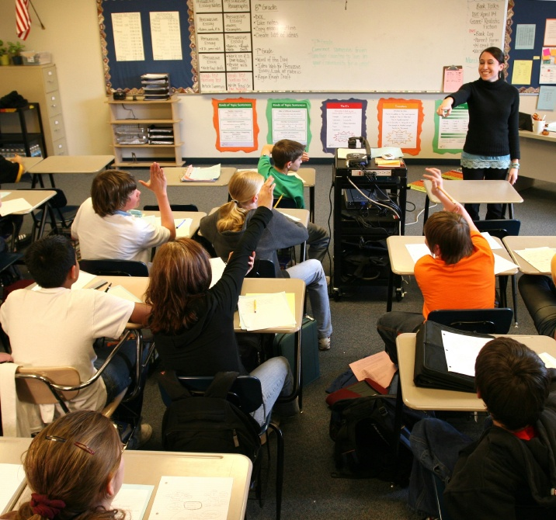
Notes:
24
- not entirely educators’ fault – the system is the issue – governed by an essential 19th century paradigm – one that was appropriate for our grandparents but not our children and grandchildren

Slide 25
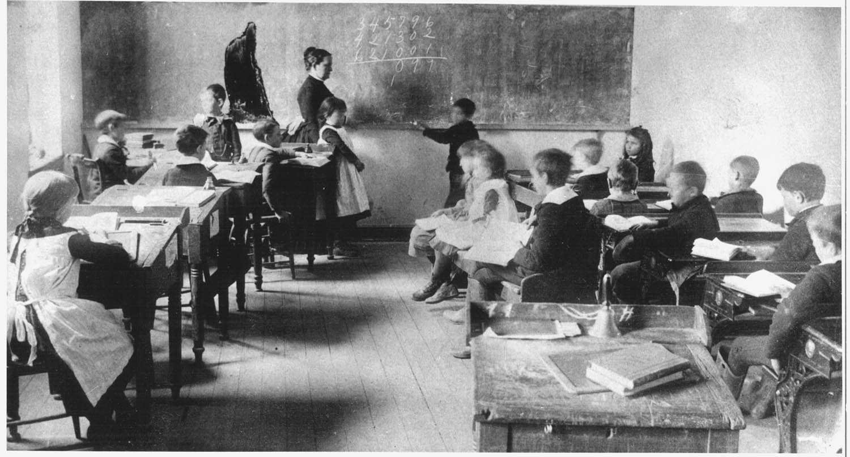
Notes:
25

Slide 26
interconnected
collaborative
personalized
autonomous
freewheeling
empowering
Notes:
This is a little scary!
Education believes in containers. The new information landscape operates without containers. This scares us to death. For how many years, or months, or days is the MySpace nation going to allow us to put their learning into containers? - David Warlick

Slide 27
High school dropout rate
Notes:
Higher in urban areas
80% to 85% had average of C or better; they were bored, unengaged, not challenged
These digital learners are coming to law schools
- Dede: we are wholly unprepared
DIGITAL KIDS, ANALOG SCHOOLS?

Slide 28
student
engagement
elementary school
high school
Notes:
Student learning curiosity / engagement with content

Slide 29
“engage me or enrage me”
Notes:
kids go home and power up, they go to school and power down
Pew Internet and American Life Project
Fully half of all teens and 57% of teens who use the internet could be considered Content
Creators. They have created a blog or webpage, posted original artwork,
photography, stories or videos online or remixed online content into their own
new creations.
Come to schools – passive information consumers, not interactive content producers
typical teacher use of technology is still for record-keeping (grades, attendance) or word processing of tests and handouts, PowerPoint – many think having students visit a few web sites is effective technology integration

Slide 30


Slide 31
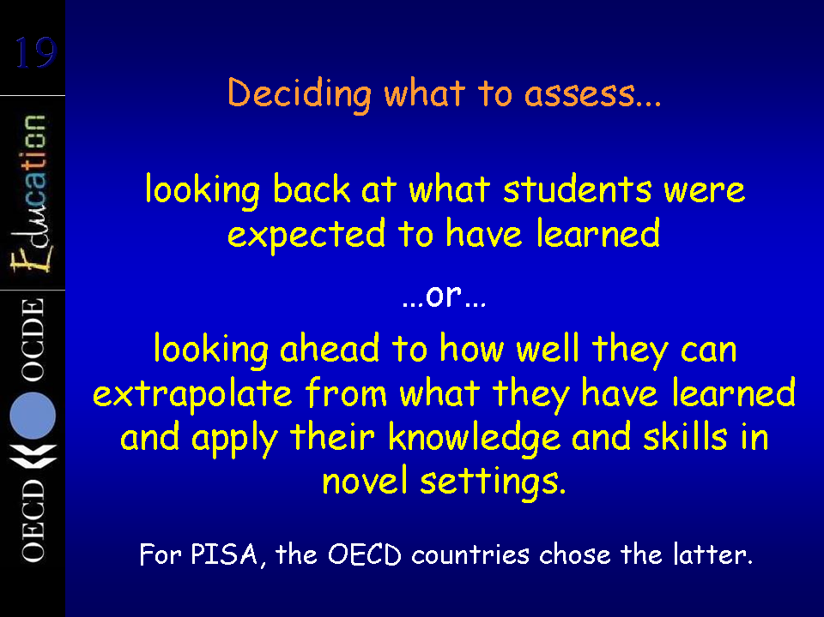

Slide 32
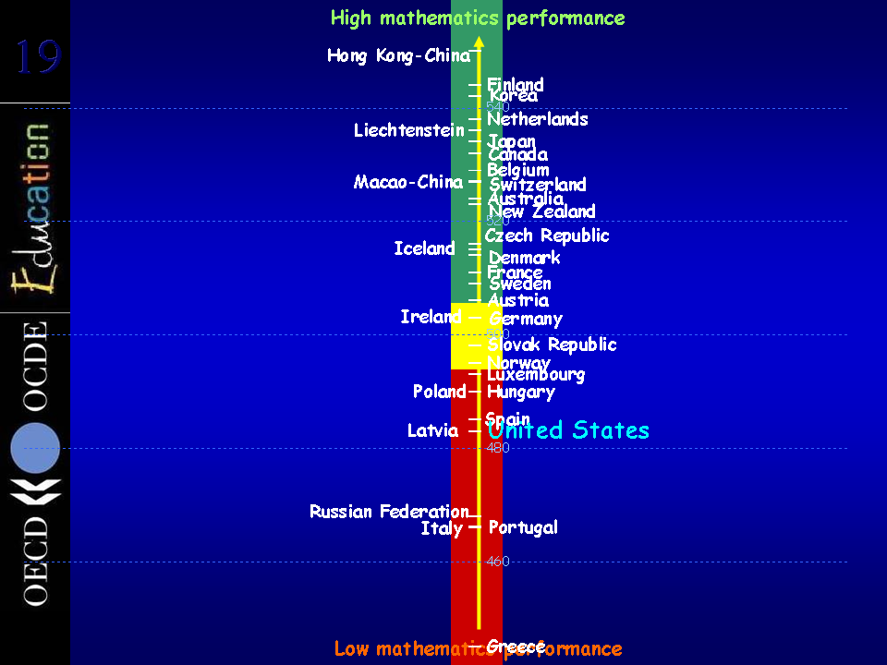

Slide 33
Notes:
Learning to Change video

Slide 34
What do students still need to memorize?

Slide 35
Notes:
Thoughts/reactions right now?

