Slide 1
Stand up!

Slide 3
ACT 5
Time to
get moving!

Slide 8
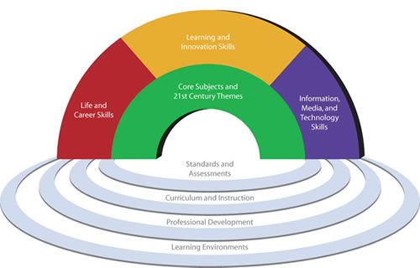
Notes:
Groups are stepping up – P21CS - business community, education leaders, and policymakers
Core subjects
Critical thinking and problem solving, communication skills, creativity and innovation, collaboration, information and media literacy
Leadership, Global awareness
ICT Literacy - the ability to use technology to develop 21st century content knowledge and skills, in support of 21st century teaching and learning.
* 21st Century Assessments. Authentic 21st century assessments are the essential foundation of a 21st century education. Assessments must measure all five results that matter - core subjects; 21st century content; learning skills; ICT literacy; and life skills. To be effective, sustainable and affordable, assessments must use modern technologies to increase efficiency and timeliness. Standardized tests alone can measure only a few of the important skills and knowledge students should learn. A balance of assessments, including high-quality standardized testing along with effective classroom assessments, offers students a powerful way to master the content and skills central to success.
Beyond NCLB – have to be careful not to judge efficacy of 21st century school initiatives solely by 20th century standardized tests
** Communities are stepping up too - giving kids laptops, teaching Chinese and Farsi and other strategic languages, moving beyond simply showing kids what foods and holidays other cultures have and helping them develop a sophisticated level of global awareness since they’ll be working with and interacting with people all over the globe, either live or virtually
8

Slide 9
Notes:
imagine when get access to arXiv, SSRN, wikipedia, google, etc.

Slide 10
They say: We can’t handle this much change.
I say: Your job and career are in jeopardy; what other options do you have?
Seth Godin, The Big Moo, pp. 49-50
Notes:
Teachers, administrators, professors, parents, politicians, policymakers say…

Slide 11
They say: Times are changing.
I say: Everything has already changed. Tomorrow is the first day of your revolution . . . or you’re toast.
- Seth Godin, The Big Moo, pp. 49-50
Notes:
Everything has already changed
Think back to examples I gave at beginning

Slide 12
They say I’m extreme.
I say I’m a realist.
- Seth Godin, The Big Moo, pp. 49-50

Slide 13
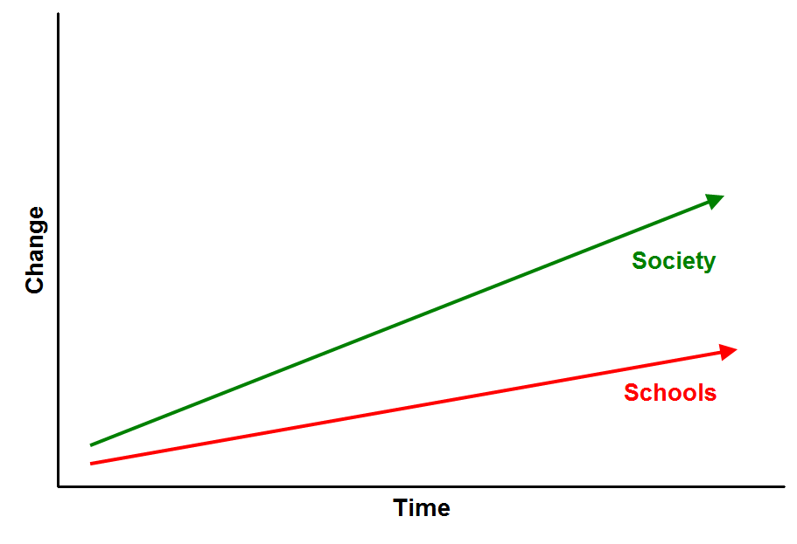
Notes:
Fundamental dilemma – schools are struggling to keep up…

Slide 14
Our intelligence tends to produce technological and social change at a rate faster than our institutions and emotions can cope with. . .
Gwynne Dyer
Notes:
Innovation is cumulative and the rate of change accelerates. We therefore find ourselves continually trying to accommodate new realities within inappropriate existing institutions, and trying to think about those new realities in traditional but sometimes dangerously irrelevant terms.
As Will Richardson notes, the kids who start school today will be retiring in the year 2065. [Think back over the last 2-3 decades. We have no idea what the world in 2065 will look like.] We can give [our students] all the content we want, but in this age, in won’t make much difference if we don’t teach them how to learn first. And they do that not by simply spitting back at us what they “know.”

Slide 15
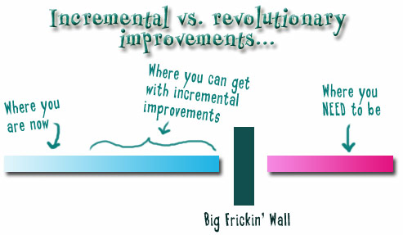
Notes:
We need to somehow change faster
No one jumps a 20 foot chasm in two
10 foot jumps. – Miguel Guhlin
When the world changes so fast that we have no reasonable way to forecast what it will look like in a mere decade or two, all we can do is teach kids how to be adaptive – to be learners in the truest sense of the word –
We’ve always talked about preparing lifelong learners in schools, but our practices typically haven’t matched our rhetoric. It’s time to put some bite into our toothless vision statements and recognize that we have to teach kids how to learn to learn if they want to be successful in this new technology-suffused, globally-interconnected world
Credits: http://tinyurl.com/2urbsm and http://tinyurl.com/37em64 (see Guhlin comment)
http://remoteaccess.typepad.com/remote_access/ 2006/06/literacy_as_bat.html (see Guhlin comment)
http://headrush.typepad.com/creating_passionate_users/2005/03/incremental_vs_.html

Slide 16
If the leaders don’t get it, it isn’t going to happen

Slide 17
leadership
v.
management

Slide 18
anticipatory
v.
reactionary

Slide 19
future-oriented
v.
compliance-oriented

Slide 20
The people in charge of leading school organizations into the 21st century …
often are the least knowledgeable about the 21st century.
dangerouslyirrelevant.org
Notes:
Licensed under a Creative Commons attribution-share alike license.
http://creativecommons.org/licenses/by-sa/3.0
Scott McLeod, J.D., Ph.D.
scottmcleod.net/contact
dangerouslyirrelevant.org
schooltechleadership.org

Slide 21
Notes:
We have to stop being afraid. Cyberbullying, inappropriate content, on a rare, rare occasion, online predator
Can’t shut everything down. That’s schools’ instinctive reaction – lock it down, keep it out – many schools keep out all blogs, all social sites, etc. Not only does this make absolutely no sense to our digital students, we’re cutting them off from the tools needed to survive and thrive in the new economy.
Driving is dangerous, but we don’t prohibit kids from getting behind the wheel – we teach them how
Swimming pools and lakes are dangerous – people drown in them - but we feel the benefits outweigh the dangers, so we don’t prohibit kids from going near the water – instead, we teach them how to swim!
http://flickr.com/photo_zoom.gne?id=36763351&size=o
http://flickr.com/photo_zoom.gne?id=29682655&size=o

Slide 22
Avoid death by risk aversion
Notes:
Fear also keeps us from being remarkable

Slide 23
Notes:
I started this presentation by quoting music star Bob Dylan. As we near the end here, I’ll end with a quote from indie rocker Liz Phair. Phair asks…
What does it mean when something changes how it’s always been?
- Liz Phair
We don’t know all the answers to this question yet, but it’s very clear that we are at the front end of something seismic and that schools need to get moving.

Slide 24
14,383 school districts
Notes:
The scale is huge…

Slide 25
95,726 public schools
+ 29,273 private schools
=
125,000 schools

Slide 26
Notes:
We can’t keep marginalizing technology in our schools. We can’t keep treating it as something that’s optional, as something that’s not a core part of the educational enterprise. We can’t keep providing a 19th and 20th century educational model to 21st century learners who need to work and live in a 21st century world.
We have to ask ourselves questions like…

Slide 27
This is meaningless
Notes:
We also need to make sure we use the right metrics. For example, we’ve prided ourselves on …
What we really need is for kids to have ready and constant exposure to computers. As David Warlick notes, they’re the pencil and paper of our time – we need to have kids using them often and frequently – can you imagine if most workers had to schedule computer time like we do in schools?
We need ubiquitous Internet access for those kids with computers, and we need 21st century curricula and pedagogies
Unfortunately…

Slide 28
This is important

Slide 29
100% proficiency
on old skills?
Notes:
Data-driven school reform
30 school districts
4 state departments of education
13 other regional service agencies, leadership associations, corporations, etc.
Education law
NASSP online school law guide

Slide 30
No one will thank you for taking care of today if you have failed to take care of tomorrow.
- Joel Barker
Notes:
I’m a relatively young professor. I don’t have the scholarly pedigree that Michael and others have. I don’t have 21 books to my credit. But I do know this. If what I’ve described is the present, then we have some professional and moral and ethical responsibility to at least try to be relevant to whatever the future may hold for our students.
Although we need skeptics and naysayers to make sure that we avoid technological determinism and that we think critically about these tools along the way, the bottom line is that they’re not going away. If as academics we wrestle with them, not just in theory but in a hands-on, applied sense,
I don’t know about you, but I’m excited about the journey.

Slide 31
“The fierce urgency of now”

Slide 32
Notes:
32

Slide 34
Thank you!
Scott McLeod, J.D., Ph.D.
Director, CASTLE
scottmcleod.net
Notes:
34
URL

